Slide 1
End Of Week(EOW)/ Cash Collections
AGENDA:
Money Order’s
DD Form 362 Statement of Charges/Cash Collection Voucher (Finance)
Relock Rekey MFR
Spread Sheet with all lost hard keys and furnishings damaged or missing
Barracks Clearance Inspection and Charge Sheet
All Barracks Managers/eMH Representatives shall create, collect, consolidate, and turn-in the above documents to Johnny R. McCoy building 49015 2nd floor room 202C (FMO) or 49017 (UH Chief or Area Managers)
Any Area Manager or UH Chief can verify the MFR and documents

Slide 2
Collection Process
BMT
Determine if Soldier is responsible for missing/loss keys damages to furnishings
BMT
Collect Funds from soldier via Money order, DD 362, DD 139
UH Office
Collect Funds and document/MFR from BMT Managers
UH
Deposit funds FHNB, BMT take DD 362 to Finance for signature & stamp
BMT
Give a copy of signed and stamp DD 362 to FMO/UH for affirmation.
Maintain copies for records
UH
Mr. McCoy will submit DMO for relock/rekey to Service Order desk. Once keys have been made, POC will be contacted by Real Property to pick up keys
FMO
Personnel on H/R will contact FMO for furnishing replacement or exchange. Proof of payment
(254) 287-5309

Slide 3
Relock/Rekey Collection Process
BMT
BMT Manager collect funds from soldier via money order or DD 362 complete relock/rekey MFR
BMT
BMT Manager bring funds and documents to UH for processing
UH Office
Collect Funds from BMT Managers, verify for accurateness, sign and stamp MFR
BMT
BMT take DD 362 to Finance for signature & stamp
BMT
Give a copy of signed and stamp DD 362 to UH for affirmation.
Maintain copies for records
BMT
Create MFR for (Relock Rekey) turn-in to Johnny McCoy at FMO Office
UH
Mr. McCoy will submit DMO for relock/rekey to Service Order desk. Once keys have been made, POC will be contacted by Real Property to pick up keys
NOTE: Relock Rekey is time sensitive as the locksmith only has 30 days before they will be forced to close the work order. Your work order will be closed if no action has been taken by you before that time. The Lock Smith new hours for this type of transaction are 1300 to 1600 Monday through Friday. Real Property will hold the keys for 60 days after that they will be sent to the metal recycle.

Slide 4
Furnishing Collection Process
BMT
Determine if Soldier is responsible for missing or damaged furnishing
BMT
Collect Funds from soldier via Money order or DD 362
UH Office
Collect Funds and verify document from BMT Managers
BMT
BMT take DD 362 to Finance for signature & stamp
UH
receive a copy of signed and stamp DD 362 for confirmation.
Maintain copies for records
BMT
BMT Manager verify eMH, submit furniture request form, complete DA Form 3161. Personnel on DA Form 1687 will contact FMO for furnishing replacement.
(254) 287-5309
FMO
Documents;
eMH generated H/R
DA 3161
DA Form 362
DD Form 200 (FLIPL)
Request for damaged/Loss property. To request property from FMO, the person replacing furniture must be listed on a DA Form 1687 with FMO. No administrative (office) furniture will be turned in to FMO, only FMO property.

Slide 5
Money orders, will be turned in to building’s 49015 (FMO) or 49017 (UH/ABMP)

Slide 6
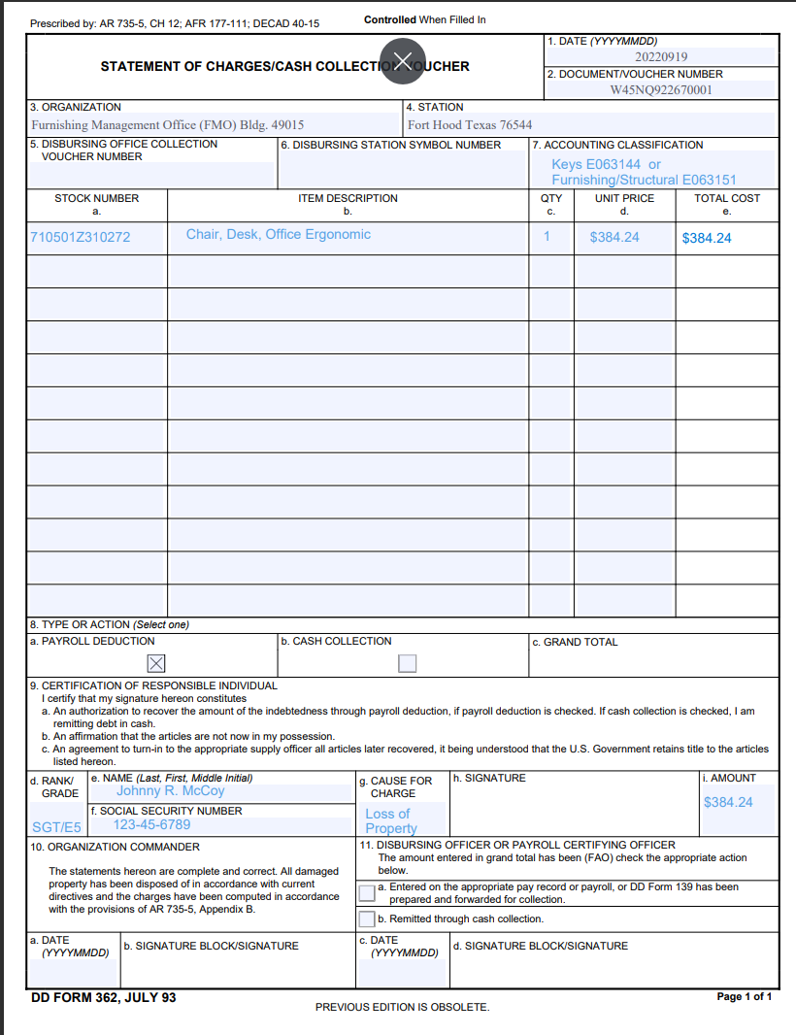
Block 7, Accounting Classification
Furnishing/Structural E063151
Keys (Hard) E063144
Once finance sign/date/stamp, the DD Form 362 shall return a copy to UH/ABMP
NOTE: The DD Form 362 will be use effective immediately. AR 735-5 Appendix B
We will no longer be using DD Form 139

Slide 7
Example of Relock/Rekey memo
Shall be signed by any Area Manager
of UH Chief

Slide 8
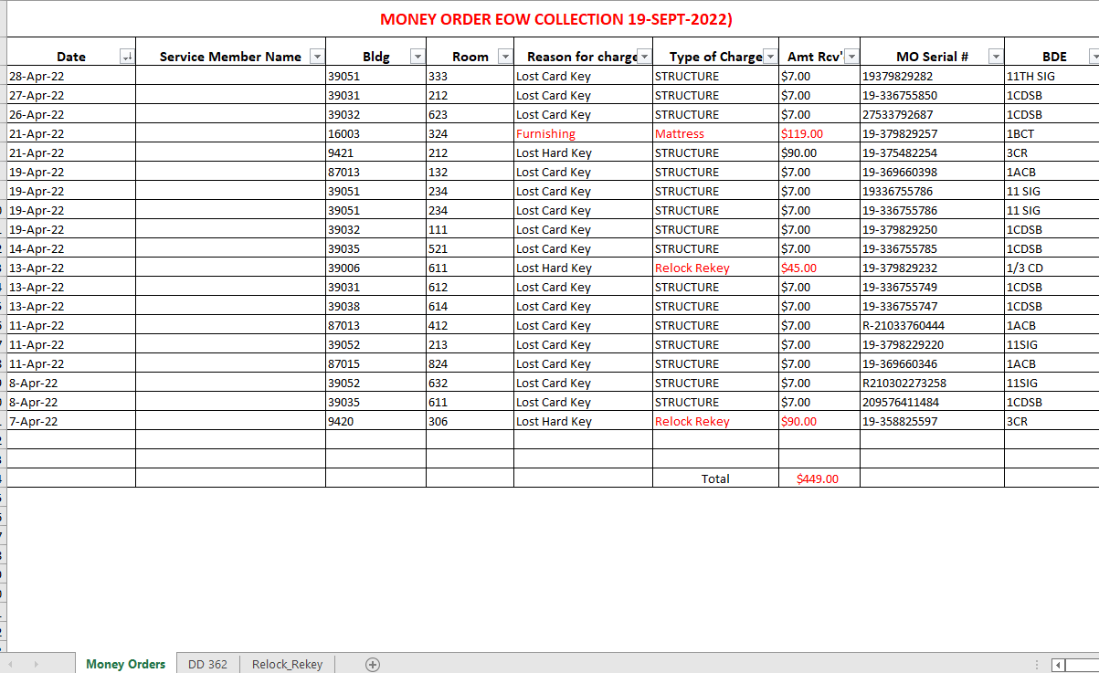
The EOW Collection Spreadsheet shall be the only document that will be sent via email

Slide 9
The Barracks Managers/eMH
Representative shall verify all pertinent information
on all documents being submitted are filled out properly,
accurately and submitted weekly.

Slide 10
EOW Collection Procedures
Barracks Managers/eMH Representatives, will create, collect, consolidate, and turn-in the following documents: money orders, DD Form 362s, relock/rekey, memorandum for records (MFRs), Barracks Clearance Inspection and Charge Sheet, and EOW Collection spreadsheet. Soldier’s assignment/termination orders presently shall be maintained with the Barracks/eMH Representative.
Once all funds have been collected, money orders counted and verified by the Mr. McCoy and Mr. Wallace. The DD Form 362’s collected shall be processed through Finance. Money orders deposited into FHNB. The MFR’s for Relock Rekey taken to Service Order Center (DMO) Soldiers then will be contacted to receive their new key (Lock Shop) or furnishing replacement (FMO)
Cost Estimate (ECOD Team) POC A.J. West, Office (254) 287-1574 or (254) 535-2835 structural damages I.E., doors, windows, floor. Large holes in walls, stove tops
Key Deposits – 1. Finance personnel submit the deposit UH send to them to DFAS.
2. Once the funds have cleared DFAS, they are returned to the Garrison to recover the replacement of the lost keys or damaged property.
Cash Collection (Monthly deduction):
1. Paperwork submitted to DFAS. DFAS determines the monthly deduction based on the amount to owed to the Government.
2. RM receives a monthly email from DFAS on the amount to be collected from the soldier.
3. Finance process the action and once cleared, the funds are returned to the Garrison to recover the lost/damaged keys/property.

Slide 11
BMT
Barracks Management Team will create, collect, consolidate, & turn-in the following documents: money orders, DD Form 362s, relock/rekey MFRs, Barracks Clearance Inspection and Charge Sheet. The EOW Spreadsheet will be the only document that will be sent via email. The remaining documents will be hand-carried to Johnny McCoy or the appropriate Area Manager (AM). The EOW spreadsheet will reflect all information from each money order, DD Form 362 and relock/rekey MFR
AM
Area Manager (Housing Managers) will collect all pertinent information from the BMT’s or eMH Representatives in the absent of Mr. Johnny R. McCoy (Preparer) All Documentation, MFR, DD Form 362’s and Relock Rekeys will be checked for accurateness.
PREP
Preparer will receive the money orders, complete a bank (FHNB) deposit slip, and DD Form 1131s to be signed by the validator and bank. The Preparer will verify the amount on the money orders with the deposit slips and DD Form 1131s (SRM and QHFM). The Preparer will create the deposits in OTC.net. The Preparer will annotate the deposit number provided from OTC.net onto one of the DD Form 1131s. The Preparer will give the money orders to the validator for approval before being taken to the bank (FHNB)
VAL
Validator (Mr. Ricky B. Wallace) The validator shall physically count and verify the amount of money orders collected for deposit into FHNB. Mr. Wallace will log into OTC.net to locate the deposit numbers provided by the preparer (Johnny R. McCoy) validator will verify the amount listed in the OTC.net and approve the deposit. The validator will digitally sign DD Form 1131 (Cash Collection Voucher) and print out three (3) copies of the generated (OTC.net Deposit Ticket) to be taken to FHNB with the money orders collected for deposit.
NOTE: The BMTs will maintain assignment & termination order for their records.
NOTE: Two separate DD Form 1131 shall be submitted for keys (QRPA) and Furnishing QHFM)

