Slide 1
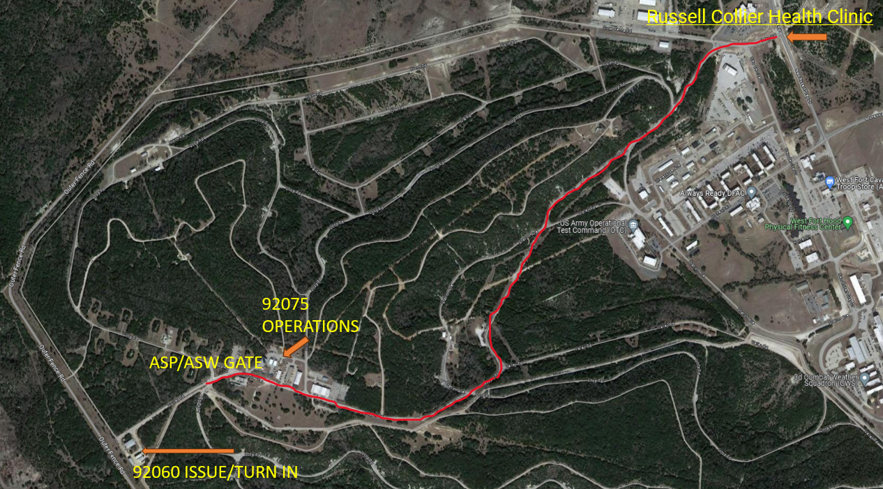
U.S. ARMY
Ammunition Supply Point
HOURS OF OPERATION
Monday –Wednesday : 0730-1600
Thursday : Closed
Friday : 0730-1600
Notice: Closed on Federal Holidays
407th AFSBn-Cavazos
Ammunition Supply Point
BLDG 92075 Supply Road, Fort Cavazos, TX 76544
Contact Information
ASP Ops : 254-286-5124/288-9095, 254-553-0722
ASP Supervisor : 254-288-1809
ASP Accountable officer : 254-286-5602
ASP COR: 254-286-5601
ASP Residue Yard: 254-288-5258/287-9115
ASP Surveillance: 254-288-9069/288-1864
ASP QASAS: 254-319-7945/254-288-9316
RECON: 254-288-1986/286-5728
ASP Stock Control : 254-288-1307
AFSBn-Cavazos provides oversight of the Fort Cavazos ASP operated by a contract activity. The ASP maintains an Accountable Officer and contracting officer representative (COR). 407th Army Field Support Brigade (AFSB) is the higher headquarters for the AFSBN-CAVAZOS under the Army Sustainment Command.
EAGLE Service Contractor operates and manages the ASP. The contractor plans, supervises, and coordinates daily operations for all supported customers. Ammunition management at the ASP is the responsibility of the contractor per the approved Performance Work Statement who is responsible to the ASP accountable officer. Automated records and DA Form 581s (Request for Issue and Turn-in of Ammunition) are used to record ammunition issues, turn-ins, and direct transactions between the ASP and customers.
Unit commanders are responsible for their unit’s ammunition program. This includes security, control, and authorization of appropriate personnel to receive and turn-in Class V items from the ASP. Commanders should ensure authorized personnel signing for ammunition complete the Ammunition Awareness Course (AAC) and have their AAC card at time of pickup.
Ammunition Supply Point Operating Procedures: ASP wall to wall inventories are required for accountability purposes and all ammunition stocks are counted as of a specific date. During wall to wall inventories all receipts, issues and shipments are on hold until completion of the inventory. Wall to wall inventories are coordinated and scheduled quarterly, for five working days (weekends and Federal holidays are not counted).
All visitors must first report to ASP Operations (Bldg. 92075), for a safety briefing, escort, or area access badges.
ASP is located on West Fort Cavazos

Slide 2
U.S. ARMY
Issue Procedures –Action Tab (AT)
Turn-in Procedures – AT
Residue Turn-in Procedures -AT
Policies and Procedures – AT
Hazard Classification of U.S. Military Explosives and Munitions (revision as of 1 AUG 2023)
usarmy.mcalester.usamc.list.dac-yellowbook@army.mil : active link

