Slide 1
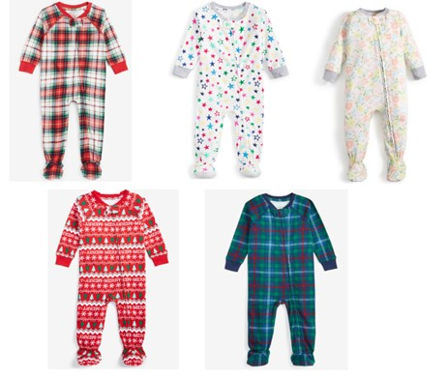
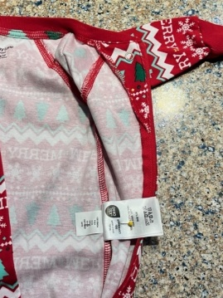
SAFETY RECALL MESSAGE
27 May 2025
Macy’s Holiday Lane Footed Pajamas Due to Injury Hazard (Recall Alert)
Company Recall Date: 22 May 2025
Recall Number: 25-291
Name of Product: Holiday Lane Infant Footed Pajamas
Hazard: The elastic on the pajamas’ ankles can be too tight and restrict blood circulation, posing an injury.
Consumer Contact: Macy’s toll-free at 833-408-0501 from 8:30 a.m. to 6 p.m. ET Monday through Friday, email at footedpajamas@realtimeresults.net, or online at https://www.recallrtr.com/footedpajamas or www.macys.com and click on “Product Recalls” at the bottom of the page for more information.
Description: This recall involves five different styles of Holiday Lane-branded infant footed pajamas. The cotton pajamas were sold in infant sizes 0-3 months, 3-6 months and 6-9 months. “Holiday Lane” is printed on the pajamas’ neck label. The size and PID/Style numbers are printed on the care instruction tag located on the pajamas’ side seam. For specific PID/Style numbers, visit https://www.cpsc.gov/Recalls/2025/Macys-Recalls-Holiday-Lane-Infant-Footed-Pajamas-Due-to-Injury-Hazard-Sold-Exclusively-by-Macys
Remedy: Consumers should immediately stop using the recalled pajamas, take them away from children and contact Macy’s for instructions on how to receive a refund. Consumers should not return the recalled pajamas to the stores. Consumers will be asked to fill out the recall form at https://www.recallrtr.com/footedpajamas. Once consumers fill out the recall form, they will be sent a pre-addressed, postage-paid envelope to return the footed pajamas free of charge. Macy’s will issue a $26.50 refund via check upon receipt of the recalled product. Macy’s is contacting all known purchasers directly.
Incidents/Injuries: Macy’s has received four reports of the elastic being too tight on infants’ ankles, resulting in chafing, imprinting or restricting blood circulation.
Sold At: Macy’s stores nationwide, including Macy’s Backstage, and online at www.macys.com
from March 2024 through January 2025 for about $27.

Slide 2
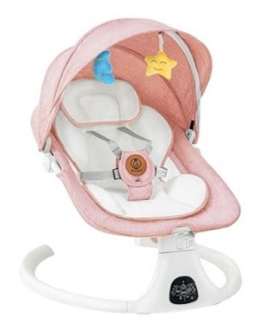
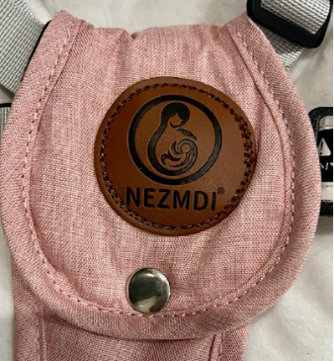
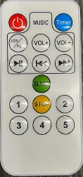
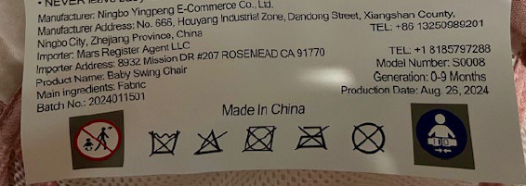
SAFETY RECALL MESSAGE
27 May 2025
Nezmdi Infant Swings Recalled Due to Risk of Serious Injury or Death from Suffocation Hazard (Recall Alert)
Company Recall Date: 22 May 2025
Recall Number: 23-290
Name of Product: Nezmdi Baby Swings
Hazard: The swings pose a suffocation hazard and a risk of serious injury or death to babies, because they were marketed for infant sleep and have an incline angle greater than 10 degrees, in violation of the Safe Sleep for Babies Act. The swing also fail to meet the mandatory warning requirements under the swing regulations. In addition, the remote control included with the swings contains a lithium coin battery and is missing the required warnings and instructions for consumer products containing button cell and coin batteries under Reese’s Law.
Consumer Contact: Nezmdi via email at yingpengds@163.com.
Description: This recall involves Nezmdi-branded electric infant swings. They were sold in pink and have a white base with a black control panel, star and moon hanging plush toys, a pillow, a seat cover and a mosquito net with a canopy. They measure about 25.5 inches in length, 25.5 inches in width and 20.8 inches in height and come with a remote control and a USB cable. A leather patch with the brand “Nezmdi” is sewn onto the restraints. “Model Number: S0008” and “Baby Swing Chair” are printed on a label located under the seat.
Remedy: Consumers should stop using the recalled infant swings immediately and contact Nezmdi for a full refund. Consumers should send a photo of the swing cover cut in half with “Recalled” written with permanent marker on its base to yingpengds@163.com, and then dispose of the swing in accordance with state and local procedures. Nezmdi is contacting all known purchasers directly.
Note: Button cell and coin batteries are hazardous. Batteries should be disposed of or recycled by following local hazardous waste procedures.
Incidents/Injuries: None reported
Sold At: Amazon.com from September 2024 through February 2025 for about $70.

Slide 3
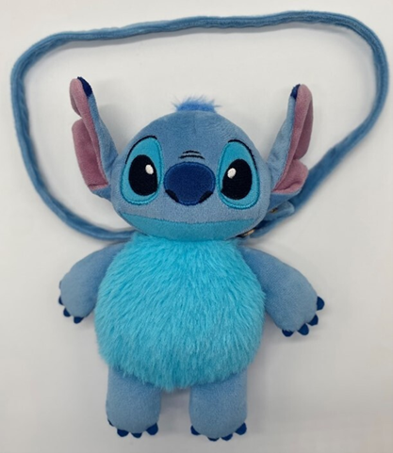
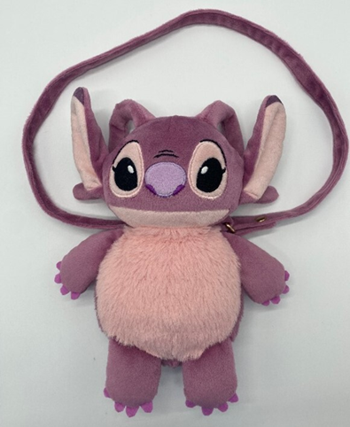
SAFETY RECALL MESSAGE
27 May 2025
Primark Recalls DTR Plush Bag Stitch and DTR Plush Bag Angel Due to Choking and Ingestion Hazards (Recall Alert)
Company Recall Date: 22 May 2025
Recall Number: 23-294
Name of Product: DTR Plush Bag Stitch and DTR Plush Bag Angel
Hazard: The zipper pull on the bag of the plush bags can detach, posing a risk of serious injury or death from choking and/or ingestion of the zipper pull.
Consumer Contact: Primark collect at 617-946-3236 from 8 a.m. to 5 p.m. ET Monday through Friday, or online at Recall Notice DTR Plush Bag Stitch and DTR Plush Bag Angel or at www.primark.com and click on “Recall” at the bottom of the page for more information.
Description: This recall involves the DTR Plush Bag Stitch and DTR Plush Bag Angel. The Stitch plush bags were sold in blue and the Angel bags were sold in purple. The bags measure about 10 inches long and 8 inches wide, with a swing tag care label that hangs off the side of the bag.
Remedy: Consumers should immediately take the recalled plush bags away from children, stop using them and return them to a Primark store for a full refund in the form of the original payment.
Incidents/Injuries: None reported
Sold At: Primark stores located in the northeast and in Florida, Maryland and Illinois from March 2024 through October 2024 for about $6.

Slide 4
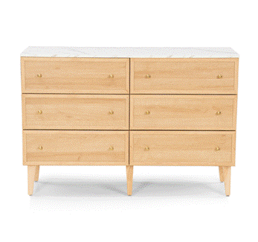
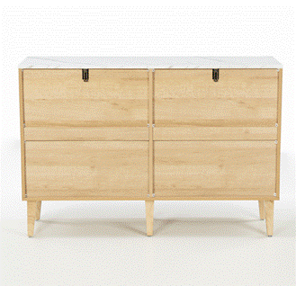
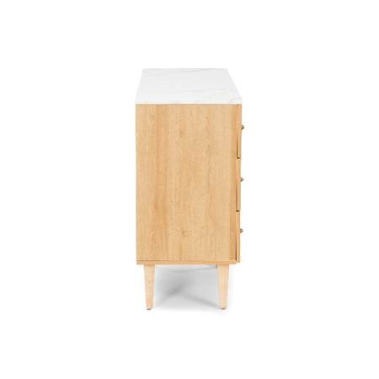
SAFETY RECALL MESSAGE
27 May 2025
Sivan Dressers Recalled Due to Risk of Serious Injury or Death from Tip-Over and Entrapment Hazards (Recall Alert)
Company Recall Date: 22 May 2025
Recall Number: 23-293
Name of Product: Sivan Six-Drawer Double Dressers
Hazard: The recalled dressers are unstable if they are not anchored to the wall, posing serious tip-over and entrapment hazards that can result in injuries or death to children. The dressers violate the performance requirements of the STURDY Act because they can tip over with fewer than 60 pounds applied horizontally, and the dressers also fail to meet the labeling requirements of the STURDY Act.
Consumer Contact: Anji Guyou Furniture by email at guyouproductrecall@163.com.
Description: This recall involves Sivan Dressers. The six-drawer double dressers measure approximately 31 inches tall, 47 inches wide and 16 inches deep. They were sold in natural oak and black colors. The model number Y-C51 is located on the packaging label.
Remedy: Consumers should immediately stop using the recalled dressers if they are not anchored to a wall and place them in an area that children cannot access. Consumers can contact Anji Guyou Furniture for instructions on how to dispose of the dressers to receive a full refund. Consumers must email a photo showing disposal of the product to guyouproductrecall@163.com. Anji Guyou Furniture and Wayfair are also contacting all known purchasers directly.
Incidents/Injuries: None reported
Sold At: Wayfair.com from May 2024 through March 2025 for between $285 and $294.

Slide 5
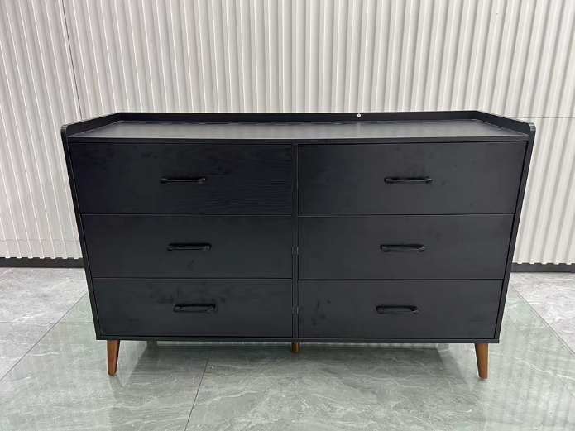
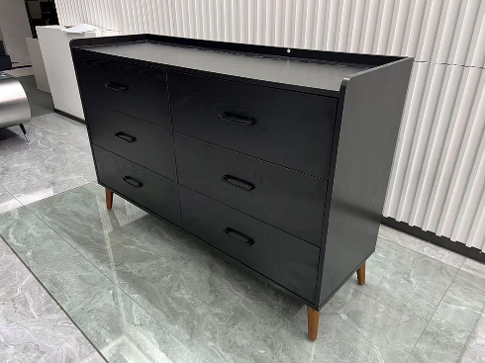
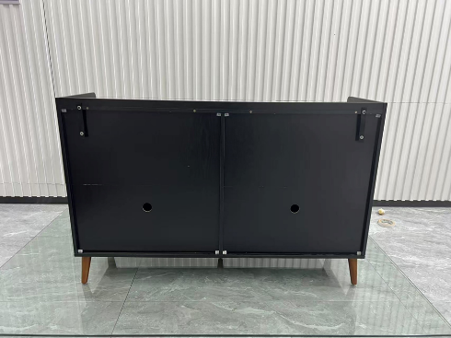
SAFETY RECALL MESSAGE
27 May 2025
Areson Recalls Rolanstar 6-Drawer Dressers Due to Risk of Serious Injury or Death from Tip-Over and Entrapment Hazards (Recall Alert)
Company Recall Date: 22 May 2025
Recall Number: 23-292
Name of Product: Rolanstar 6-Drawer Dressers
Hazard: The recalled dressers are unstable if they are not anchored to the wall, posing serious tip-over and entrapment hazards that can result in injuries or death to children. The dressers violate the performance requirements of the STURDY Act because they can tip over with fewer than 60 pounds applied horizontally, and the dressers also fail to meet the labeling requirements of the STURDY Act.
Consumer Contact: Areson toll-free at 888-864-7995 from 9 a.m. to 6 p.m. PT Monday through Friday, email at Support@Areson.shop, or online at https://www.rolanstar.com/pages/recall or Rolanstar.com and click “Recall” at the top of the page for more information.
Description: This recall involves Rolanstar 6-Drawer Dressers. They measure about 15 x 16 x 33 inches and were sold in the color black. The model number DC006-BK130-1-RR is printed on the product packaging.
Remedy: Consumers should stop using the recalled dressers immediately if they are not anchored to the wall and place them in an area that children cannot access. Areson, through Amazon Logistics Service, is contacting all known purchasers directly. Contact Areson for instructions on how to receive a full refund and how to submit a photo showing the disposal of the product to the firm at Support@Areson.shop.
Incidents/Injuries: None reported
Sold At: www.Amazon.com from September 2023 through March 2025 for between $100 and $213.

