Slide 1
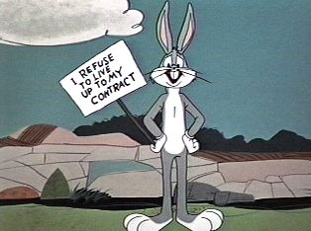
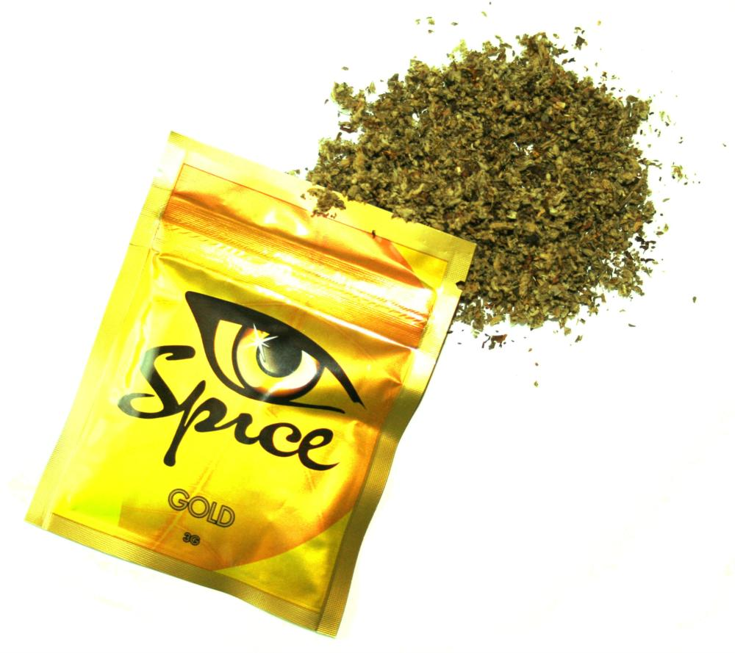
Herbal Smoking Blends: An Introduction
Spice, Spice Gold etc.

Slide 2
Definition:
Herbal Smoking Blends: Usually smoked for Marijuana-like effects believed to be caused by a mixture of synthetic cannabinoid drugs. Several different Brands of Herbal Smoke have been marketed and shown to contain different proportions of the synthetic cannabinoid, active ingredients, and reportedly produce subtly different effects.

Slide 3
Ingredients
traditionally used medicinal herbs, each produces mild effects; overall blend results in cannabis-like intoxication
Common Ingredients: Baybean, Blue Lotus, Lion's Tail, Lousewort, Indian Warrior, Dwarf Scullcap, Maconha Brava, Pink Lotus, Marshmallow, Red Clover, Rose, Siberian Motherwort, Vanilla and Honey (Varied to Taste/Flavor).

Slide 4
Ingredients Cont.
Baybean: known as a potentiator that enhances sensitization of other compounds. Smoked as a Marijuana substitute in Mexico.
Blue Lotus/Nymphaea caerulea: known to have psychoactive properties, inducing slight stimulation, a shift in thought processes, enhanced visual perception, and mild closed-eye visuals.

Slide 5
Ingredients Cont.
Lions Tail: Traditional uses include the control of painful, arthritic, and other inflammatory conditions. Used in South Africa for euphoric/inebriant effects.
Indian warrior/Pedicularis densiflora: uses include muscle relaxer, tranquilizer, aphrodisiac, and sedative.

Slide 6
Ingredients Cont.
Dwarf Scullcap: Known as a sedative with anti anxiety properties.
Maconha brava/ zornia latifolia: known to have psychoactive effects. Used in Brazil as a visionary aid.
Siberian Motherwort: Psychoactive Alkaloid, used as a marijuana substitute in Mexico and Brazil.

Slide 7
Ingredients Cont.
Marshmallow: the root is helpful for soothing sore throats, chapped skin, and minor wounds.
Red Clover: used to treat menopause, coughs, bronchitis, eczema, sores, scrofula. Contains compounds like caffeic acid that starve tumors and reduce inflammation.

Slide 8
Intoxicating Effects
Similar to Marijuana: lowered blood pressure, impairment of psychomotor coordination, concentration, short-term memory.
Duration: initial effects 20-30 min, high reportedly last 8-12 hours.

Slide 9
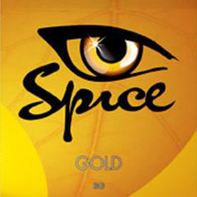
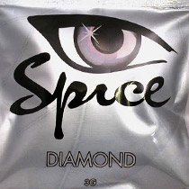
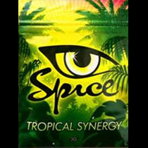
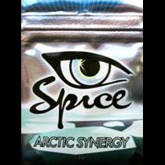
Brands/flavors
Spice:
Ingredients: Baybean, Blue Lotus, Lion's Tail, Lousewort, Indian Warrior, Dwarf Scullcap, Maconha Brava, Pink Lotus, Marshmallow, Red Clover, Rose, Siberian Motherwort, Canavalia Maritime, Leonotis Leonurus, Leonurus Sibiricus, Pedicularis Densiflora, Scuttellaria Nana, Vanilla Planifolia, Zorinia Latifolia, Magnolia Officinalis, Rosa Gallica, Trifolium

Slide 10
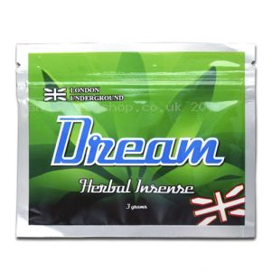
Brands/Flavors
Dream
Ingredients: : Baybean, Blue Lotus, Lion's Tail, Lousewort, Indian Warrior, Dwarf Scullcap, Machona Brava, Pink Lotus, Marshmallow, Red Clover, Rose, Siberian, Vanilla and Honey.

Slide 11
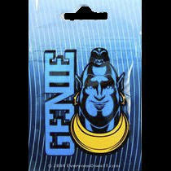
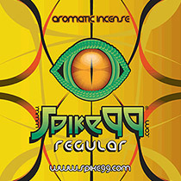
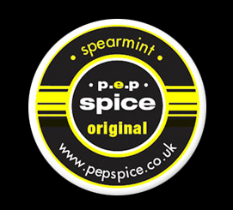
Brands/Flavors
Other Common Brands:

Slide 12
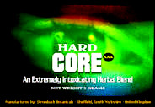
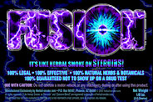
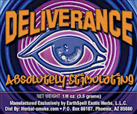
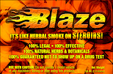
Brands/Flavors
Others cont.

Slide 13
Controlled Substances
Royal Society of Chemistry 2009 “Chemistry World”
JWH-018, a cannabinoid receptor, has been found in herbal mixtures sold under various 'spice' names.
JWH-018 is four to five times more potent than tetrahydrocannabinol, or THC, the main psychoactive substance in cannabis.
The chemical structure does not look at all like THC, but it produces the same effects.'

Slide 14
Controlled Substances
HU-210 found present in small quantities in Herbal Smoke products.
HU-210 has slightly different chemical structure than THC in marijuana.
Up to 800 times more potent than THC.
HU-210 listed by DEA as Schedule I substance.

Slide 15
Analog Chemical Structures
THC Tetrahydrocannabinol
Psychoactive substance found in the Cannabis plant. isolated by Raphael Mchoulam.
HU-210
Synthetic cannabinoid synthesized 1988 by Prof. Raphael Mchoulam, Hebrew University. 100 to 800 times more potent than natural THC.
JWH-018
Analgesic drug which acts as a cannabinoid agonist. Produces effects similar to THC, but with a shorter duration of action.
4 to 5 times more potent than THC.

Slide 16
Pricing
Approximately $25/gram.
Locally Approx. $75-$80/3gram pack.
NOTE: Marijuana street price $5-$15/gram.
Varied pricing dependant on quality.
Paying for Security.

Slide 17
Legal Issues
The Federal Analog Act, 21U.S.C Sect. 813, of the United States Controlled Substances Act, allows any chemical "substantially similar" to an illeglal drug (Schedule I or II) to be treated as Schedule I.
Must be intended for human consumption.

Slide 18
Military Legal Issues
UCMJ: Article 92: Failure to obey order or regulation
“Any person subject to this chapter who—
1) violates or fails to obey any lawful general order or regulation;
(2) having knowledge of any other lawful order issued by a member of the armed forces, which it is his duty to obey, fails to obey the order; or
(3) is derelict in the performance of his duties; shall be punished as a court-martial may direct.”

Slide 19
What to Do?
Newest in a long line of mind altering substances used as a way to skirt drug laws.
No different than Prohibition, Methamphetamine, LSD, MDMA, and other designer drugs
People will always find a way to alter their state of consciousness.

Slide 20
Health Effects of Synthetic Marijuana
Scientists warn that the chemical compounds present in Spice products are much more potent than traditional marijuana. Users may experience the following health effects:
Elevated blood pressure
Racing heartbeat
Visual disturbances
Anxiety
Stroke
Seizures
Note: No long term research available on the side effects of spice.

Slide 21
Problem is Two-Fold
Matter of Personal Integrity.
A person can get high using chemicals found under any given sink, or at any grocery.
It’s a personal choice not to use mind altering substances.
Lack of deterrents.
Separation in lieu of punishment.

Slide 22
Suggestions
Create a form of punishment to deter future offenders.
Our target is the Service Member considering getting high, not the one who already popped.
Confinement, Work Details, etc.

Slide 23
Suggestions Cont.
Be Proactive.
Random, continued drug/health and welfare sweeps in barracks.
Rewards/incentives for reporting narcotics related intelligence.

Slide 24
Additional information about Spice or any other drug can be obtained by contacting:
Ft Gordon Army Substance Abuse Program
202 7th Avenue, Bldg 38702
(706) 791-5797 / 7148,
or visit the Army Center for Substance Abuse Programs website at www.acsap.army.mil.

Slide 25
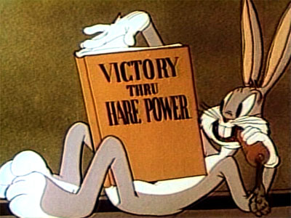
Questions/Comments?

