Slide 1
DRUGGED DRIVING

Slide 2
What is drugged driving?
Driving under the influence of any drug that:
effects the brain
impairs motor skills
reaction time
judgment
10 Drugs
Drugged driving kills

Slide 3
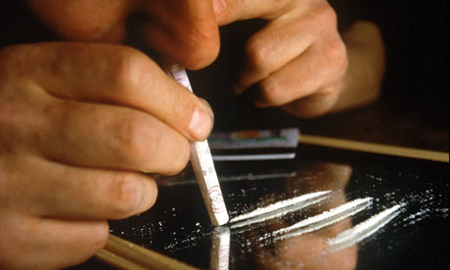
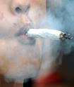
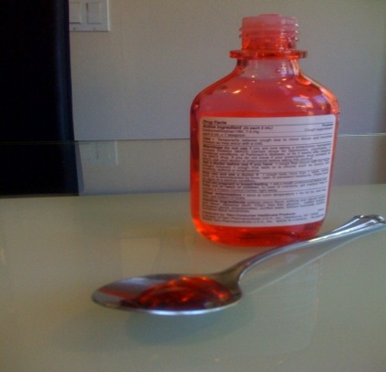
What types of drugs are used?
Illegal
Prescription
Over the Counter

Slide 4
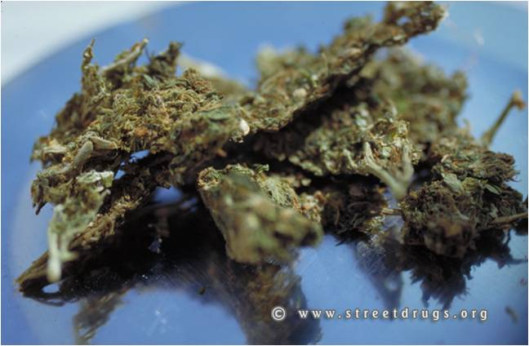
Which drug is most detected?
Most common illegal drug detected in impaired drivers
4 to 14 percent of drivers injured or killed in traffic accidents tested positive for THC
*National Institute on Drug Abuse (NIDA)*

Slide 5
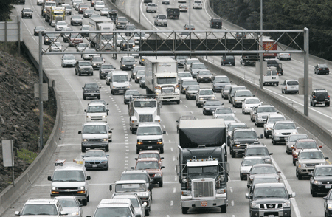
Drugged Driving Survey
An estimated 10.5 million people aged 12 or older reported driving under the influence of illicit drugs
*2009 National Survey on Drug Use and Health (NSDUH)*

Slide 6
Which group has the highest drugged driving rate?
The rate of drugged driving in 2009 was the highest among adults 18 to 25 (12.8 percent)
* 2009 National Survey on Drug Use and Health (NSDUH) *

Slide 7
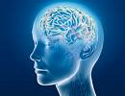
How does drugged driving cause car accidents?
Alters Perception
Increases Drowsiness
Attention Loss
Loss of Balance
Hinders Coordination
Delays Reaction Time
Dulls Judgment
Affects Memory
Blurred Vision
Various other qualities

Slide 8
Who is at risk?
Drivers
Passengers
Pedestrians
*Drugged driving is a dangerous activity that puts us ALL at risk*

Slide 9
Drugged-Driving Laws
There are three types of drugged-driving laws:
1) Statutes that require drugs to render a driver “incapable” of driving safely
2) Statutes requiring that the drug impair the driver’s ability to operate safely or “under the influence” of an intoxicating drug
3) “Per se” statutes make it a criminal offense to have a drug or metabolite in one’s body/body fluids while operating a motor vehicle “zero tolerance”

Slide 10
Recent drugged driving deaths
May Wise, 33 who had five times the appropriate dosage of Xanax in her system, hit Charles H. Payton Sr. sending him flying 100 feet through the air. He died at the scene.

Slide 11
Drugged driving injuries
Jeremy Turla, 26, was charged with driving under the influence of drugs and possession of heroin following the mid-afternoon crash.

Slide 12
Drugged driving accident
After the minor accident, Scroggins used his car to ram into the other car multiple times. Marijuana found at the scene.

Slide 13
Summary
Make responsible decisions when driving or riding as a passenger when drug use is noticeable
Find someone else to drive if you absolutely must take a prescription drug that may impair your driving ability
Be aware of the drug's potential interactions with alcohol, other prescription medicines, and over-the-counter medicines
Driving behind the wheel with prescription drugs is as deadly as with over-the-limit alcohol

Slide 14
Resources
www.whitehousedrugpolicy.gov/druggeddriving
www.nhtsa.gov
www.nida.nih.gov
www.samhsa.gov
www.cnnhealth.com

Slide 15
Additional information on Drugged Driving can be found by contacting your local Army Substance Abuse Program or by visiting www.acsap.army.mil

