Slide 1
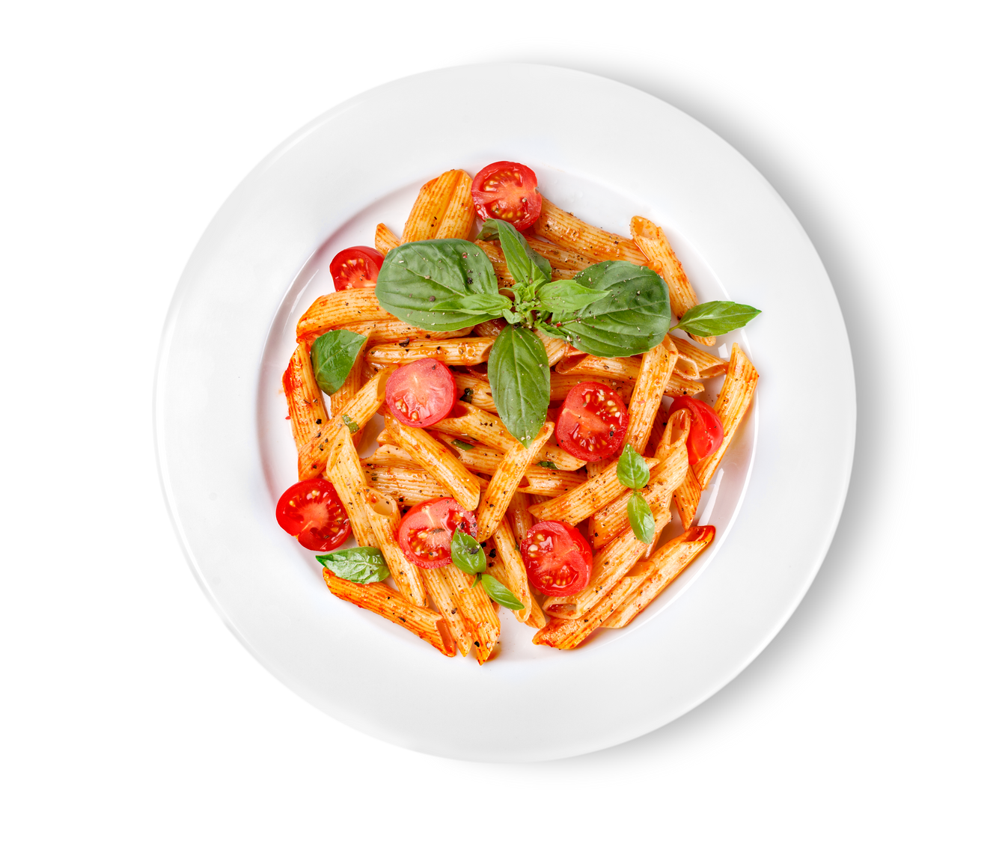
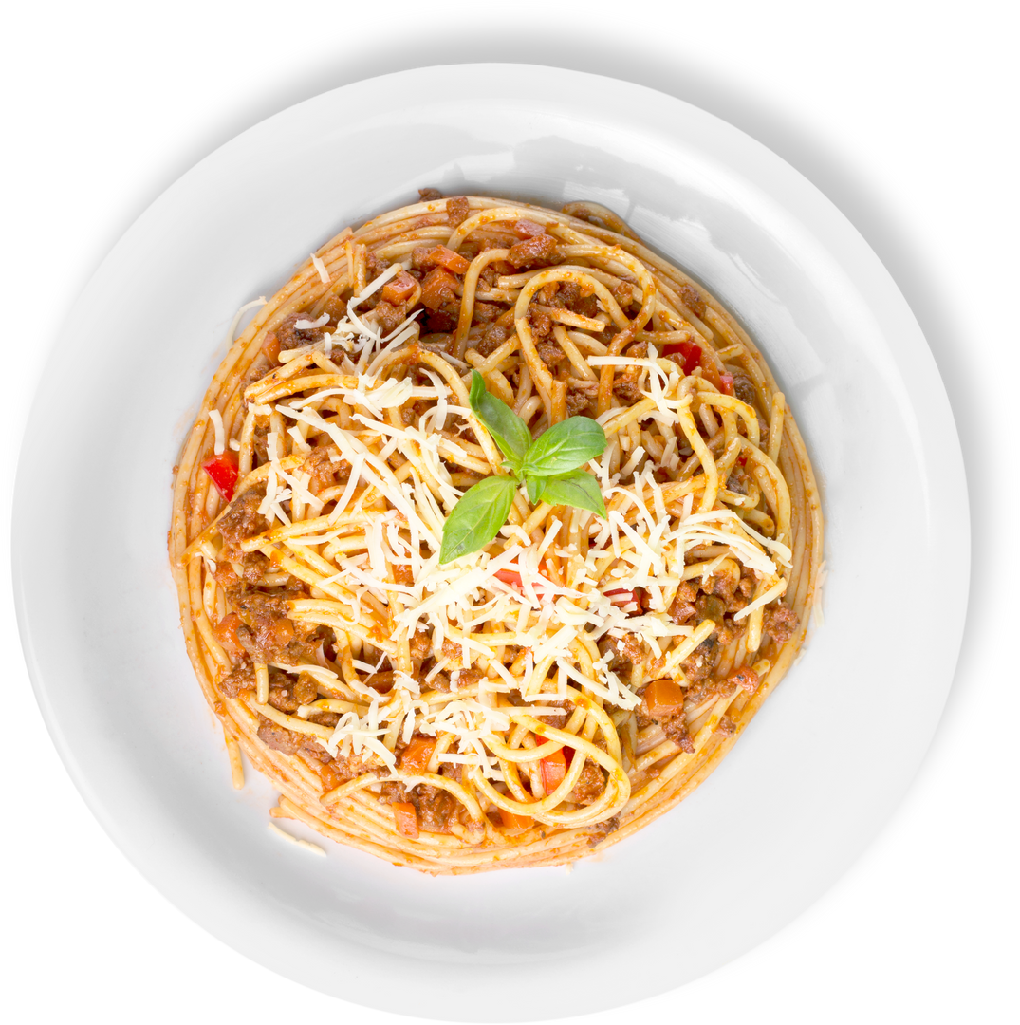

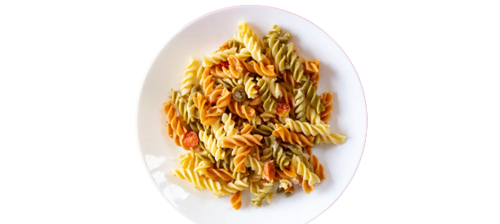



Every
13
Warrior
Monday
Restaurant 13
PASTA
Bar
Select Your Pasta
Penne
Spaghetti
Rotini
Add Your Sauces
Meat Sauce w/Turkey
Marinara
Alfredo
Choose From a Variety of Toppings
Grilled Chicken
Meatballs
Fire Roasted Tomato
Tender Crisp Broccoli
Caramelized Onions
Sauteed Mushrooms
Roasted Bell Peppers
Garlic Bread
Menu Items Subject To Change

Slide 2
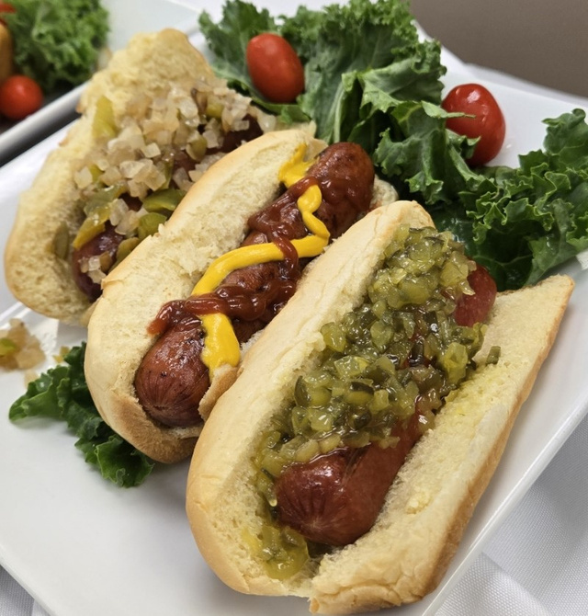
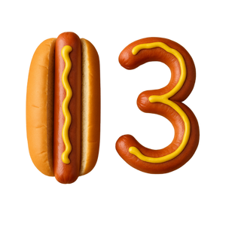
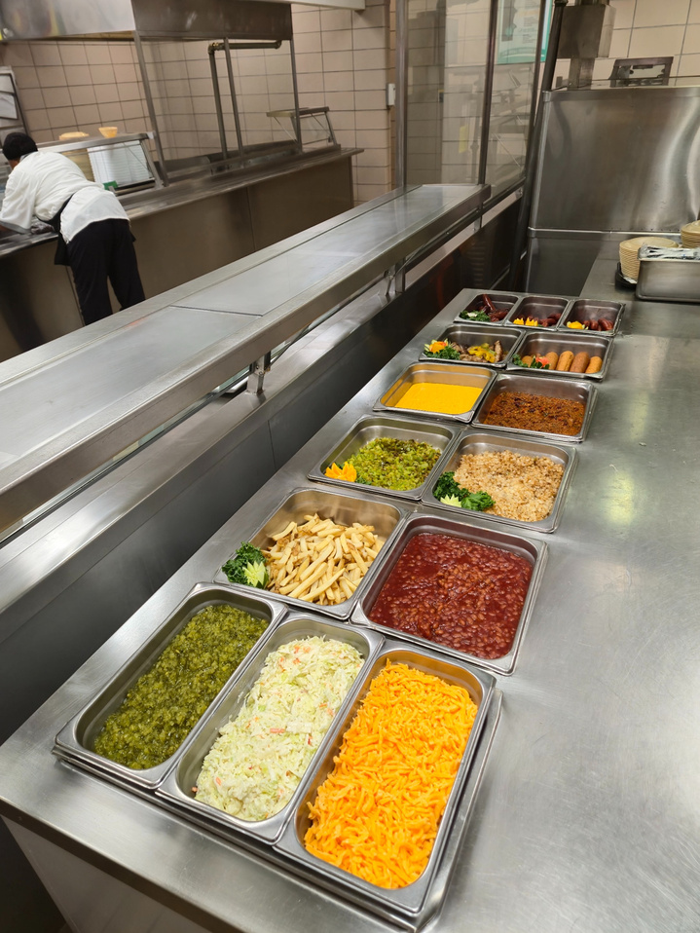

FRANKS FOR YOUR SERVICE
Warrior
Restaurant
Load it up, Warrior Style!
Battle Basics
Ketchup
Mustard
Mayo
Sweet Relish
Onions (Raw or Grilled)
Tactical Toppings
Vegan Chili
Cheese Sauce
Tomatoes(Raw, Roasted, Sautéed & Grilled)
Jalapeños
Roasted Bell Peppers
Cole Slaw
Roasted Broccoli
Choose Your Dog
All-beef Hot Dog
Turkey Dog
Italian Rope Sausage
Polish Links Kielbasa
Warrior Sides
French Fries
Baked Beans
Every Tuesday
Menu Items Subject To Change

Slide 3



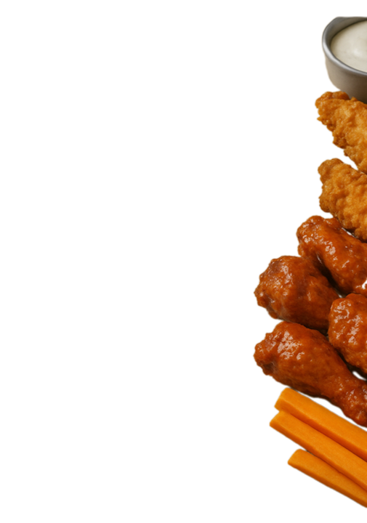
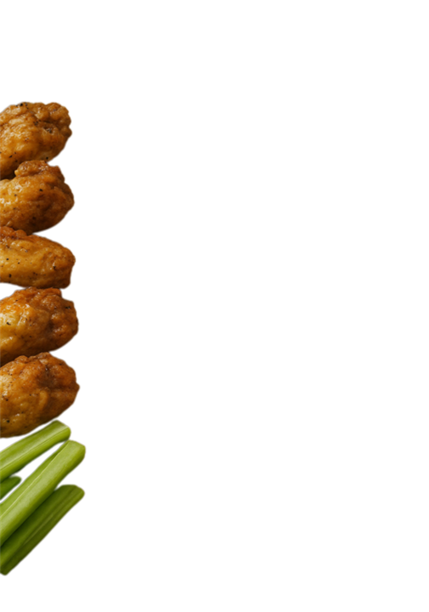
WINGS OF MASS SATISFACTION
Suit Up - Fall In & Report To The Line
Every Wednesday
This is not a Drill
THE ARSENAL
LEMON PEPPER - Tangy with a tactical twist
BUFFALO - Classic heat with a fiery attitude
TERIYAKI - Sweet, salty, and straight from the flavor barracks
PLAIN - No frills, No flash. Just good old-fashioned firepower
CHICKEN TENDERS - No bones just business
RATIONS (SIDES)
Carrots & Celery - Crunchy reinforcements, perfect for flavor combat
Choice of Dipping Sauces
Ranch or Blue Cheese
WARRIOR RESTAURANT 13
FEEDING THE FORCE!
MENU ITEMS SUBJECT TO CHANGE

Slide 4




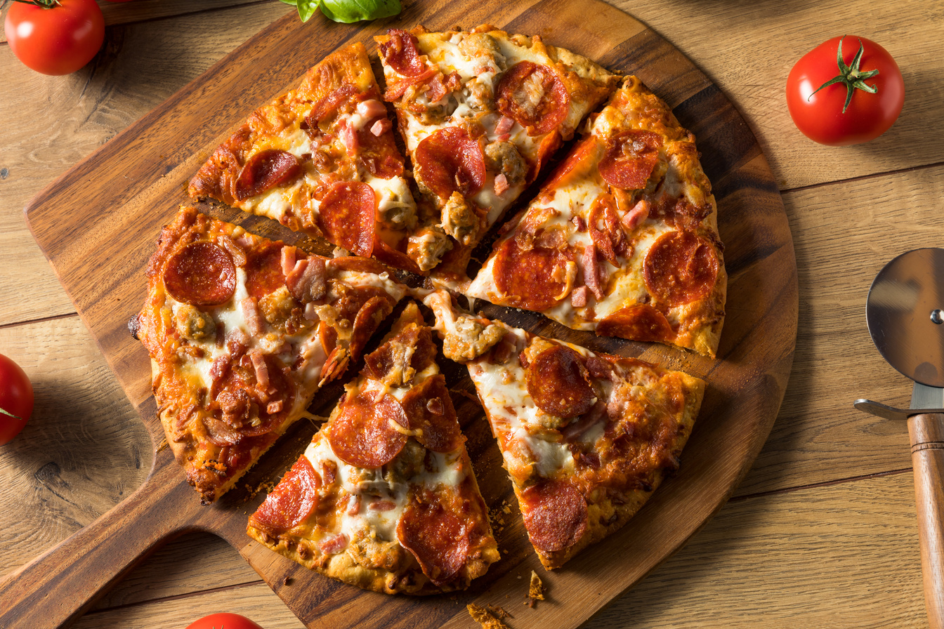

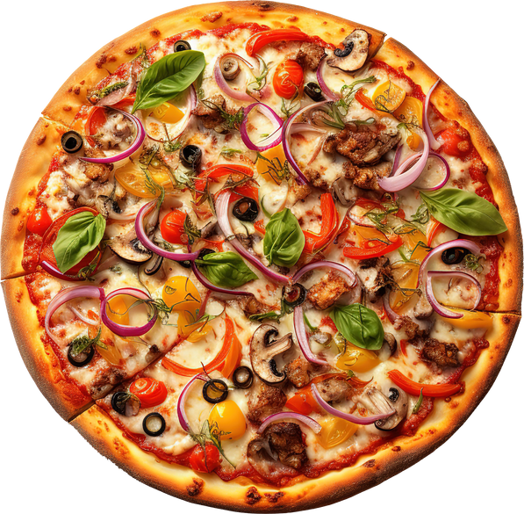

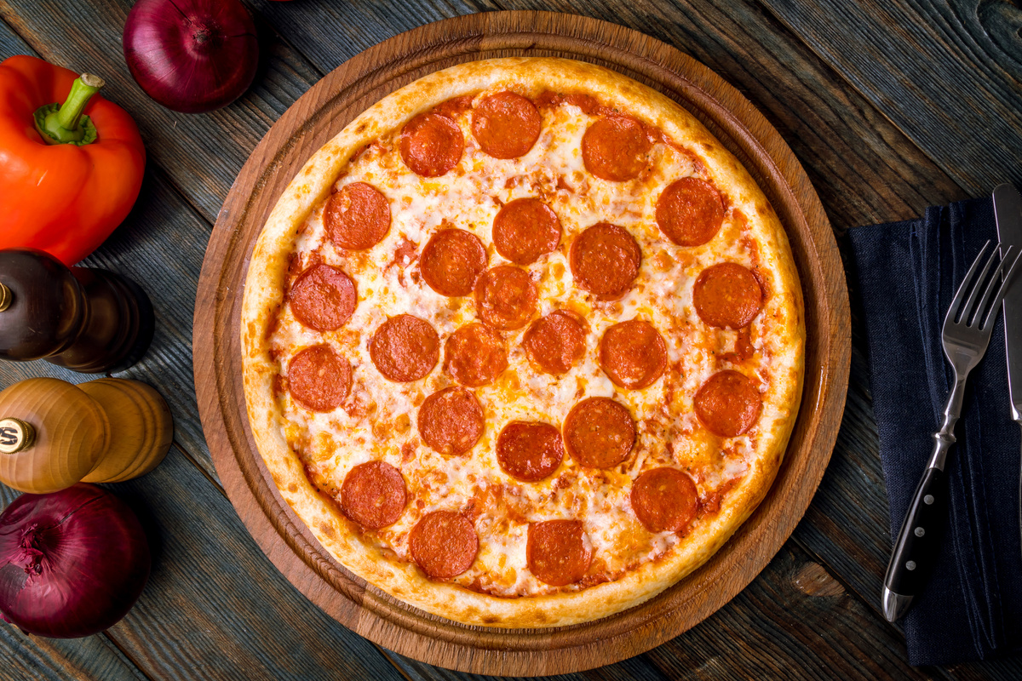



PIZZ
B R
Warrior Restaurant
MEAT LOVERS
A full-on flavor assault loaded with pepperoni, sausage, beef, and ham—this pie is locked, loaded, and ready to serve!
VEGGIE PIZZA
Every Thursday
This is your green mission: mushrooms, bell peppers, onions, and black olives unite for a plant-powered punch.
Breadsticks & Marinara Sauce
PEPPERONI PIZZA
Crispy pepperoni, melty mozzarella, and bold tomato sauce on a golden crust a classic slice with combat-ready flavor.
Parmesan Cheese
CHEESE PIZZA
Crushed Peppers
A no-frills, high-caliber favorite mozzarella and tangy tomato sauce come together in perfect formation.
Menu Items Subject To Change

Slide 5


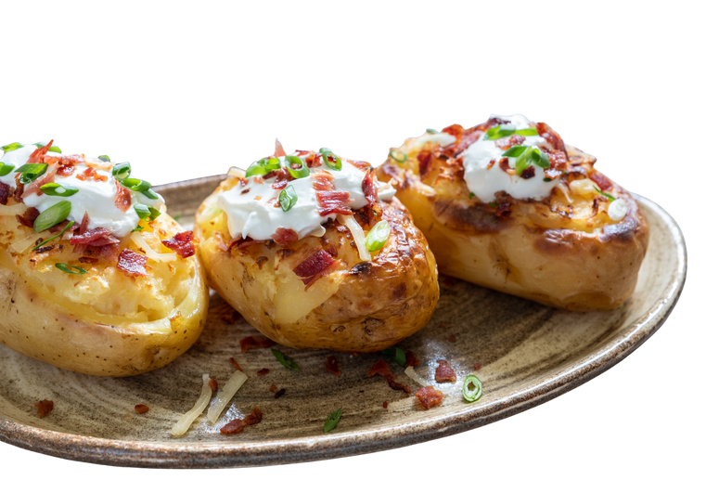
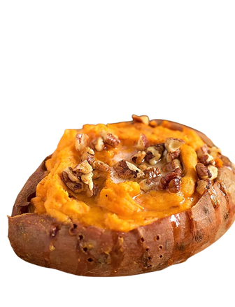

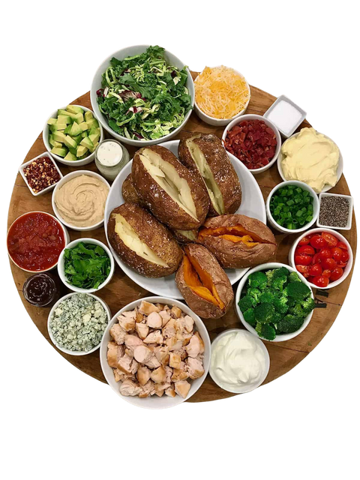
Warrior Restaurant
13
operation
spud strike
Every
Friday
BASE CAMP
CHOOSE YOUR POTATO
BATTLEFIELD BROWN
RUSSET
SUNBURST SIEGE
SWEET POTATO
HEAVY ARTILLERY
PROTEINS
GRILL SERGEANT
GRILLED CHICKEN
MEATLESS MORTAR
VEGAN CHILI
FIELD GREENS DIVISION
VEGGIES
EMBER ROUNDS
ROASTED TOMATOES
GREEN BRIGADE
CRISP & TENDER BROCCOLI
OPERATION CRUNCH
DICED ONIONS & PEPPERS
SPICY ORDNANCE
JALAPEÑO
DAIRY DETACHMENT
CHEESE & CREAM
MELTED MUNITION
CHEESE SAUCE
CHEESE SHRAPNEL
SHREDDED CHEESE
AMMO SUPPLY DROP
CRUNCH & SWEET
COOL COVER
SOUR CREAM
CANNON CRACKLE
BACON BITS
GOLDEN RATIONS
BUTTER
CRUNCH CORPS
NUTS
SWEET SURRENDER
BROWN SUGAR
Menu Items Subject To Change

