Slide 1
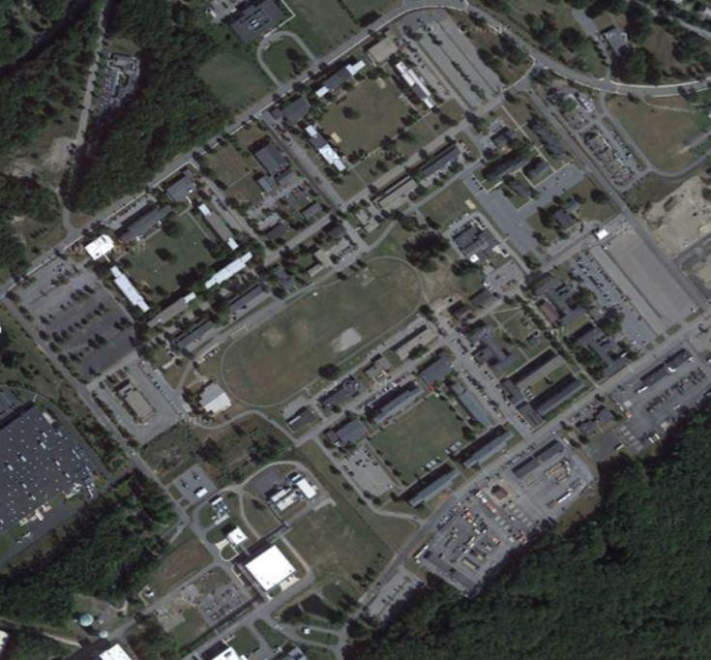
What is Stormwater?
What Should I do if There is a Spill?
Stormwater Pollution Prevention
Stormwater (i.e., rain or snowmelt) flows over the ground and impervious surfaces, such as parking lots, roads, sidewalks, and rooftops instead of being absorbed into the ground.
Why is Stormwater Runoff a Problem?
If the spill is life-threatening, immediately call 911, then the DPW – Environmental Division
If not life-threatening, immediately call the DPW – Environmental Division 978-615-6106 or the DoD Police 978-615-6067
If safe to do so:
STOP THE FLOW OF PRODUCT
WARN PERSONNEL
PROTECT STORMWATER INLETS
SHUT OFF IGNITION SOURCES
INITIATE CONTAINMENT
COMPLETE THE SPILL RESPONSE FORM AND SUBMIT IT TO THE ENVIRONMENTAL POC
At
Fort Devens RFTA
As stormwater runoff
flows over surfaces, it
collects pollutants, such as trash, chemicals, nutrients, and sediment. This untreated runoff flows into storm drains that lead directly to rivers, streams, wetlands, or coastal waters. The
runoff carries pollutants into the waterbodies we use for drinking, swimming, and fishing.
Sediment can cloud the water, making it difficult for aquatic plants to grow.
Excess nitrogen and phosphorus from fertilizers can cause algae blooms.
Bacteria and other pathogens can create health hazards.
Litter and debris can choke, suﬀocate, or disable aquatic life such as ducks, fish, crabs, and birds.
Common pollutants like trash, pesticides, paint, solvents, and motor oil can poison animals and people.
What is an Illicit Discharge?
An illicit discharge is any discharge into a storm drain system that is not composed entirely of stormwater.
What to look for...
Water, chemicals, and other ﬂuids ﬂowing in storm drains during dry weather
Water that is cloudy, dirty, has a sheen, contains debris or litter, has an odor
Sediment, trash, fuels, and oils on the ground
Contact Information: (978) 615-6106
E-mail Stormwtater Program
Fort Devens RFTA Stormwater Webpage
According to the EPA, impervious surfaces in a typical city block generate more than 5x the runoﬀ than a forested area the same size.
IF YOU SPILL SOMETHING OR
SUSPECT AN ILLICIT DISCHARGE, CONTACT THE DPW – ENVIRONMENTAL DIV. at 978-615-6106

Slide 2
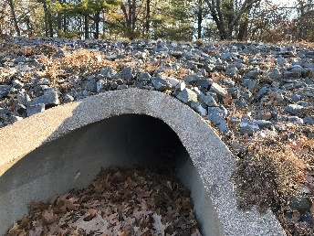
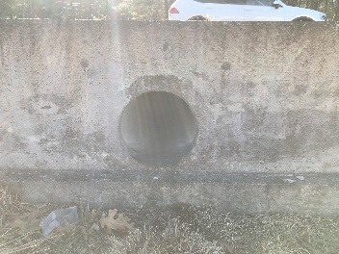
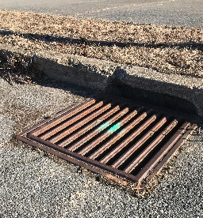
What We’re Doing at
Fort Devens RFTA
Pollution Prevention and You
How You Can Reduce Your Impact on Stormwater Pollution
Low-Impact Development (LID)
Good Housekeeping
At work, at home, anywhere!
LID Practices are stormwater management practices that mimic natural inﬁltration or evaporation to remove pollutants and reduce the amount of stormwater runoff.
Fort Devens RFTA attempts to manage stormwater as close to its source as possible by preserving and recreating natural landscape features, minimizing impervious areas, and treating stormwater as a resource rather than a waste.
Good housekeeping is the easiest and most effective way you can help reduce or eliminate stormwater pollution.
NEVER DUMP ANYTHING DOWN STORM DRAINS!
Don't litter!
Maintain your car.
Fort Devens RFTA’s GOAL: Keep stormwater contacting pollutants and entering drains.
Reduction of Phosphorus to Streams
Excess fertilizers and pesticides applied to lawns and gardens wash off and pollute streams. In addition, yard clippings and leaves can wash into storm drains and contribute nutrients and organic matter to streams.
Wash your car at a car wash or on your lawn.
Pick up after your pet.
Have your gutters discharge to vegetated or grassed areas.
Reseed lawns to prevent sediment runoﬀ.
Compost or recycle yard waste.
Use water-based paints and clean paint brushes in a sink.
Deliver used oil to recycling centers.
Use minimal amounts of fertilizers and pesticides.
Consider using porous/permeable pavers when building patios and walkways.
Clean up oil and chemical spills upon discovery.
Keep a look out!
Contact Fort Devens RFTA DPW - Environmental Division if you see any of the following:
Help Reduce Bacteria and Pathogens in Stormwater!
•Pick up pet waste.
•Practice proper septic system maintenance to reduce bacteria and pathogens reaching catchments and water bodies.
Help Reduce Phosphorus in Stormwater!
•Properly dispose of grass clippings in the spring and summer. Not down storm drains.
•Properly use slow-release and phosphorus-free fertilizers in the spring.
•Pick up pet waste all year long.
•Properly dispose of leaf litter in the fall. Not down storm drains.
Sediment or litter in drains,
Dying vegetation
Sediment in roads or not contained to construction sites
Blocked drains
Signiﬁcant litter on the ground
Chemical spills, leaks, or stains

