Slide 1
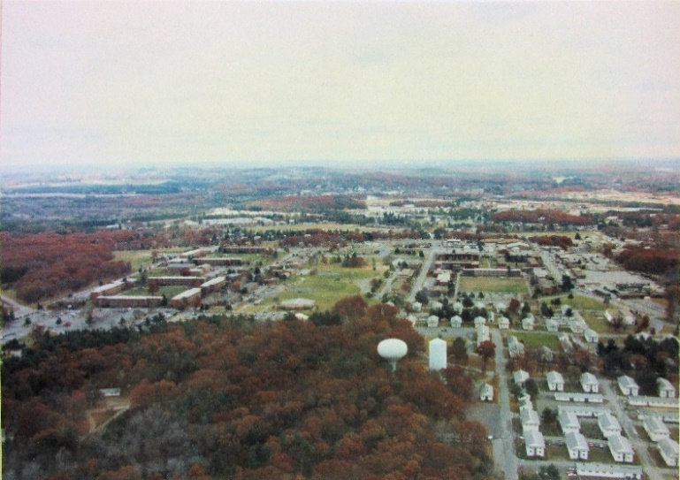
What is Stormwater Runoff?
Stormwater runoff is water from rain or snowmelt that flows over the ground surface. It flows over impervious surfaces such as parking lots, roads, sidewalks, and rooftops instead of being absorbed into the ground.
Why is Stormwater Runoff a Problem?
As stormwater flows over impervious surfaces it collects pollutants such as trash, chemicals, and dirt. The water flows untreated into a storm sewer system or directly into rivers, lakes, streams, wetlands, or coastal waters. Pollutants are then carried into the waterbodies we use for swimming, drinking, and fishing.
Sediment can cloud the water and make it difficult or impossible for aquatic plants to grow.
Excess nutrients can cause algae blooms.
Bacteria and other pathogens can create health hazards.
Debris can choke, suffocate, or disable aquatic life like ducks, fish, turtles, and birds.
Household hazardous wastes like pesticides, paint, solvents, and used motor oil can poison animals and people.
The EPA estimates that stormwater runoff accounts for 65% of pollution in rivers.
The Premiere Training Facility in New England
Fort Devens RFTA
Environmental Division
Stormwater Pollution Prevention
When rain flows over the ground, it can carry litter, chemicals, dirt, and other pollutants to the Nashua River and Robbins Pond.
Local Resources
The Nashua River Watershed Association
592 Main Street, Groton, MA 01450 www.nashuariverwatershed.org
Think Blue Massachusetts
c/o Town of Charlton, 37 Main St, Charlton, MA 01507
www.thinkbluemassachusetts.org
Massachusetts's Stormwater Management Program
Massachusetts DEP: 617-556-1157 https://www.mass.gov/info-details/ stormwater
More Information on the Fort Devens RFTA Website Here

Slide 2
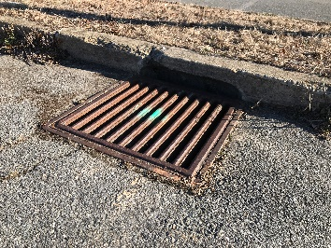
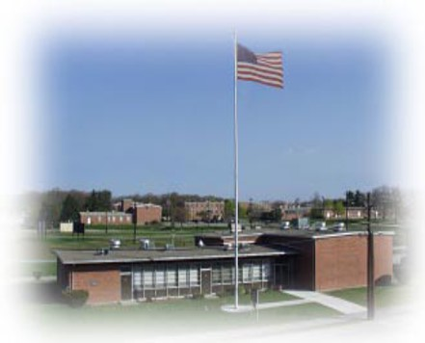
How You Can Help!
At Home, Work, Anywhere!
Donʼt litter!
Never dump anything down storm drains.
Wash your car at a car wash or on your lawn instead of on a paved surface.
Pick up after your pet.
Eat certified organic food, which is produced without the use of chemical pesticides and fertilizers that would otherwise end up in the water.
Outflow from gutters should run into grass, not paved surfaces.
Check your car for oil leaks!
Clean paint brushes in a sink, not outdoors, and use water-based paints.
Eliminate the use of pesticides and fertilizers, or use as little as possible.
Compost or recycle yard waste when possible.
Properly dispose of chemicals. NEVER POUR CHEMICALS IN STORM DRAINS!
Consider the use of porous pavers when building patios and walkways.
Clean oil and chemical spills upon discovery.
Stormwater Pollution Prevention at Fort Devens RFTA
Fort Devens RFTA utilizes a variety of stormwater Best Management Practices (BMPs) and weʼre adding more with every major construction project.
Take Action at Home!
Build a Rain Garden
Choose a location - Pick a place that can collect as much runoff as possible, is 5ʼ-15ʼ away from your home, and is free of tree roots, utilities, etc.
Call Dig Safe before digging - Dig safely, call Dig Safe at 811.
Test the soil infiltration - If infiltration is too low, water will pool or runoff.
Size the rain garden – Base the size on the amount of runoff, infiltration rate, and garden depth.
Construct – Excavate, fill with soil media mix, choose and plant your vegetation (native plants are always your best option).
Maintain - Rain gardens require about as much maintenance as a standard landscaped bed such as weeding, watering, and raking mulch.
Rain gardens can remove up to 90% of nutrients and chemicals and up to 80% of sediments from stormwater runoff.
For more information visit: https://www.mass.gov/info-details/ stormwater#municipal-resources-for-ms4-compliance-

