Slide 1


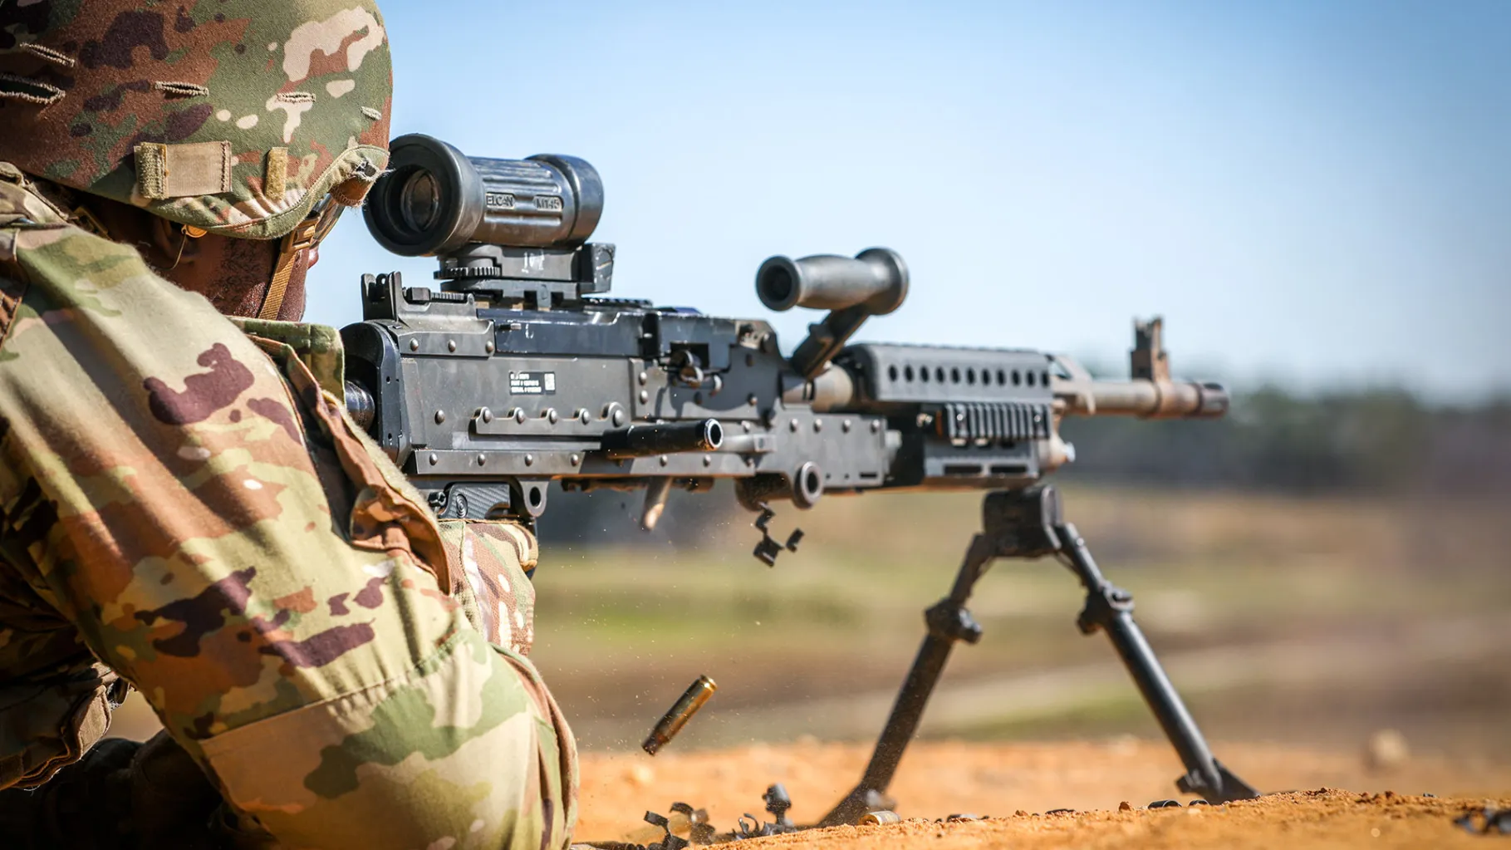
USARC SAFETY SENDS
Live Fire Incident
At approximately 1700 hours on 12 May 2026, a Soldier assigned to the 76th Operational Response Command, was conducting live‑fire ground gunnery at Fort McClellan, Alabama. During firing operations, a crew experienced a weapon malfunction, and the Range Safety called “Malfunction” in accordance with established range procedures. The crew opened the Cover Assembly and conducted a chamber sweep and identified a live round in the chamber. The crew prepared to close the feed tray and attempt to fire the round. At that moment, the round detonated unexpectedly, causing debris to strike the Gunner in the face.
Leader Tasks:
Ensure all gun crews conduct supervised hands-on training focusing on Immediate Action, Remedial Action and Stuck Cartridge Case or Live Round with a hot / cold gun as prescribed in TM 9-1005-313-10.
Ensure headspace on assigned/spare barrels is set and tagged to gun receiver. Rotate usage of barrels. Do not interchange barrel assembly or bolt assembly from one machine gun to another without being headspaced/gaged. Doing so may result in injury to, or death of, personnel.
Ensure Range Safety personnel enforce proper malfunction procedures.
Ensure gun crews and Range Safety personnel adhere to TM WARNING “If nothing ejected, you have a hot gun (200 rounds fired within a 2-minute period), DO NOT open the cover. Place safety to “S” safe, keep weapon pointed down range, and remain away from the weapon for 15 minutes. After 15 minutes, clear the weapon.
Soldier Tasks:
Complete the required Preliminary Marksmanship Training on the machine gun and participate in hands-on training to ensure you fully understand the malfunction procedures.
Avoid becoming task complacent, adhere to all warnings, follow the proper loading, firing, unloading, and malfunction procedures no matter how many times you have completed the task.
Always wear task specific PPE.
ENSURE WIDEST DISSEMINATION AND POST ON BULLETIN BOARDS

