Slide 1
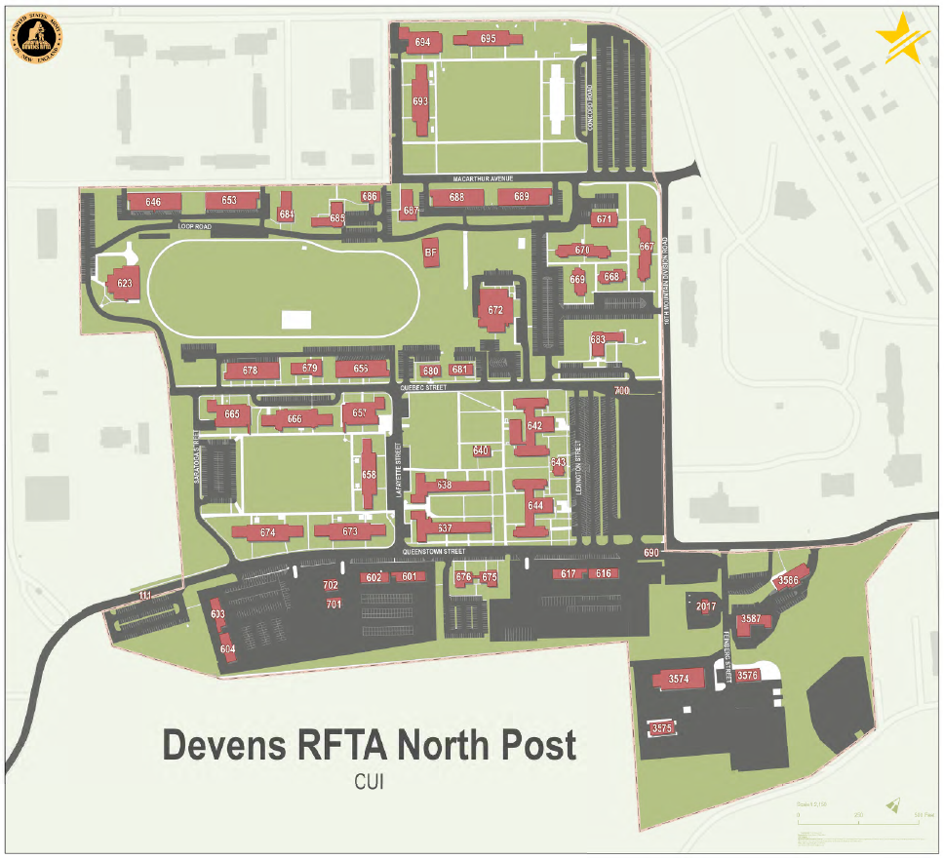
Main Gate
Park along the fence line only

