Slide 1
Installation Housing Office Plain Language Briefing
Annex F to OPORD 20-048 – Plain Language Brief
USAG Fort Detrick
As of 10 July 2020

Slide 2
Welcome to the Garrison Housing Office
The Fort Detrick Housing staff are employed by the Army to assist Service Members and their Families with housing matters and advocate on their behalf with community partners/agencies both on and off the installation
The Housing Service Office (HSO) provides referral services and tenant/landlord dispute services
The Installation Housing Office provides oversight of the privatized company managing on post housing and provides tenant/landlord dispute services
The Garrison Housing Manager manages the Installation Housing Office and reports directly to the Director of Public Works and Garrison Leadership
Garrison Leadership
Garrison Commander: COL Dexter Nunnally
Garrison Command Sergeants Major: CSM Jason Gusman
Garrison Deputy Garrison Commander: Mr. Wilfred Plumley
Garrison Housing Manager: Ms. Yvette Bell

Slide 3
Privatized Housing Contacts
Balfour Beatty Communities LLC (BBC),, sometimes referred to as the Residential Communities Initiative (RCI) Company, is the privatized company that owns and manages the family housing on this installation
Balfour Beatty Communities LLC (BBC), is the private partner and managing member of Fort Detrick/Walter Reed Army Medical Center Housing LLC
Balfour Beatty Communities is the property management company that manages the day to day operations of the privatized housing to include ensuring prompt and professional maintenance and repair, property concerns, and rent/billing issues. This is your landlord for privatized housing
Fort Detrick BBC Contacts: Glen Haven Apts BBC Contacts
Property Manager: mking@bbcgrp.com Property Manager: CDeMarco@bbcgrp.com
(240) 379-6410 (301) 649-9700
Maintenance Supervisor: JStewart@bbcgrp.com Maintenance Supervisor: SBellamy@bbcgrp.com

Slide 4
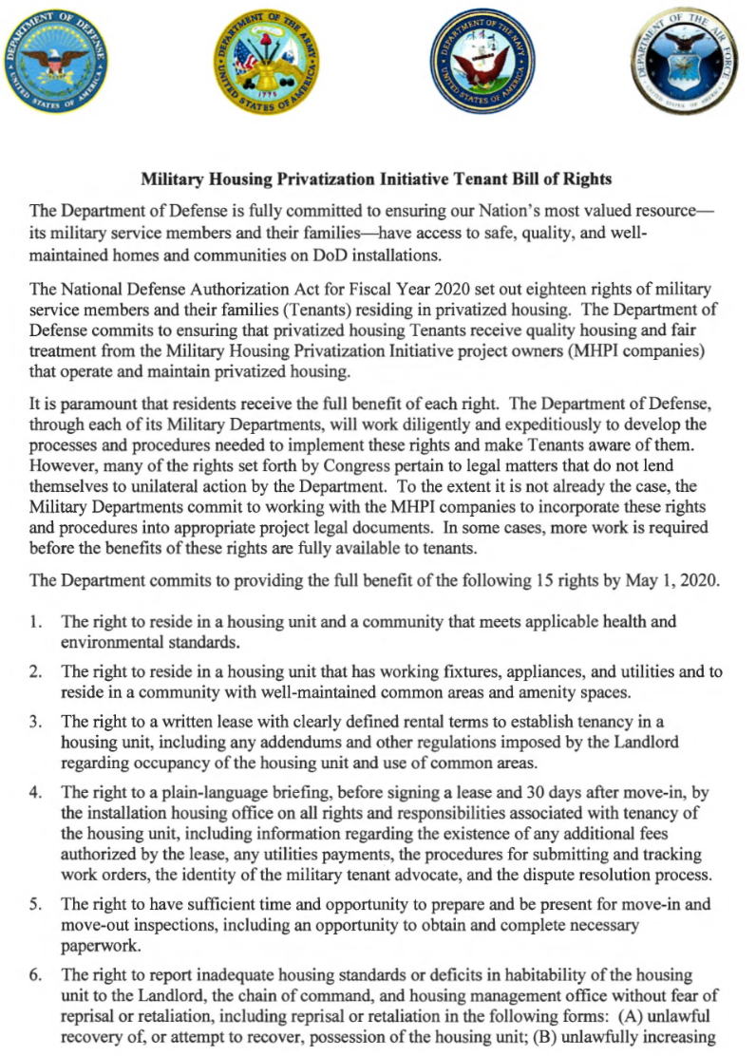
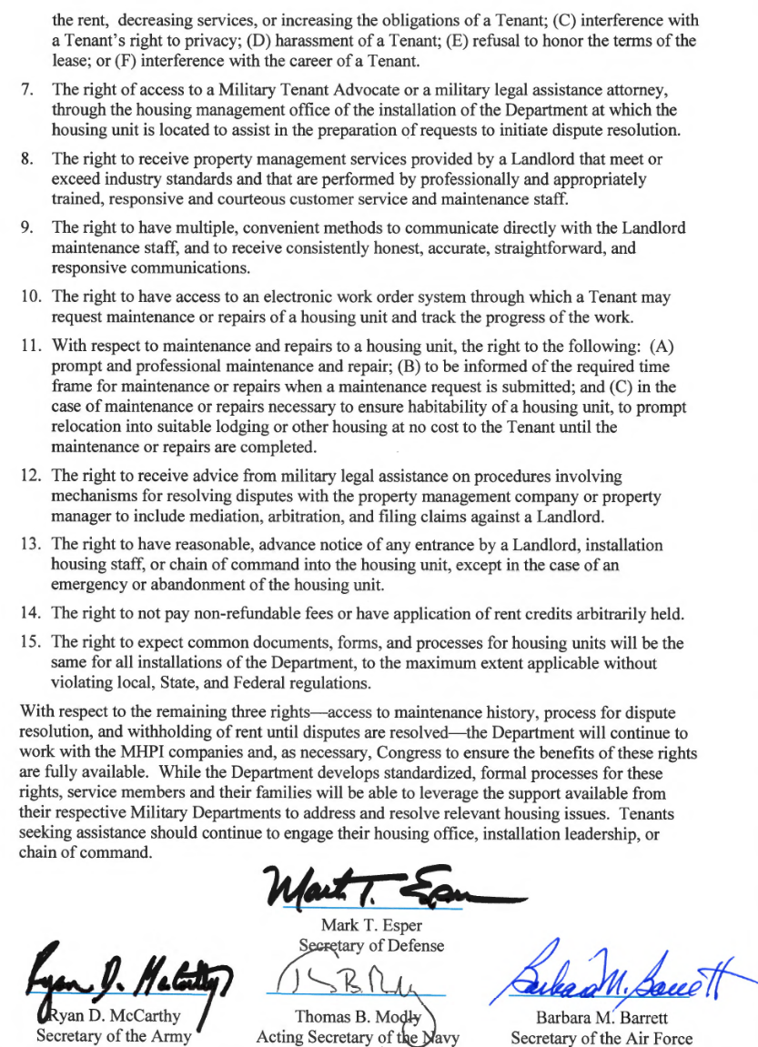
Privatized Housing - Tenant Bill of Rights
* Copy is available upon request

Slide 5
Privatized Housing - Tenant Bill of Rights
The Military Housing Privatization Initiative Tenant Bill of Rights requires the Garrison Housing Office provide a plain language brief to all residents of privatized housing prior to lease signing and again 30 days after move-in on all rights and responsibilities associated with tenancy of the housing unit
You have the right to reside in a housing unit and a community that meets applicable health and environmental standards. (Right 1)
You have the right to reside in a housing unit that has working fixtures, appliances, and utilities and to reside in a community with well-maintained common areas and amenity space. (Right 2)
You have the right to a written lease with clearly defined rental terms to establish tenancy in a housing unit, including any addendums and other regulations imposed by the Landlord regarding occupancy of the housing unit and use of common areas. (Right 3)
The right to a plain-language briefing, before signing a lease and 30 days after move-in, by the installation housing office on all rights and responsibilities associated with tenancy of the housing unit (Right 4)
You have the right to have sufficient time and opportunity to prepare and be present for move-in and move-out inspections, including an opportunity to obtain and complete necessary paperwork. (Right 5)

Slide 6
Privatized Housing - Tenant Bill of Rights
You have the right to report inadequate housing standards or deficits in habitability of the housing unit to the Landlord, the chain of command, and Installation housing office without fear of reprisal or realization, including (A) unlawful recovery of, or attempt to recover, possession of the housing unit; (B) unlawfully increasing the rent, decreasing services, or increasing the obligations of a tenant; (C) interference with a tenant’s right to privacy; (D) harassment of a tenant; (E) refusal to honor the terms of the lease; (F) interference with the career of the tenant (Right 6)
You have the right to access to a Military Tenant Advocate or a military legal assistance attorney, through the Installation housing office to assist in the preparation of requests to initiate dispute resolution (Right 7)
The right to receive property management services provided by the Landlord that meet or exceed industry standards and that are performed by professionally and appropriately trained responsive and courteous customer service and maintenance staff. (Right 8)
The Fort Detrick Installation Housing Office Installation Housing Office serves as your Military Tenant Advocate.
usarmy.detrick.imcom.mbx.dpw-housing@mail.mil, (301) 619-3224

Slide 7
Privatized Housing - Tenant Bill of Rights
You have the right to receive advice from military legal assistance on procedures involving mechanisms for resolving disputes with the property management company or property manager in include mediation, arbitration, and filing claims against the Landlord. (Right 12)
SJA Office POC: brett.c.conyers.civ@mail.mil
You have the right to have multiple, convenient methods to communicate directly with the privatized Landlord maintenance staff, and to receive consistent, honest, accurate, straightforward and responsive communications. (Right 9)
You have the right to have access to an electronic work order system through which a tenant may request maintenance or repairs of a housing unit and track the progress of the work. (Right 10)
Balfour Beatty Communities LLC
Maintenance Shop Contact Number: (240) 379-6410 (Detrick Normal Hrs)
(240) 379-6518 (Detrick Emergency 24-Hrs)
(301) 649-9700 (Glen Haven Normal & Emergency)
Ft Detrick Office: 6000 Ditto Ave, Fort Detrick, MD
Glen Haven Office: 1200 McMahon Road, Wheaton, MD
Maintenance Website Detrick: https://detrickhomes.securecafe.com
Maintenance Website Glen Haven: https://glenhavenapartments.securecafe.com
Maintenance Application Detrick: https://detrickhomes.securecafe.com
Maintenance Application Glen Haven: https://glenhavenapartments.securecafe.com

Slide 8
Privatized Housing - Tenant Bill of Rights
You have the right to the following: (A) prompt and professional maintenance and repair; (B) to be informed of the required time frame for maintenance and repairs when a maintenance request is submitted; and (C) in the case of maintenance or repairs necessary to ensure habitability of a housing unit, to prompt relocation into suitable lodging or other housing at no cost to the tenant until the maintenance or repairs are completed. (Right 11)
Displaced Resident Policies
ASAIE&E Memorandum, SAIE, Feb 14, 2020, Army Residential Communities Initiative Company Minimum Standard Resident Displacement Guidelines
ASAIE&E Memorandum, SAIE, Jan 23, 2020, Subject: Procedures for Approving Privatized Housing Habitability after Remediation, Mitigation, Stabilization and abatement
IMCOM Memorandum, Headquarters Installation Management Command, IMPW-H, JAN 31 2020, subject: Procedures for Certifying Housing Habitability for Army Family Housing, Leased Housing, Unaccompanied Housing and Privatized Homes
IMCOM Memorandum, Headquarters Installation Management Command, IMPW-H, MAR 11 2020, subject: Command Guidance Army Residential Communities Initiative (RCI) Company Minimum Standard Resident Displacement Guidelines
ASA IE&E Memorandum, Dated XXX,
“Housing Maintenance Quality Assurance and Environmental Hazard Oversight Program” provides
clear standards and details of required oversight of Army housing maintenance
* Copy is available upon request

Slide 9
Privatized Housing - Tenant Bill of Rights
Contact Detrick Homes or Glen Haven Apartments to report maintenance issues right away
Emergency, urgent, routine work orders
Trouble calls
Safety concerns
Resident compliance issues
Emergency and urgent work orders should be called in immediately to:
Detrick Homes: 240-379-6518
Glen Haven Apartments: 301-649-9700
Routine work orders should be entered online through the Resident Portal
Access the Resident Portal online at detrickhomes.com
Or download the RentCafe Resident app in the App Store or on Google Play

Slide 10
Privatized Housing - Tenant Bill of Rights
Residents can submit routine maintenance requests online through the Resident Portal, or contact the Maintenance team by phone at (240) 379-6518
24-Hour Emergency Maintenance After hours emergencies should be reported to the Maintenance team directly at (240) 379-6518
Work order or maintenance ticket to be closed only once the tenant and Installation Housing Office signs off
The right to have reasonable advance notice of any entrance by the Landlord, Installation housing staff, or chain of command into the housing unit, expect in the case of an emergency or abandonment of the housing unit. (Right 13)
Residents will be given 48 hours advance notice from Detrick Homes before entering a resident’s home for a non-emergency situation.
The right to not pay non-refundable fees or have application of rent credits arbitrarily withheld. (Right 14)
Military service members will not be charged fees including but not limited to, application fees, security deposits, pet deposits, transfer fees.
The right to expect common documents, forms, and processes for housing units will be the same for all Army Installations, to the maximum extent applicable without violating local, state, or federal regulations. (Right 15)

Slide 11
Privatized Housing - Tenant Bill of Rights
Type of Work Order | Examples | Response Time *Depending on Parts
Emergency Critical safety, life threatening issues Resident with a medical requirement for stable temp levels | Gas leaks, fire, power outage, sewage back-up, flood, only toilet inoperable | Initial response within 30 minutes Available 24/7/365
Urgent Habitability issue | Broken window, garage door inoperable, kitchen sink back-up, light-fixtures not working, Refrigerator inoperable | Initial response within 4 hours
Routine Convenience Unit care issues | Single burner inoperable, repair screens, light bulb replacement | Work completed within 2 business days*

Slide 12
Privatized Housing - Tenant Bill of Rights
EMERGENCY/ URGENT WORK ORDERS
RESIDENT SIGN OFF
ROUTINE WORK ORDERS
TRACK STATUS/PROGRESS
COMPLETION
Call in immediately to the maintenance team
Promptly submit online via Resident Portal (access on our website or RentCafe Resident app)
Can upload photos
Through Resident Portal
Work orders remain open until resident signs off on completion
Team calls resident to ensure satisfaction, check for questions or updates
Online satisfaction survey issued

Slide 13
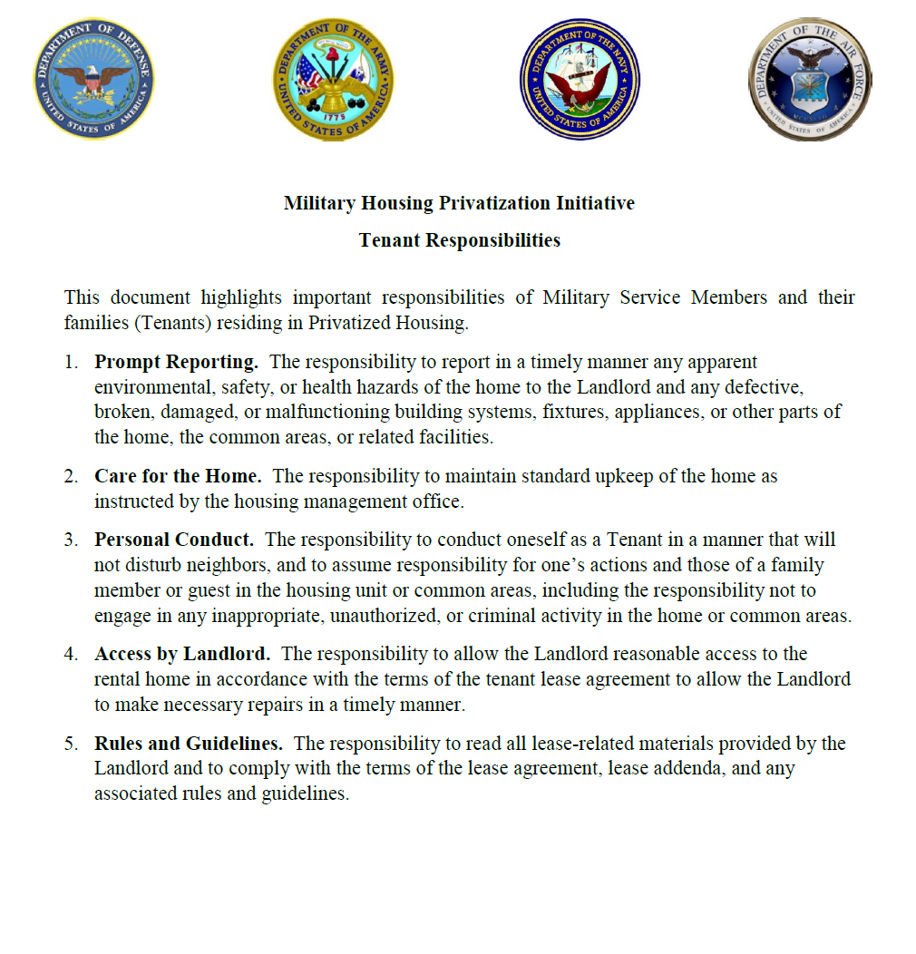
Privatized Housing – Tenant Responsibilities
* Copy is available upon request

Slide 14
Privatized Housing – Tenant Responsibilities
The Military Housing Privatization Initiative Tenant Bill of Rights highlights 5 important responsibilities for Service Members and their Families while they reside in privatized family housing.
The responsibility to report in a timely manner any apparent environmental, safety, or health hazards of the home to the Landlord and any defective, broken, damaged, or malfunctioning building systems, fixtures, appliances, or other parts of the home, the common areas, or related facilities.
The responsibility to maintain standard upkeep of the home as instructed by the housing management office.
Prevent pests: Prevent damage to appliances and systems:
Promptly clean kitchen counters and dispose Only flush toilet paper down toilets
of food debris Keep fats, oils and grease out of drains
Keep food in air-tight containers Check and change your filters
Clear outside doorways and windows of leaves Clean and monitor major appliances
and dirt. Check and change batters for smoke/CO detectors
Report pest issues immediately for prompt service Remove debris from dishes prior to placing in dishwasher
Prevent mildew, moisture, mold:
Check your toilets and faucets for leaks
Use exhaust fans in bathrooms and laundry rooms
Report leaks and issues immediately
Check drains and keep them clear
Regularly clean all areas of the home

Slide 15
Privatized Housing – Tenant Responsibilities
The responsibility to conduct oneself as a Tenant In a manner that will not disturb neighbors, and to assume responsibility for one’s actions and those of a family member or guest in the housing unit or common areas, including the responsibility not to engage in any inappropriate, unauthorized, or criminal activity in the home or common areas.
Residents are encouraged to report any issues or concerns regarding neighbor actions or community policies not being followed as outlined in the Resident Guide to the Detrick Homes community management office at:
Detrick Homes: 240-379-6410 or detrickleasing@bbcgrp.com
Glen Haven: 301-649-9700 or glenhavenleasing@bbcgrp.com
The Resident Guide can be found in the Resident Portal under the “Community Info” tab
The responsibility to allow the Landlord reasonable access to the rental home in accordance with the terms of the tenant lease agreement to all the Landlord to make necessary repairs in a timely manner.
The responsibility to read all lease-related materials provided by the Landlord and to comply with the terms of the lease agreement, lease addenda, and any associated rules and guidelines.

Slide 16
Garrison Housing Services Office (HSO)
The goal of the HSO is to implement and maintain a high quality worldwide resource for relocation services that is innovative, comprehensive, and the first choice of information and support when Soldiers and families relocate.
Non-discriminatory listings of adequate and affordable rental and for-sale housing
Counseling/referral on eligible installation services (i.e. legal, education, Exceptional Family Member Program)
Preliminary inquiries to validate housing discrimination complaints
Liaison with community and government officials / organizations (on and off post)
Housing data exchange with other DoD housing offices
Liaisons with Army Community Services in support of the Housing Relocation Assistance Program
Housing market area data for use in developing market analyses Rental negotiations and lease review

Slide 17
Garrison Housing Services Office (HSO)
One-Stop, Full Service from Arrival to Departure for the Following:
Home buying counseling
Landlord-tenant dispute resolution
Basic Allowance for Housing (BAH) data submission
Property inspections
NEW---Per FY20 NDAA: If tenant is not available for pre-assignment walkthrough inspection, Housing Office must attend on tenant's behalf
NEW---Per FY20 NDAA: The Housing Manager shall initiate contact with resident 15 day and 60 days after move in regarding the satisfaction of the resident.
Administrative assistance with utility company fees/deposits, connections, and billings
Informational briefings (in- and out-processing, entitlements),community outreach

Slide 18
Furniture Safety & Additional Information
Tenants are permitted to anchor any furniture, television, or large appliance to the wall of the unit for purposes of preventing such item from tipping over without incurring a penalty or obligation to repair the wall upon vacating the unit if the Landlord does not anchor the furniture for the tenant.
Housing Motto: Our enduring obligation is to take care of our people — our Soldiers, families and civilian employees. At Fort Detrick, we are fully committed to providing a safe, secure environment on our installation.

Slide 19
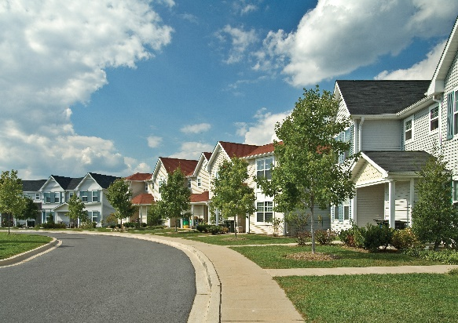
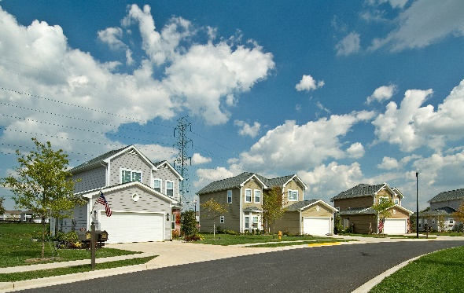
Detrick Homes
Two, three, and four-bedroom floor plans available
Pet-friendly
Curbside trash/recycling pick-up
Lawn care services
Resident activities and events
Ample amenities
Basketball courts
Community center with business center and game room
Playgrounds and tot lots
Recreational trails

Slide 20
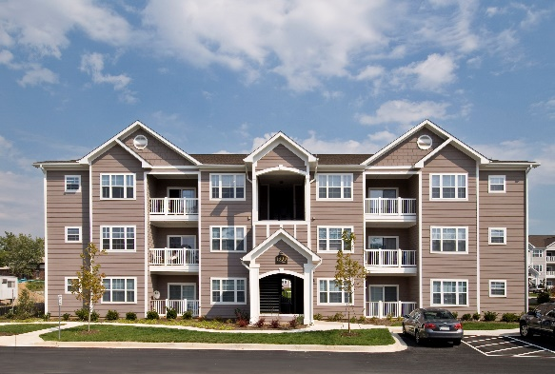
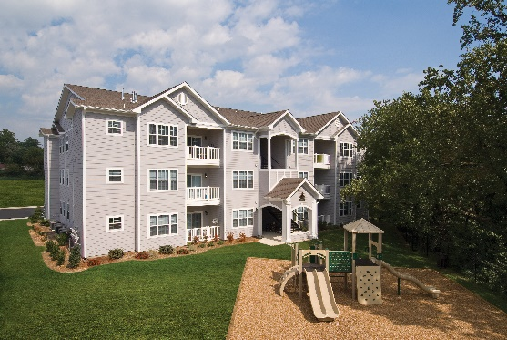
Glen Haven Apartments
Three, and four-bedroom floor plans available
Pet-friendly
Curbside trash/recycling pick-up
Lawn care services
Resident activities and events
Ample amenities
Ample parking
Basketball court
Capital Bikeshare
Community and business center
Fitness center
Playground and BBQ/picnic area

Slide 21
End of Brief

