Slide 1
Fort Detrick RAB Meeting Agenda for 6/22/2022
Time | Subject | Person | Action
6:30 – 6:35 PM | Welcome | Gary Pauly, RAB Co-Chair | Information
6:35 – 6:40 PM | Introductions, Ground Rules, Meeting Purpose, Meeting Minutes | Joseph Gortva, DoD Co-Chair | Information
6:40 – 7:20 PM | Waverley Property | Brianne Witman, Army Corps of Engineers | Information
7:20 – 7:40 PM | Area B Groundwater Pump and Treat Pilot Study | John Cherry, Arcadis | Information
7:40 – 7:55 PM | Area B Sampling | John Cherry, Arcadis | Information
7:55 – 8:05 PM | Upcoming Work – Pilot Testing | John Cherry, Arcadis | Information
8:05 – 8:15 PM | Upcoming Work – Well Installation and Sampling | Kenneth Cunningham, APTIM | Information

Slide 2
Area B Off-Post Waverley View Property Groundwater Investigation Restoration Advisory Board Project Update Brianne Witman, P.E. Project Manager

Slide 3
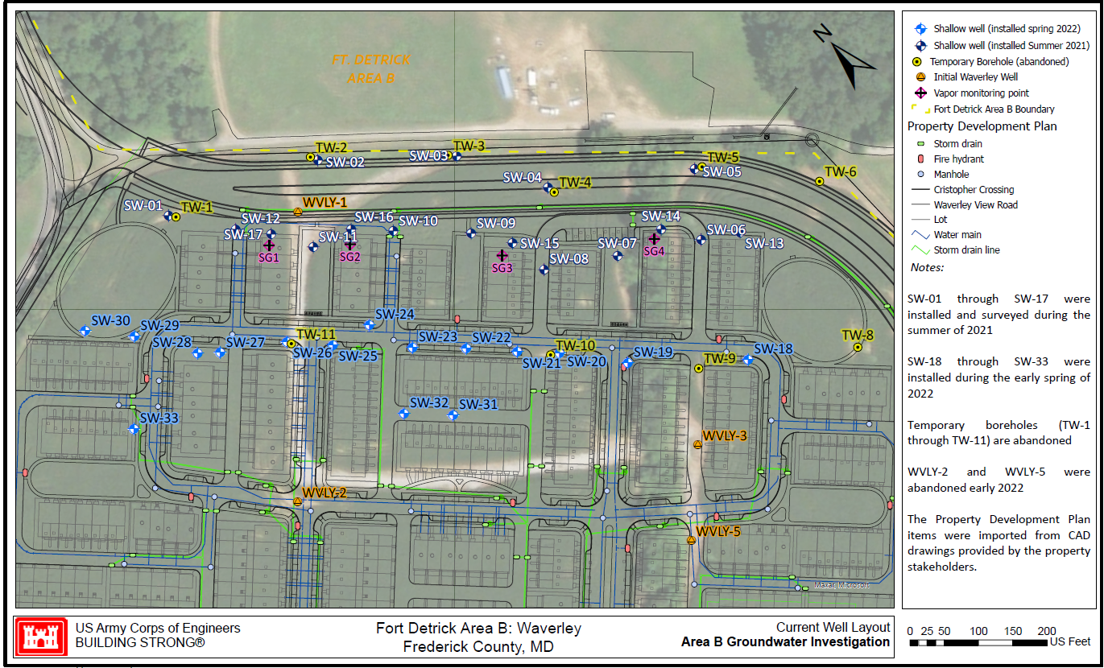
Waverley View Property Groundwater Investigation
Background
Single-family home development planned on Waverley View property, adjacent to Fort Detrick, Area B
Groundwater samples collected from certain monitoring wells installed in 2013 and 2014 at Waverley View had detections of volatile organic compounds (VOCs), both above and below regional screening levels (RSLs)
The Army is completing an investigation to assess potential risk to future human receptors at the Waverley View property from vapor intrusion

Slide 4
Waverley View Property Groundwater Investigation
Monitoring Well Installation
Existing wells
WVLY-01 through WVLY-05 (WVLY-02 and WVLY-05 abandoned)
Temporary wells TW-01 through TW-11 (abandoned)
Groundwater monitoring wells installed 2021 – 2022 to determine extent of VOCs
17 monitoring wells installed in 2021
(SW-01 through SW-17)
16 monitoring wells installed in 2022
(SW-18 through SW-33)

Slide 5
Waverley View Property Groundwater Investigation
Groundwater Sampling
July 2020 Groundwater Sampling
Three VOCs (1,1-dichlorothene, chloroform, and tricholoroethene) were detected above the regional screening level at WVLY-01
Trichloroethene was detected above the RSL at TW-02, TW-03, and TW-04
August 2021 Groundwater Sampling
Trichlorothene detected in SW-02, SW-03, SW-04, SW-08, SW-09, SW-10, SW-11, SW-15, SW-16, and SW-17 at concentrations of 0.92 to 100 µg/L, above the RSL of 0.49 µg/L.
Chloroform detected in SW-01 through SW-16 above the RSL of 0.22 µg/L at concentrations of 0.94 µg/L to 47.7 µg/L.
1,2-Dichloroethane detected in SW-04 (0.46 µg/L), SW-15 (0.65 µg/L), and SW-18 (0.98 µg/L), above the RSL of 0.17 µg/L.
Bromodichloromethane detected in SW-09 (1.2 µg/L), SW-10 (0.90 µg/L), and SW-11 (1.1 µg/L), above the RSL of 0.13 µg/L.
May/June 2022 Groundwater Sampling
Lab results pending
August 2022 and November 2022 Groundwater Sampling

Slide 6
Waverley View Property Groundwater Investigation
Vapor Intrusion Risk Results
USEPA Vapor Intrusion Screening Level (VISL) Calculator Results indicates there are 8 wells where there may be unacceptable risk from vapor intrusion to future residents (without mitigation measures): SW-2, SW-3, SW-4, SW-10, SW-11, SW-15, SW-16, and SW-17 (Circle these well on map)
Army installed 16 additional wells in 2022 to find the extent of the VOC plume (SW18 through SW-33)
Lab data collected in May/June is pending with results to be shared at the next RAB meeting
The Army will collect two additional rounds of groundwater samples, update VISL model projections, and will use to ensure protection of human health as the Waverley View property is developed

Slide 7
RAB Meeting
Area B Remedial Investigation (RI) and Environmental Support
Fort Detrick, Frederick, MD
APTIM Federal Services, LLC
June 22, 2022
US Army Corps of Engineers
BUILDING STRONG®

Slide 8
Agenda
General Contract Information
Task Order Objectives
Remedial Investigation Scope of Work
Preliminary Schedule
Questions and Discussion

Slide 9
Fort Detrick Area B Remedial Investigation and Environmental Support
Baltimore AE Contract #W912DR-18-D-0002
Performance Period:
Start: September 30, 2021
End: September 30, 2024
Prime Contractor is APTIM
Arcadis will provide support as subcontractor

Slide 10
Task Order Objectives
Finalize current Draft Final RI Report for Area B groundwater including:
Address outstanding regulatory comments on 2019 Draft Final RI
Performance of RI activities in the BMW-77 Area and neighboring Waverley View Property
Update Area B CSM (spell out) and RI to include recent Army and USGS investigative activities (published reports)
Complete comprehensive human health and ecological risk assessments to incorporate new data
Abandon and replace Area B monitoring wells BMW66D, BMW68E, and BMW73

Slide 11
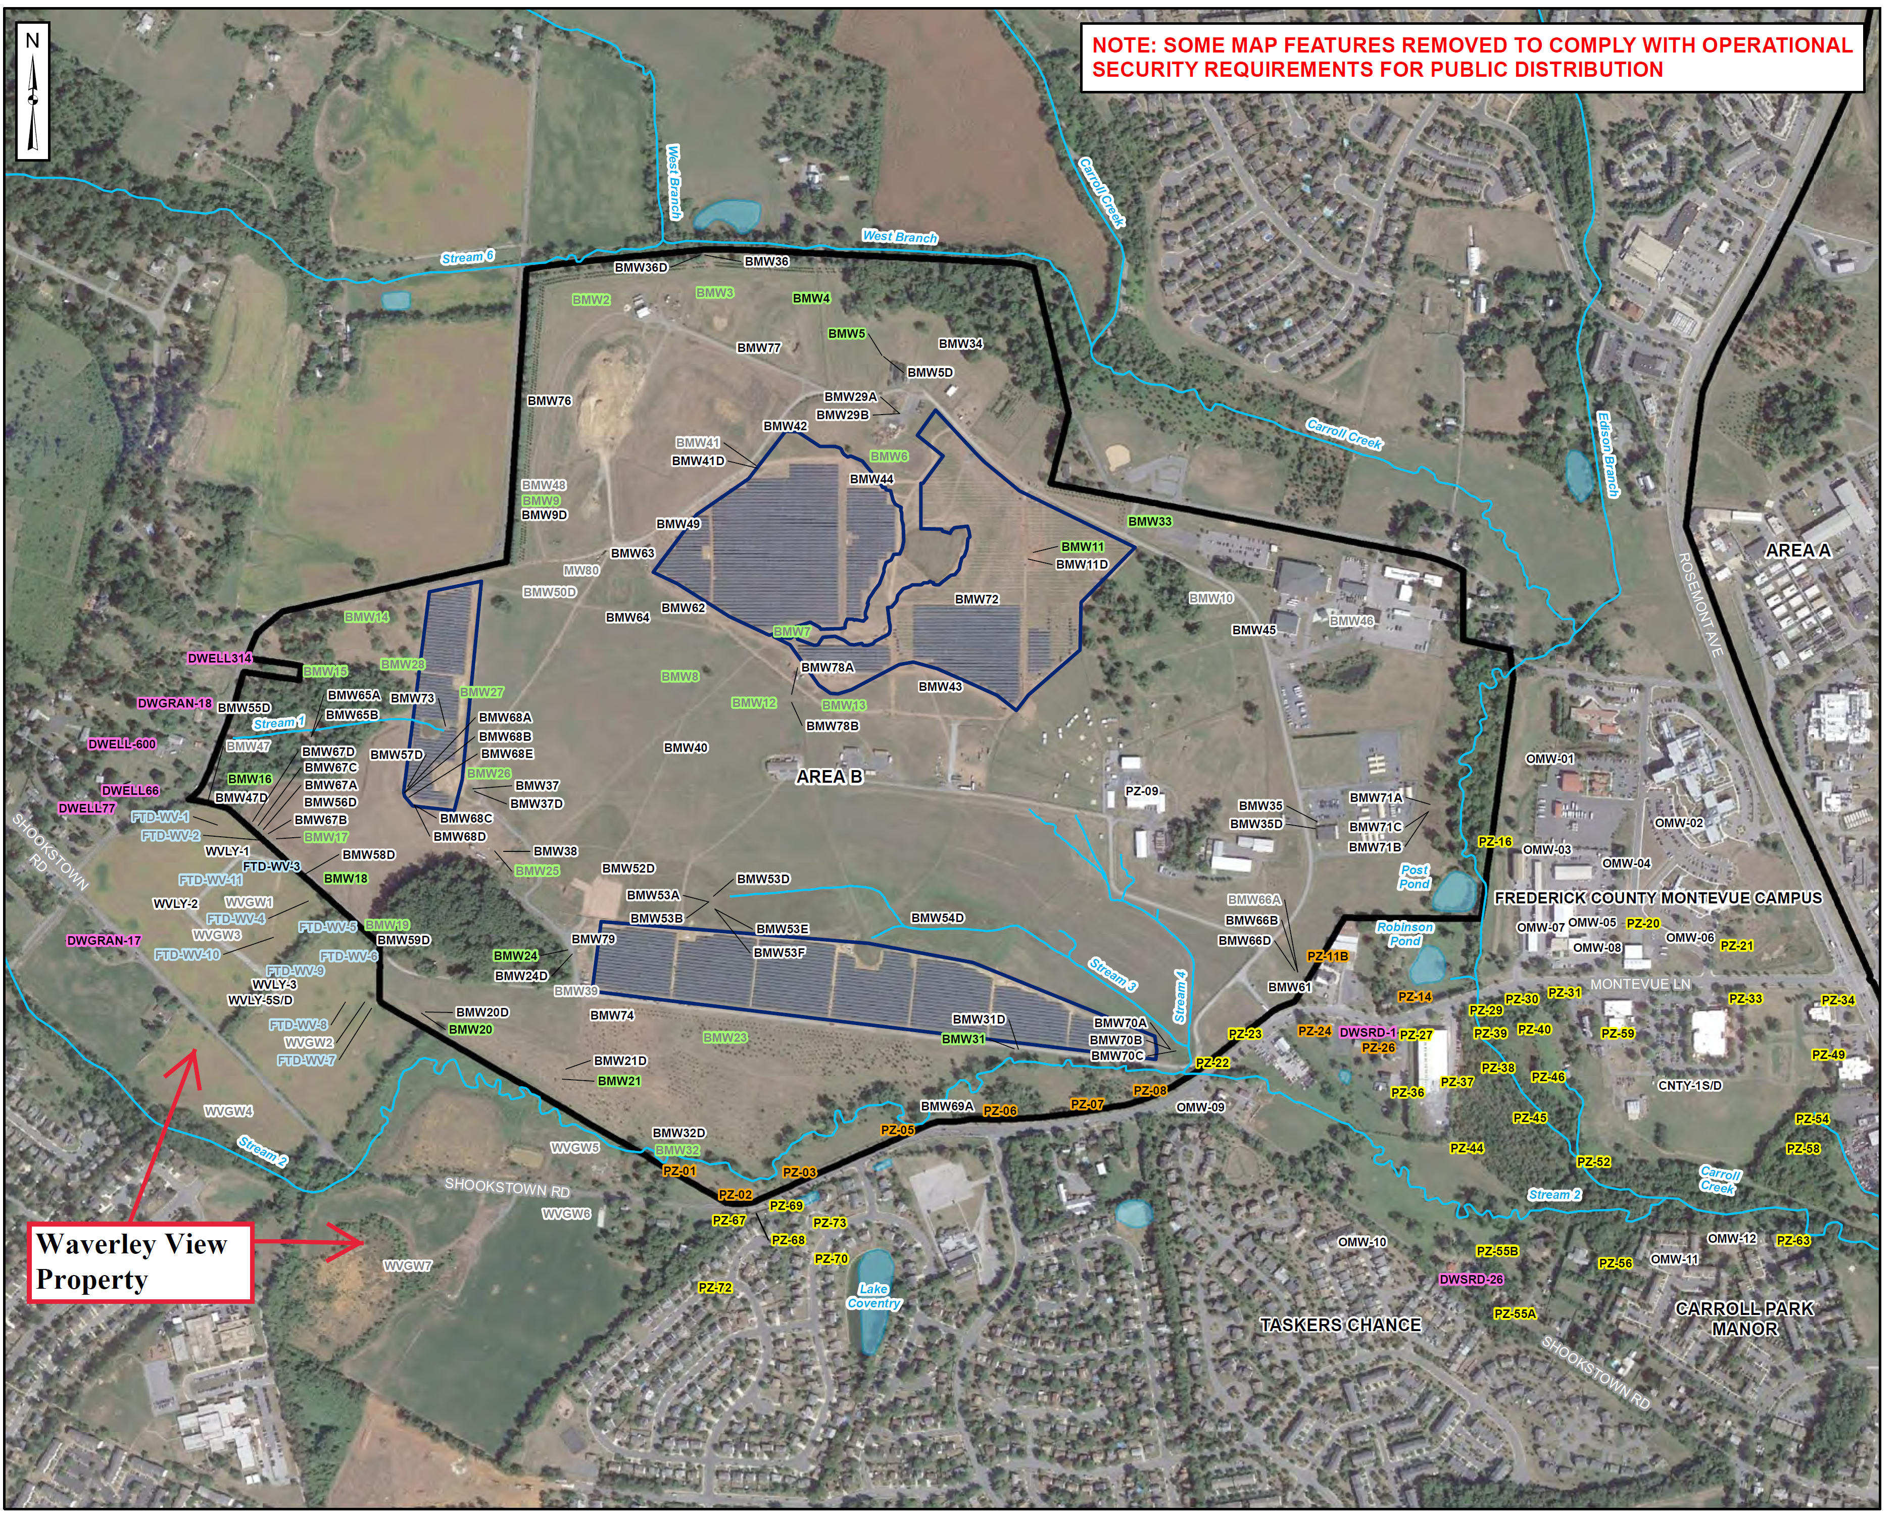
Area B RI Study Area

Slide 12
RI Scope of Work
Conduct supplemental RI field work at Waverley View Property and in the vicinity of BMW-77
Borehole drilling using sonic technology
Geophysical logging of boreholes
Packer testing selected intervals of boreholes
New well installation
Synoptic water levels measurement
Sample collection to support SLERA/Focused BERA (spell out both and explain what it is)
Two years of 1/4rly groundwater sampling/annual reporting for selected BMW-77 and Waverley View Property wells

Slide 13
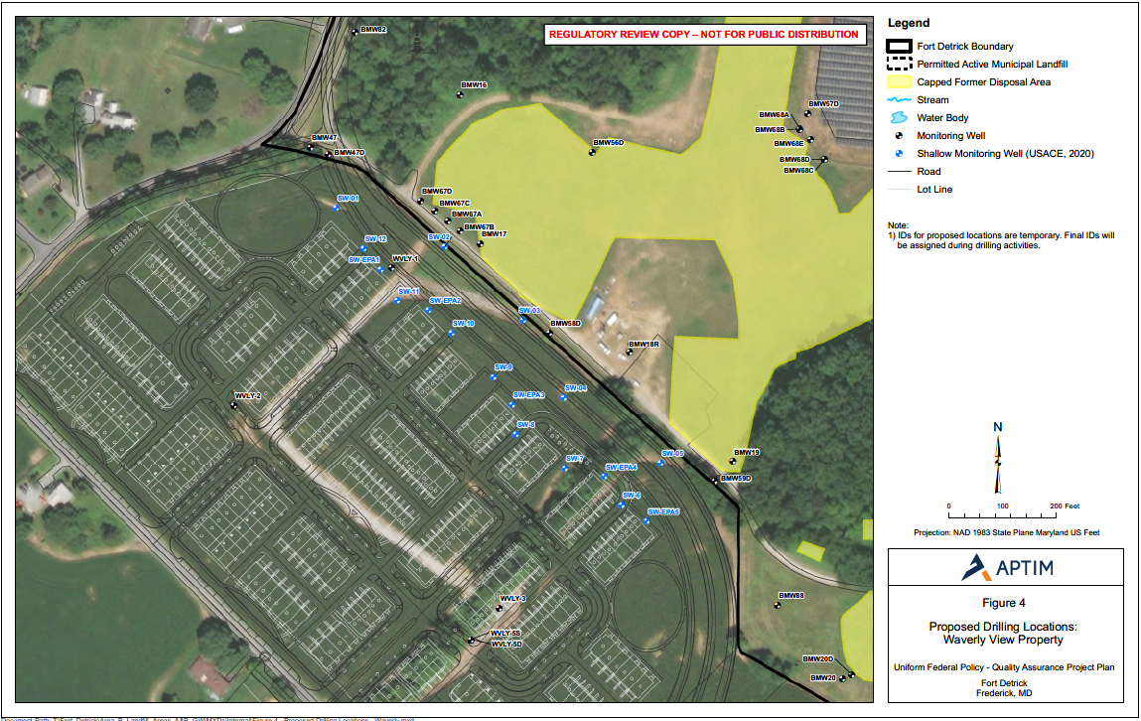
(Need statement as to purpose)
BW8
Proposed deep well locations based on prior Army, EPA, MDE, property owner discussions.
BW7
BW6
Contract includes:
Up to 4 new borings with nested wells (up to 8 screened intervals)
Sonic drilling to 225 ft bgs
Geophysical logging in 2 stages
Up to 4 packer test samples per boring
Locations subject to property owner review based on development plans and long-term access
Proposed Drilling Locations on the Waverley Property

Slide 14
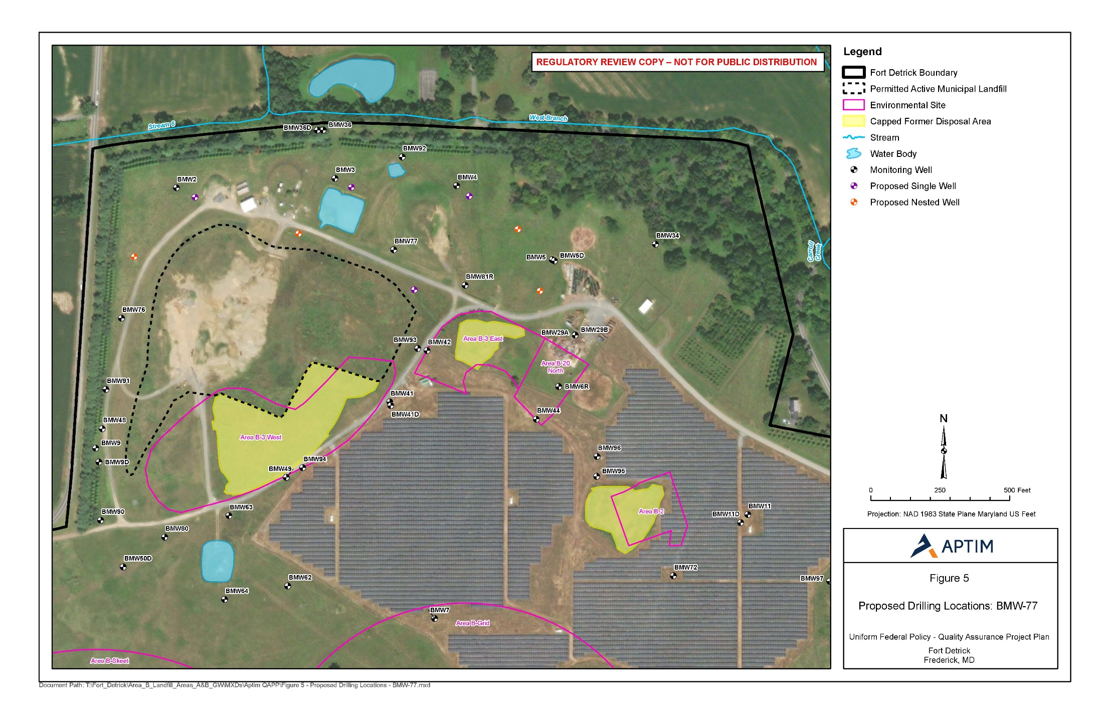
2
4
6
3
7
1
5
8
(Need statement as to purpose)
Contract includes:
8 new borings incl. 4 nested wells (up to 8 screened intervals) and 4 single wells.
Sonic drilling to 200 ft bgs for nested wells and 100 ft for single wells.
Geophysical logging and 2 to 4 packer test samples per boring
Proposed Drilling Locations in the Vicinity of BMW-77

Slide 15
RI Scope of Work (cont’d)
Additional ecological sampling to include:
Collocated surface water and sediment samples
Collocated spring/seep and sediment samples
Porewater samples
Collocated surface water and sediment samples for toxicity analysis
Abandonment and replacement of wells BMW66D, BMW68E, and BMW73
Using similar drilling, geophysical logging, packer sampling approaches to identify appropriate screened zones.
One year of 1/4rly groundwater sampling/reporting for the three replacement wells

Slide 16
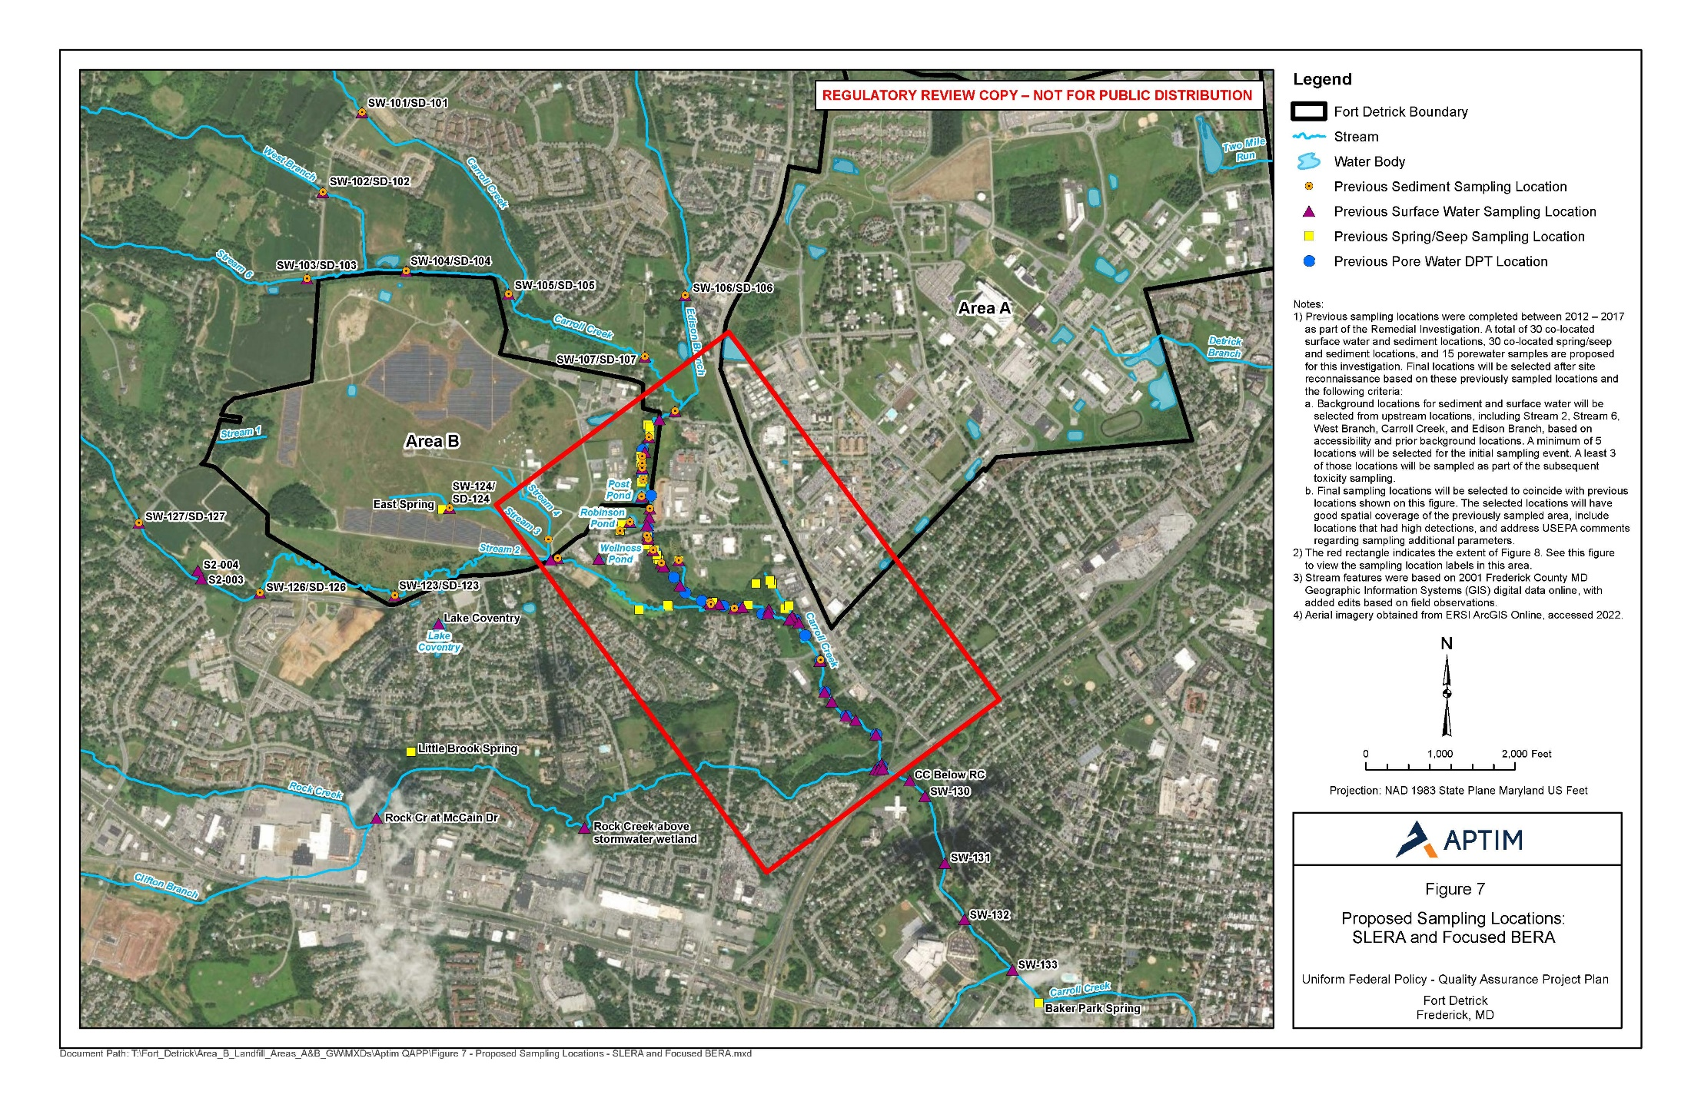
Proposed Sampling Locations for SLERA and Focused BERA

Slide 17
BMW73
BMW68E
BMW66D
Location | Original Depth | Planned Drilling Depths & Logging/Packer Range
BMW73 | 37.5 ft | ~100 ft
BMW66D | 275 ft | ~325 ft
BMW68E | 328 ft | ~375 ft
Locations of Wells to be Replaced*
* Existing wells are unusable because of stuck pumps or other obstructions

Slide 18
Preliminary Schedule
Deliverable | Due Date
Begin RI Field Work | August-September 2022
Complete RI Field Work | April 2023
Draft Final RI Report | October 2023
Final RI Report | May 2024

Slide 19
Questions and Discussion

Slide 20
Backup Slides

Slide 21
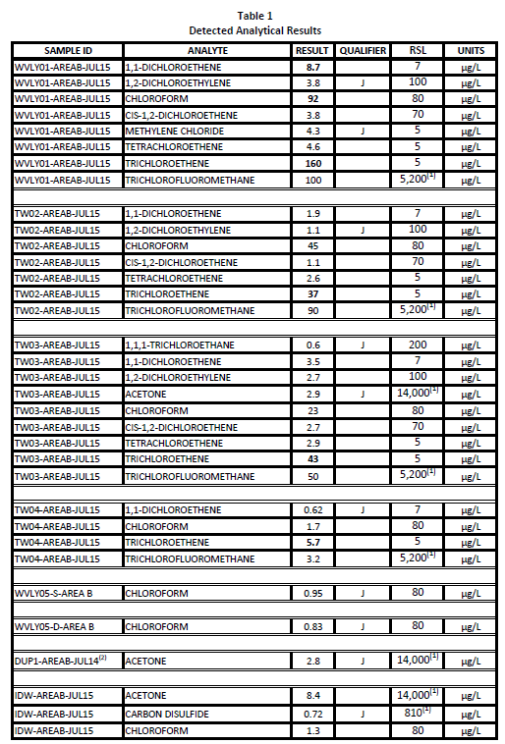
Backup Slides

Slide 22
Backup Slides

Slide 23
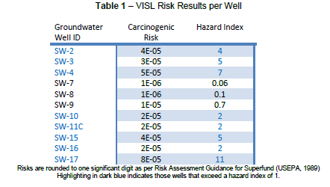
Backup Slides

