Slide 1
Fort Carson Snow Removal Plan 2023-2024
Prepared by Doug Homa, Chief, DPW Operations and Maintenance Division
September 2023

Slide 2
Snow Removal plan – areas
Areas plowed by the DPW operations and maintenance contractor:
Cantonment area
Wilderness Road area
Butts Army Heliport
Route 1 to Range 143 when needed
Areas plowed by others:
D8 Schools (D8)
Housing area internal streets (BBC)
Motorpools (units)
Evans Army Community Hospital (Evans Contractor)
Academy Blvd. & Hwy 115 (CDOT and El Paso County)

Slide 3
Snow Removal Plan – response plan
Monitoring: The DPW will monitor weather forecasts in conjunction with Fort Carson Operations Center (FCOC) and send out SITREPS to Garrison leadership in advance of oncoming storms indicating preparations and pretreatment plans.
Pretreatment: Based on storm predictions, DPW will pre-treat roads with magnesium chloride. Pre-treatment is only applied on hills, curves, intersections and other "hazardous" locations.
Priority 0 – Special Events
Throughout all priorities, real world deployment or special event requirements will be addressed immediately.
Response can take place during normal duty hours and after hours.
Priority 1 – Main roads, Butts Army Heliport, Public Sidewalks and special areas
Response can take place during normal duty hours and after hours.
Special areas will be cleared immediately at first snowfall and throughout storm.
Government will provide direction to contractor on when to progress to next level of priority based on condition of previous priorities, and conditions of lower priorities areas. However, the lower priority areas may have been cleared from solar melt and traffic prior to having resources available for those lower priorities.

Slide 4
Snow Removal Plan – response plan (cont)
Priority 2 – Secondary Roads
Response during normal duty hours only.
Priority 3 – Parking Lots
Parking lots will not be completely cleared. Only the aisles will be plowed and treated with de-icer.
Response during normal duty hours only.
Priorities are in the following general order:
Fire Stations and Police Stations
DIV and USAG HQs
Army Community Service
Mountain Post Soldier Center (MPSC)
Medical, Dental and Behavioral Clinics
DFACs
Physical Fitness Centers
Special Events Center
Elkhorn Conference Center
Tri-foods

Slide 5
Snow Removal Plan – response plan (cont)
Limited Response:
For storms with less than 3” of snow accumulation or ice storms.
Response will focus on applying de-icer and clearing specific and localized slippery spots by priority order.
These light storms typically do not create lingering slippery conditions and therefore an extensive or sustained response is not needed.
Full Response:
For storms with 3” or greater of snow accumulation.
Response will clear snow from roads in priority order with plows and other heavy equipment.
Standard measuring points for snowfall: Bldg. 1435 Helipad; Bldg. 8200; Gates 5, 6, 19 and 20; and Bldg. 9601 at Butts Army Heliport.
Crews will start plowing prior to 3" accumulation if Fort Carson is expected to receive at least 3” by the end of storm.
Delayed Reporting: Allows DPW to get better start on clearing roads before morning rush hour starts. Once cars start arriving and traffic gets heavy, it gets very hard to effectively plow as the snow gets packed and plows get stuck in traffic.

Slide 6
Snow Removal Plan – Butts Army Heliport
Intent:
Keep the main runway (13/31) and taxiway C and ramp C (for crash station access) clear to support 24/7 emergency runway capability.
Clear taxiways and ramps to meet flying mission priorities and timelines. Use Sidewalks: DPW will clear mainline sidewalks when weather forecasts indicate sustained conditions of snow and ice on the walks.
Plan:
DPW will use existing snow removal equipment staged at Bldg. 8200 and will use nylon blades in lieu of steel.
DPW will pretreat the baseline surfaces (runway13/31 and taxiways Bravo and Charlie) with E36 product, dependent on weather conditions and forecast.
DPW will clear the baseline surfaces at the onset of snow/ice accumulation 24/7 due to its status as an emergency runway. The trigger for this response will be independent of the snow response for cantonment roads.
DPW will clear the other taxiways and ramp areas in priority order (as set by Butts Army Heliport base ops based on flying mission requirements) beginning the next normal duty day. Should there be a weekend flying mission, DPW will clear those needed ramps on the weekend as requested by Butts Army Heliport base ops and supported by 4th CAB. All ramps will have to be cleared of aircraft prior to snow removal operations.

Slide 7
Snow Removal Plan – sidewalks
Common Use Sidewalks: The DPW will clear mainline sidewalks when weather forecasts indicate sustained conditions of snow and ice on the walks.
Building Entrances (50’ Rule): Building occupants are required to clear snow and ice on the sidewalk leading from their doorstep to the first mainline sidewalk, which is typically less than 50’, but could be more.
Facility Managers may draw free Ice Melt from the DPW Supply Warehouse, Bldg. 8100, located off O’Connell Boulevard and Bennett Street on the north end of the cantonment.

Slide 8
Snow Removal Plan – Priority 1 special areas
Sidewalks
Chapels
Weekend Services
Soldier Recovery Unit (SRU) Admin
Business hours
SRU Barracks
24/7
DFACs
Child Development Centers
3” rule
Parking Lots
Chapels
Weekend Services
SRU Admin and Barracks
24/7
Emergency Vehicle Bays
24/7
DFAC Loading Docks
Commissary & Main Exchange
Shopettes/Expresses
ASP
Child Development Centers
3” rule

Slide 9
snow removal plan – EQUIPMENT
DPW Fleet Equipment
5 Dump trucks w/plow and sander
1 Truck w/mag chloride
1 Truck w/mag chloride and rubber blade for the heliport
7 Graders (1) w/rubber blade for the heliport
3 Tractors w/blades
6 Utility vehicles w/plows (4) w/spreader for sidewalks and parking lots
1 Skidster w/box blade

Slide 10
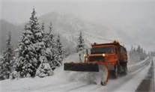
SNOW removal plan – RESPONSE COMMO PLAN
DPW
Joe Wyka – 719-244-1152
Doug Homa – 719-491-8596
Scott Clark– 719-726-8852
GC
COL Brown
T&H Services Contacts
1. Alvin Jackson – if less than full response
2. Snow Desk – operated during full response
COR
Jerald Just – 719-761-2033
Bryan Dorcey – 719-725-8083
El Paso County
T&H Services
1. Alvin Jackson – 719-896-6864
2. Snow Desk – 719-526-5568
T&H Services
Shift Supervisor - as listed in SITREP
DPW
D8
LEGEND
FCOC
“USARMY Ft Carson IMCOM Central List DPTMS Installation Ops Center”
FCOC = Commo Hub for spot reports
BBC
Guidance / Spot Reports
SITREP (generated by DPW)
Direct Coordination when necessary
DES
“USARMY Fort Carson IMCOM Central List DES PPMD Desk“
Desk Sgt. – 719-526-2333
FOD

Slide 11
SNOW removal plan – RESPONSE SITREP
Reports will be generated by T&H Services Shift supervisor.
Reports will be generated before COB on days when storm events are predicted to occur overnight.
Reports will be sent via e-mail body text (and not an attachment) for easy reading on mobile devices.
SITREP 8-LINE FORMAT
Report as of: DTG
Current snow accumulation / ice conditions on roadways:
Driving Conditions:
Active T&H Services response on Cantonment: (monitoring storm, limited ice response, full snow response, snow desk operational, supervisor (name, #), etc.)
Active T&H Services response on Butts Army Heliport: (monitoring storm, limited ice response, full snow response, snow desk operational, supervisor (name, #), etc.)
Significant areas: (list geographic areas of specific concern, heightened efforts, PX/Commissary, railhead, hills, etc.)
Reported by:
Next report due: (every 2 hours during a response)

Slide 12
Snow removal plan – north map
Emergency Snow Route
Snow Service Roads
Snow Sidewalks

Slide 13
Snow removal plan – South map
Emergency Snow Route

Slide 14
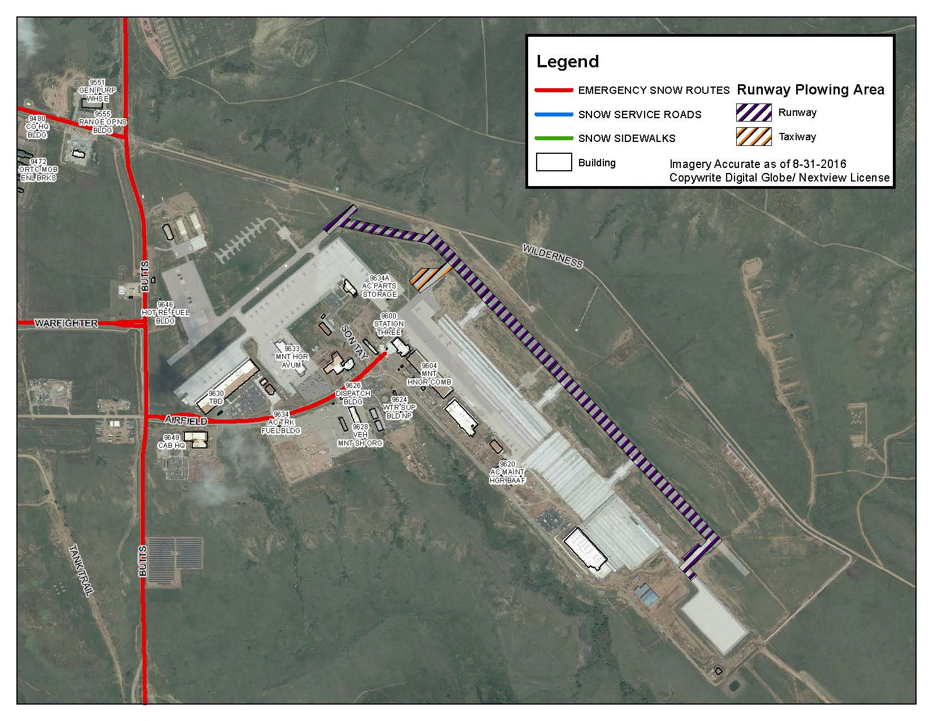
snow removal plan – Butts Army Heliport

Slide 15
Snow removal plan – contacts
T&H Services 24/7 Service Order Desk – 719-526-5345
Fort Carson Operations Center (FCOC) – 719-526-3400/5500
Butts Army Heliport Weather Station – 719-526-3620
Fort Carson Dispatch – 719-526-2333

