Slide 1
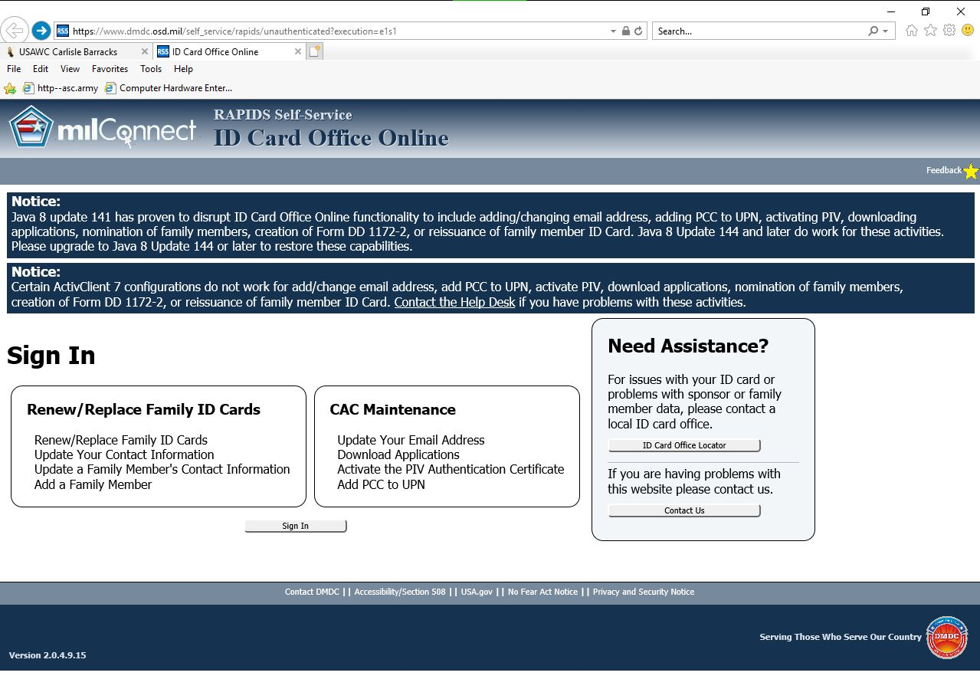
Instructions for Completing DD Form 1172-2 On-Line with a Common Access Card (CAC)
Google (Search) for milConnect RAPIDS Self Service ID Card Office Online

Slide 2
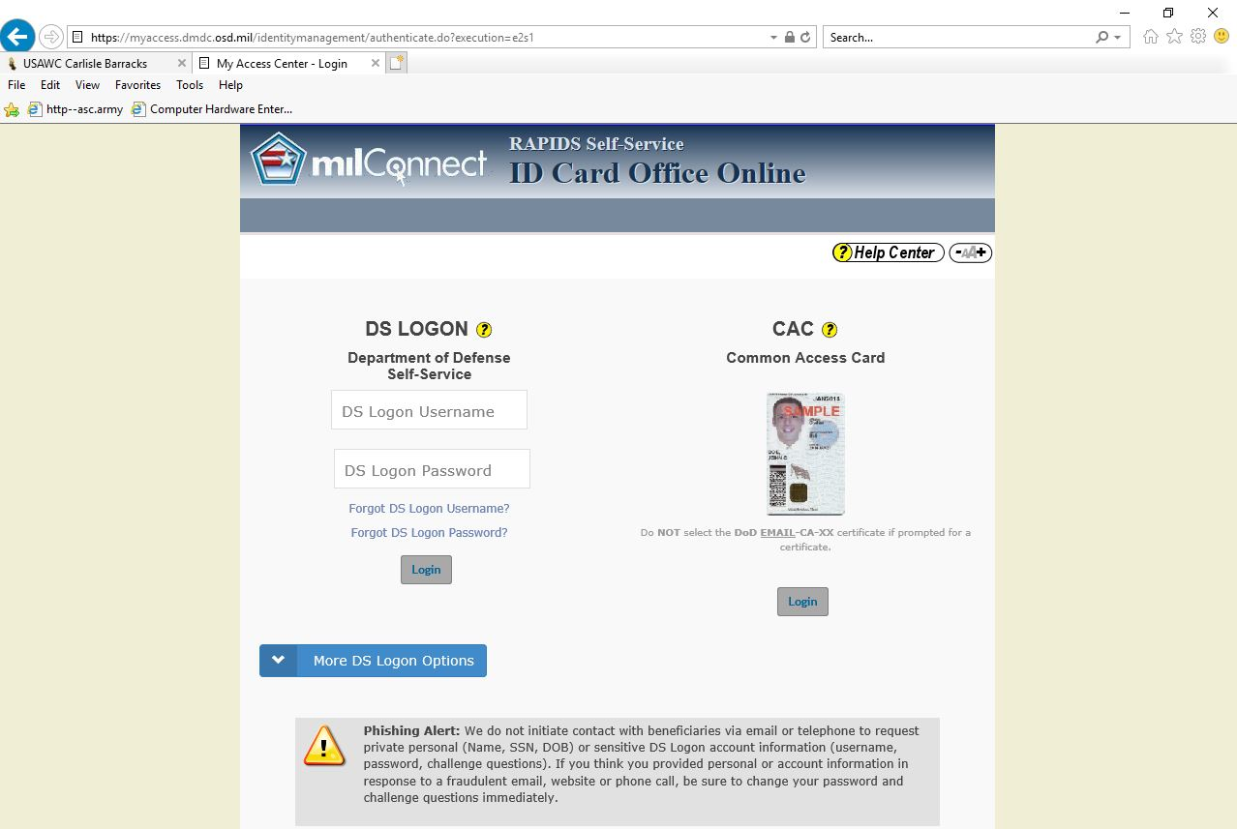

Slide 3
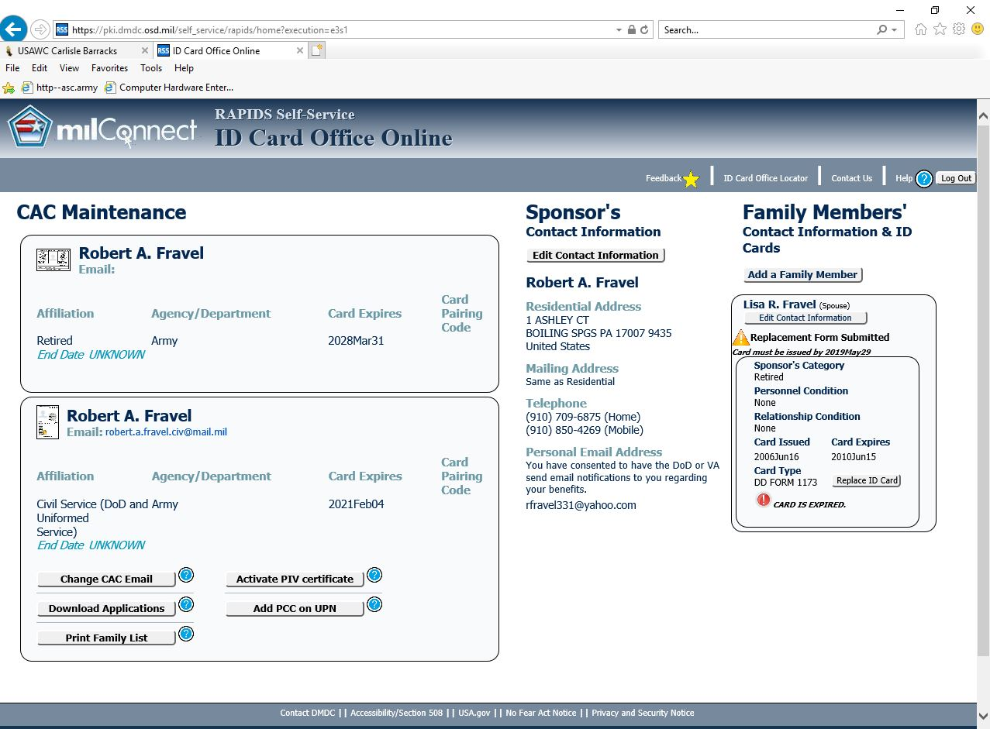

Slide 4
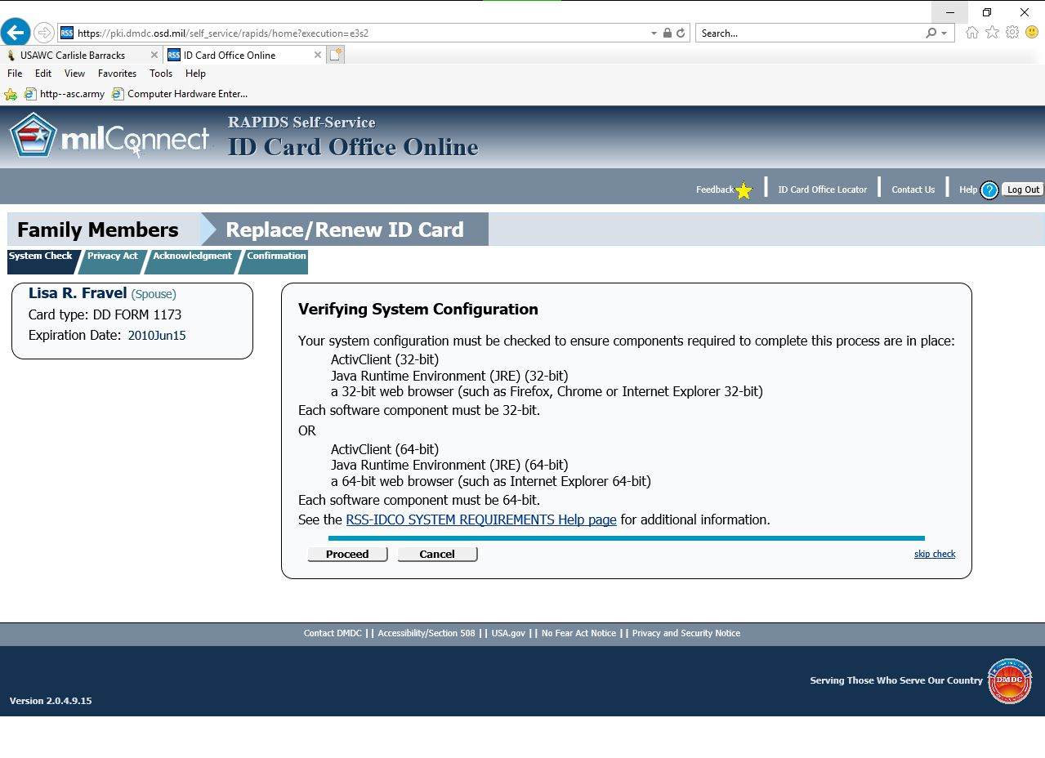

Slide 5
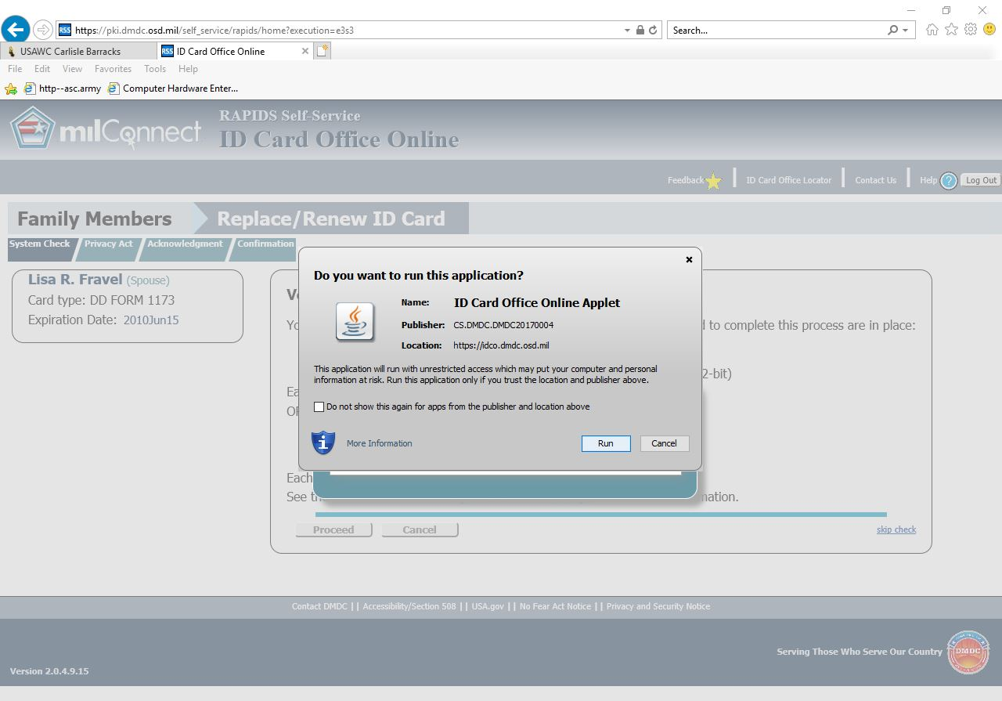

Slide 6
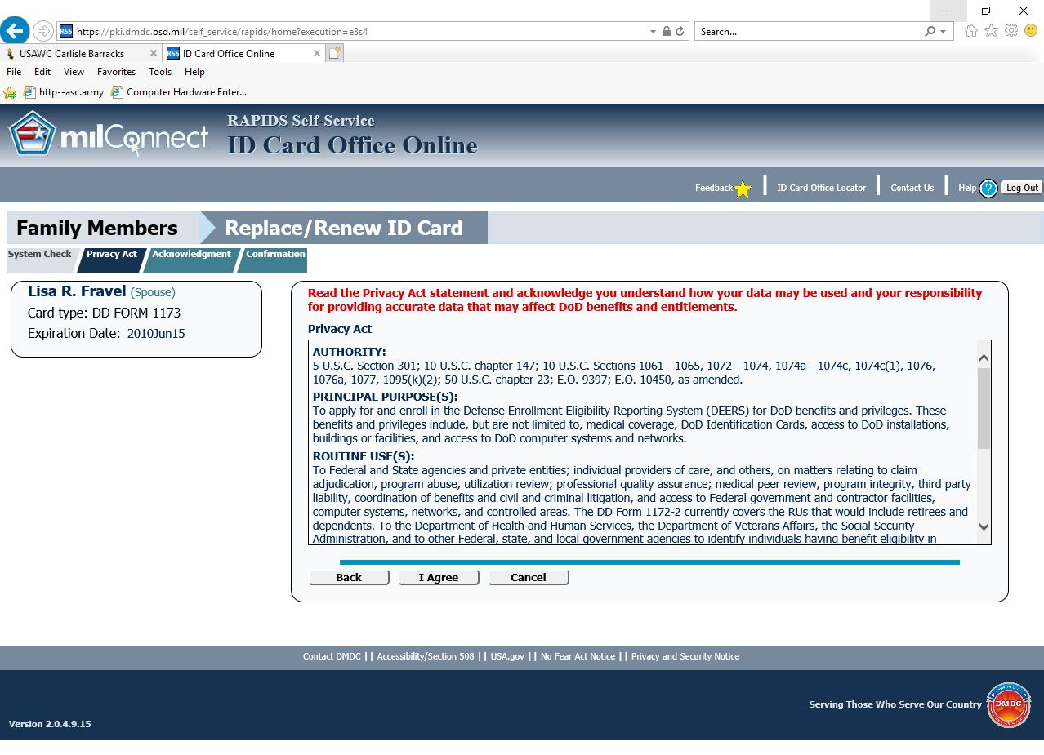

Slide 7
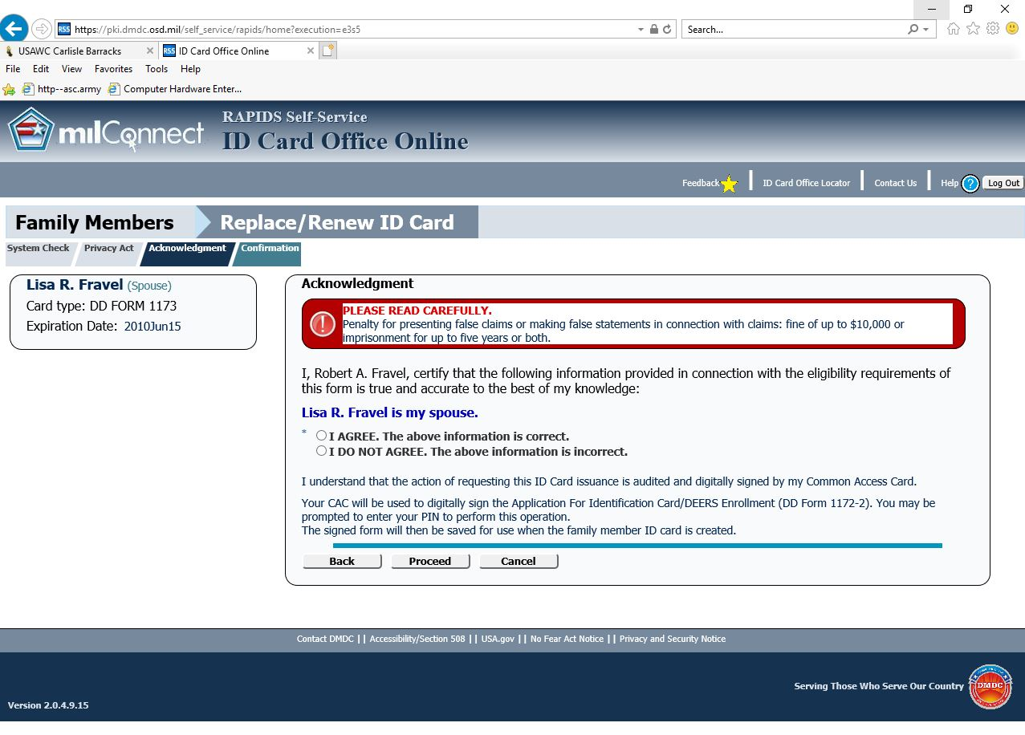
1.
2.

Slide 8
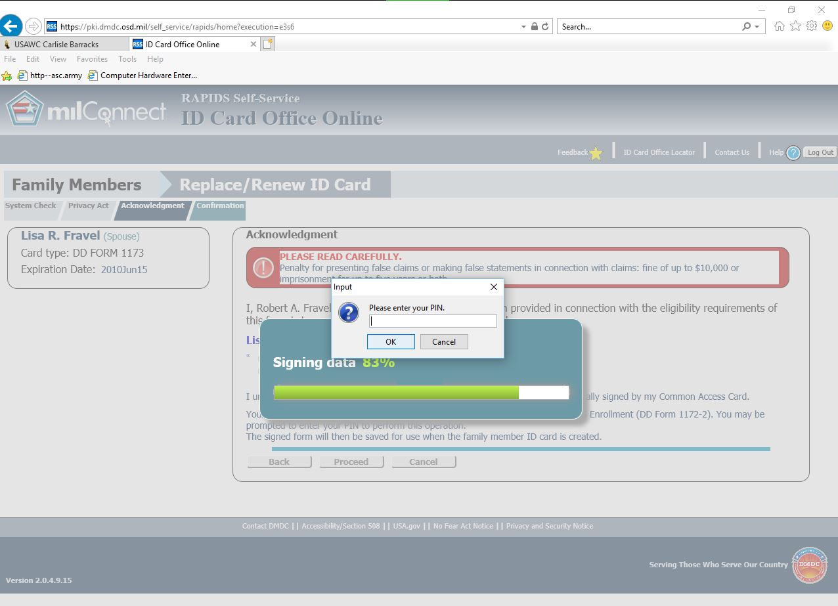
Enter your CAC PIN.
Click the “OK” button.

Slide 9
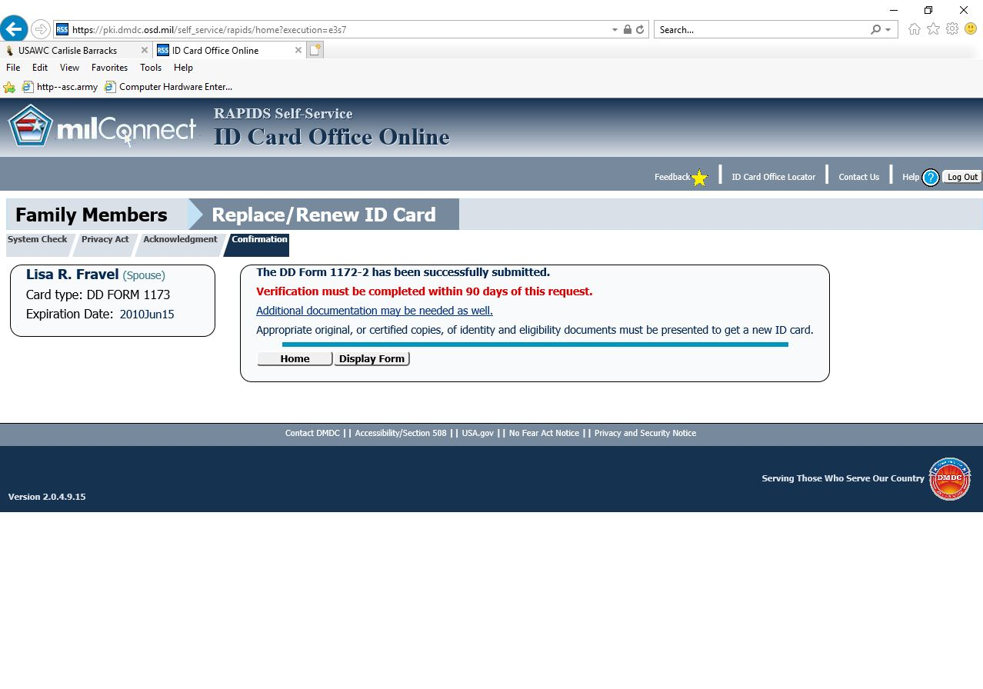
The DD Form 1172-2 will auto-populate into the Family member’s file in your DEERS record.
The DD Form 1172-2 can then be accessed from any ID Card Facility in the world.
The Family member(s) will need to physically sign the DD Form 1172-2 at the ID Card Facility.
You can call the ID Card Facility to confirm that the 1172-2 appears in your DEERS record prior to coming in for a new card.

