Slide 1












Army Housing Office Plain Language Brief (PLB)
WE ARE THE ARMY’S HOME
USAG Carlisle Barracks
U.S. Army Installation Management Command
As of: 03 JULY 2025
Plain Language Brief_ Version I

Slide 2



Plain Language Brief Explained
The Military Housing Privatization Initiative (MHPI) Tenant Bill of Rights requires the garrison AHO to provide a plain language brief presenting the facts on tenants’ rights and responsibilities associated with tenancy of the housing unit to all residents of privatized housing prior to lease signing and again 30 days after move-in on all rights and responsibilities.
“The Department of Defense is fully committed to ensuring that associated with tenancy of the housing unit, including MHPI housing projects provide our Nation’s most valued resource—its military members and their families—safe, quality, and well-maintained housing where our members and their families want and choose to live.
“The Department of Defense has issued all policy guidance necessary to implement prospectively all rights for military members and their families residing in privatized family and unaccompanied
housing (Tenants) at all MHPI housing projects. However, as Congress recognized, retroactive
application of the requirements at existing projects requires voluntary agreement by the respective
MHPI company; the Department cannot unilaterally change the terms of the complex, public-private
partnerships that established the MHPI housing projects. The Department of Defense has been
seeking to secure voluntary agreements, and nearly all of the MHPI companies have agreed to
implement all 18 Tenant rights at their existing projects. The Department will continue to pursue
agreements not yet reached. Tenants should contact their installation housing office to confirm the
rights fully available to them.”
WE ARE THE ARMY’S HOME

Slide 3
Garrison Points of Contact
The Carlisle Barracks Army Housing Office (AHO) staff are employed by the Army to assist Service Members and their families with housing matters and advocate on their behalf with community partners/agencies both on and off the installation
The Army Housing Chief reports directly to the Director, Public Works and garrison leadership
The AHO provides oversight of the privatized on-post family housing project managed by the privatized housing company and provides tenant/landlord dispute services
The AHO provides referral services to Service Members and families that reside or are seeking to reside off the installation
Garrison Leadership
- Garrison Commander: LTC Torsten Gojowsky
- Garrison Command Sergeant Major: CSM Titus Kamau
- Deputy Garrison Commander: Mr. Drew Turinski
- Garrison Director of Public Works: Mr. Craig Rudy
- Garrison Army Housing Chief: Ms. Bif Coyle
Army Housing Office
22 Ashburn Drive
Upton Hall, Room B32
Phone Number: 520-673-7742
Web Page: Housing Office: U.S. Army Carlisle Barracks
WE ARE THE ARMY’S HOME

Slide 4
Project Company Contacts
Balfour Beatty Communities is the privatized company that owns and manages the Family or Privatized Unaccompanied housing on this installation
  Balfour Beatty Communities is the private partner and managing member of Carlisle Barracks Homes and your landlord.
  Carlisle Barracks Homes is the property management company that manages the day to day operations of the privatized housing to include ensuring prompt and professional maintenance and repair, addressing of property concerns, and rent/billing issues.
Balfour Beatty Communities/Carlisle Barracks Homes Contacts and Contact Numbers:
  Operations Director: Mrs. Patricia Frank
  Project Director: Mr. Brad Clouse
  Facility Manager: Mr. Scott Wert
  Carlisleleasing@bbcgrp.com; Phone: 717-243-7177
WE ARE THE ARMY’S HOME

Slide 5
Tenant Bill of Rights
In 2020, laws were passed to assure military tenants basic rights to:
Reside in a housing unit and a community that meets applicable health and environmental standards.
Reside in a housing unit that has working fixtures, appliances, and utilities and to reside in a community with well-maintained common areas and amenity spaces.
A previous seven-year maintenance history of the prospective housing unit within two business days after making request before signing a lease. A current tenant who did not receive maintenance information before signing a lease has the right to receive such information within five business days after making the request.
A written lease with clearly defined rental terms to establish tenancy in a housing unit including any addendums and other regulations imposed by the Landlord regarding occupancy of the housing unit and use of common areas.
A plain-language briefing, before signing a lease and 30 days after move-in, by the AHO on all rights and responsibilities associated with tenancy of the housing unit, including information regarding the existence of any additional fees authorized by the lease, any utilities payments, the procedures for submitting and tracking work orders, the identity of the Military Tenant Advocate, and the dispute resolution process.
Given sufficient time and opportunity to prepare and be present for move-in and move-out inspections, including an opportunity to obtain and complete necessary paperwork.
Report inadequate housing standards or deficits (deficiencies) in habitability of the housing unit to the Landlord, the chain of command, and Installation housing office without fear of reprisal or retaliation.
WE ARE THE ARMY’S HOME
Notes:
Follow Verbiage from Federal Regulation/ Federal Law

Slide 6
Tenant Bill of Rights
Access a military tenant advocate or a military legal assistance attorney, through the AHO to assist in the preparation of requests to initiate a dispute resolution. This includes the ability to submit a request to withhold payments during the formal dispute resolution process.
Receive property management services provided by the Landlord that meet or exceed industry standards and that are performed by professionally and appropriately trained responsive and courteous customer service and maintenance staff.
Have multiple, convenient methods to communicate directly with the Landlord maintenance staff, and to receive consistent, honest, accurate, straightforward and responsive communications.
Have access to an electronic work order system through which a tenant may request maintenance or repairs of a housing unit and track the progress of the work.
  Balfour Beatty Communities/Carlisle Barracks Homes
  24/7 Maintenance Line Contact Number: 717-243-0067
  Maintenance Shop Location: 304 Engineer Avenue, Carlisle Barracks, PA
  Maintenance Website: carlislebarrackshomes.com
  Maintenance Application: Rent Café Resident App
Prompt and professional maintenance and repair, to be informed of the required time frame for maintenance and repairs when a maintenance request is submitted and when maintenance or repairs are necessary to ensure habitability of a housing unit, to prompt relocation into suitable lodging or other housing at no cost to the tenant until the maintenance or repairs are completed.
WE ARE THE ARMY’S HOME

Slide 7
Tenant Bill of Rights
Receive advice from military legal assistance on procedures involving mechanisms for resolving disputes with the property management company or property manager to include mediation, arbitration, and filing claims against the Landlord.
  SJA Office POC : CPT Katie Ocampo, katie.l.ocampo.mil@army.mil – 717-245-4940
Enter into a dispute resolution process should all other methods be exhausted and, in which case, a decision in favor of the tenant may include a reduction in rent or an amount to be reimbursed or credited to the tenant.
Have your basic allowance housing payments segregated and held in escrow, with approval of a designated commander, and not used by the property owner, property manager, or landlord pending completion of the dispute resolution process.
Have reasonable advance notice of any entrance by the Landlord, Installation housing staff, or chain of command into the housing unit of no less than 24 hours, except in the case of an emergency or abandonment of the housing unit.
Not pay non-refundable fees or have application of rent credits arbitrarily withheld.
Expect common documents, forms, and processes for housing units will be the same for all Army Installations, to the maximum extent applicable without violating local, state, or federal regulations.
Note: Tenants seeking assistance with housing issues should continue to engage their garrison AHO, installation leadership, and/or chain of command.
WE ARE THE ARMY’S HOME

Slide 8
State-Specific Addendum
Pennsylvania
Premises Condition on Lease Commencement Date (Section 3.A):
Section 3.A of the Lease is amended by adding the following sentence: If Tenant does not
choose to have a pre-rental inspection, they agree to accept the rental Unit in “as is” condition.
Final Move Out Inspection (Section 3.C): The first sentence of Section 3.C is deleted and
replaced with the following:
Owner shall perform a final move-out inspection within thirty (30) days after the date the
Lease is terminated, or Tenant surrenders with acceptance, or abandons the Premises.
Rent (Section 4): Section 4 of the Lease is amended by adding the following “Rent Summary” Section as 4.E:
a) The amount of rent is as shown on Box 7 of Schedule 1 of the Lease. Tenant agrees to
pay the monthly rent in advance on or before the 1st day of each month. Owner does
not have to ask (MAKE DEMAND UPON) Tenant to pay rent. Tenant agrees to pay
rent pursuant to Section 4.B of the Lease.
b) If Tenant mails the rent to Owner, the date of payment will be the date the letter is
postmarked.
c) Owner’s acceptance at any time of late rent payment is not a waiver of timely payments
at a later time. Tenant agrees to pay a late charge of 5% of the monthly rent if rent is
not paid on or before the 5th day of the month.
d) All other payments of any kind due from Tenant to Owner, including late charges, or
utility charges, are considered to be additional Rent. Failure to pay this additional rent
is a breach of the lease in the same was as failing to pay the regular rent.
WE ARE THE ARMY’S HOME
Notes:
Follow Verbiage from State Regulation/ State Law

Slide 9
State-Specific Addendum
Pennsylvania
Rent (Section 4.C): Continued
e) Tenant agrees that all payments will be applied against outstanding additional Rent that
is due before they will be applied against the current Rent due. When there is no
outstanding balance of additional Rent, prepayment will be applied to the month’s Rent
that would be due next.
Revision 6.2021
f) Tenant will pay a fee of $25.00 for any payment that is returned by any financial
institution for any reason. If payment is returned or declined, the grace period does not
apply and the late charge will be applied.
g) The Security Deposit, if any, may not be used to pay rent during the Term or Renewal
Term of this Lease.
Rent and all other charges owed by Tenant and not paid by a Rent Payment Service Option
or Allotment shall be payable by personal check, certified check, money order, automated
clearing house or through the Owner’s online/website or smart device application (e.g.,
Rent Café resident portal).
Refund (Section 4): Section 4.C of the Lease is amended in its entirety as follows:
After the Premises is vacated, any refund due to Tenant will be made within thirty (30)
calendar days of the termination of the Lease, surrender with acceptance, or abandonment
of the Premises.
WE ARE THE ARMY’S HOME
Notes:
Follow Verbiage from State Regulation/ State Law

Slide 10
State-Specific Addendum
Pennsylvania
Security Deposit (Section 4.D): Section 4.D of the Lease is amended as follows: Tenant may be required to pay a security deposit, if any, as more particularly set forth on Schedule 1.
a. If required, Tenant has paid to Owner a security deposit in the amount set forth on
Schedule 1, as security that Tenant will perform their obligations under this Lease.
Owner may use the security deposit to pay for losses or damages caused by
Tenant’s breach of this Lease. Owner may also use the security deposit to pay for
any damage to the Leased Unit. Tenant must pay losses or damages which are not
covered by the security deposit as additional rent. Owner may keep the security
deposit if Tenant fails to make rental payment or if Tenant leaves before the end of
the Lease Term. Such remedy shall not be Owner’s exclusive remedy. SECURITY
DEPOSIT SHALL NOT BE USED BY TENANT IN LIEU OF PAYMENT OF
LAST MONTH'S RENT. If all or any portion of the security deposit is used during
the term of this Lease, Tenant agrees to reinstate the security deposit within five
days after written notice is delivered to Tenant.
b. Owner shall deposit the security deposit at Bank of America. In the event such
security deposit is in an amount in excess of $100, Owner shall deposit this amount
in a FDIC insured bank escrow account specifically designated for security
deposits.
c. The security deposit may be increased to match any rent increase, however, after
five (5) years of occupancy, the Owner may no longer increase the security deposit.
WE ARE THE ARMY’S HOME
Notes:
Follow Verbiage from State Regulation/ State Law

Slide 11
State-Specific Addendum
Pennsylvania
Security Deposit (Section 4.D): Continued
d. Deposits held by Owner, or Owner’s agent, for less than two (2) years need not earn
interest. After the second anniversary of the leasehold, the Owner shall have the
Revision 6.2021
security deposit deposited in an interest-bearing account, if not already done.
Owner may keep one percent (1%) per year of the deposit to cover administrative
costs. The remaining interest earned by the security deposit shall be paid to Tenant
once a year.
e. When the Tenant moves out, the Owner will prepare a list of charges for damages
beyond normal wear and tear, and any unpaid rent or other fees and charges. The
Owner can deduct these charges, if any, from the security deposit and will return
the balance with any interest due to the Tenant within 30 days from the termination
of the lease or upon surrender and acceptance, whichever occurs first. The Tenant
must give the Owner written notice of the Tenant’s new address or make other
arrangements with the Owner for the return of the security deposit.
Fees (Section 5):
Section 5 of the Lease is amended to include the following as Section 5.C:
If the term of the Lease is for years, Owner may notify Tenant of any changes to the Lease
at least 30 days prior to the end of the term. Tenant may choose to accept such changes, or
may elect to terminate the Lease by providing written notice pursuant to Section 10.P.
If the term of the Lease is month-to-month, Owner may provide Tenant 30 days written
notice of any changes to the terms of the Lease, including applicable fees and charges.
Unless Tenant provides notice pursuant to Section 10.G., such changes are deemed
automatically accepted.
WE ARE THE ARMY’S HOME
Notes:
Follow Verbiage from State Regulation/ State Law

Slide 12
State-Specific Addendum
Pennsylvania
Right to Relocate (Section 8): None
Informal Dispute Resolution Process (Section9):
1. Paragraph 9 of the Lease is amended as follows: If Tenant has a dispute with respect
to Owner’s performance of responsibilities under the Lease or attached schedules,
Tenant may first attempt to resolve it through informal dispute resolution processes
set forth by the MHO or by bringing the request or concern to the attention of the
Owner. Information regarding the informal dispute resolution requirements as set
forth by the MHO is available by contacting the MHO. If Tenant has a dispute
pertaining to the Premises that is not resolved using the information resolution
processes and/or the Tenant has elected not to pursue the informal dispute
resolution processes, and the dispute pertains to rights and responsibilities set forth
in the Lease, including maintenance and repairs, rental payments, displacement
rights, Lease termination, inspections, or fees and charges (each an “Eligible
Housing Dispute”), Tenant or Tenant’s designated agent may submit the request
or concern to the MHO for formal dispute resolution, in accordance with the
Dispute Resolution Process set forth on Schedule 3. Tenant or Owner may seek
legal advice or seek to resolve the dispute and pursue any remedy available by law
in accordance with applicable law, except that Tenant and Owner shall not pursue
such remedy available in law if Tenant has elected to use the formal dispute
resolution process under Schedule 3.
WE ARE THE ARMY’S HOME
Notes:
Follow Verbiage from State Regulation/ State Law

Slide 13
State-Specific Addendum
Pennsylvania
Liability (Section 10.B):
(a) Resident agrees to obtain and maintain at all times during the term of this Agreement,
at Resident’s expense, liability insurance with a minimum coverage of $100,000 to
protect Resident from claims for property damage and physical injury caused by or to
Resident, or Resident’s family member(s), invitees or guests. Upon execution of this
Agreement and thereafter upon request of Landlord, Resident will provide Landlord with
evidence of the required insurance coverage, which shall name Landlord as an interested
party. Landlord also strongly encourages Resident to obtain property insurance to cover
losses or damage to personal property.
b) Resident acknowledges that: (i) Landlord’s insurance does not cover the loss of or
damage to Resident’s personal property, and (ii) Resident’s failure to maintain the
insurance required by subsection (a) above may result in Resident being liable to
Landlord and others for loss or damage caused by Resident’s actions or those of any
family member(s), invitees or guests of Resident.
Early Termination Fee (Section10.G.4): Section 10.G of the Lease is amended to include the following as Section 10.G.5.
Except as provided in Section 10.G., Tenant may not end this Lease and move out of the
Premises before the end date of the Lease or any renewal term, unless Tenant does all of
the following:
a. Tenant continues to pay all rent until the end of the term of the Lease or any renewal
term, or unit a new tenant is approved by Owner and a new lease takes effect, whichever
happens first;
b. Tenant give Owner at least 30 days written notice; and
c. Tenant pays Owner an Early Termination Fee of one month’s rent.
WE ARE THE ARMY’S HOME
Notes:
Follow Verbiage from State Regulation/ State Law

Slide 14
State-Specific Addendum
Pennsylvania
Termination by Tenant (Section 10.G): Section 10G of the Lease is amended by adding the following as subsection (5):
Pursuant to Pennsylvania’s Military Civil Relief Act, servicemembers have a right to
terminate the Lease at any time after entry into military service or receipt of military orders
for deployment. Such right to terminate is also triggered when a servicemember is
honorably discharged or released from active duty. If applicable to Tenant, in order to
terminate the Lease under this act, Tenant must provide Owner with written notice of such
termination together with a copy of Tenant’s military orders.
Notices (Section 10.P): Section 10.P of the Lease is amended to include the following:
Owner: All notices to be directed to address in Box 13 on Schedule 1.
Tenant: All notices to be directed to address in Box 2 on Schedule 1 and Tenant’s email
address in Box 6 on Schedule 1.
Any notice required under this Lease shall be served pursuant to Section 10.P. of the Lease.
i. In the case of expiration of a term or of a forfeiture for breach of the conditions of
the lease where the lease is for any term of one year or less, the notice shall specify
that the Tenant shall remove within fifteen (15) days from the date of service
thereof; when the lease if for more than one year, then within the Tenant shall vacate
within thirty (30) days from the date of service thereof.
ii. In the case of Tenant’s failure to pay rent, the notice shall specify that the Tenant
shall remove within ten (10) days from the date of service of such notice.
WE ARE THE ARMY’S HOME
Notes:
Follow Verbiage from State Regulation/ State Law

Slide 15
Tenant Responsibility
Per your lease, it is your responsibility to:
Report in a timely manner any apparent environmental, safety, or health hazards of the home and any defective, broken, damaged, or malfunctioning building systems, fixtures, appliances, or other parts of the home, common areas, or related facilities to the landlord.
Maintain standard upkeep of the home as instructed by the property management company.
Conduct oneself as a tenant in a manner that will not disturb neighbors, and to assume responsibility for one’s actions and those of a family member or guest in the housing unit or common areas, including the responsibility not to engage in any inappropriate, unauthorized, or unlawful activity in the home or common areas.
The Property Management Resident Handbook provides specific information. The resident handbook can be found under the “Community Info” tab of the Resident Portal at Carlislebarrackshomes.com
Allow the landlord reasonable access to the rental home in accordance with the terms of the tenant lease agreement to make necessary repairs in a timely manner.
Read all lease-related materials provided by the landlord and to comply with the terms of the lease agreement, lease addenda, and any associated rules and guidelines.
WE ARE THE ARMY’S HOME

Slide 16
Work Order Process
Balfour Beatty Communities/Carlisle Barracks Homes
To alert the Landlord (Carlisle Barracks Homes) of maintenance issues:
  Emergency or Urgent work orders – Call in immediately to: (717) 243-0067
  Routine work orders – enter online through the Resident Portal
The Resident Portal is available online at carlislebarrackshomes.com or download the RentCafe Resident App in the App Store or on Google Play
https://www.carlislebarrackshomes.com/
Track progress of work orders by viewing information in the RentCafe Resident App
Work order or maintenance ticket will be closed once tenant and Garrison Housing Office signs off stating that the work was completed
Important to contact Carlisle Barracks Homes to report maintenance issues right away
Contact Carlisle Barracks Homes to report emergency, urgent, routine work orders, trouble calls, safety concerns, or resident compliance issues
WE ARE THE ARMY’S HOME

Slide 17
Types of Service Calls
Types of Service Calls | Examples | Response Time
Emergency Critical safety, life threatening issues Resident with a medical requirement for stable temp levels | Gas leaks, fire, power outage, sewage back-up, flood, only toilet inoperable | Target response time within 1 hour Available 24/7/365
Urgent Habitability Issue | Broken window, garage door inoperable, kitchen sink back-up, light-fixtures not working, Refrigerator inoperable | Target response time within 4 hours
Routine Convenience Unit care issues | Single burner inoperable, repair screens, light bulb replacement | Targeted response to be scheduled with Resident
*Depending on parts
WE ARE THE ARMY’S HOME

Slide 18
Informal Dispute Resolution
The informal dispute resolution process is a measured approach intended to resolve disputes at the garrison level that may be used to resolve disputes pertaining to the lease as well as issues that fall outside the specific parameters of the lease document, such as personal property claims.
The tenant may submit a completed informal dispute resolution request form with any documents that support the dispute to the AHO.
An informal dispute resolution form is available at the AHO and on-line at https://home.army.mil/carlisle/index.php/Carlisle-Barracks/all-services/hso
Tenants may also visit the garrison Installation legal office to seek assistance in completing the informal dispute resolution form.
The Garrison Commander will serve as the mediator between the property owner and tenant in an effort to resolve the dispute at the local level, normally within 10 business days.
WE ARE THE ARMY’S HOME

Slide 19
Formal Dispute Resolution
The formal dispute resolution process allows eligible tenants to obtain prompt and fair resolution of housing disputes concerning rights and responsibilities set forth in the lease that could not be resolved through the informal dispute process.
A formal dispute resolution form is available at the AHO and on-line at https://home.army.mil/carlisle/index.php/Carlisle-Barracks/all-services/hso.
The tenant may submit a completed formal dispute resolution request form with any documents that support the dispute to the AHO. Tenants may also visit the Installation legal office to seek assistance in completing the formal dispute resolution form.
The formal dispute resolution may include a home inspection. If the tenant fails to grant access to the premises for inspection the formal dispute resolution process shall terminate, and no decision will be rendered.
The Commanding General, HQ IMCOM, is the Deciding Authority and will generally render a decision within 30 days, but not later than 60 days.
Tenants may request “rent segregation” for up to 60 days while the dispute is being reviewed.
The formal dispute resolution eligibility is limited to military members, their spouse or other eligible individual who qualifies as a “tenant” as defined in 10 USC Section 2871.
Tenants may seek legal advice or dispute resolution through any remedy available by law, except that Tenant and Owner shall not pursue such remedy available in law while a formal dispute resolution under this process is pending.
WE ARE THE ARMY’S HOME

Slide 20
Additional Information
Tenants are permitted to anchor any furniture, television, or large appliance to the wall of the unit for purposes of preventing such item from tipping over without incurring a penalty or obligation to repair the wall upon vacating the unit if the Landlord does not anchor the furniture for the tenant.
Please refer to the next slide for locations of Carlisle Barracks Homes Leasing Center and the Army Housing Office
WE ARE THE ARMY’S HOME

Slide 21

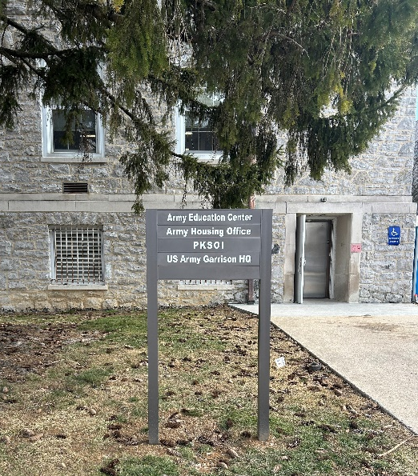
Army Housing Office
22 Ashburn Drive
Upton Hall, Room B32
Carlisle, PA 17013
WE ARE THE ARMY’S HOME

Slide 22
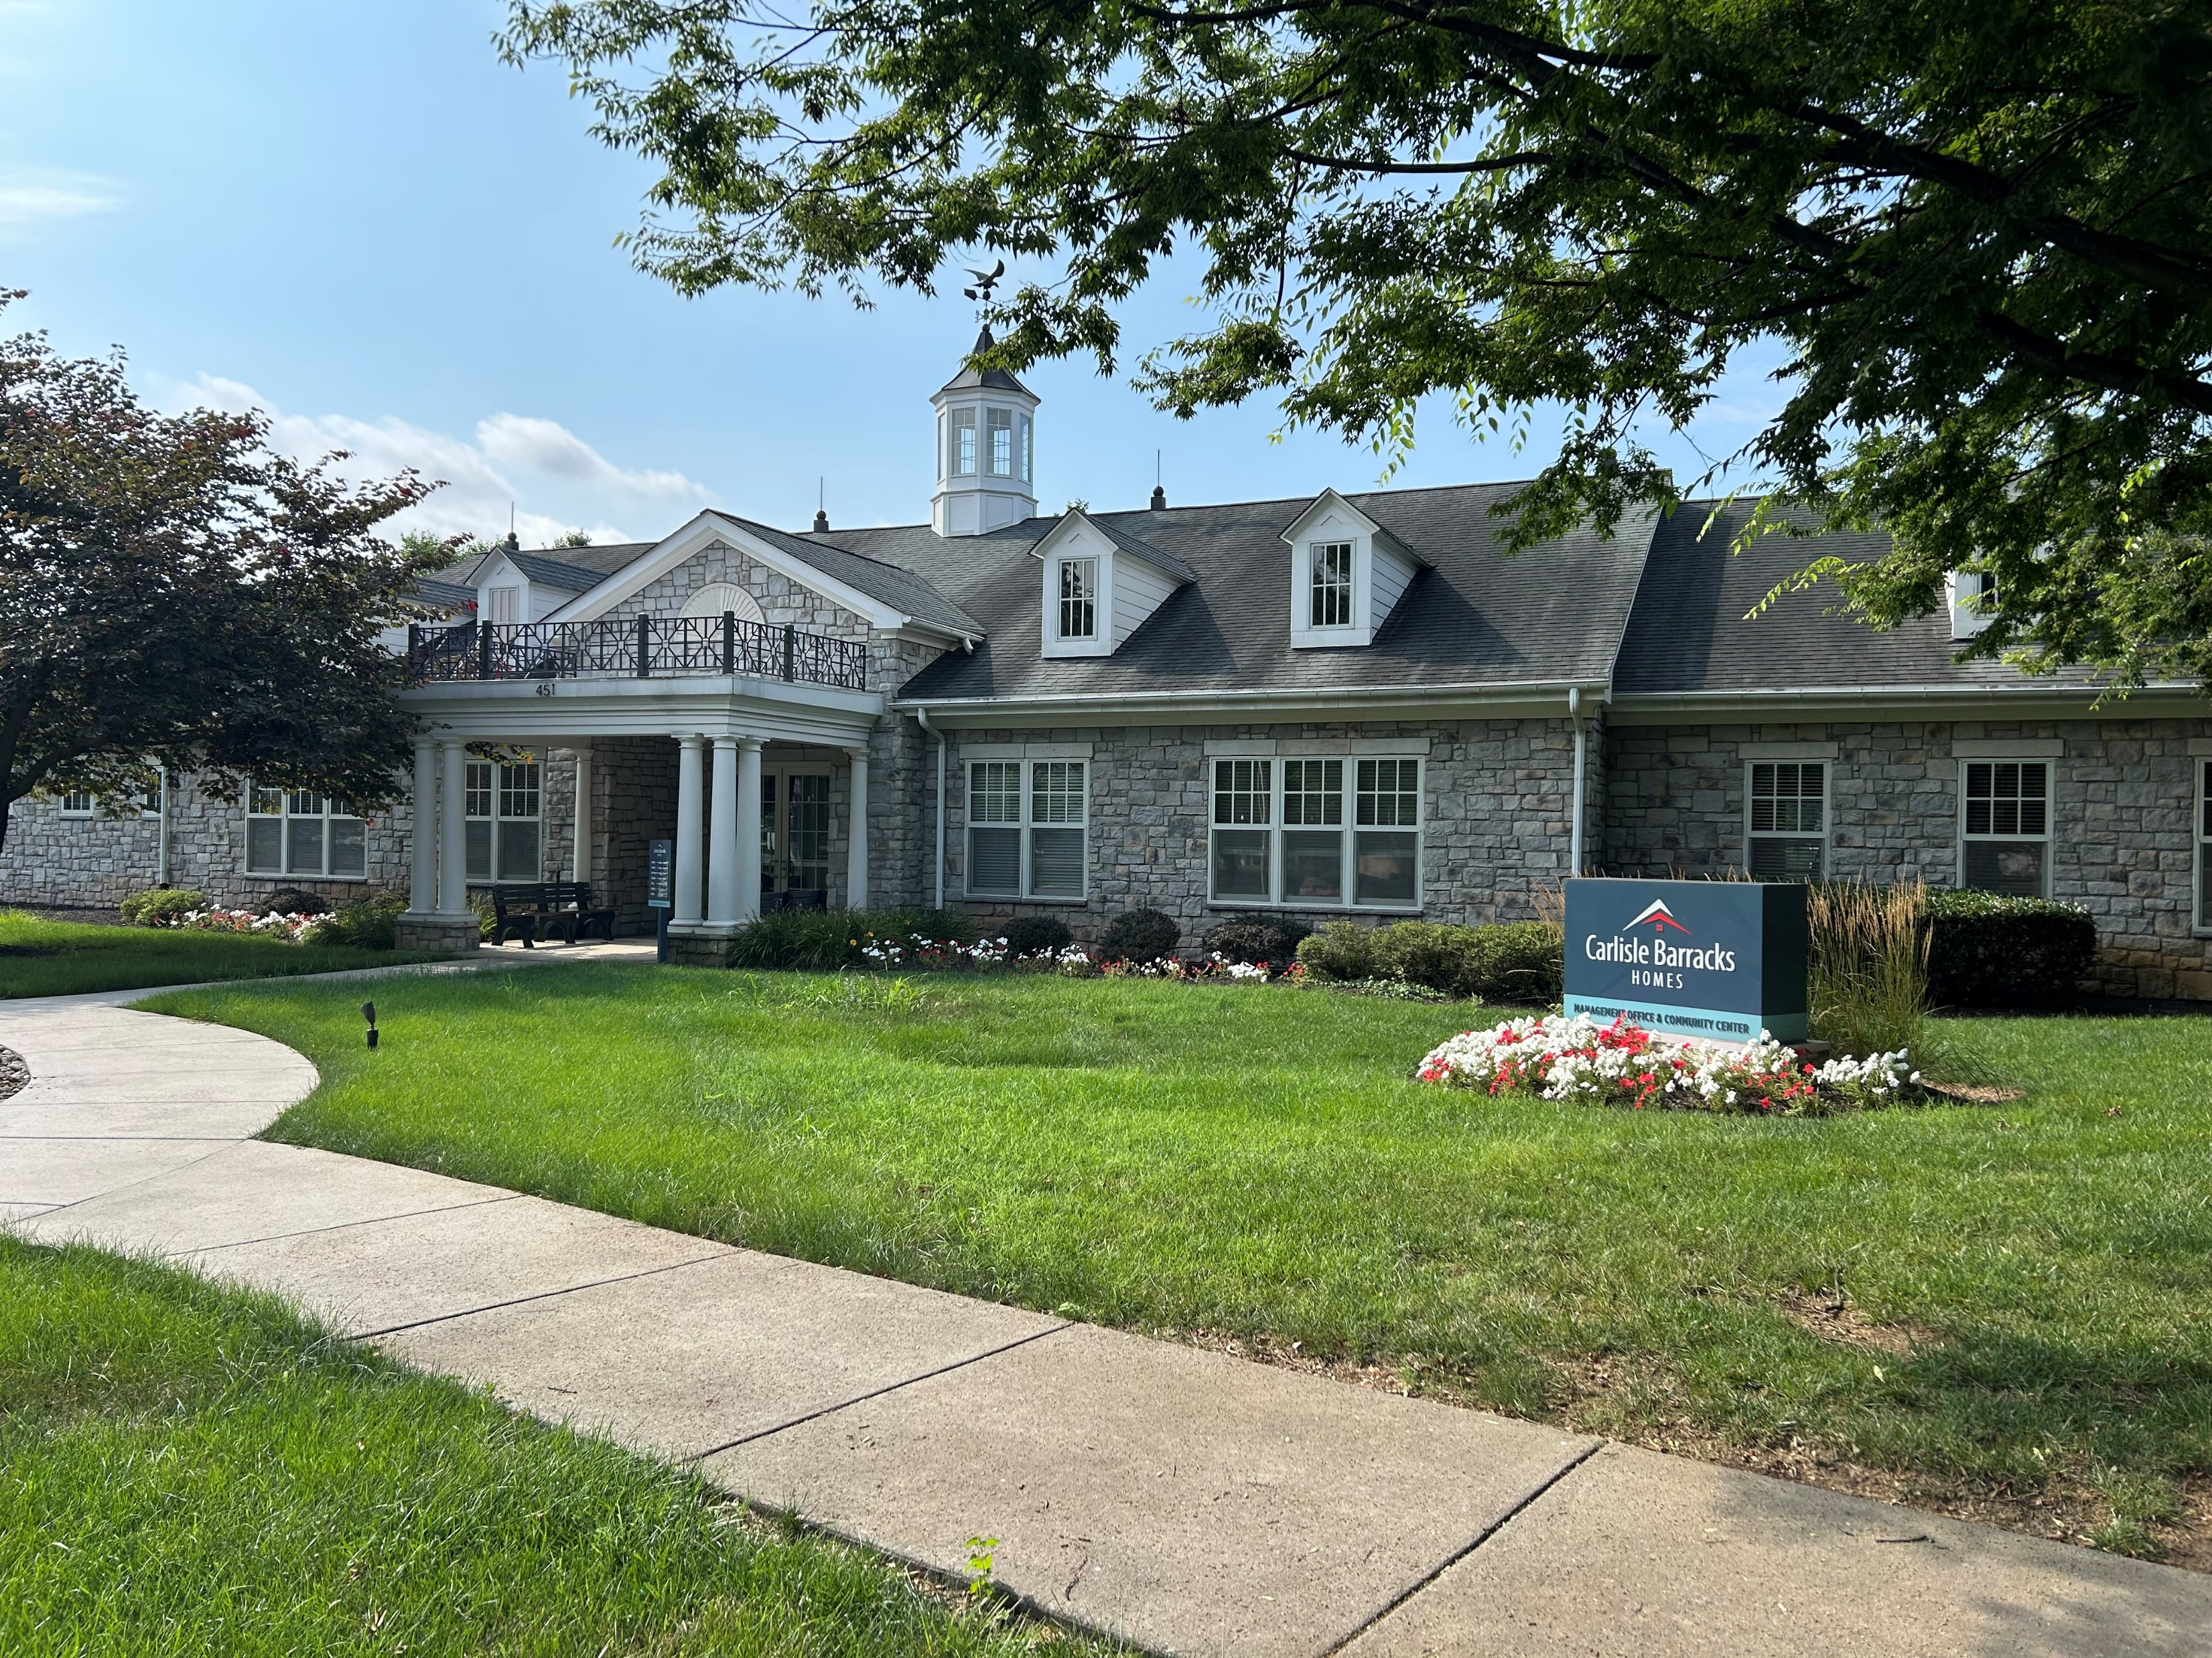
Project Company Leasing Center
451Fletcher Rd
Carlisle, PA 17013
WE ARE THE ARMY’S HOME

Slide 23
DOD Housing Feedback System
Section 3016(b) of the Fiscal Year (FY) 2020 National Defense Authorization Act (Public Law 116-92) added a new section 2894a to title 10 United States Code (10 U.S.C.) that requires the Department of Defense (DoD) establish a publicly available database that permits privatized housing tenants to file a complaint regarding their housing unit.
To satisfy this requirement, the Department developed the DoD Housing Feedback System (DHFS) to enable Military Housing Privatization Initiative (MHPI) tenants to submit complaints, compliments and/or “feedback.”
Publicly accessible information in the DHFS regarding tenant feedback includes the name of the installation where the housing unit is located, the name of the privatized housing landlord responsible for the unit, and a description of the feedback nature.
The DHFS can be accessed at https://www.dhfs.mil.
WE ARE THE ARMY’S HOME

