Slide 1
The Sabalauski Air Assault School
Packing List Layout Brief
As of 1 March 2023

Slide 2
THE SABAULASKI AIR ASSAULT SCHOOL STUDENT PACKING LIST
ALL ITEMS MUST BE IN COMPLIANCE WITH AR 670-1 AND SERVICEABLE
**ALL ITEMS ARE REQUIRED TO BE STANDARD MILITARY ISSUED UNLESS MARKED WITH AN ASTERISK**
Carried Items
1x MOLLE Rucksack
Large with frame, waist belt, and nametape sewn on top flap
Medium with frame, waist belt and nametape affixed
1x IOTV/Plate Carrier with Front/Back ESAPI Plates, all Kevlar inserts, name and rank affixed
1x ACH, with chinstrap and proper padding with 2" masking tape (Front and Back)
1x Jacket, Wet Weather w/ rank (Slip-on/Pin-on)
1x Patrol Cap, with name and rank affixed
1x OCP Blouse (with all required patches affixed)
1x OCP trousers
1x Coyote Brown t-shirt (no logos, unit emblems, or writing)
1x Pair Boot Socks, Black/Brown/Green*
1x Pair of Earplugs with hard case (may be foam or flanged variety)*
1x Hi-Lighter*
1x Black ink pen (Must be Black Ink)*
1x Gallon-sized Ziploc style bag*
1x APEL Approved eye protection or APEL Approved Goggles (must have clear lens)*
1x One-quart canteen with 2" masking tape affixed to front
1x One-quart canteen carrier
1x Headlamp OR Angle-Necked Flashlight, operational with batteries (must be red lens capable)*
Additional batteries for light source*
1x Black Fleece Watch Cap
1x Waterproof bag
1x Small Notebook (Must fit in Cargo Pocket)*
1x Pair of Running Shoes (Day 0 and 4 ONLY) *
1x Reflective Belt, Yellow
1x MRE, Complete (Day 0 only)
1x Leather work gloves w/ wool inserts ( w/ full palm friction bearing surface)
1x Color Unit Patch with Velcro*
1x Beret (enlisted with unit crest, officers with rank)
Air Assault Handbook (when issued)
Casualty Feeder Card (when issued)
Completed FC 4137 (All walk-ons) and DD-1610 (TDY Personnel)
Worn Items
OCP Blouse (with all required patches affixed)
OCP Trousers
Coyote Brown Belt*
Coyote Brown T-Shirt (no logos, unit emblems, or writing)
Boot Socks, Black/Brown/Green*
ID Tags (2 ID Tags, Long Chain, Short Chain)
ID Card (not expired or due to expire during the course)
Coyote Brown Combat Boots*
Army IPFU Shirt (Day 4 Only)
Army IPFU Shorts (Day 4 Only)
Additional Winter Items (01 OCT – 01 APR Only)
1x GEN III Grid Fleece Top (Waffle Top)
1x GEN III Grid Fleece Bottom (Waffle Bottom)
1x Pair of Winter Gloves*
Winter IPFU (Day 4 Only)
Gloves*
Fleece Cap
Army IPFU Jacket
Army IPFU Pants
Army IPFU Shorts
Army IPFU Shirt
Army IPFU Long Sleeve Shirt
PROHIBITED ITEMS
Cell Phones
Knives/Gerber/Leatherman
GPS devices to include watches with storage capabilities
Headphones
Tobacco products/Vape devices
CAO 1 March 2023

Slide 3
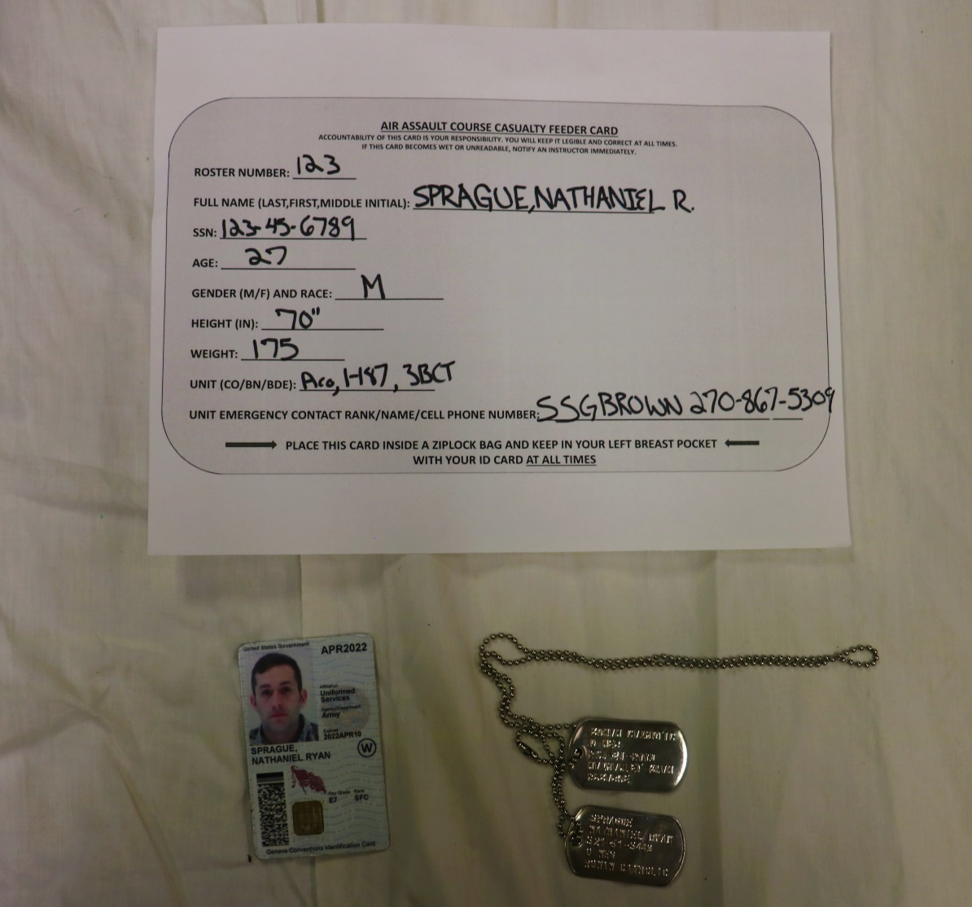
Mandatory Safety Items
Required in all uniforms. Failure to have ID Card, ID Tags, or improperly filled out Casualty Feeder card will result in a Day 0 safety drop.

Slide 4
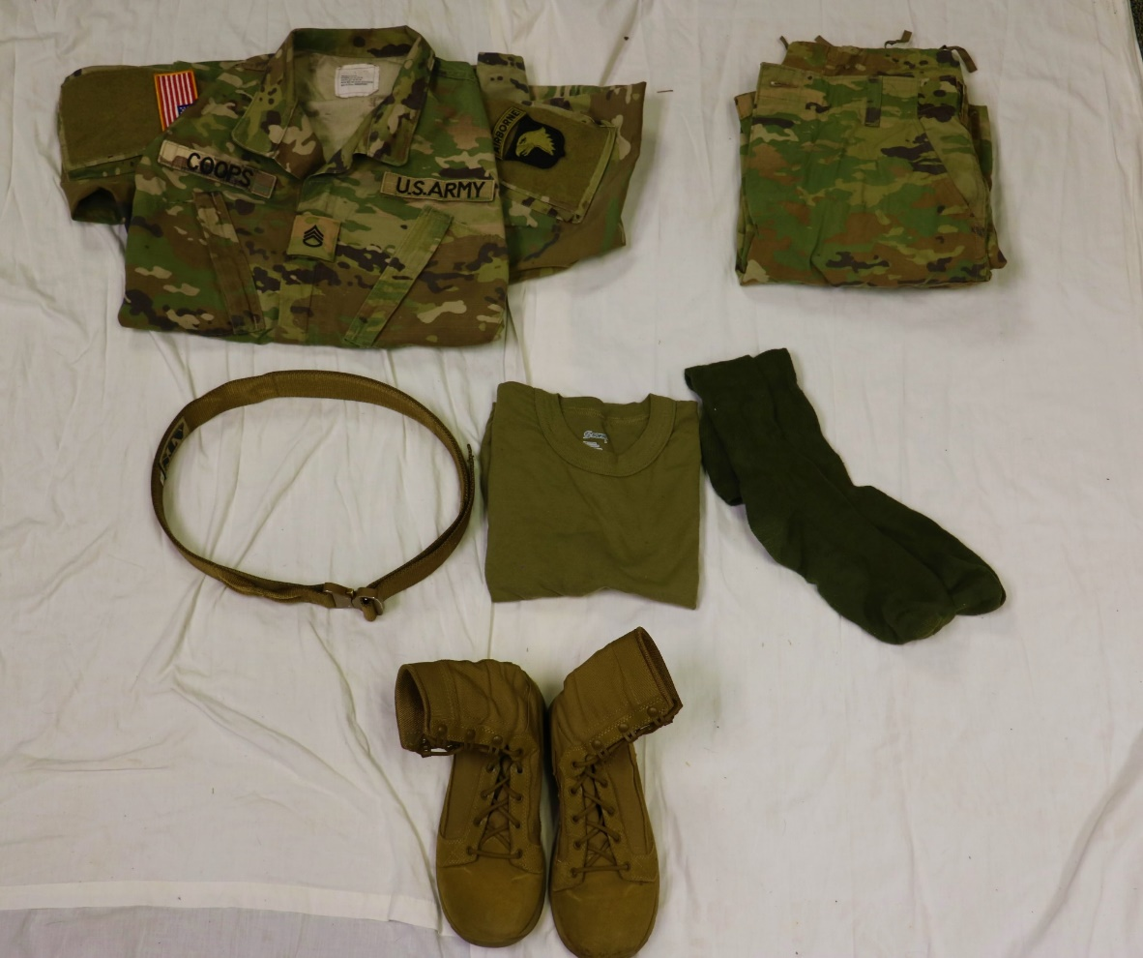
Worn Items
All Patches must be affixed
AR 670-1 compliant belt
1x Pair of AR 670-1 compliant boot socks
No logos, unit emblems, or writing
AR 670-1 compliant Boots

Slide 5
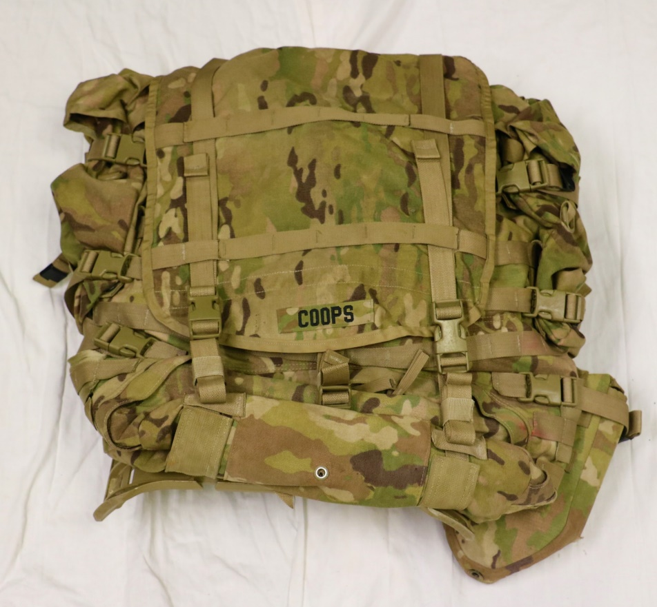
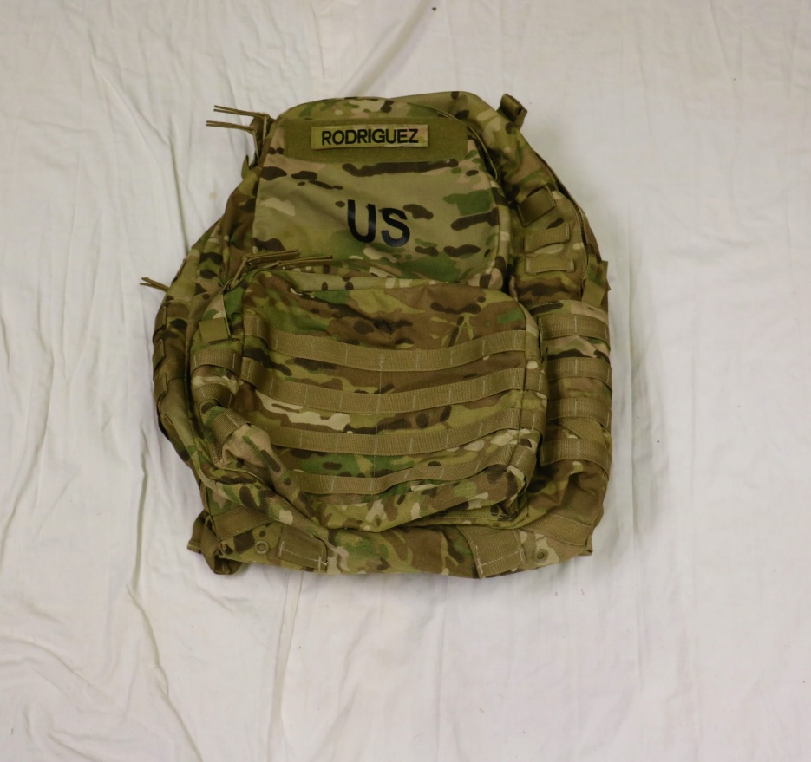
MOLLE Rucksack
Nametape must be sewn on the Large MOLLE Rucksack as shown
Nametape must be affixed to the Medium MOLLE as shown

Slide 6
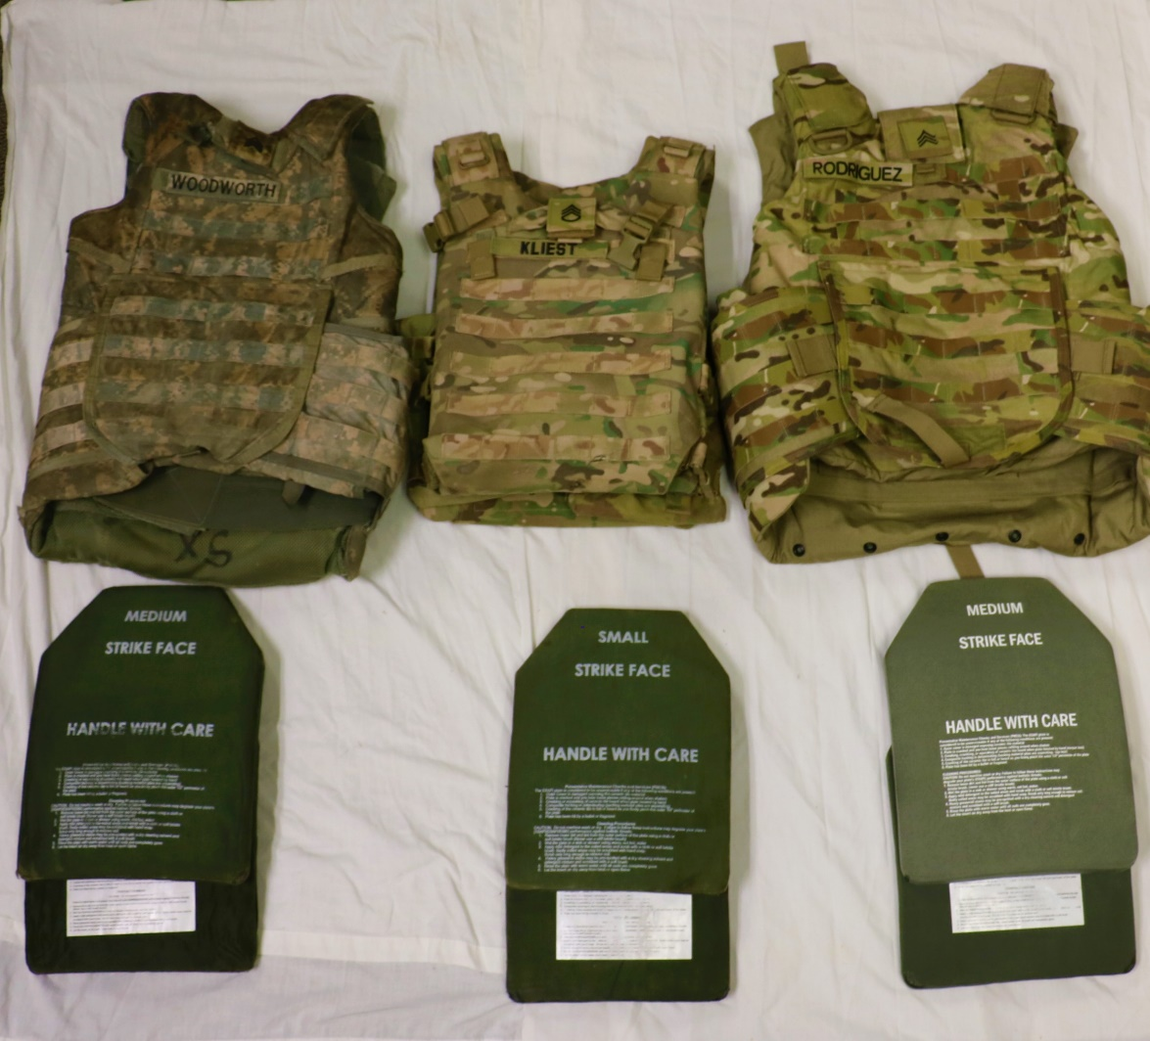
IOTV / Plate Carrier
Issued IOTV / Plate Carrier must have front and back ESAPI plates and name and rank affixed.
NOTE: One of the issued plate carrier does not have a place to affix rank, nametape is still required

Slide 7
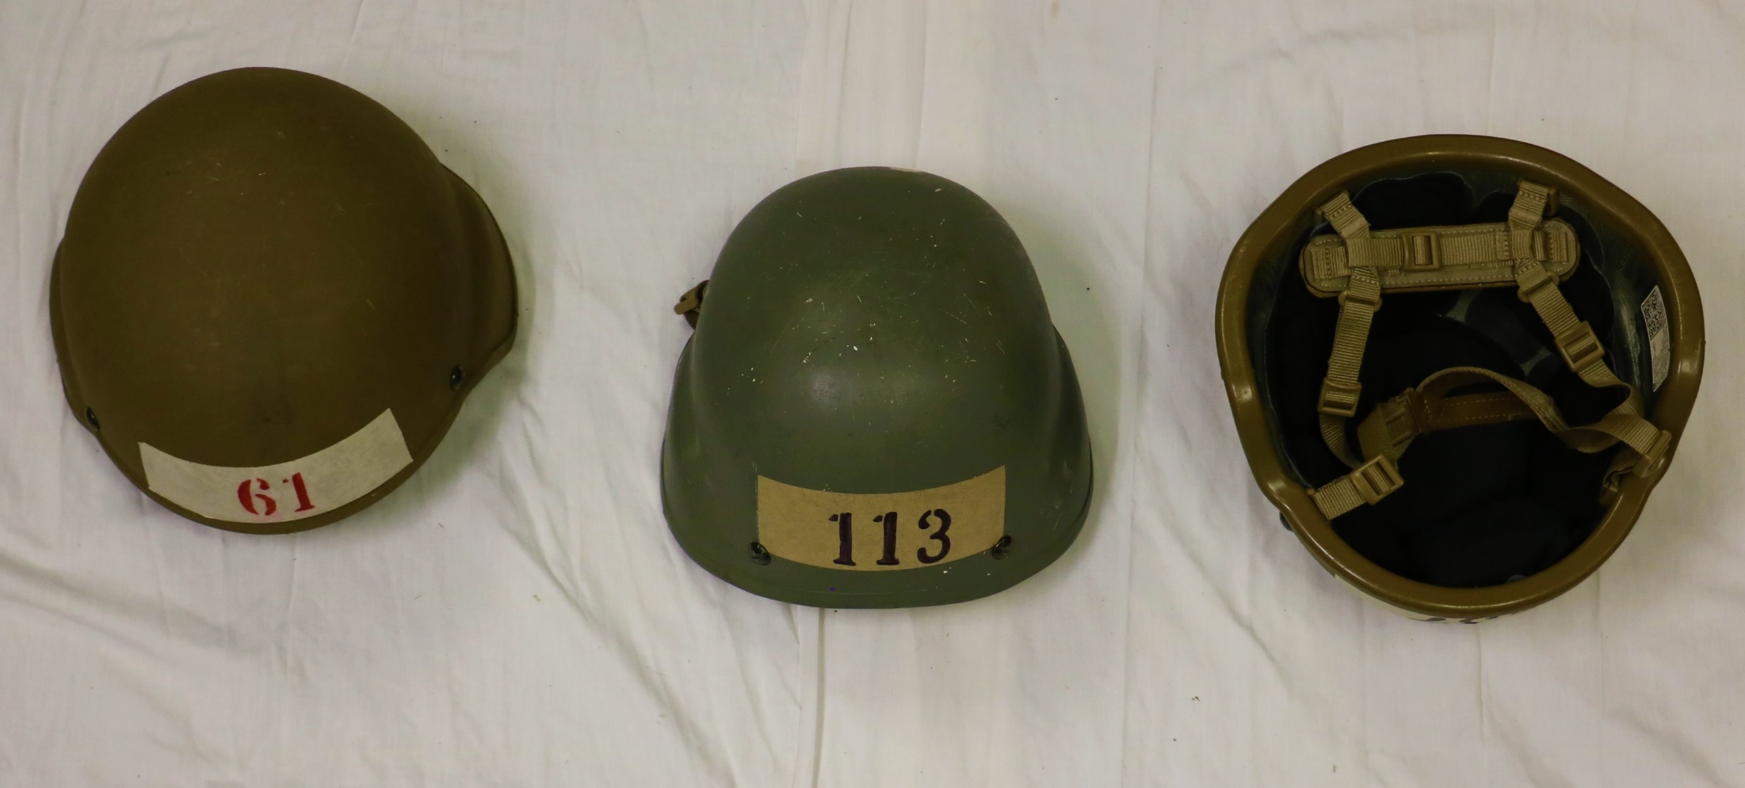
ACH
Masking tape must be placed on the front and rear of the ACH
Masking tape dimensions: 6” wide by 2” tall
Must have appropriate padding and chinstrap

Slide 8
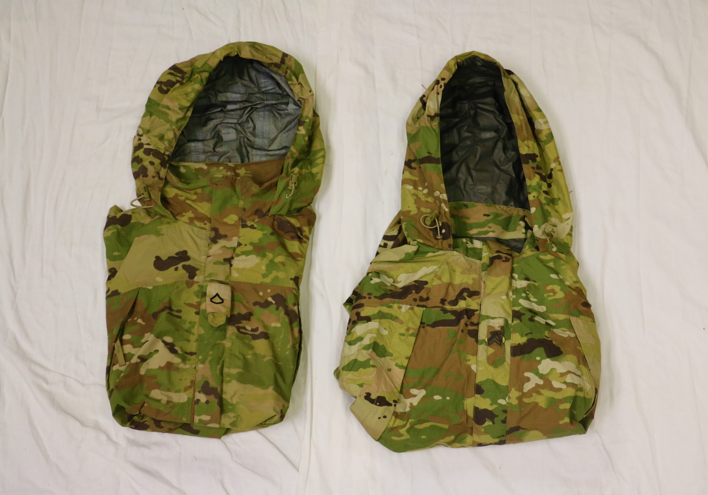
Wet-Weather / Extreme Cold Weather Jacket
Slip on rank
Pin on rank
Rank must be present: Pin on or slip on are authorized

Slide 9
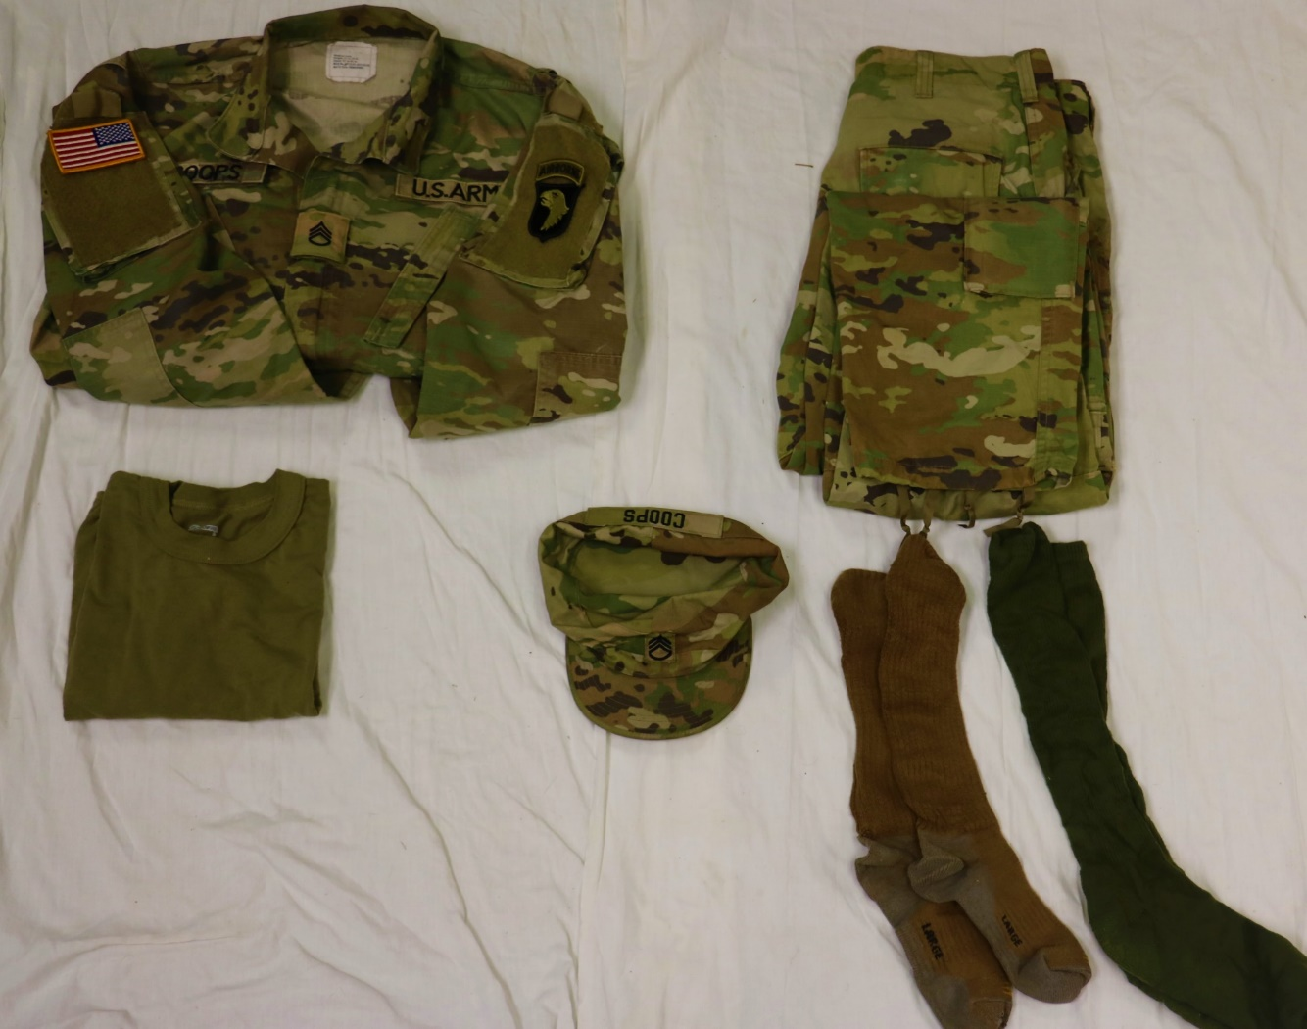
Uniform Packed in Rucksack
All Patches must be affixed
No logos, unit emblems, or writing
Patrol cap must have nametape and rank affixed
1x Pair of AR 670-1 compliant boot socks

Slide 10
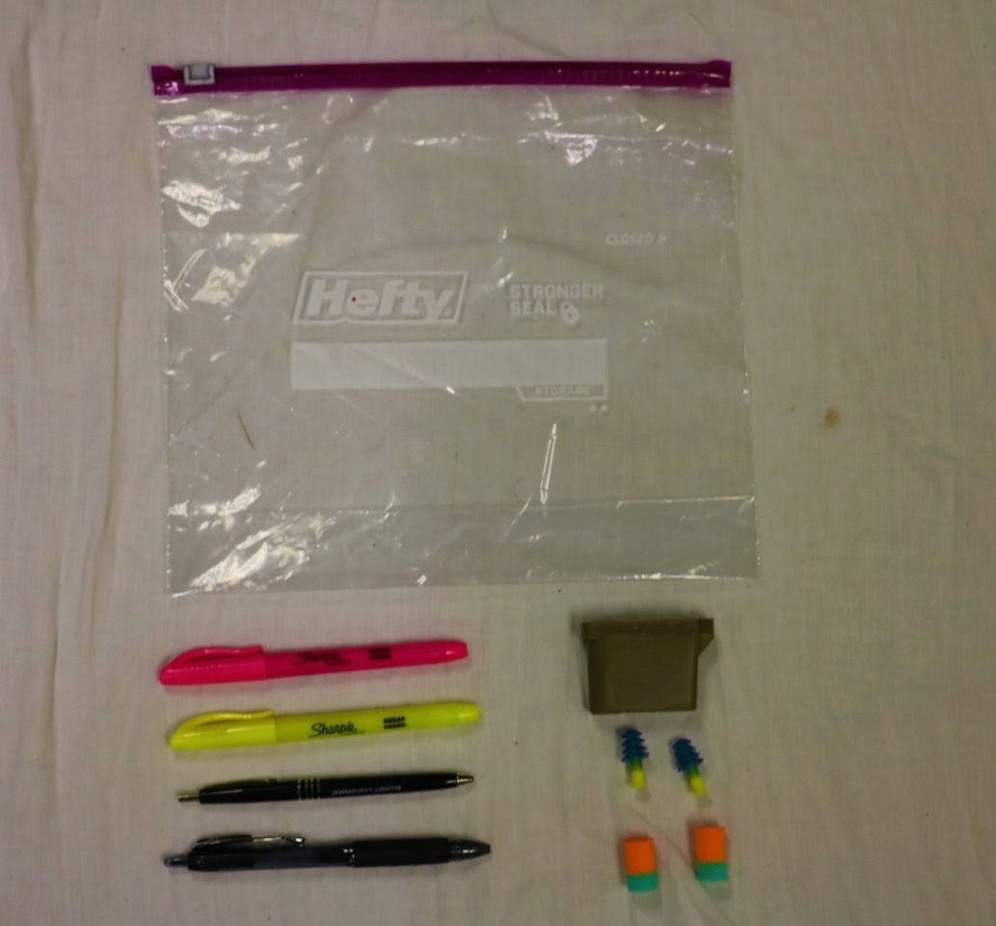
Items Packed in Rucksack (1 of 3)
1-Gallon Sized Ziploc Bag
Must be black ink
Earplugs must have hard case
Note: Earplugs may be flange or foam

Slide 11
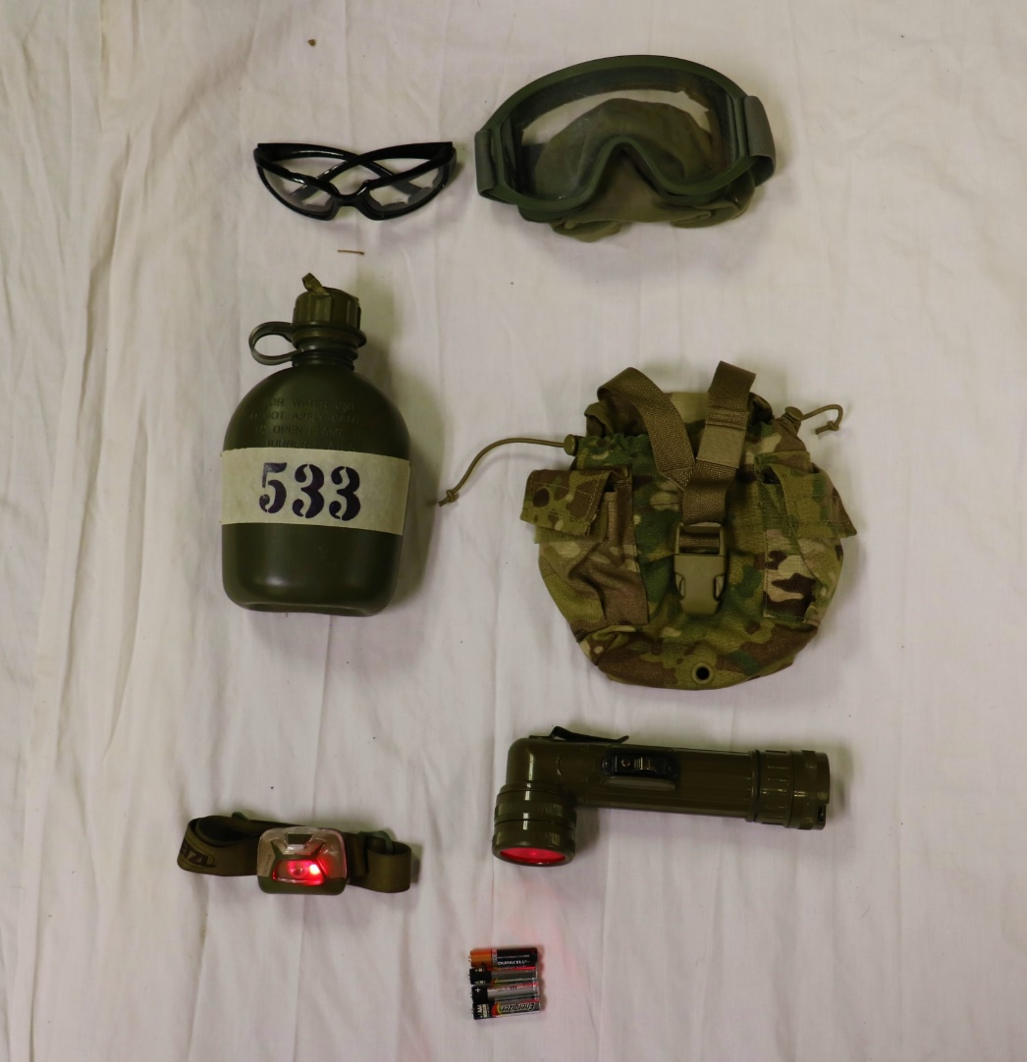
Items Packed in Rucksack (2 of 3)
APEL Approved Eye Protection
Eye Pro OR Goggles
*Must have clear lenses*
Canteen Carrier
Canteen must be full and have 2” masking tape
Dimensions: 2” Tall by 6” wide
Red Lens Capable Flashlight
Headlamp OR L-Shape is authorized
NOTE: Additional Batteries must match flashlight

Slide 12
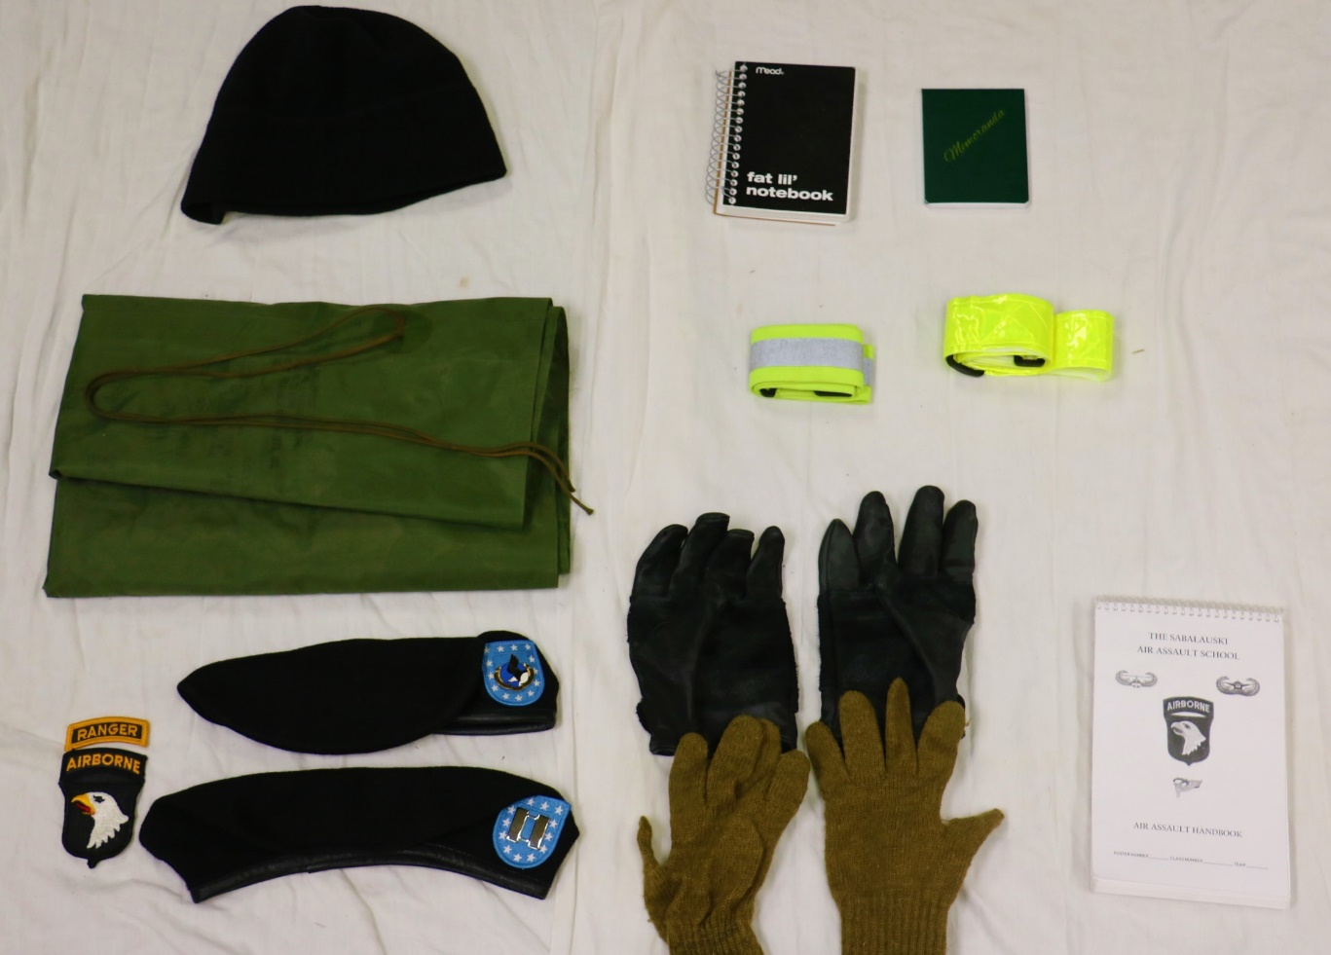
Items Packed in Rucksack (2 of 3)
Must be black
Must fit in cargo pocket
Must be yellow
Must have Velcro backing
Handbook:
*When Issued
Beret with appropriate items:
Enlisted: Unit Crest
Officer: Rank
Leather work gloves with inserts
Must have friction bearing surface
Must be AR 670-1 compliant

Slide 13
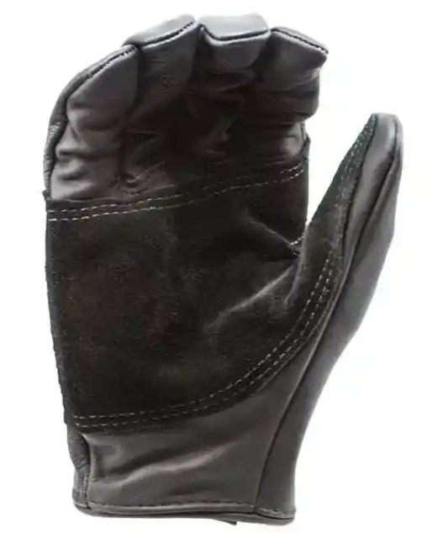
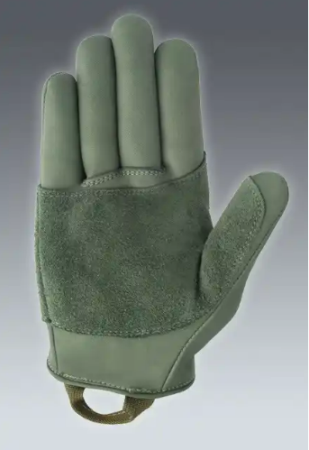
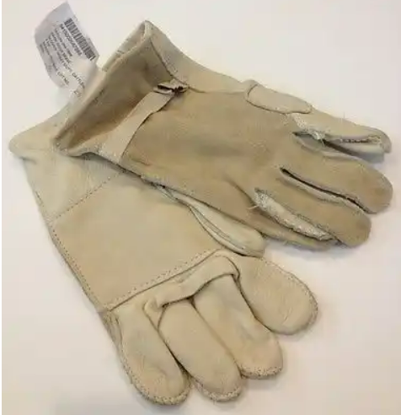
Leather Work Glove

Slide 14
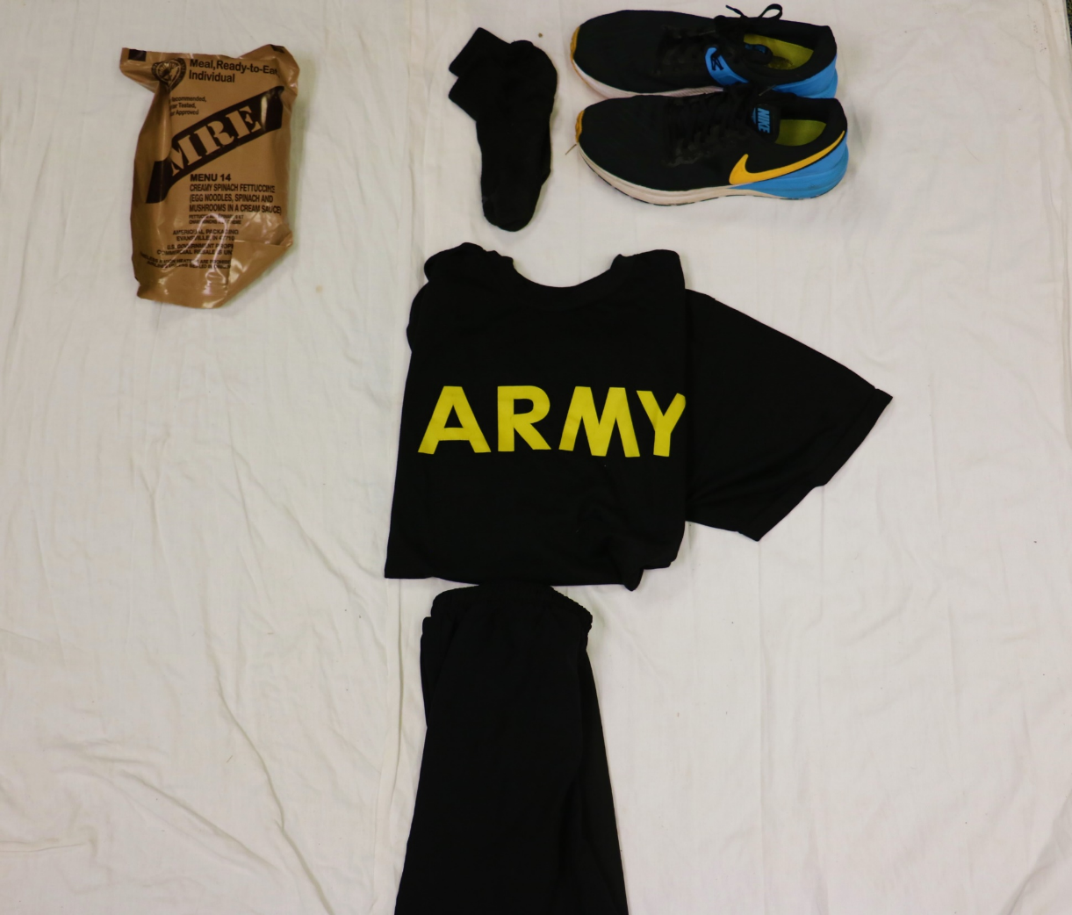
Day 0 / Day 4 Items
Day 0 & Day 7
Day 0 Only
Day 7 Only
PT Socks
IPFU Complete

Slide 15
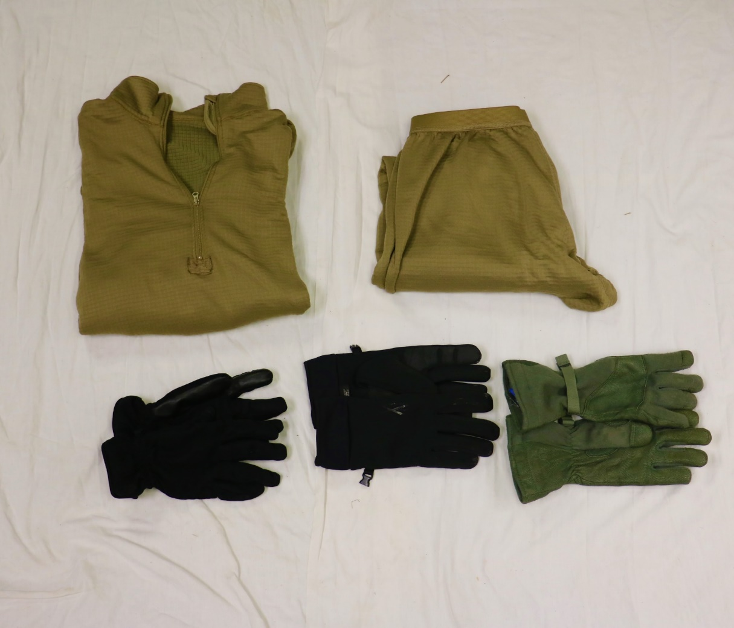
Additional Winter Items
ECWCS Level II
(Waffle Top / Bottom)
AR 670-1 compliant gloves *Do not have to be military issue
**Additional Winter Items are required if Day 0 falls between 01 OCT through 01 April

Slide 16
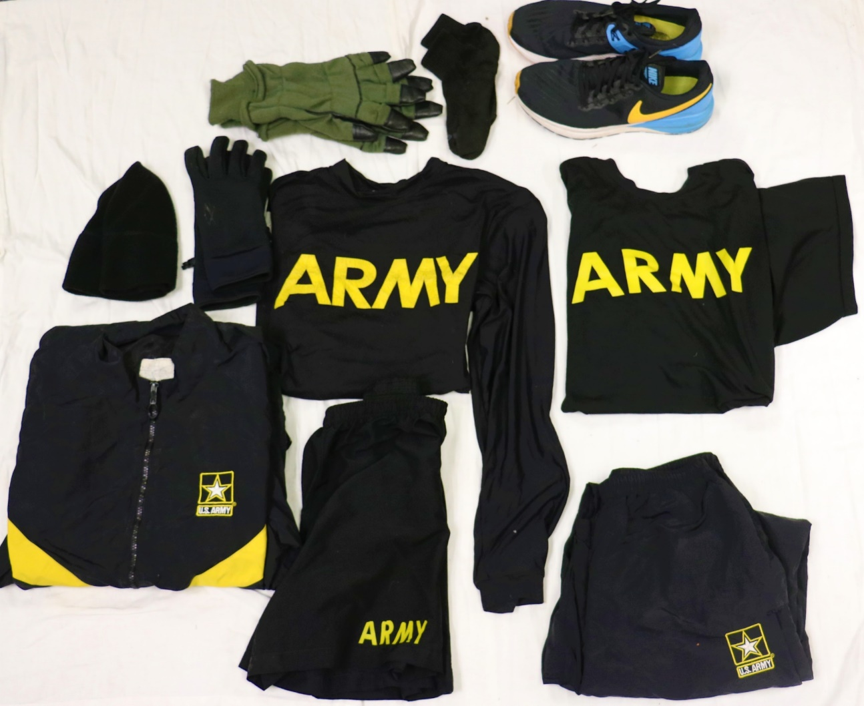
Winter IPFU
Winter IPFU Complete:
(Day 7 Only)
IPFU Shorts
IPFU Short Sleeve Shirt
IPFU Long Sleeve Shirt
IPFU Jacket
IPFU Pants
Fleece Cap
Gloves
PT Socks
Running Shoes
**Additional Winter Items are required if Day 0 falls between 01 OCT through 01 April

Slide 17
PROHIBITED ITEMS
Cell Phones
Knives/Gerber/Leatherman
GPS devices to include watches with storage capabilities
Headphones
Tobacco products/Vape devices

Slide 18
The Sabalauski Air Assault School
QUESTIONS
Notes:
Subject to questions, this concludes the brief. AIR ASSAULT!

