Slide 1
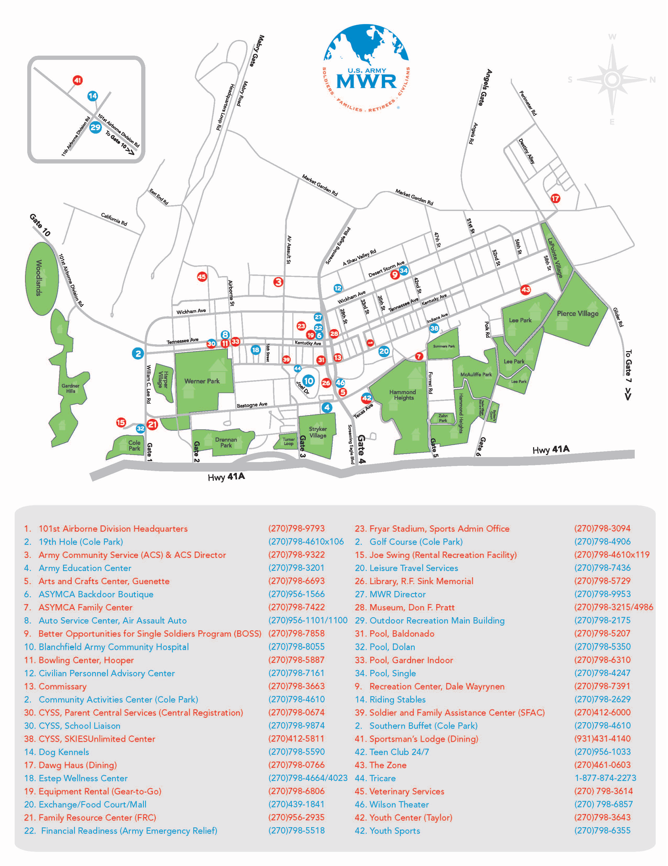
Building 7523
Turn Left then right to access Headquarters loop.
Turn Left on 1st Street
Enter Here At Gate 1
To I-24
To Clarksville, TN

