Slide 1
M1301 (ISV)

Slide 2
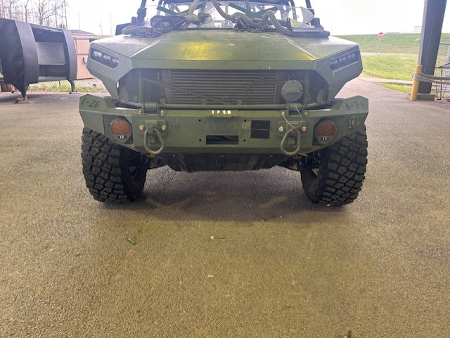
1
2
1. Hood Pins
2. Wheels

Slide 3
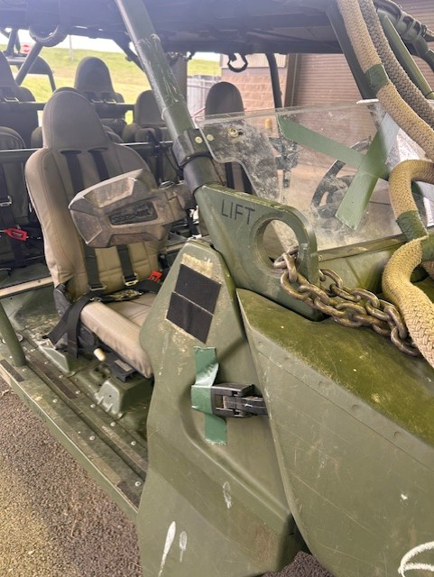
1
2
1. Windshield Mount
2. Hood Latch

Slide 4
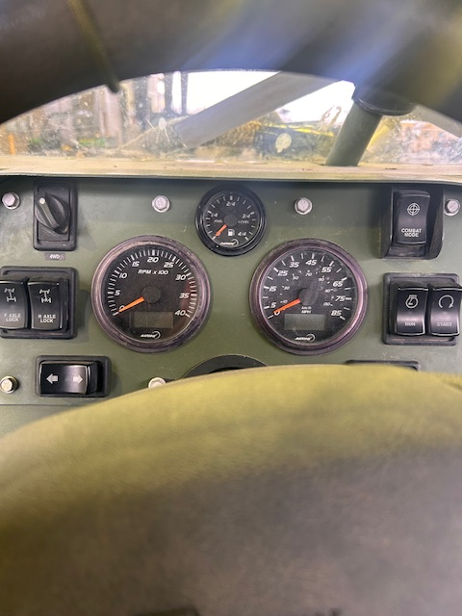
1
1. Instrument Cluster

Slide 5
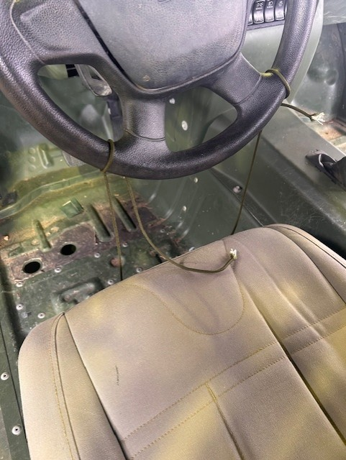
1
1. Steering Wheel

Slide 6
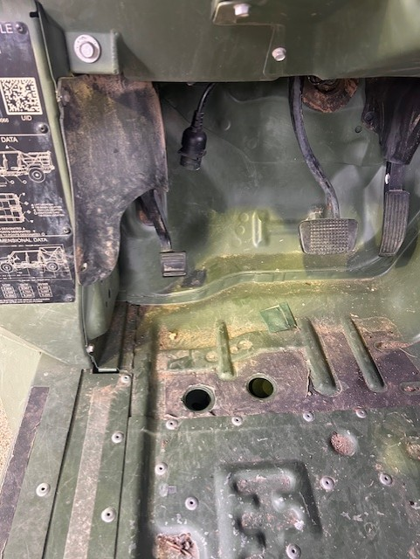
1
1. Parking Brake

Slide 7
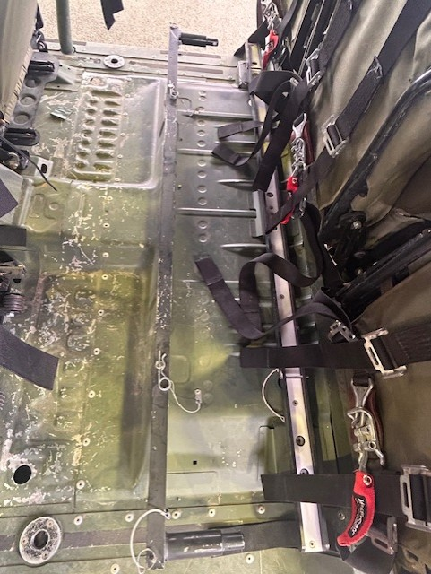
1
1
1. Litter Rail

Slide 8
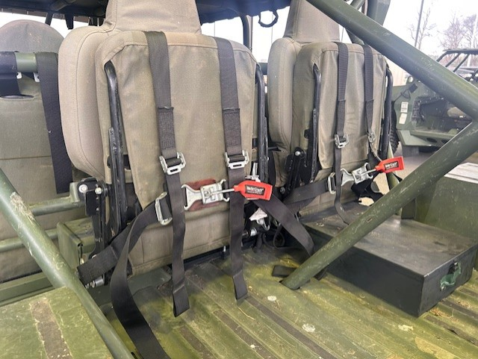
1
2
1. Seats Stowed
2. BII Box

Slide 9
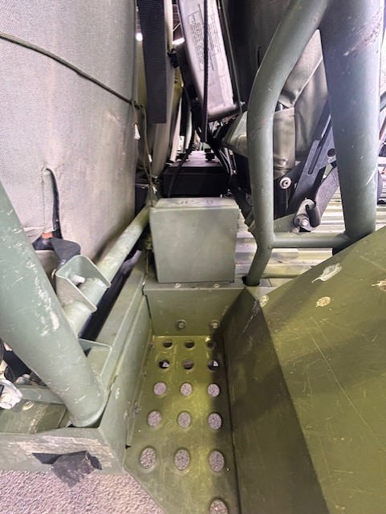
1
1. Fuel Fill Door

Slide 10
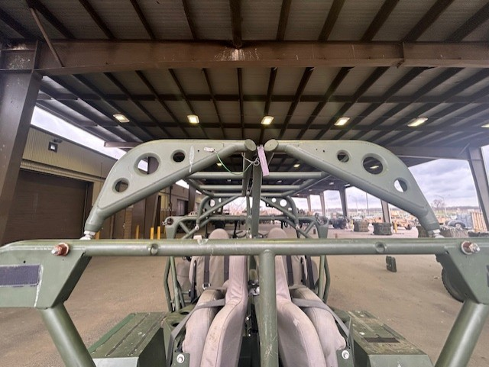
1
1. Roll Over Protection System (ROPS)

