Slide 1
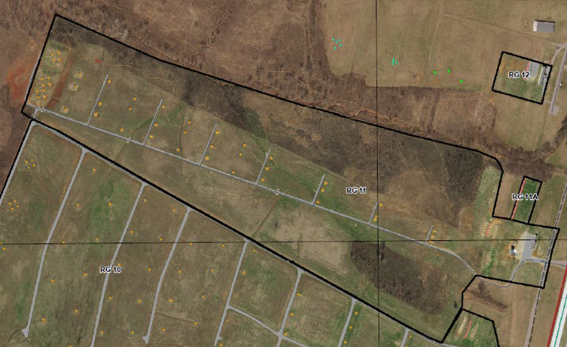
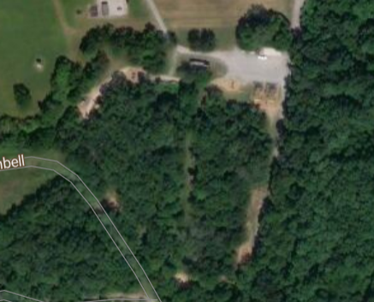
WEEK –TW 22
FY – 24
Air Assault O-Course
START:07 0800 JUN 17
END: 07 2300 JUN 17
START:
END:
N
TSAAS
REFERENCES
8 Step Training Model
Obstacle Course :: FORT CAMPBELL (army.mil)
FLA
RANGE OIC/NCOIC
Water Point
RANGE CHECKLIST
EVENT | STATUS
Land
Ammo
Target Operator
Range Walk
Range Packet
Risk Assessment
Range Detail
Medical Detail | Company Medics
COMMO | Cell
Class I | Water
CONCEPT OF THE OPERATION
OVERVIEW
Uniform
Notes:
This is the new standard CONOP format that will need to be used for every CONOP submitted for the BTM. CONOPs will only be briefed in T+5;. For T+4 through T CONOPs will only be briefed if there are changes to the original approved plan or concerns that need to be presented. Otherwise they will be hidden. Be sure to inform the S3 shop of any CONOPs that you need to have unhidden in T+4 through T weeks by 1600 MON.

