Slide 1
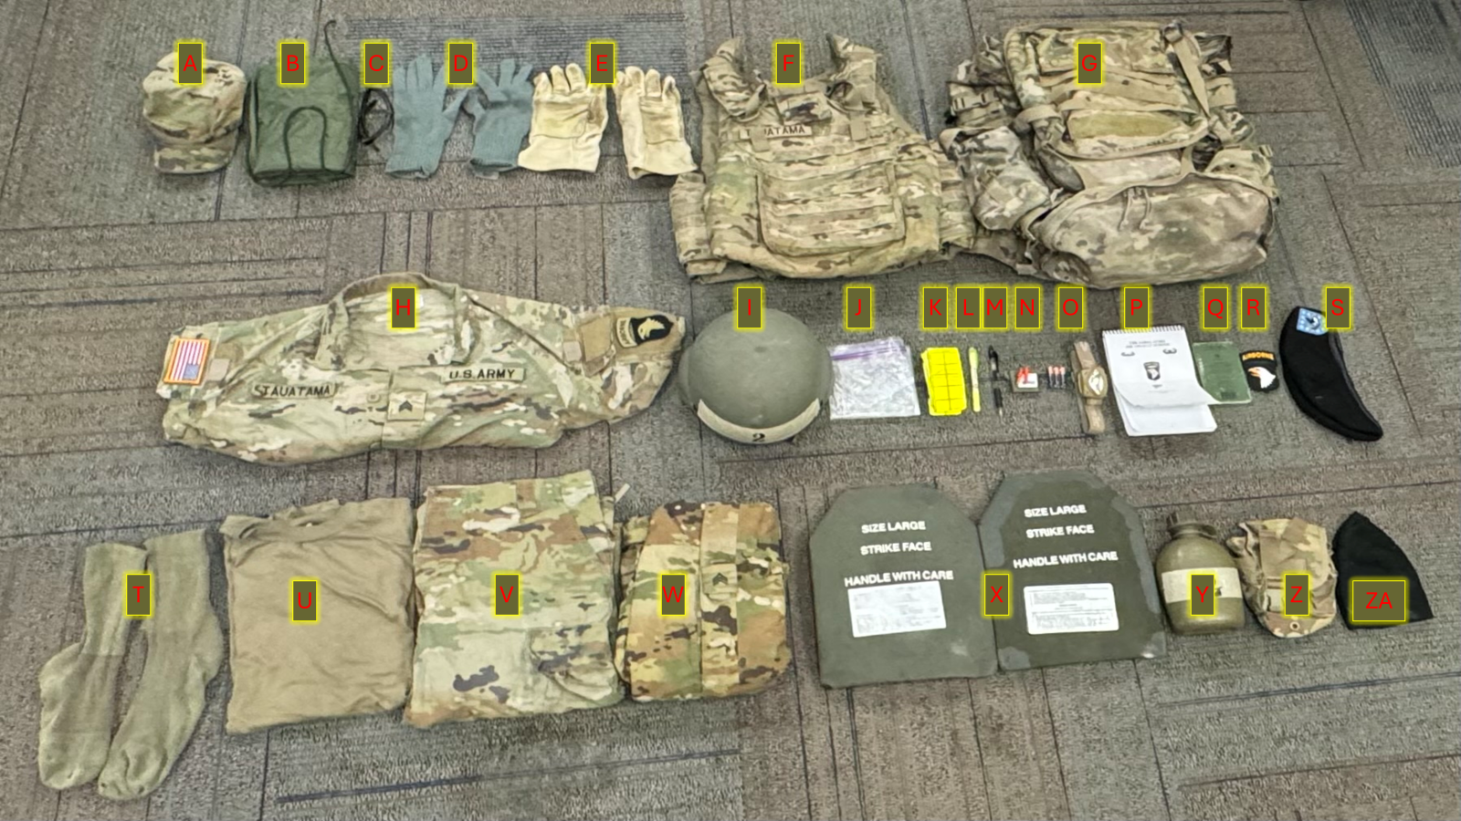
1X MOLLE Rucksack
i. Large with frame, waistbelt, sustainment pouches and
nametape sewn on top of flap
ii. Medium with frame, waistbelt and nametape affixed
THE SABAULASKI AIR ASSAULT SCHOOL STUDENT PACKING LIST
ALL ITEMS MUST BE IN COMPLIANCE WITH AR 670-1 AND SERVICEABLE
** ALL ITEMS ARE REQUIRED TO BE STANDARD MILITARY ISSUED UNLESS MARKER WITH AN ASTRISK**
CARRIED ITEMS:
A. Patrol Cap W/ rank and name affixed
B. Wet weather bag W/ strings affixed
C. Apel Approved Eye Pro protection or Apel approved Goggles (must have clear lense) https://www.peosoldier.army.mil/Equipment/Approved-Eyewear-QPL/
D. Wool glove inserts
E. Leather work gloves
F. IOTV/Plate Carrier w/ all Kevlar inserts, name and rank affixed
G. 1X MOLLE Rucksack
i. Large with frame, waistbelt, sustainment pouches and
nametape sewn on top of flap
ii. Medium with frame, waistbelt and nametape affixed
H. OCP Blouse (with all required patches affixed)
I. ACH W/ chine strap and required padding (7 Pads) and 2-inch masking tape on Front and Back of ACH
J. Gallon-sized Ziploc style bag*
K. Yellow reflective belt
L. High Lighter
M. Black ink pen
N. Ear pro W/ hard case (Foamed or Flanged)*
O. Headlamp or Angle-Necked Flashlight with batteries (Red Lens capable and Additional Batteries, enough to replenish headlamp and correct type of batteries specific to your headlamp)
P. Air Assault Handbook
Q. Small Notebook (must fit in cargo pocket)
R. Color unit patch W/ Velcro*
S. Beret (enlisted with unit crest, Officer with rank)
T. Pair boot socks, Brown/Black/Green*
U. Coyote Brown t-shirt (no logos, unit emblems, or written)
V. OCP Trousers
W. Wet weather top W/ rank slip on or pin on
X. ESAPI Plates (2)
Y. One-Quart Canteen W/ 2inch masking tape affixed to the front
Z. One-Quart Canteen carrier
ZA. Black/Tan Fleece watch cap

Slide 2
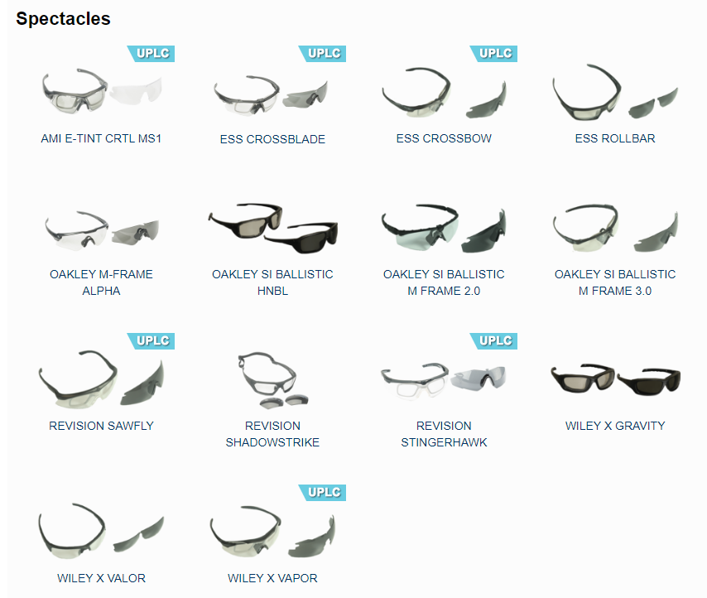
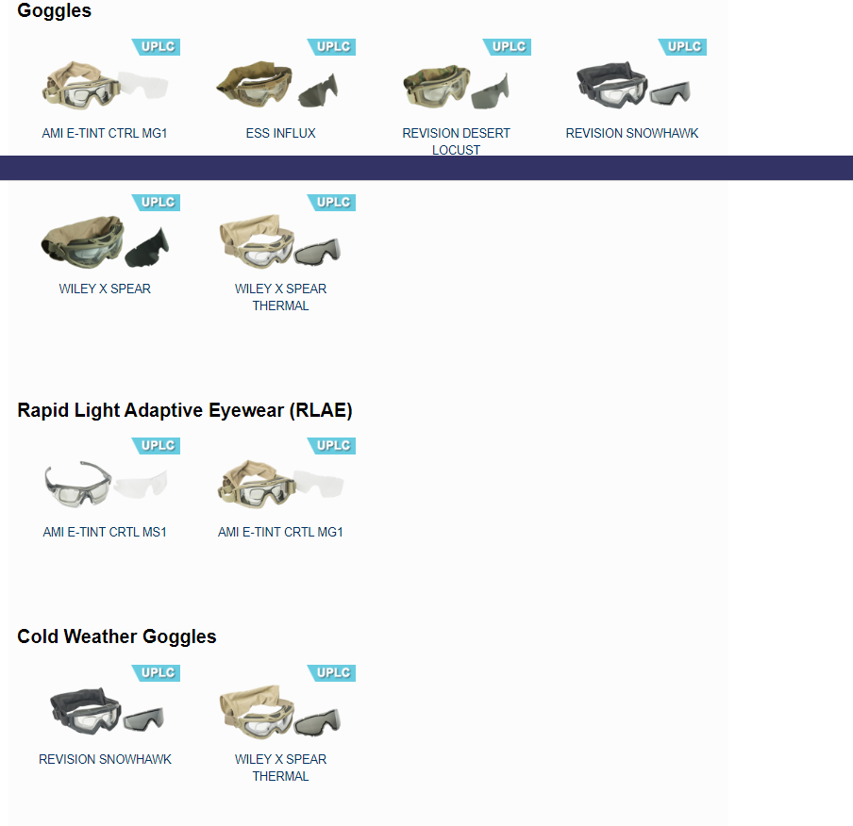
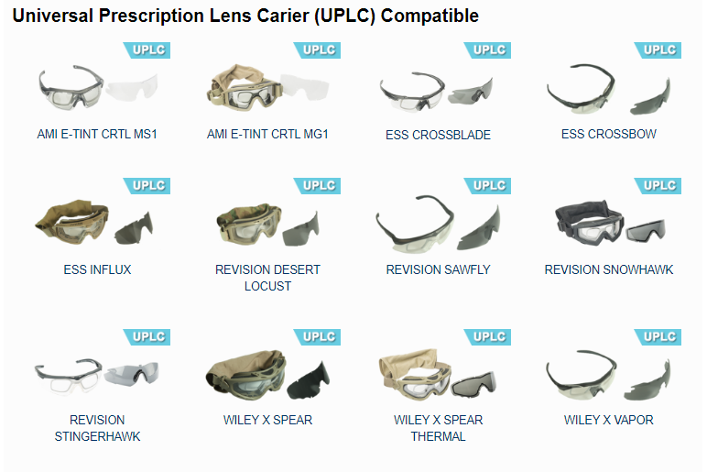

Slide 3
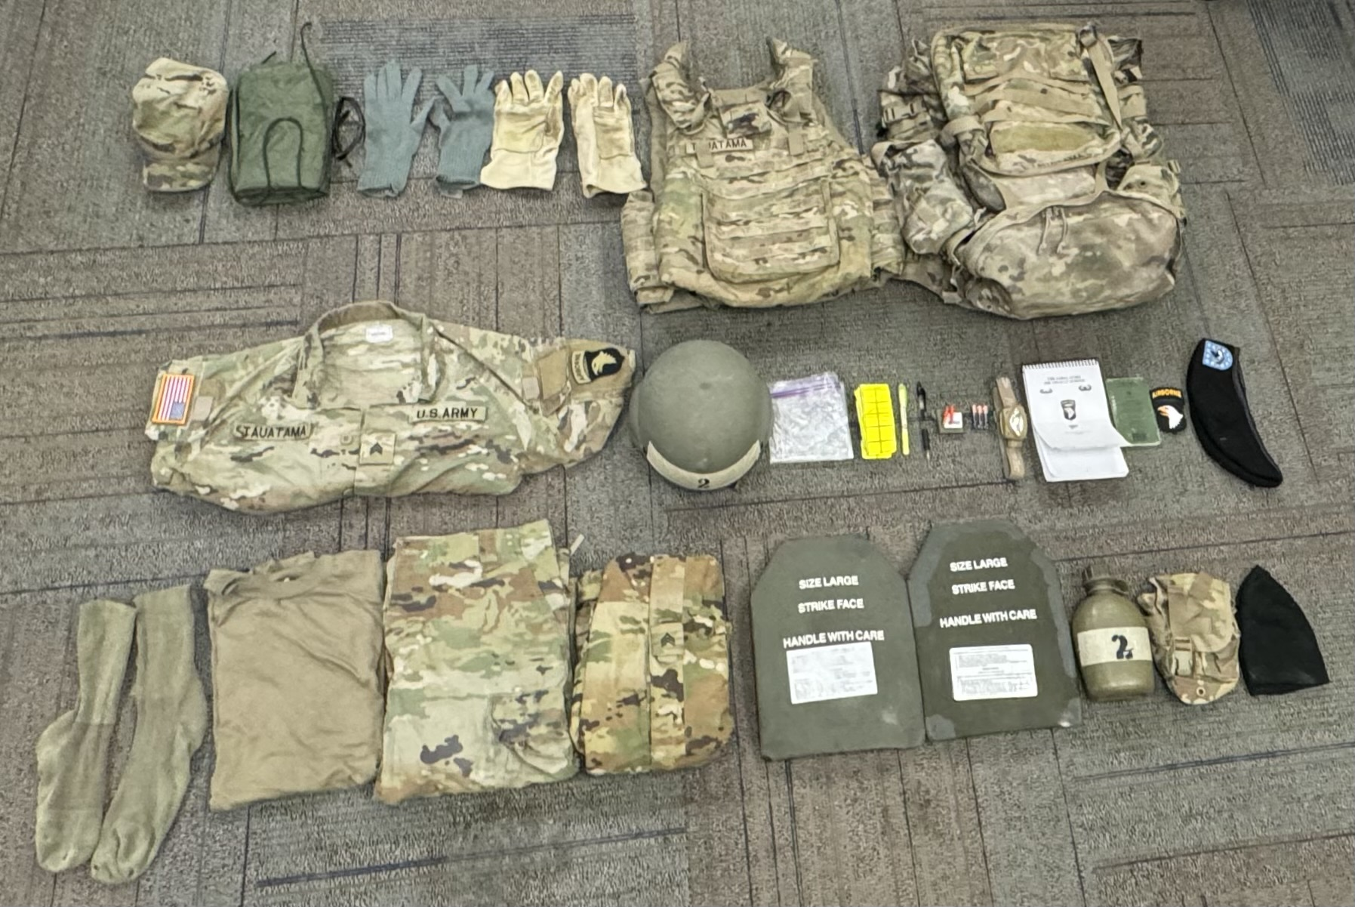
A
B
C
D
E
F
G
H
I
J
K
L
M
N
O
P
Q
R
S
T
U
V
W
X
Y
Z
ZA

Slide 4
1X MOLLE Rucksack
i. Large with frame, waistbelt, sustainment pouches and
nametape sewn on top of flap
ii. Medium with frame, waistbelt and nametape affixed
THE SABAULASKI AIR ASSAULT SCHOOL STUDENT WINTER PACKING LIST
ALL ITEMS MUST BE IN COMPLIANCE WITH AR 670-1 AND SERVICEABLE
** ALL ITEMS ARE REQUIRED TO BE STANDARD MILITARY ISSUED UNLESS MARKER WITH AN ASTRISK**
A
CARRIED ITEMS:
A. Waffle Bottom
B. Patrol Cap W/ rank and name affixed
C. Wet weather bag W/ strings affixed
D. Apel Approved Eye Pro protection or Apel approved Goggles (must have clear lense) https://www.peosoldier.army.mil/Equipment/Approved-Eyewear-QPL/
E. Wool glove inserts
F. Leather work gloves
G. IOTV/Plate Carrier w/ all Kevlar inserts, name and rank affixed
H. 1X MOLLE Rucksack
i. Large with frame, waistbelt, sustainment pouches and
nametape sewn on top of flap
ii. Medium with frame, waistbelt and nametape affixed
I. Waffle Top
J. OCP Blouse (with all required patches affixed)
K. ACH W/ chine strap and required padding (7 Pads) and 2-inch masking tape on Front and Back of ACH
L. Gallon-sized Ziploc style bag*
M. Yellow reflective belt
N. High Lighter
O. Black ink pen
P. Ear pro W/ hard case (Foamed or Flanged)*
Q. Headlamp or Angle-Necked Flashlight with batteries (Red Lens capable and Additional Batteries)
R. Small Notebook (must fit in cargo pocket)
S. Air Assault Handbook
T. Color unit patch W/ Velcro*
U. Beret (enlisted with unit crest, Officer with rank)
V. Cold Weather Gloves (BLACK, GREEN, TAN)
W. Fleece Watch Cap (tan or black)
X. Pair boot socks, Brown/Black/Green*
Y. Coyote Brown t-shirt (no logos, unit emblems, or written)
Z. OCP Trousers
ZA. Wet weather top W/ rank slip on or pin on
ZB. ESAPI Plates (2)
ZC. One-Quart Canteen W/ 2inch masking tape affixed to the front
ZD. One-Quart Canteen carrier
A
A
A
A
B
C
D
E
F
G
H
A
A
A
R
I
J
K
L
M
N
O
P
Q
R
S
T
U
V
W
X
Y
Z
ZA
ZB
ZC
ZD

