Slide 1
THE
IG UPDATE
Volume 23-03, July 2023
Guidance on Army Body Fat Assessment for the Army Body Composition Program
Policy
Effective 9 June 2023, the following policy applies to all Soldiers, all retention actions, and all military schools and institutional training course.
Authorized Methods
The only U.S. Army authorized methods of estimating body fat are:
One-site circumference-based tape method
Multi-site circumference-based tape method
Supplemental body fat assessment
One-site Circumference Method Phase
The Army will phase in the one-site circumference-based tape method over the next year. During the 12-month period extending from the date of Army Directive 2023-11, Soldiers who require a circumference-based tape test will take the one-site tape test. Those who fail the one-site tape method are authorized to have their confirmation test conducted utilizing the multi-site circumference-based tape method, as prescribed in AR 600-9.
Note: After 12 months from the date of AD 2023-11, the one-site tape test will be the only authorized circumference-based tape method.
DA Form 5500/5501
As prescribed in AR 600-9, Appendix B, DA Form 5500 (Body Fat Content Worksheet (Male)) or DA Form 5501 (Body Fat Content Worksheet (Female)) must be completed for Soldiers who exceed the weight for their respective height.
Note: IAW Army Directive 2023-08, Soldiers who qualify for the 540+ Army Combat Fitness Test exemption will only be required to fill out their name, rank, height, and weight on the form for administrative purposes.
Failure
Commanders will flag Soldiers who fail the circumference-based tape methods. Those Soldiers may request a supplem-ental body fat assessment if the means for such testing is reasonably available.
The Soldier must request to take a supplemental body fat assessment at the time they are formally counseled by their command for failing the tape test and confirmation tape test. Any decision to opt-out of a supplemental body fat assessment is final at the time of the counseling.
Note: Commanders of Soldiers who do not request a supplemental body fat assessment or who fail the supplemental body fat assessment will maintain the original flagging action, and the Soldier will be enrolled in the ABCP.
Note: Commanders may grant an extension of up to 60 days in the event supplemental assessment resources are not easily accessible or available.
Supplemental Body Fat Assessment
The authority to determine whether the supplemental body fat assessment testing is reasonably available is delegated to the commanders of Army commands, Army service component commands, and direct reporting units; the Chief, National Guard Bureau; and the Chief of the Army Reserve. This authority may be further delegated.
Authorized supplemental body fat assessments are:
Dual-energy X-ray Absorptiometry (DXA)
Inbody 770 (Bioelectrical Impedance Analysis)
Bod Pod® (Air Displacement Plethysmography)
Note: Supplemental body fat assessments must be recorded on DA Form 5500 or DA Form 5501
Compliance
If a Soldier is in compliance with AR 600-9 based on their supplemental assessment results, their flag will be removed, and they will not be enrolled into the Army Body Composition Program. The Soldier’s results will be valid until their next record height and weight screening or body fat assessment.
References
AR 600-9 – The Army Body Composition Program (16 July 2019)
MILPER 23-017 – Guidance for Conducting Confirmatory Body Fat Percent Assessment for the ABCP (12 January 2023)
Army Directive 2023-11 – Army Body Fat Assessment for the ABCP (09 June 2023)
Army Directive 2023-08 – Army Body Fat Assessment Exemption for ACFT (15 March 2023)
ALARACT 046-2023 – Notification of New Army Body Fat Assessment for the ABCP (12 June 2023)
DA Form 5500/5501 – B0dy Fat Content Worksheet (June 2023)
DoDI 1308.03 – DoD Physical Fitness/Body Composition Program (10 March 2022)
101st Airborne Division (AASLT) & Fort Campbell Inspector General
Command IG:
LTC Michael B. Gray
IG NCOIC:
MSG Virginia A. Taib
Fort Campbell IG: BLDG 2574, 23rd Street
Fort Campbell, KY 42223
IG Office Phone #
270-461-0754

Slide 2
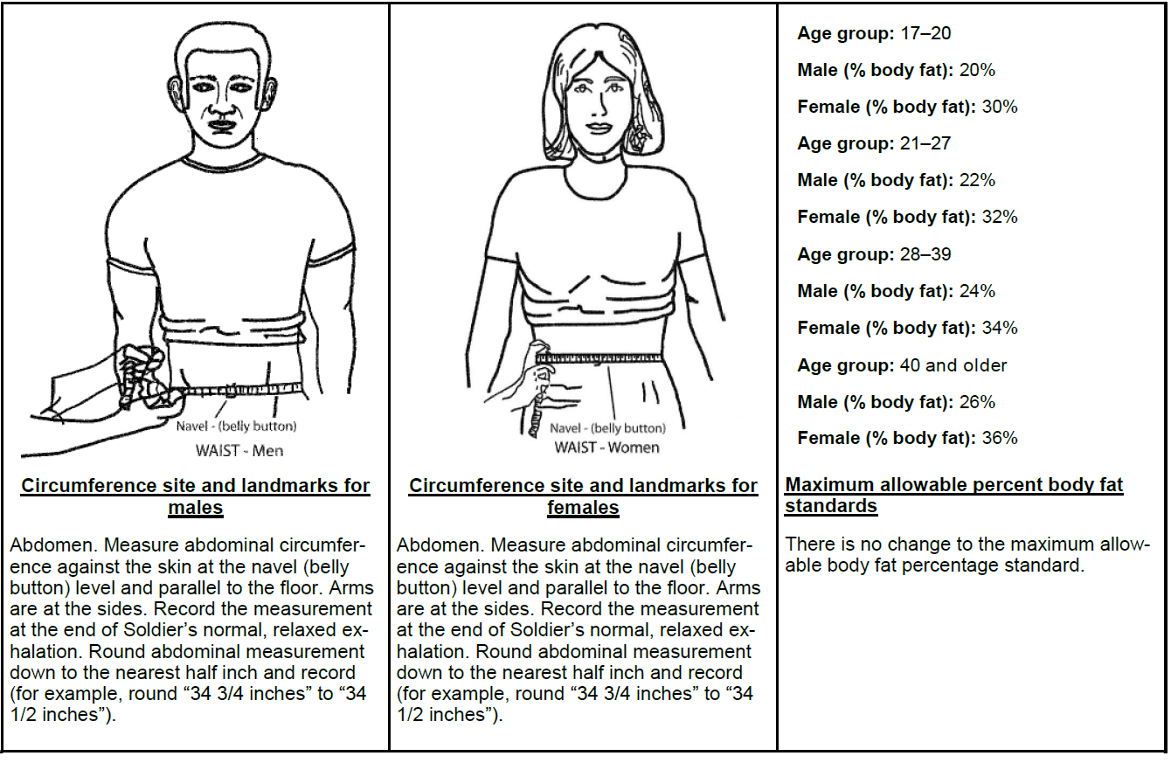
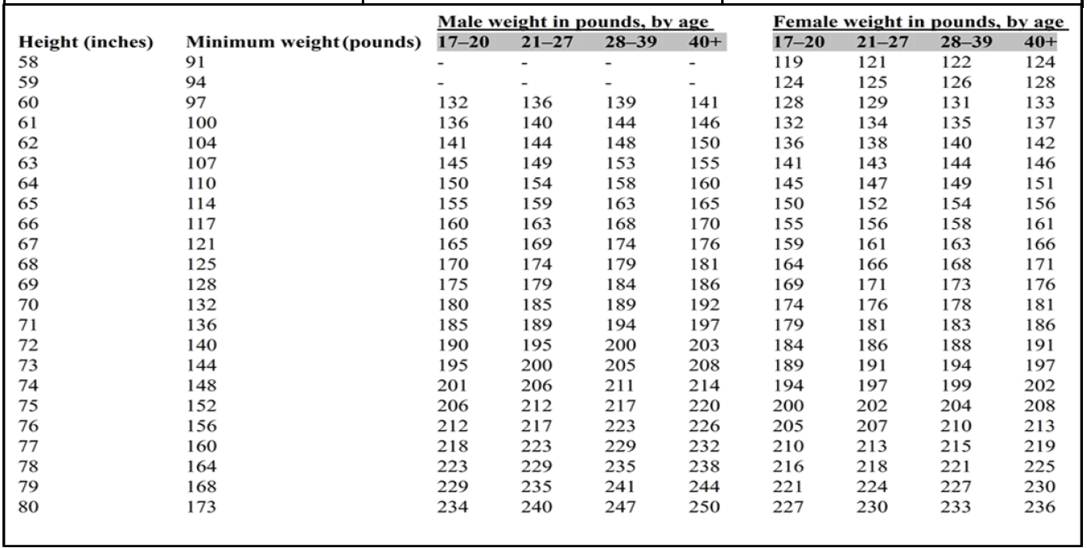
THE
IG UPDATE
Volume 23-03, July 2023
Guidance on Army Body Fat Assessment for the Army Body Composition Program

