Slide 1
1
1
2
2
3
3
24” Suspension Web
Connector Snap
D-Ring

Slide 2
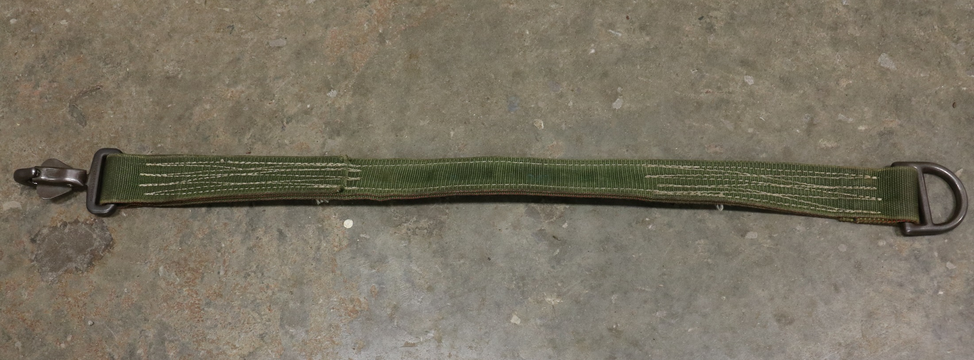
2
3
1
24” Suspension Web
Connector Snap
D-Ring

Slide 3
5k and 10k Cargo Nets

Slide 4
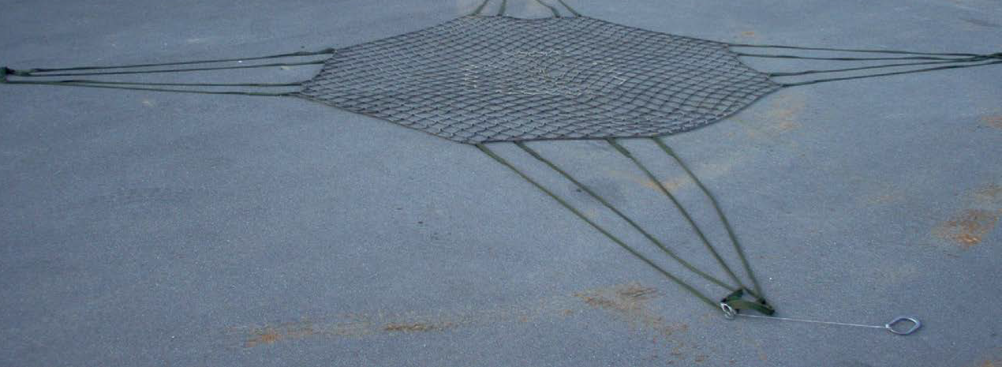
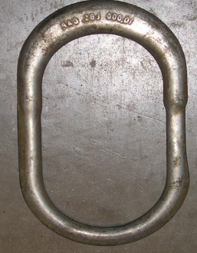
5,000 LBS Cargo Net
1
5
2
4
3
5,000 LBS Cargo Net- Rated capacity: 5,000 lbs- Size: 15 ft x 15 ft. Mesh size: 6 in x 6 in
Lifting Leg
Hook
Net Apex Fitting- Rated capacity: 10,000 lbs
Load Zone- Size: 5 ft x 5 ft.

Slide 5
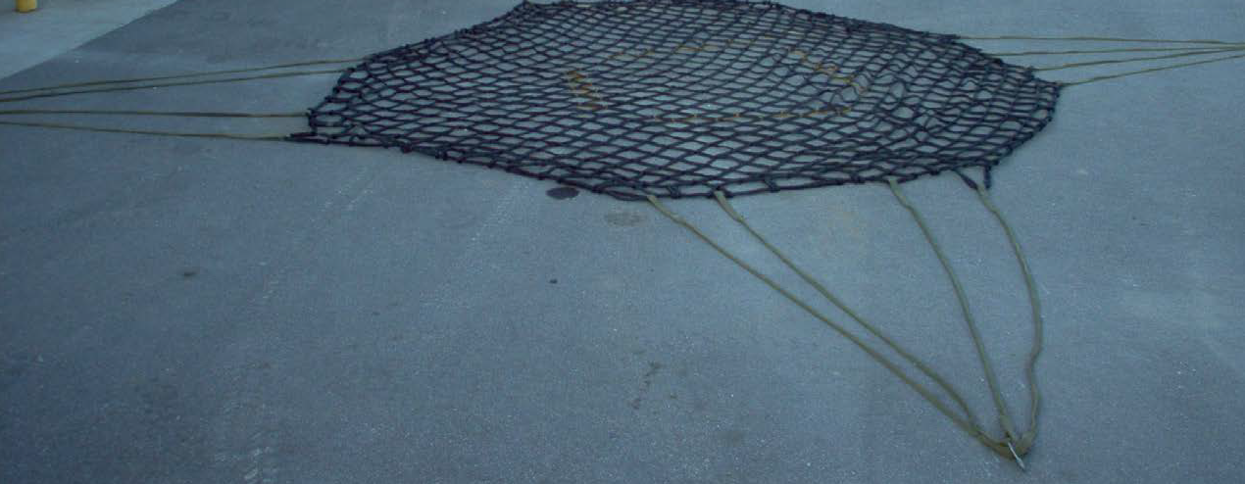
10,000 LBS Cargo Net
4
1
3
2
1. 10,000 LBS Cargo Net- Rated capacity: 10,000 lbs- Size: 18 ft x 18 ft. Mesh size: 7.5in x 7.5 in
2. Lifting Leg
3. Hook
4. Load Zone. Size: 6 ft x 6 ft

Slide 6
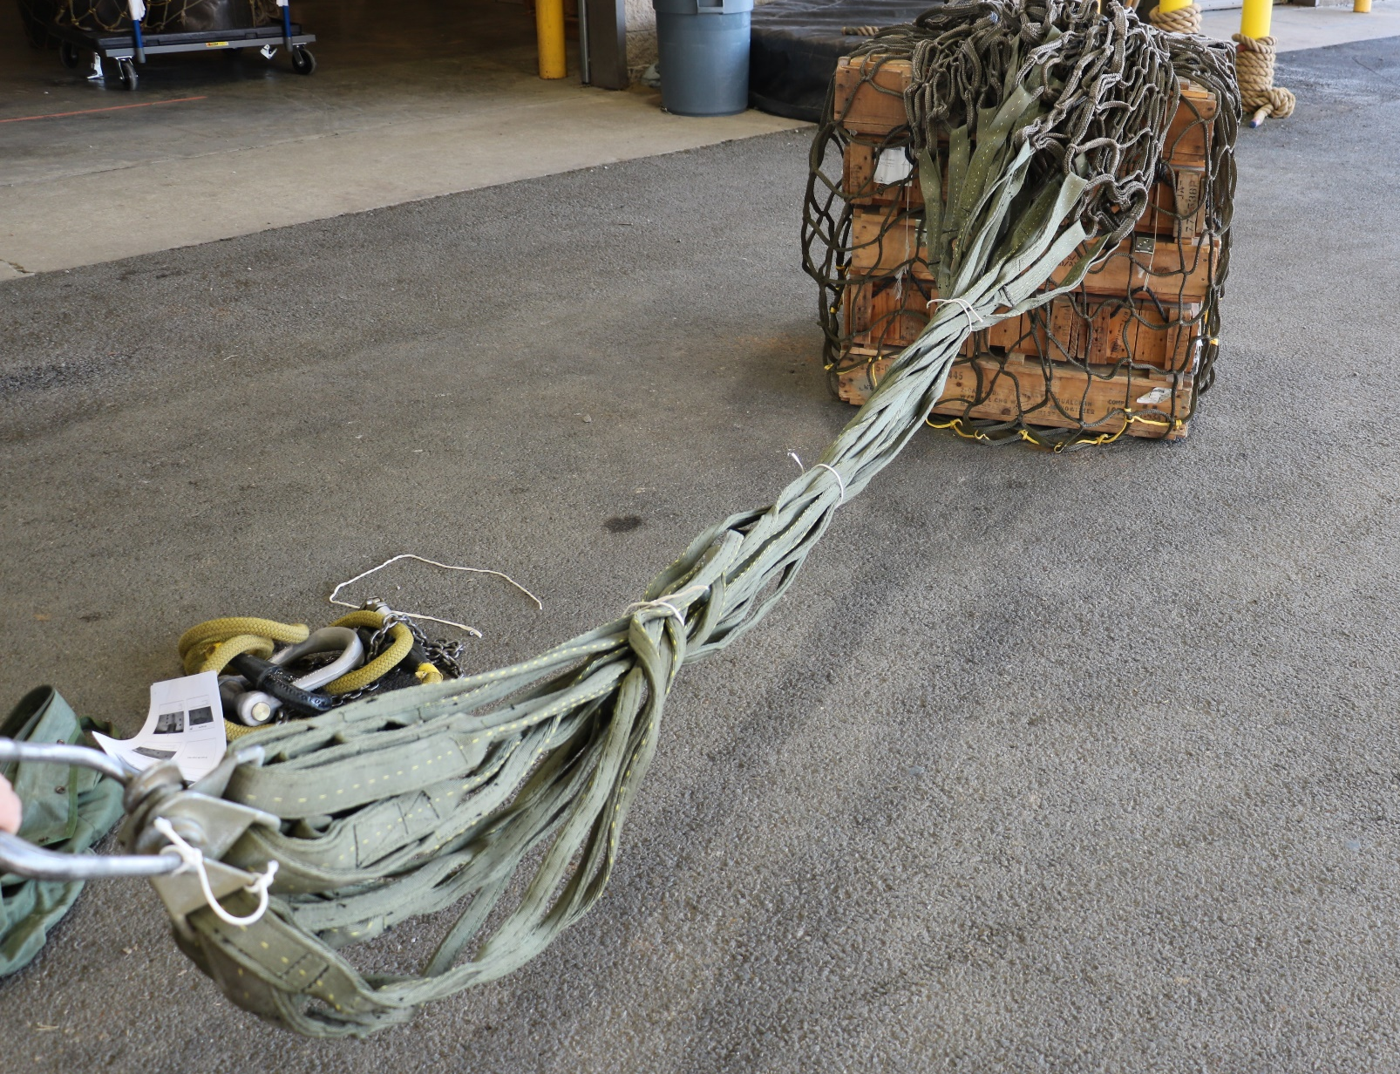
3
1
4
2
Net Apex Fitting
Hooks
Breakaway Tie
Lifting Legs

Slide 7
3
1
2
Net Apex Fitting
Net Apex Tether Cord
Hook (Hooks must be taped, tape omitted in picture to show entire hook)

Slide 8
M1101 TRAILER

Slide 9
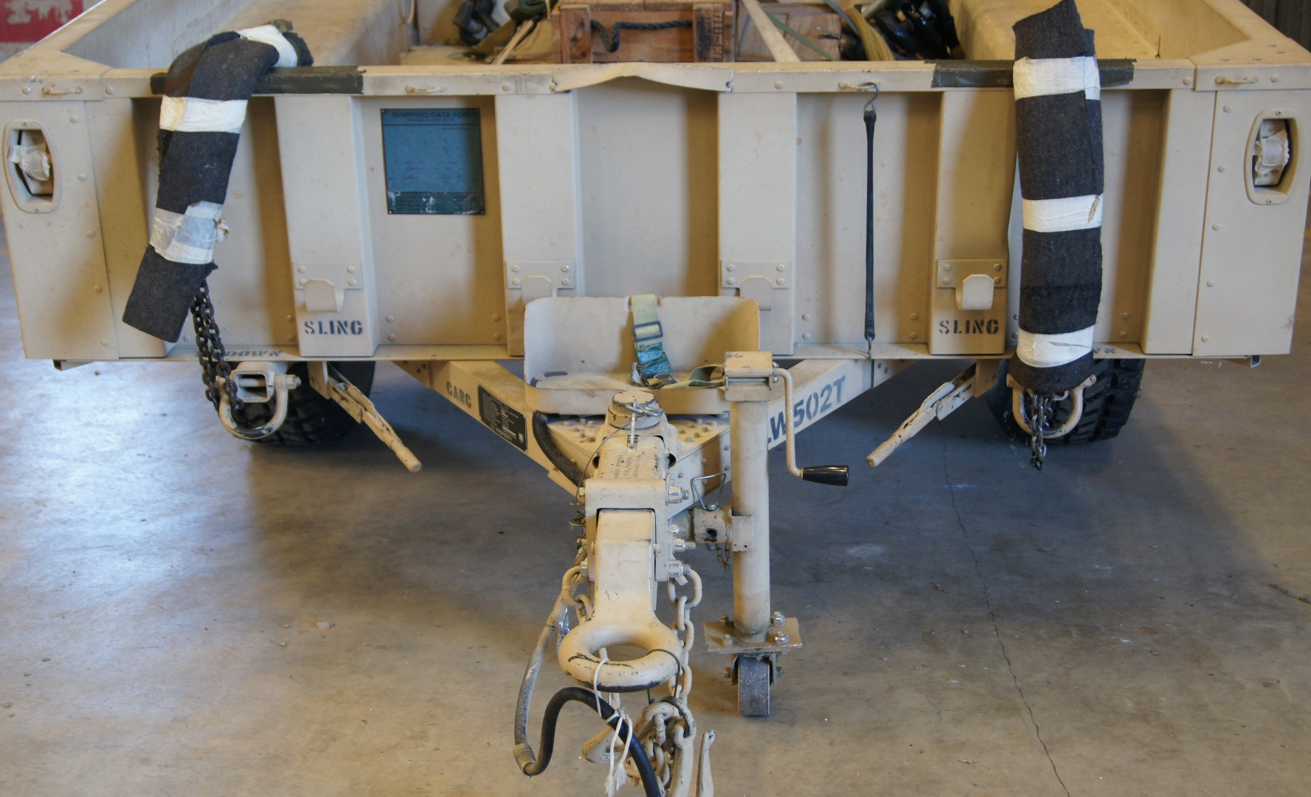
6
1
4
2
3
5
Cattle Hair Felt
Parking Brake
Lunette
Front Jack
Safety Chains
Data Plate

Slide 10
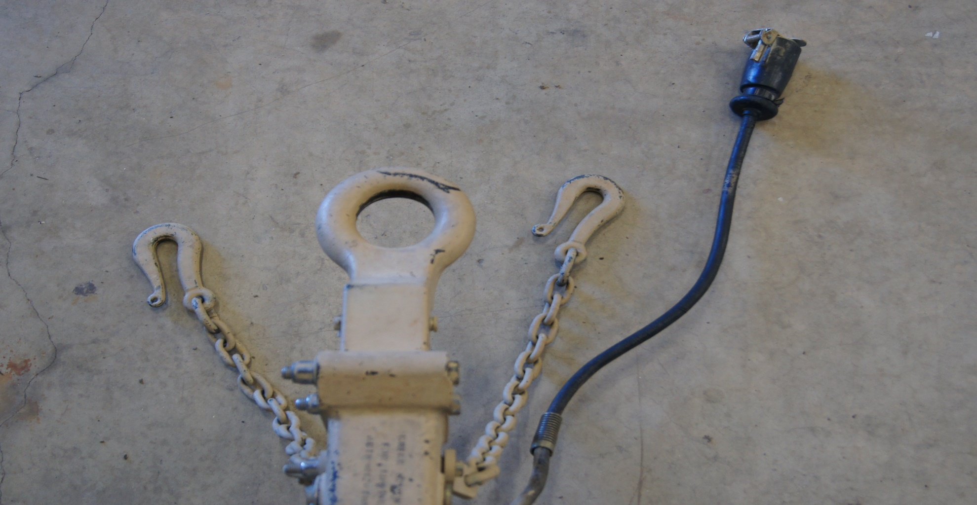
2
3
1
Lunette
Safety Chains
Light Cable

Slide 11
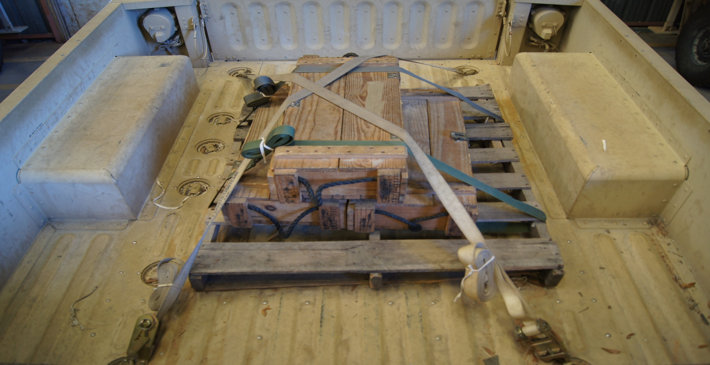
3
2
1
CGU-1/B
A7A Strap
Load

Slide 12
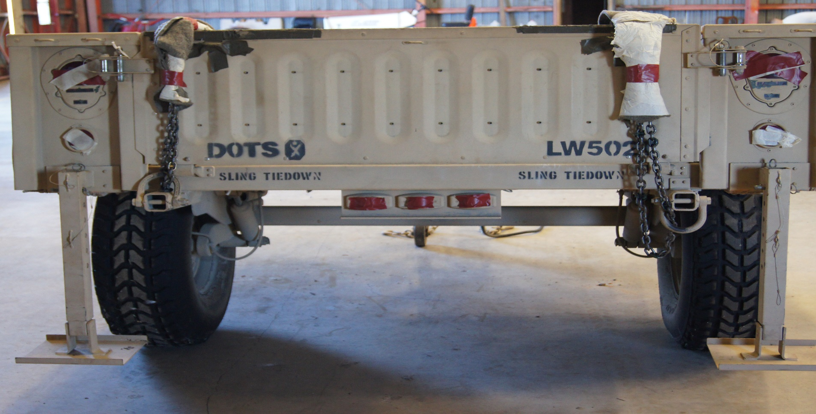
2
3
1
Stabilizer Leg
Cattle Hair Felt
Tailgate Latch

Slide 13
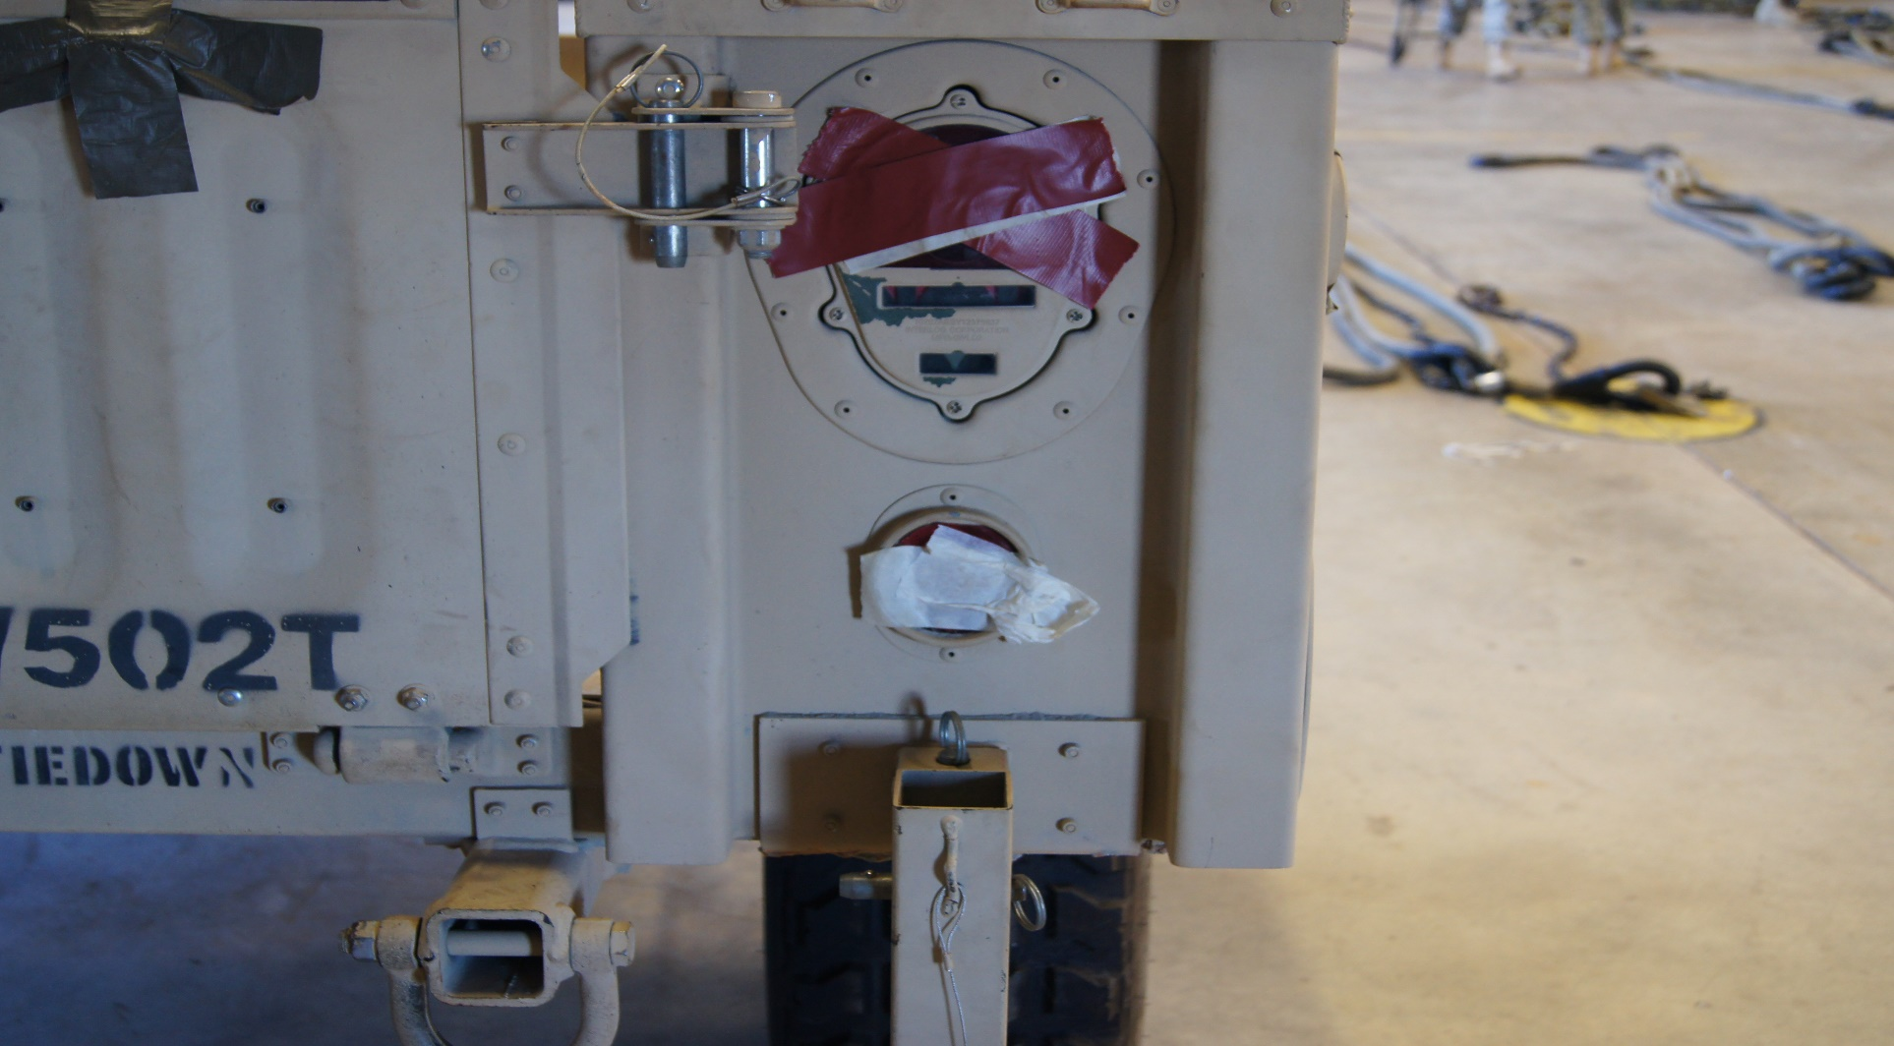
2
1
3
1
Manufactured Pin
Tailgate Latch
Stabilizer Leg

Slide 14
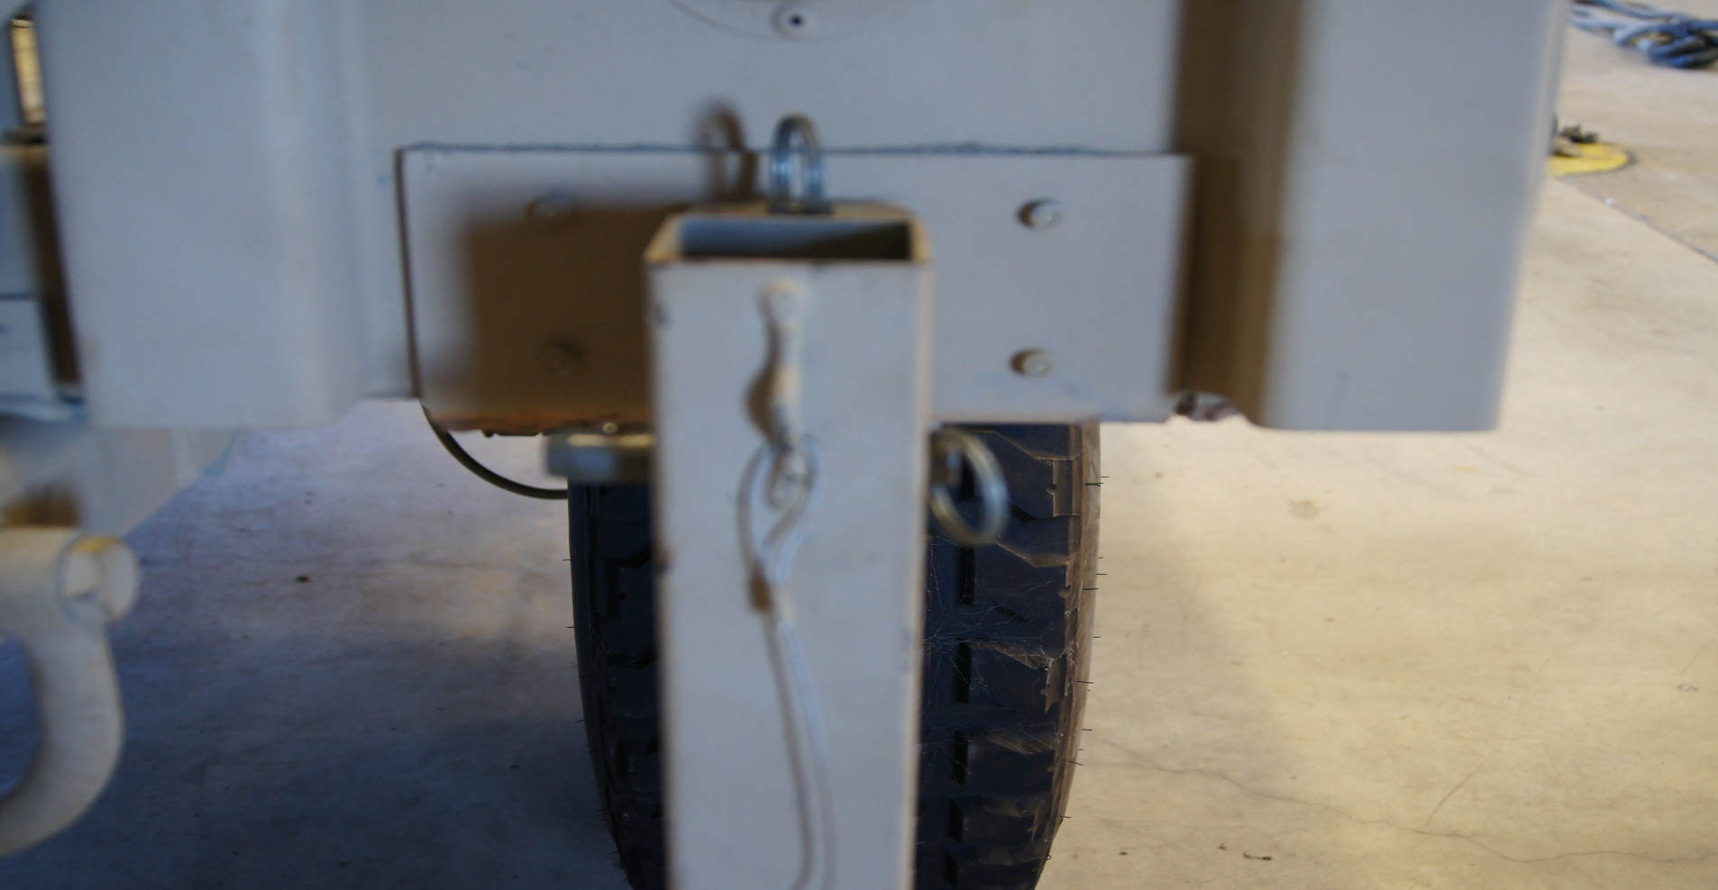
2
1
Stabilizer Leg
Manufactured Pin

Slide 15
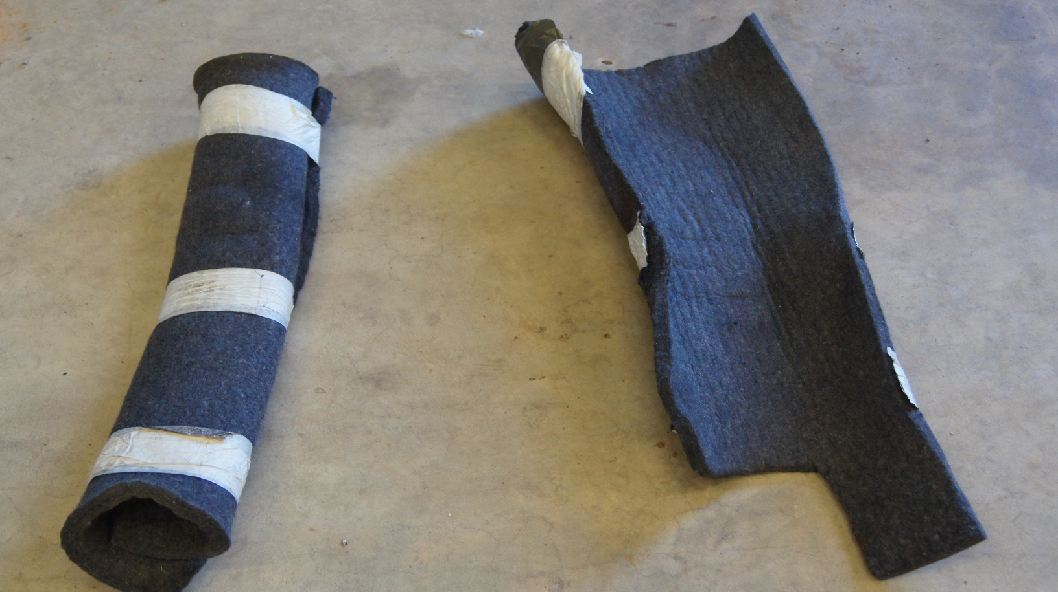
1
1. Cattle Hair Felt

Slide 16
M1151

Slide 17
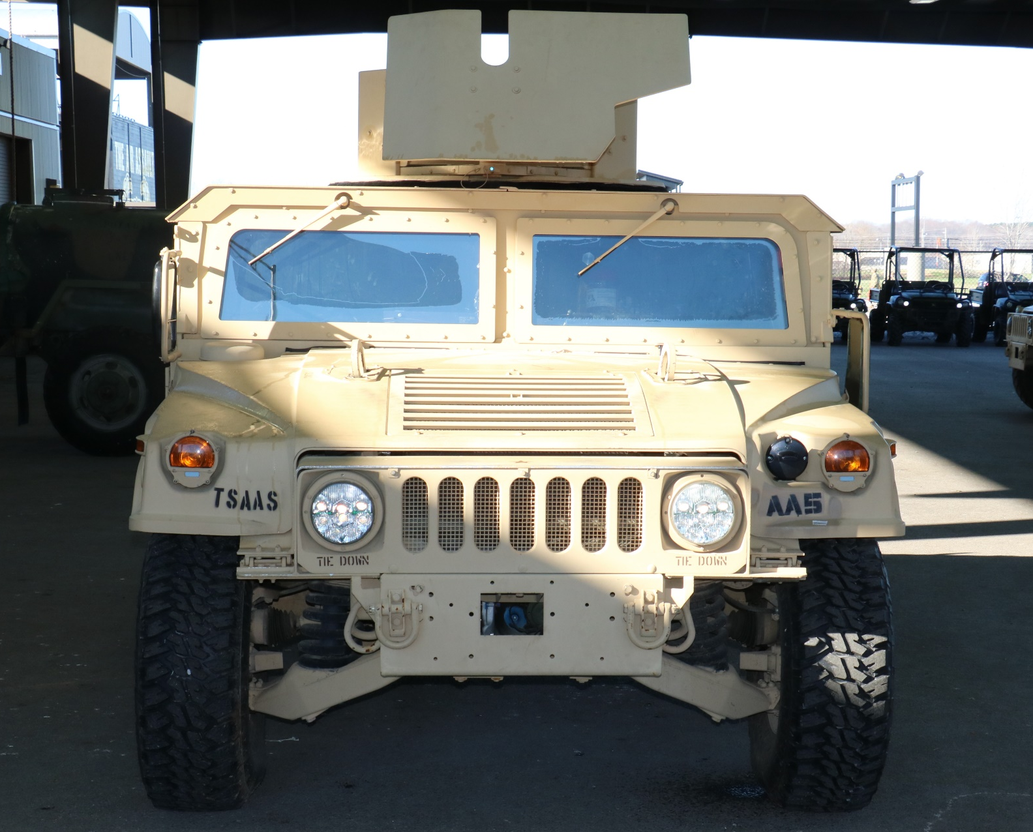
1
2
Turret
Wheels

Slide 18
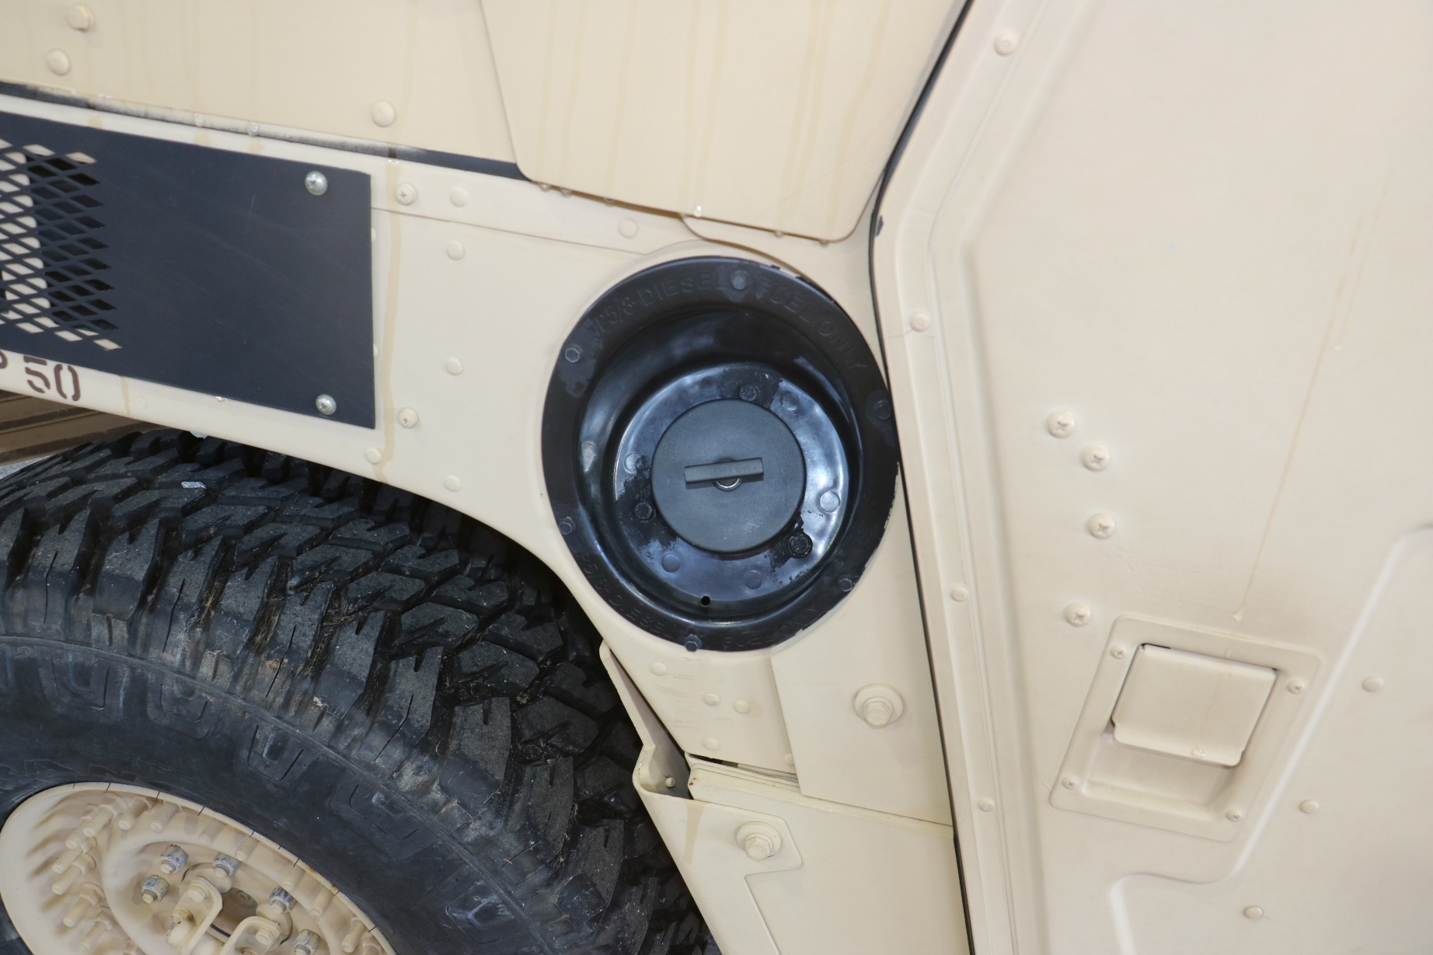
1
Fuel Cap

Slide 19
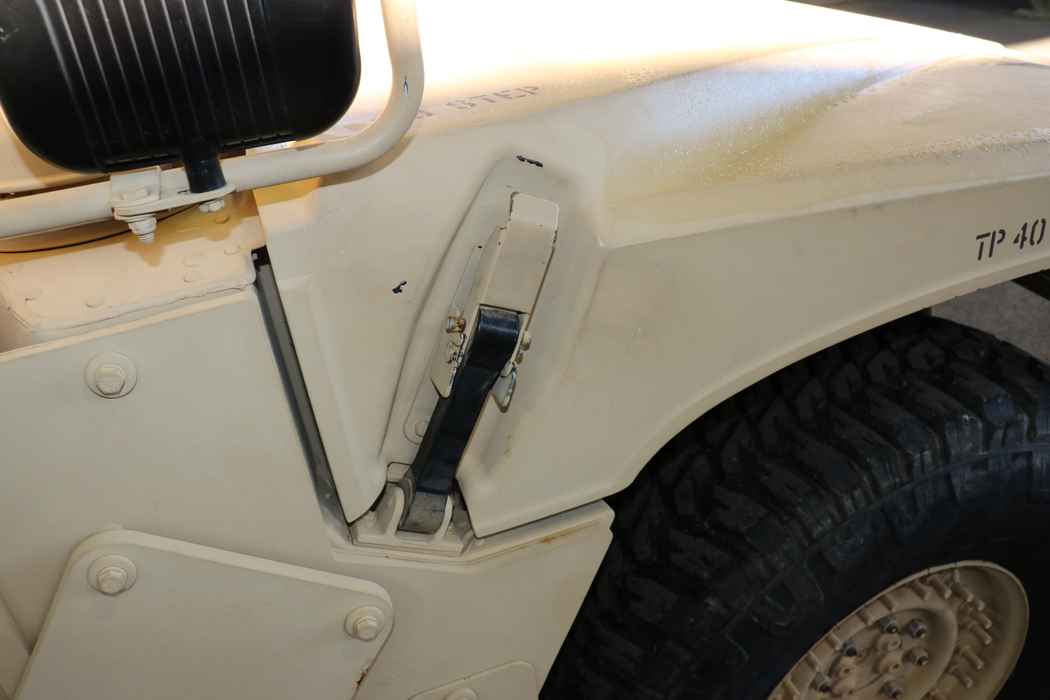
1
2
Hood Latch
Wheels

Slide 20
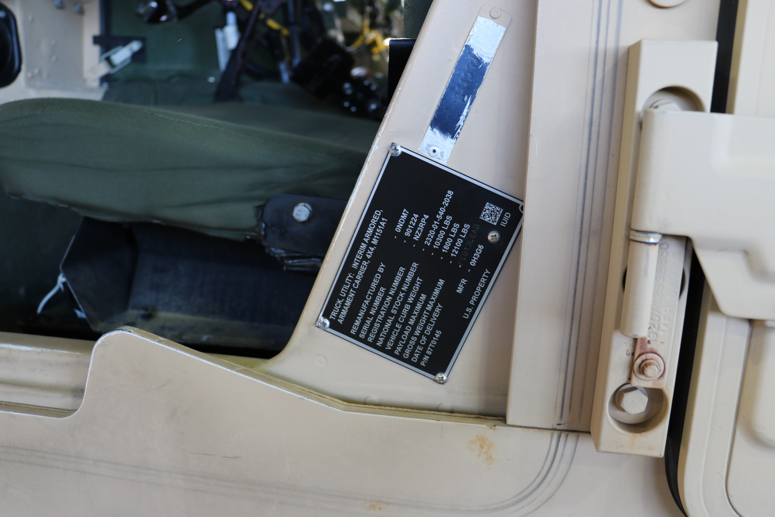
1
Data Plate

Slide 21
1
2
3
4
Instrument Cluster
Steering Wheel
Cable
Lock

Slide 22
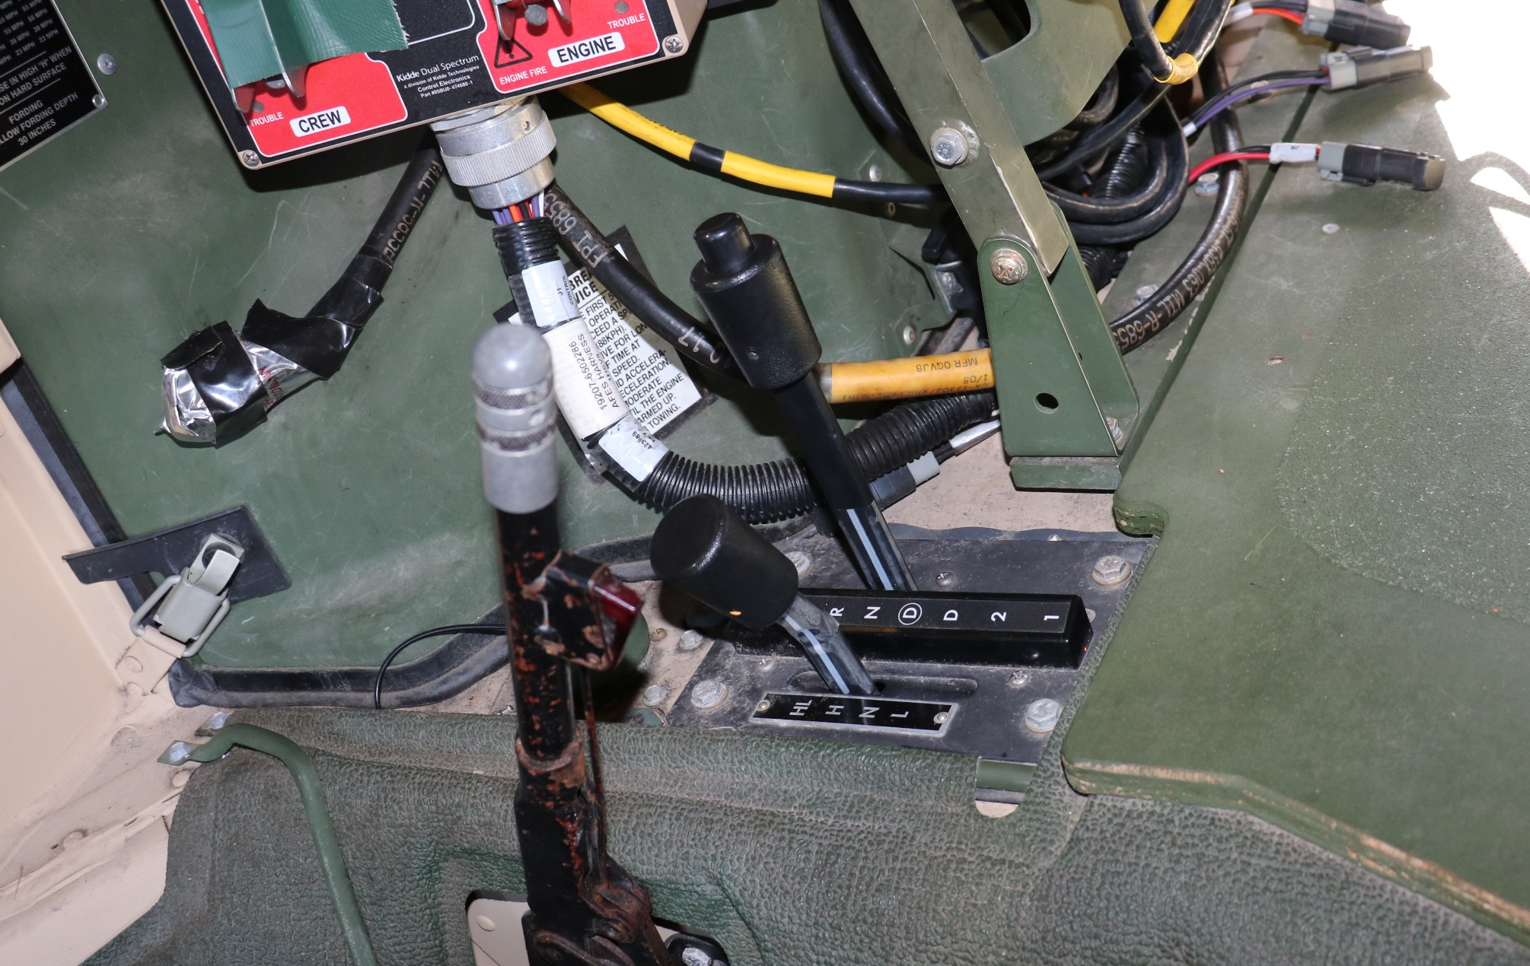
1
1
3
2
Engine Cover Latch
Parking Brake
Transmission Selector

Slide 23
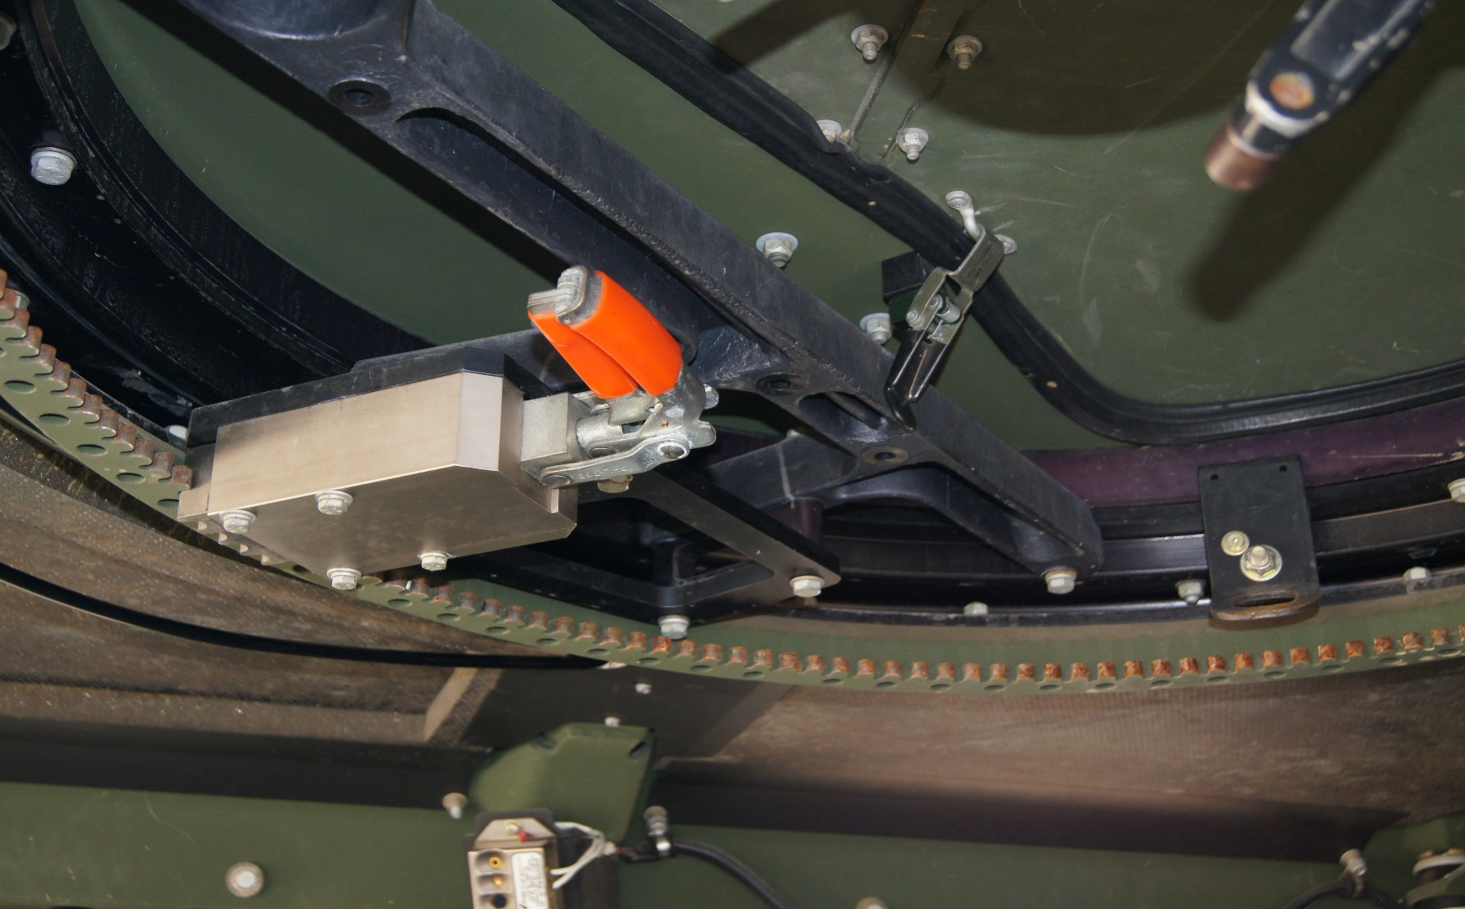
1
1. Turret Lock

Slide 24
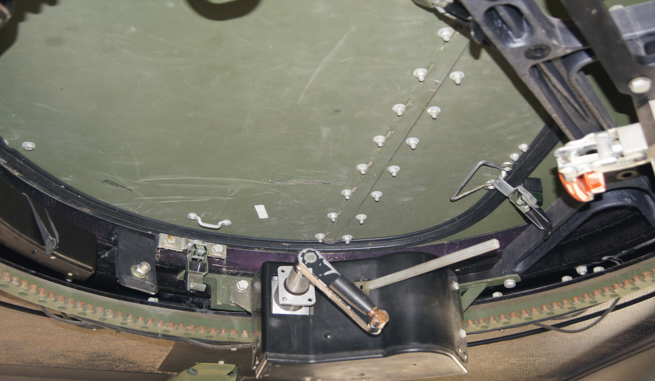
1
3
2
Turret Latch
Turret Handle
Turret Lock

Slide 25
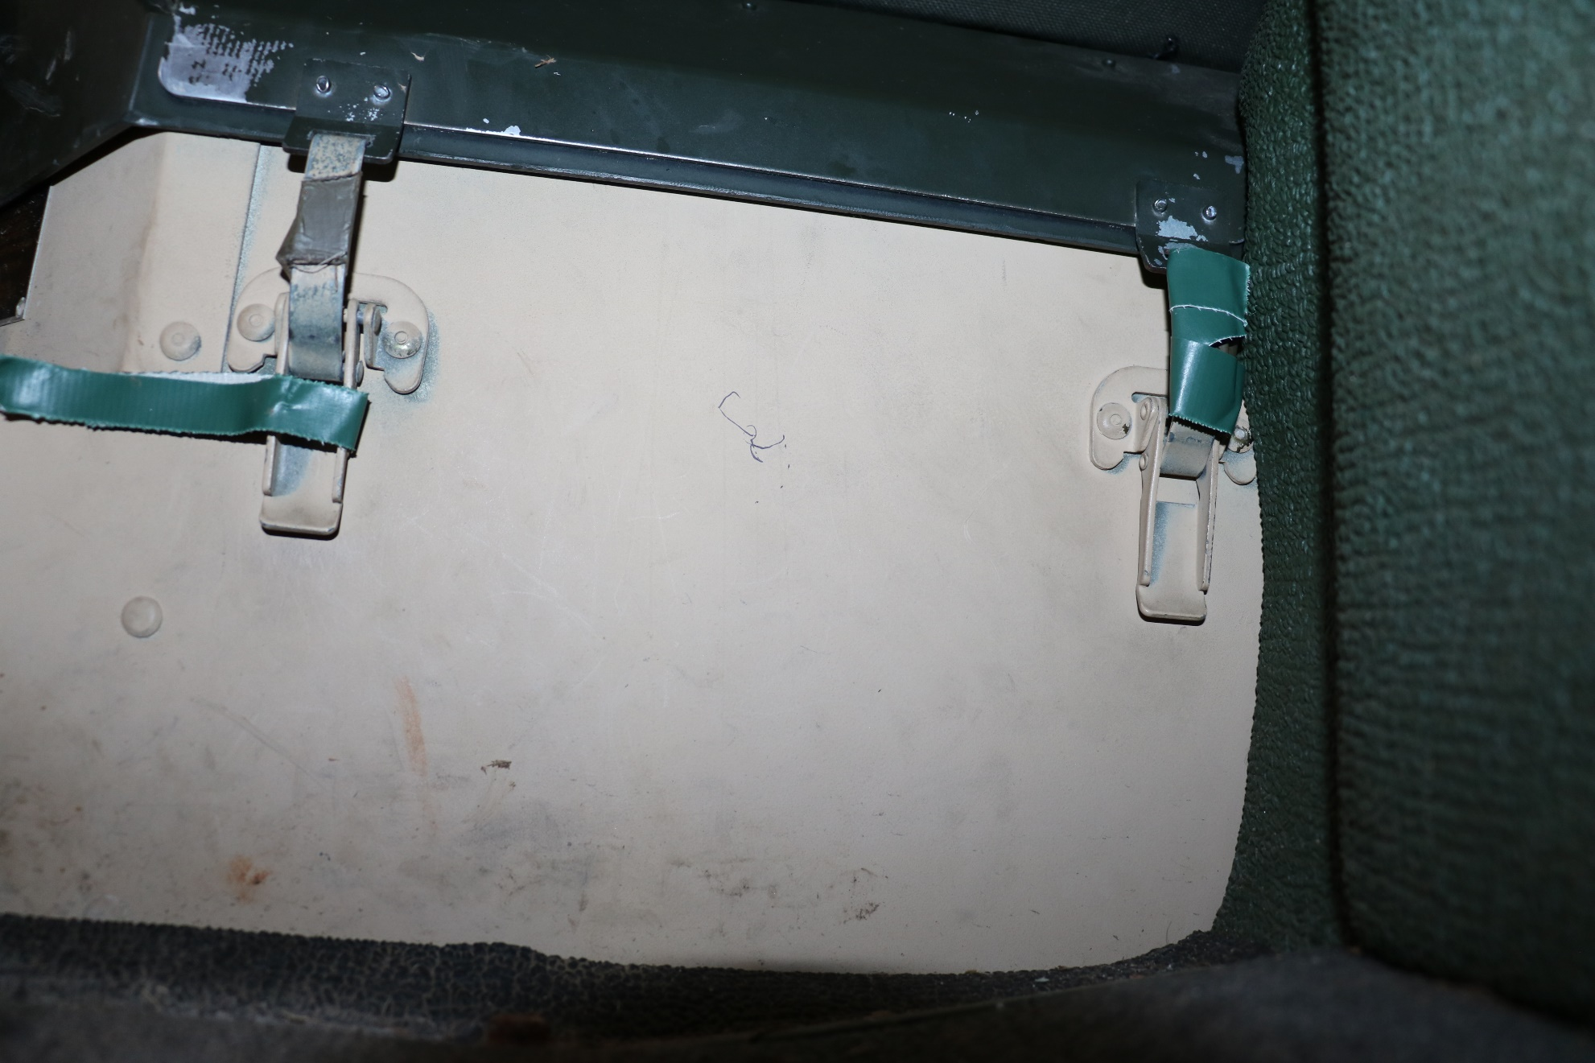
1
Battery Box Latch (under passenger seat)

Slide 26
Triple Blivets

Slide 27
4
1
3
2
Bezel Ring
Fuel Nozzle
5/8” Screw Pin Clevis
Cluster Breakaway

Slide 28
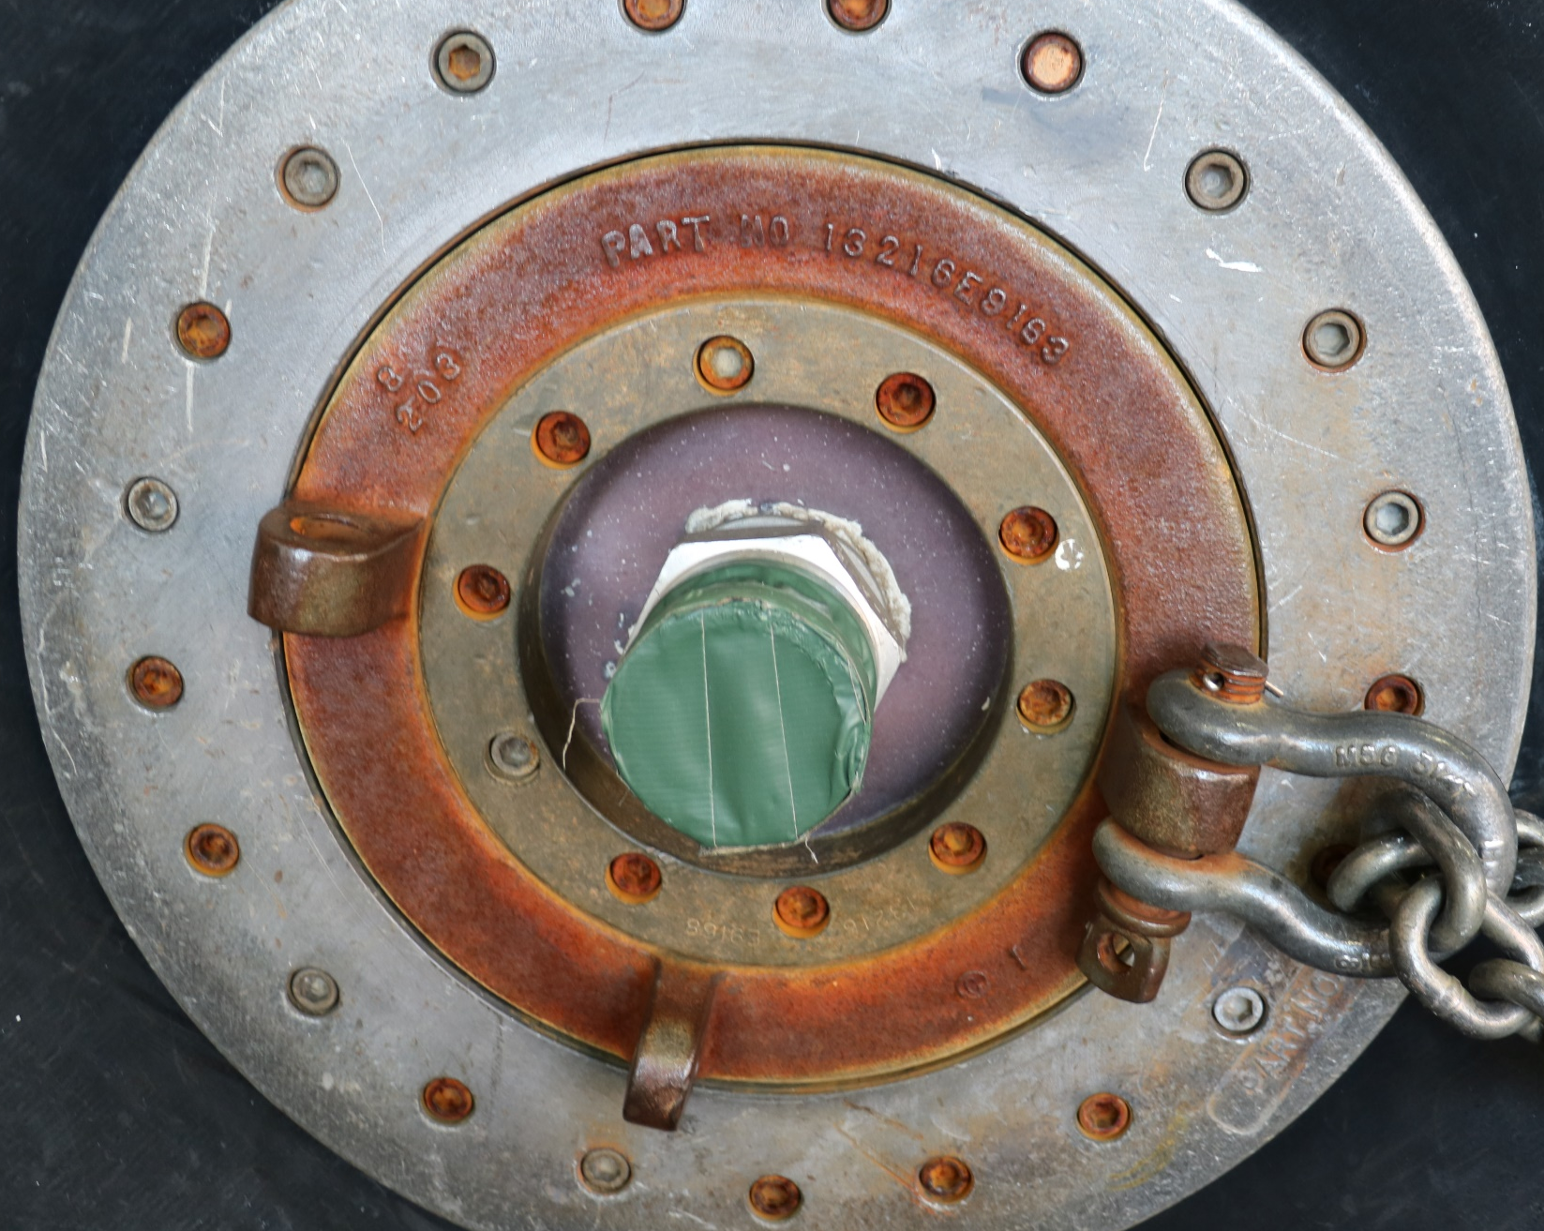
1
3
4
2
Bezel Ring
Fuel Nozzle (Covered with 2in Tape)
Cotter Pin
5/8” Screw Pin Clevis

Slide 29
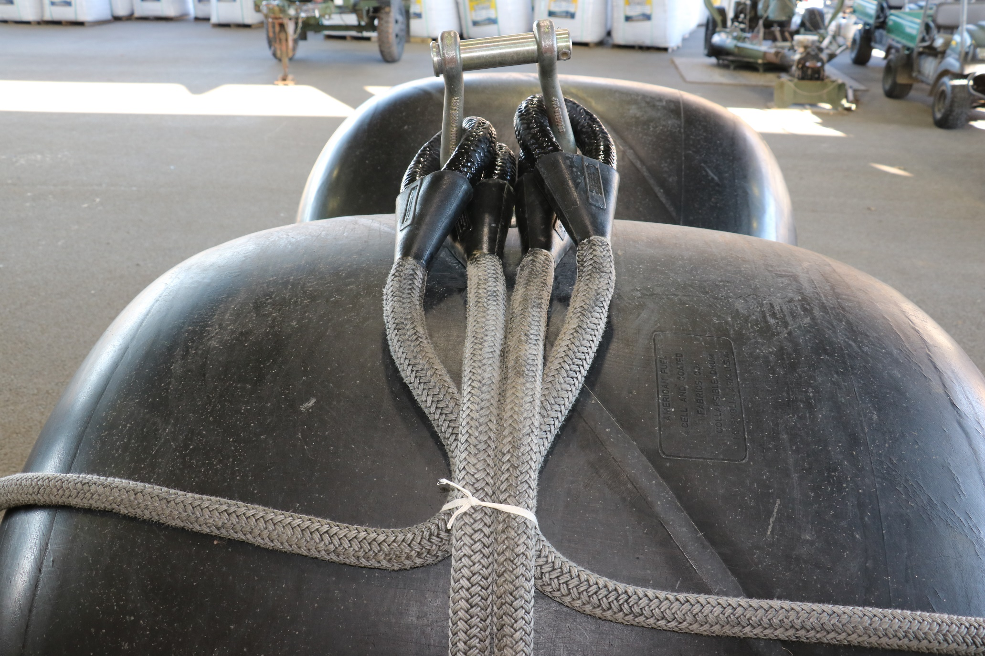
1
Cluster Breakaway

Slide 30
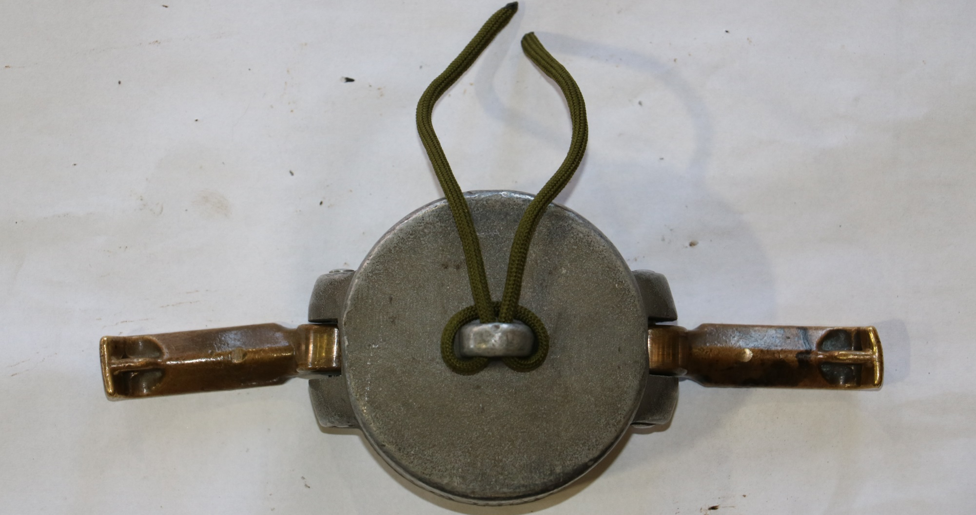
1
Fuel Cap

