Slide 1
The U.S. Army Pathfinder School
Nomenclature

Slide 2
Common Sling Load Equipment Note: Students are required to know both proper nomenclature and all rated capacities. Information (in parenthesis) is not testable.

Slide 3
Aerial Delivery Sling Type XXVI Multi-Loop Line
Rated capacity
# of loops | Pendant | Lifting Provision
2 | 8,900 lbs | 5,600 lbs
3 | 13,500 lbs | 8,500 lbs
4 | 17,800 lbs | 11,200 lbs
6 | 27,000 lbs | 17,000 lbs

Slide 4
Aerial Delivery Sling Type XXVI Multi-Loop Line
Lengths
# of loops | Lengths Available
2 | 3’, 9’, 11’, 12’, 16’, 20’, and 120’
3 | 60’ and 140’
4 | 3’, 9’, 11’, 12’, 16’, 20’, and 28’
6 | 60’ and 120’

Slide 5
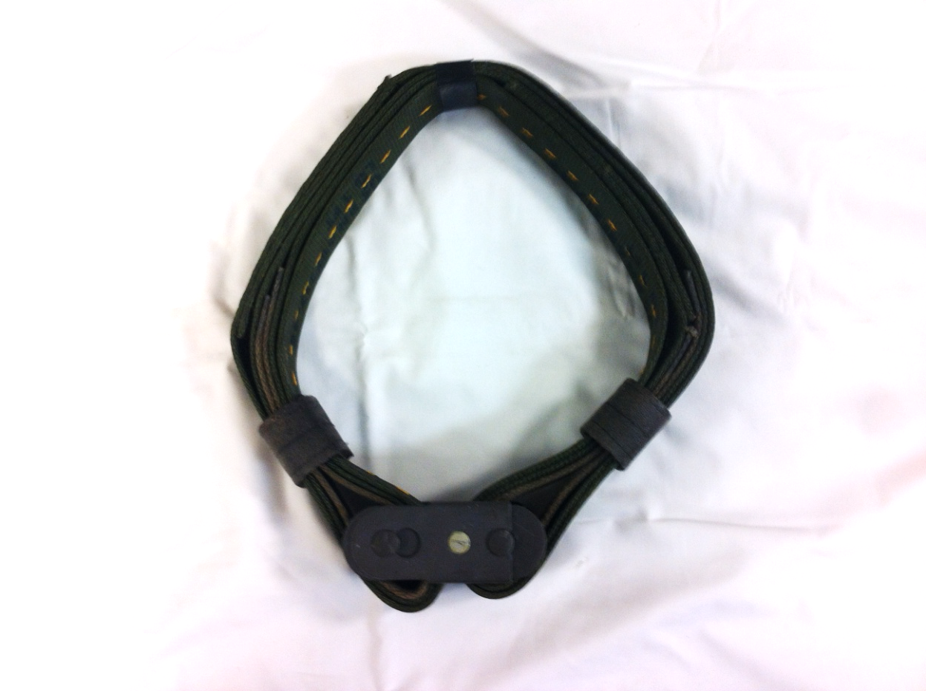
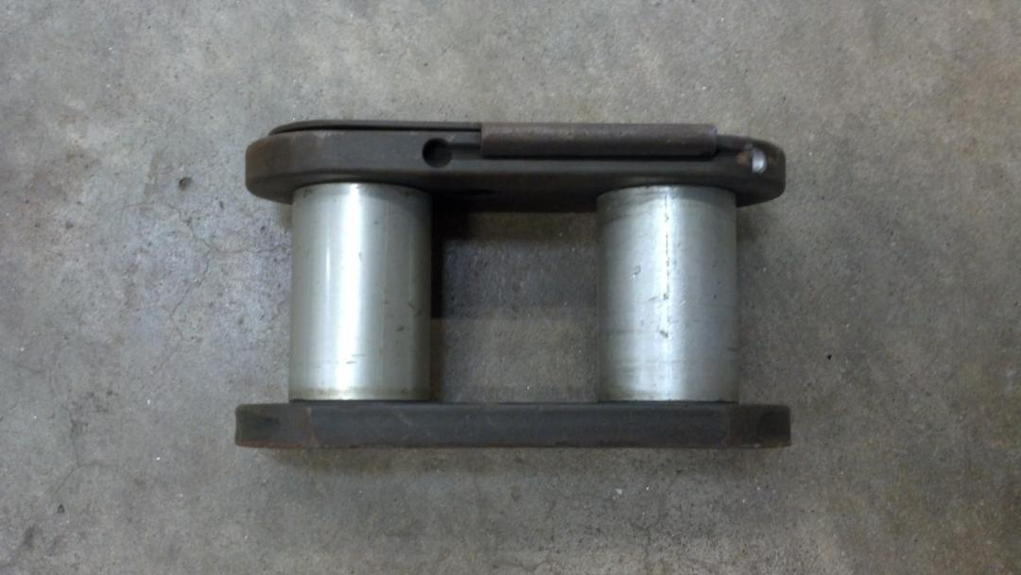
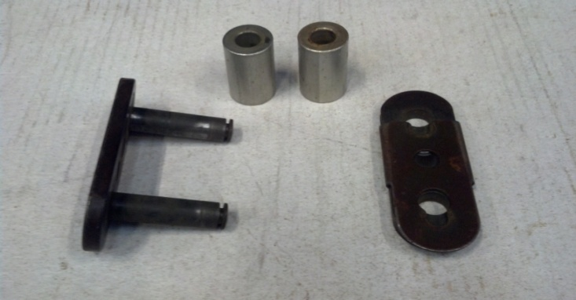
3 Foot Apex Ring or Donut Ring (Aerial Delivery Sling with Type IV Connector Link)
1
3
4
5
2
3 Foot Apex Ring or Donut Ring-Rated capacity: 10,000 lbs
Type IV Connector Link-Rated capacity: 12,500 lbs
Base Plate
Aluminum Buffers
Locking Plate
Cotton Buffer
6

Slide 6
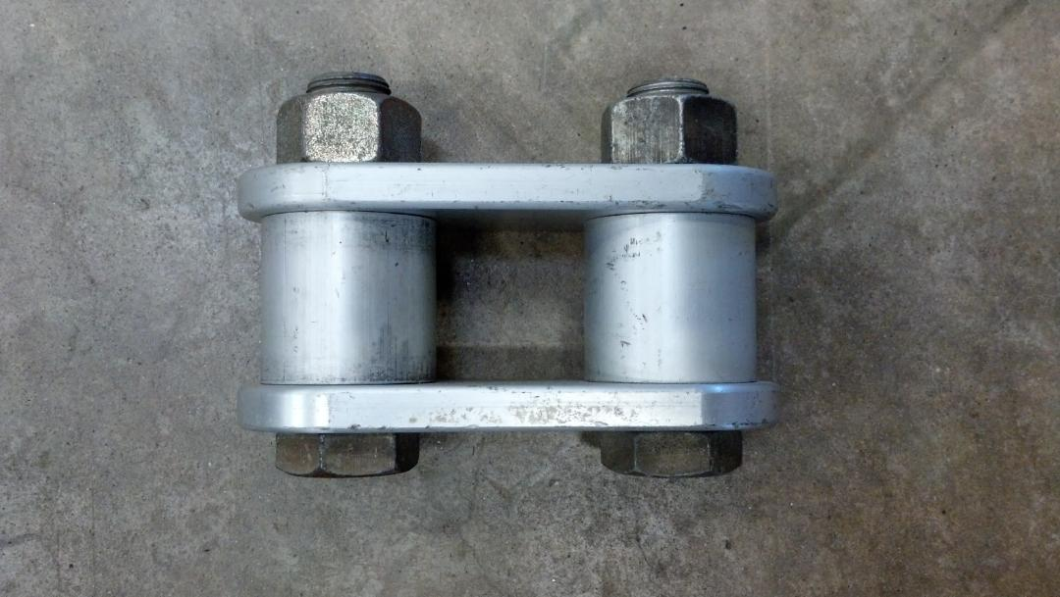
Two Point Link Assembly
1
1. Two Point Link Assembly- Rated capacity: 25,000 lbs

Slide 7
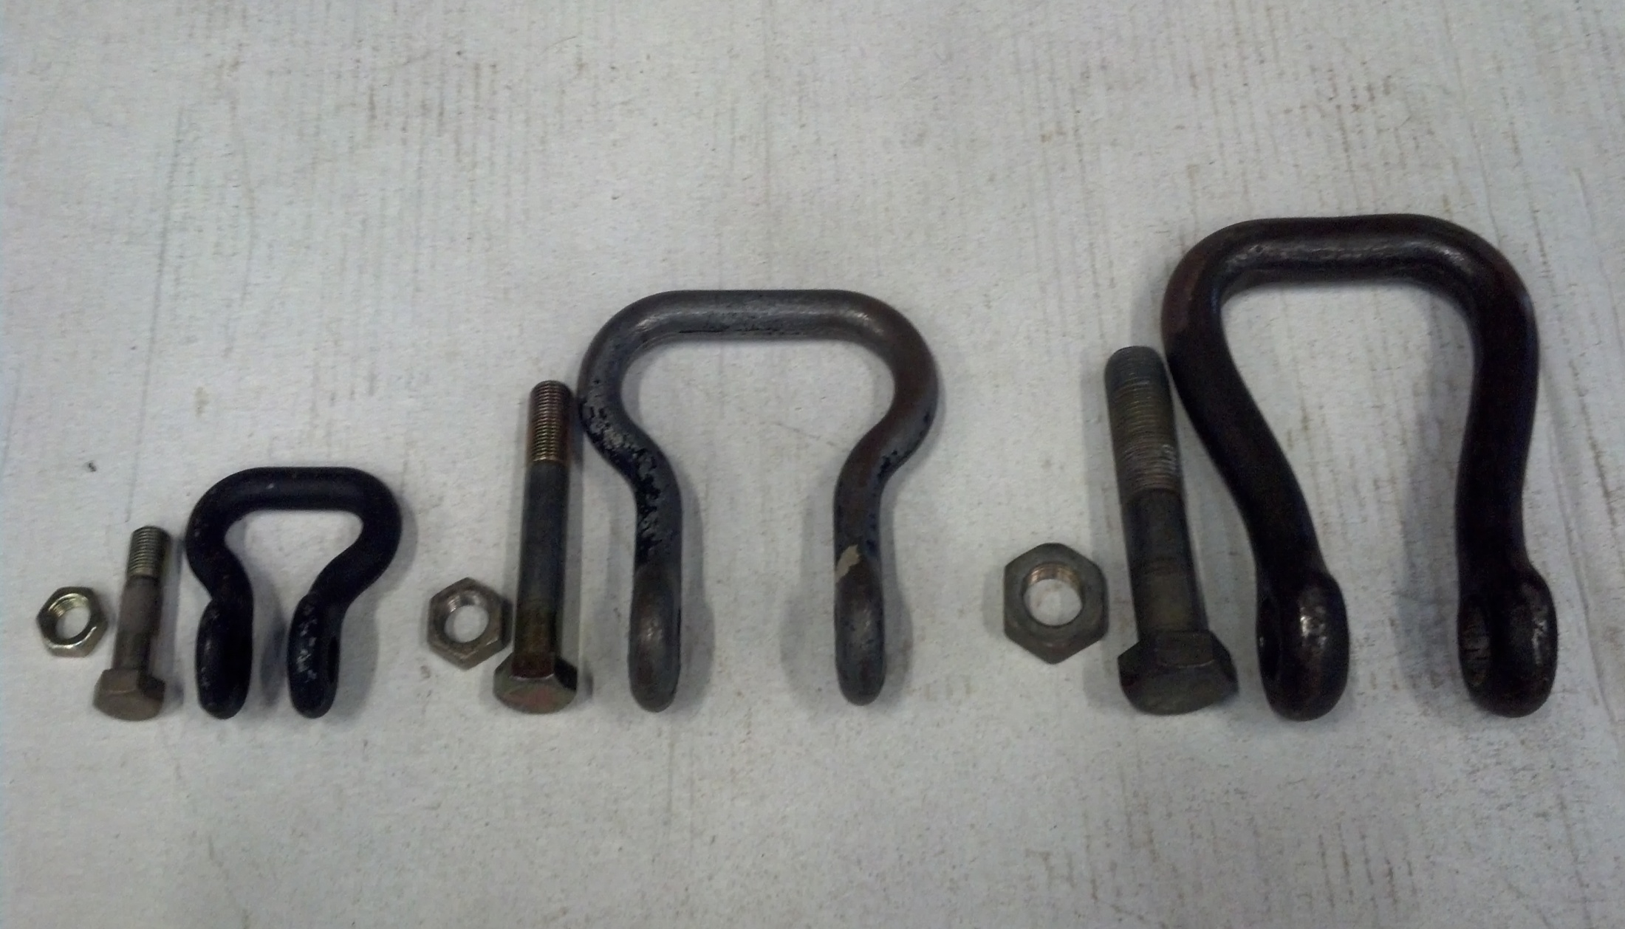
Suspension Clevises
3
2
1
4
5
5
5
4
4
Small Suspension Clevis- Rated capacity: 6,250 lbs, Lifting provision: 3,750 lbs
Medium Suspension Clevis- Rated capacity: 6,250 lbs, Lifting provision: 3,750 lbs
Large Suspension Clevis- Rated capacity: 12,500 lbs, Lifting provision: 7,875 lbs
Nut
Bolt

Slide 8
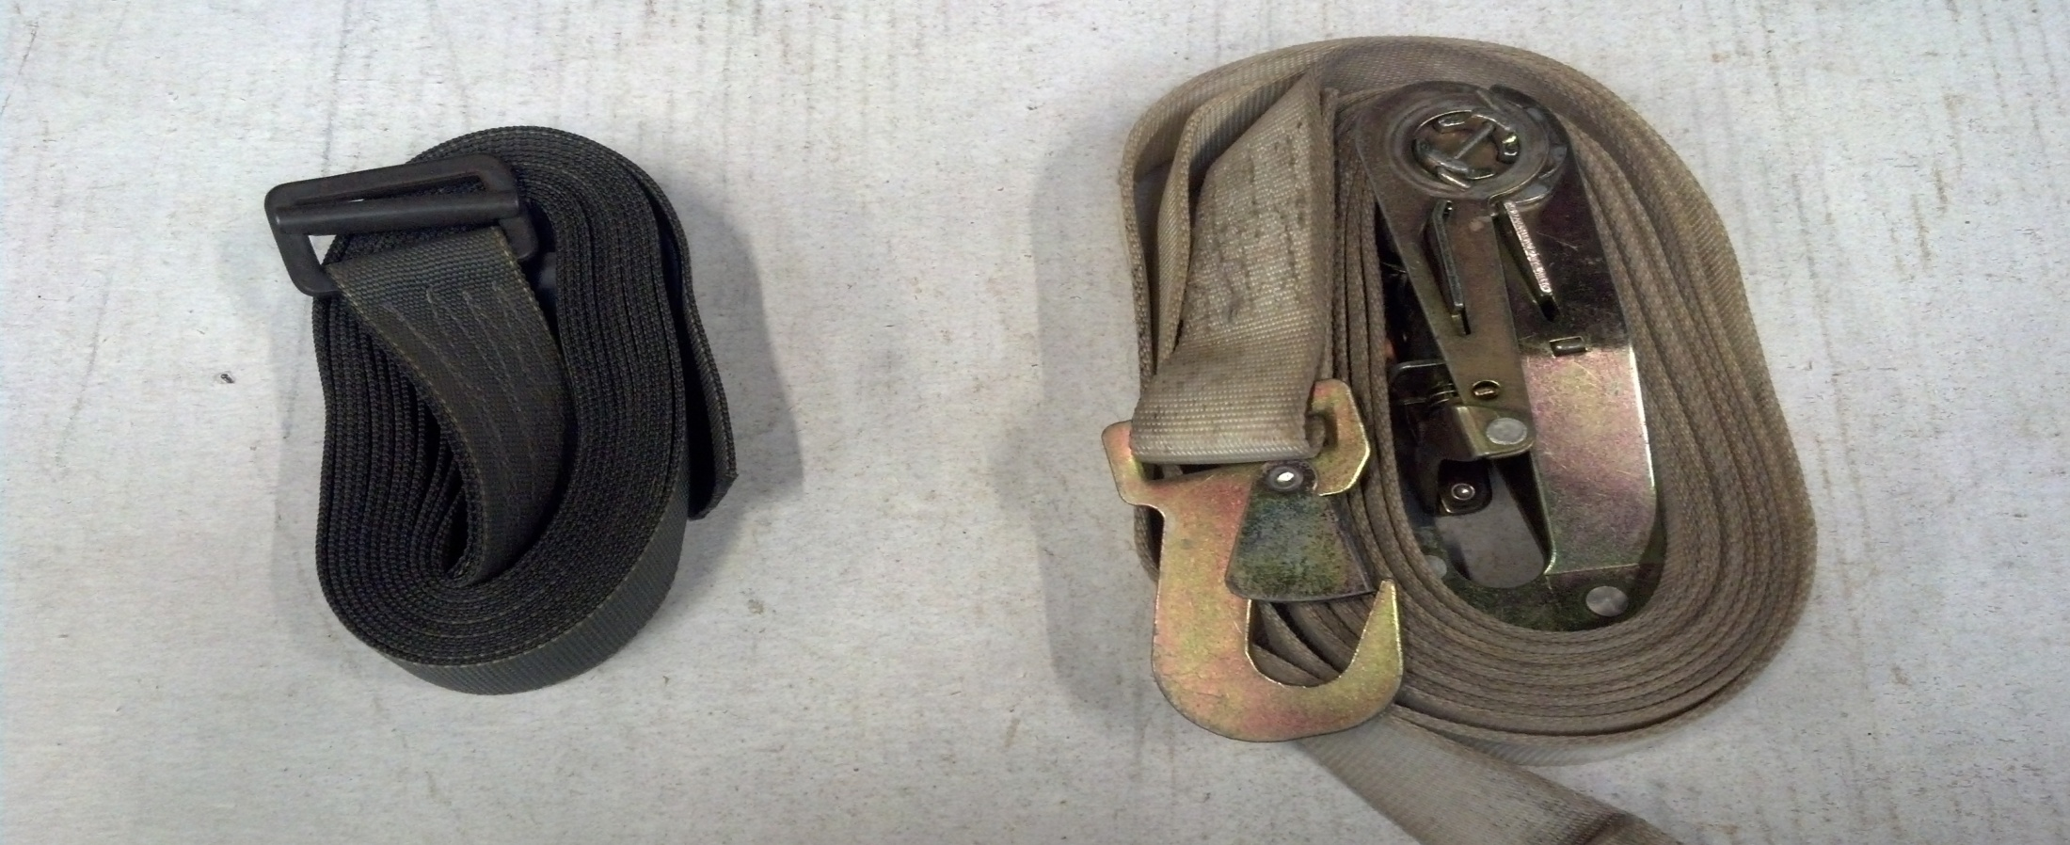
Cargo Tie-Down Equipment
1
2
3
A7A Strap- Rated capacity: 500 lbs
Friction Adapter
CGU-1/B- Rated capacity: 5,000 lbs

Slide 9
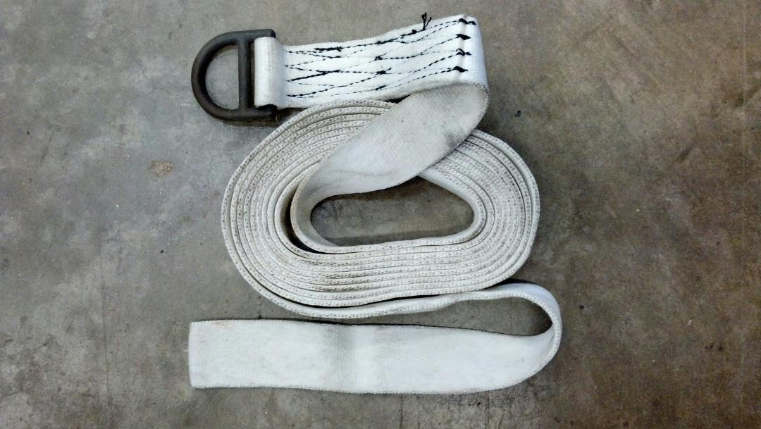
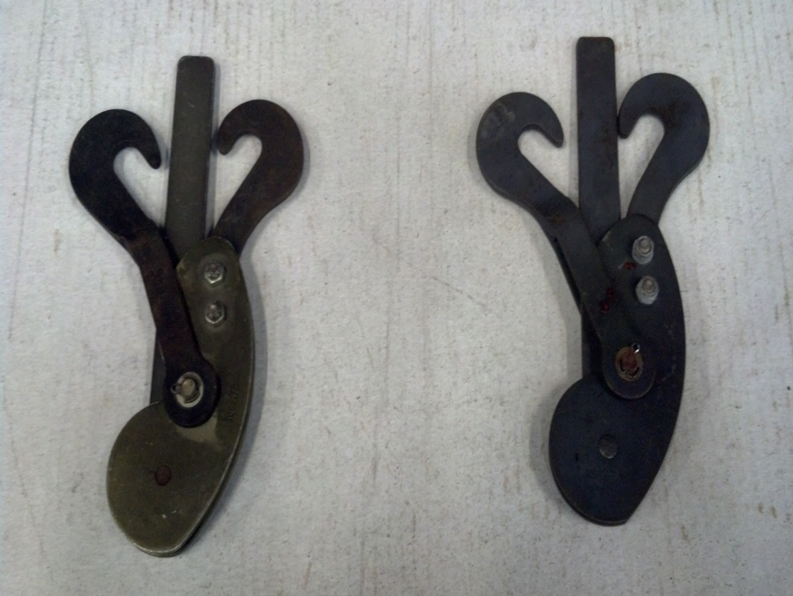
Cargo Tie-Down Equipment
1
4
2
3
15 Foot Tie-Down Strap (Dacron Lashings)- Rated capacity: 10,000 lbs
D-Ring
Silver Load Binder- Rated capacity: 5,000 lbs
Black Load Binder- Rated capacity: 10,000 lbs

Slide 10
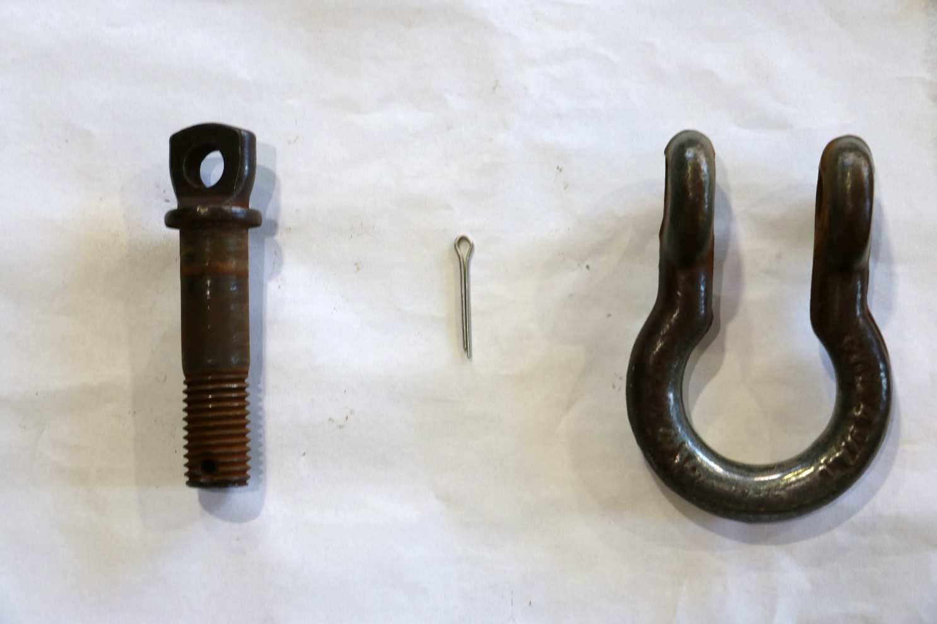
Cargo Tie-Down Equipment
1
3
2
Screw Pin
Cotter Pin
5/8in Screw Pin Clevis- Rated Capacity: 4,420 lbs

Slide 11
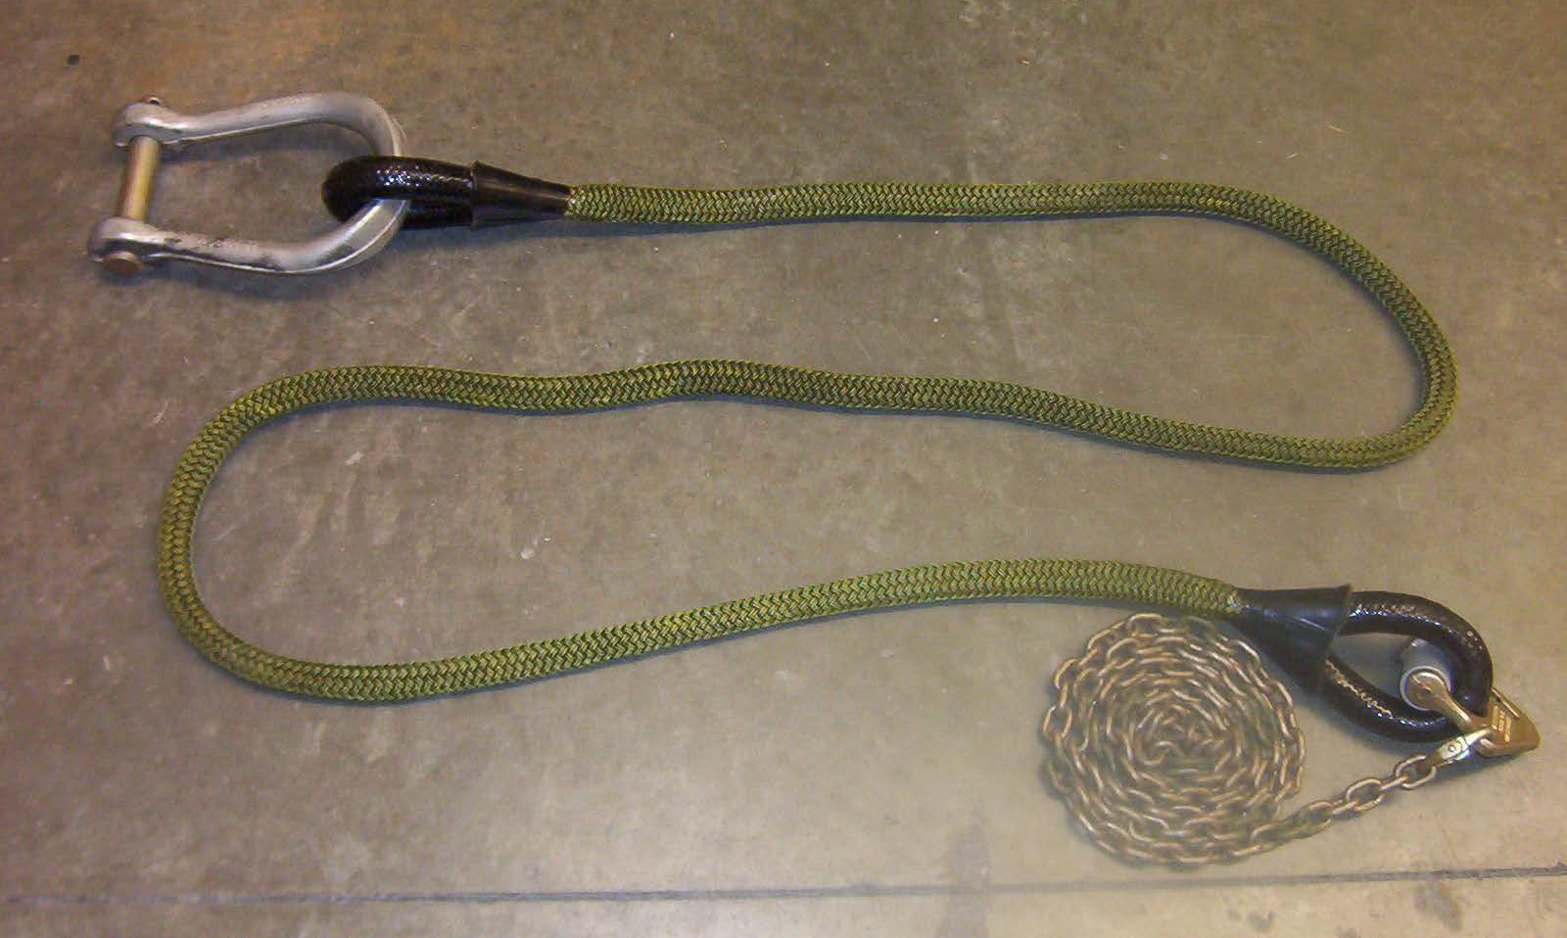
10,000LBS Sling Leg
4
1
3
2
10,000 lbs Apex Fitting- Rated capacity: 10,000 lbs
10,000 lbs Sling Leg- Rated capacity: 2,500 lbs
Chain
Grabhook Assembly

Slide 12
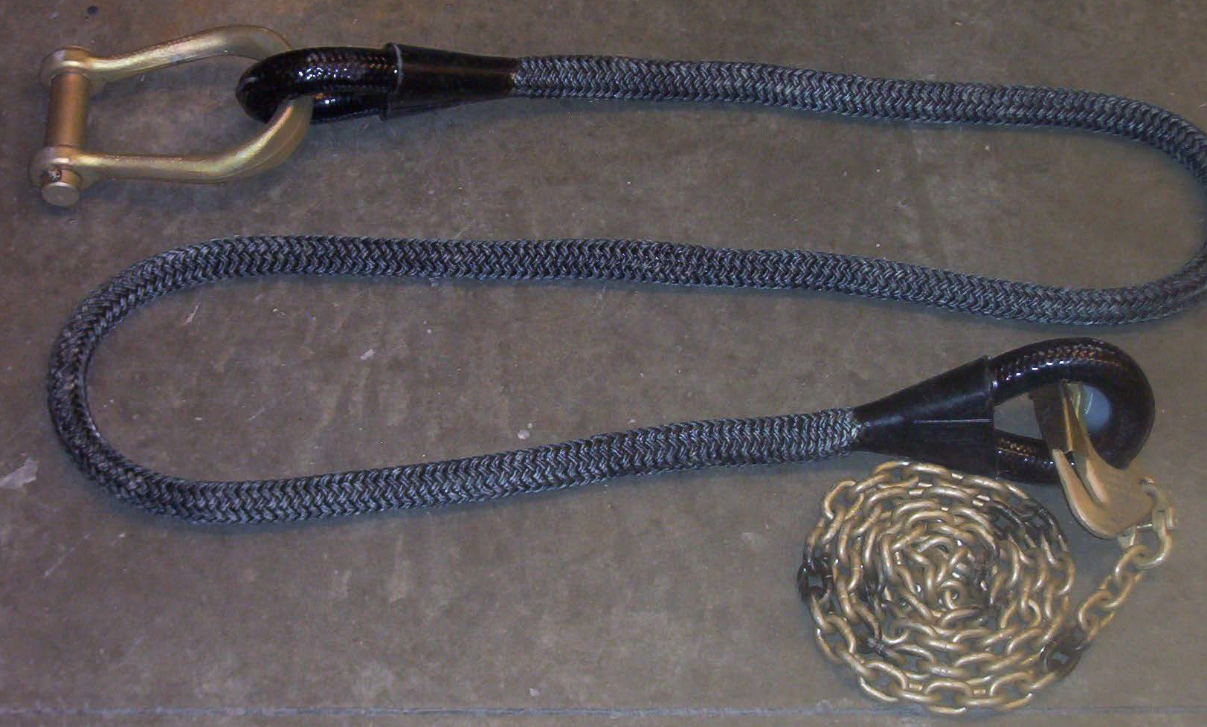
25,000 LBS Sling Leg
4
1
3
2
25,000 lbs Apex Fitting- Rated capacity: 25,000 lbs
25,000 lbs Sling Leg- Rated capacity: 6,250 lbs
Chain
Grabhook Assembly

Slide 13
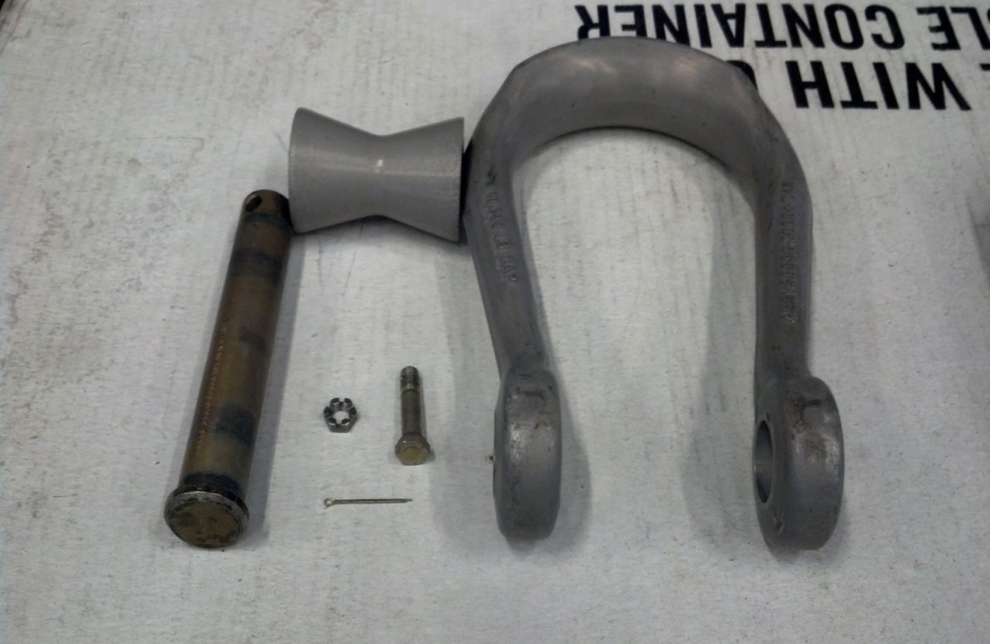
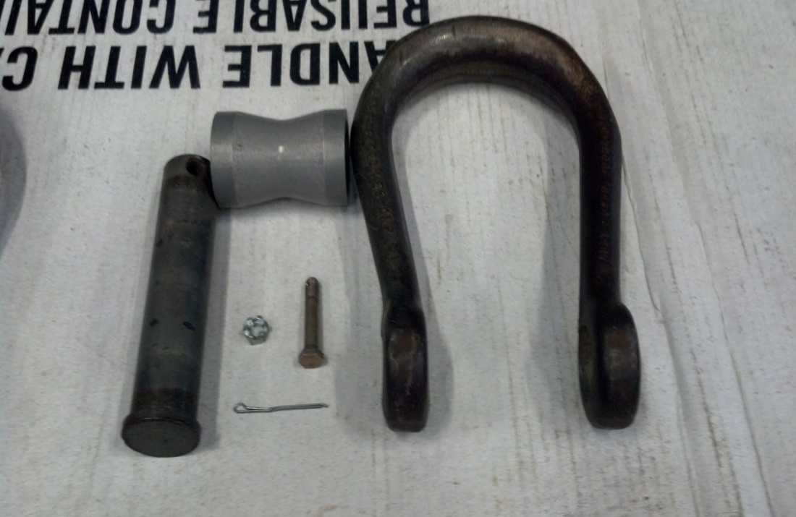
Apex Fitting
2
2
3b
1a
3a
1b
4
4
5
5
6
6
Apex Fitting Pin- Rated capacity: 10,000 lbs=1 1/8 Inch (1a), 25,000 lbs=1 ½ Inch (1b)
Apex Spacer
Apex Shackle- Rated capacity: 10,000 lbs (3a) AND 25,000 lbs (3b)
Castellated Nut
3/8 Inch Drilled Bolt
Cotter Pin

Slide 14
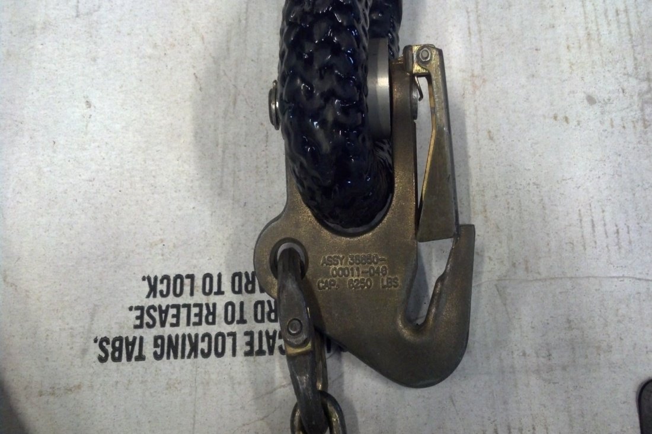
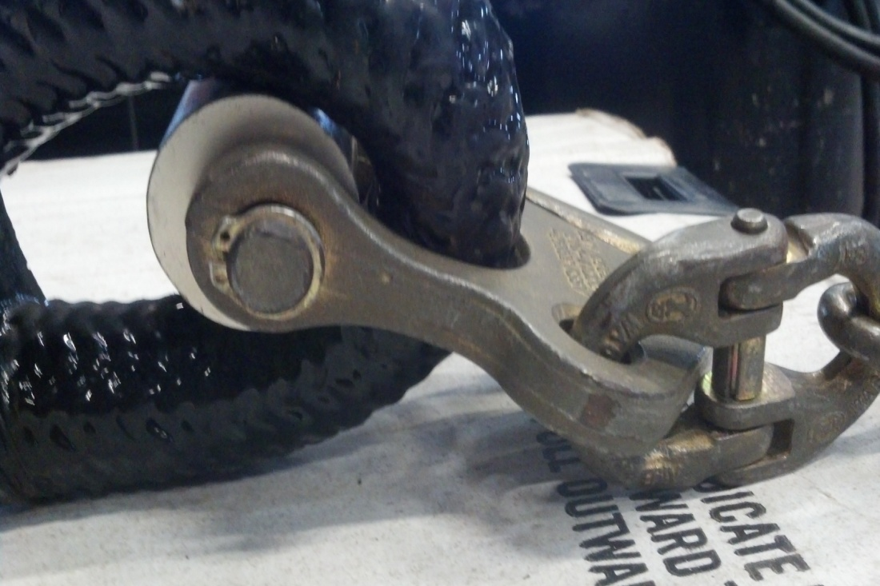
Grabhook Assembly
1
4
2
5
8
6
3
7
4
9
7
Bolt and dome nut/locking nut 6. Eye
Keeper 7. Coupling Link
Hook 8. Spacer
Pin 9. Snap Ring
Yoke

Slide 15
25,000 LBS Cargo Hook Reach Pendant
1
3
4
2
Large Looped End (Towards the load)
Directional Arrow
Handle
Small Looped End (Towards the aircraft)

Slide 16
11,000LBS Cargo Hook Reach Pendant
3
1
2
4
Large Looped End (Towards the load)
Directional Arrow
Handle
Small Looped End (Towards the aircraft)

Slide 17
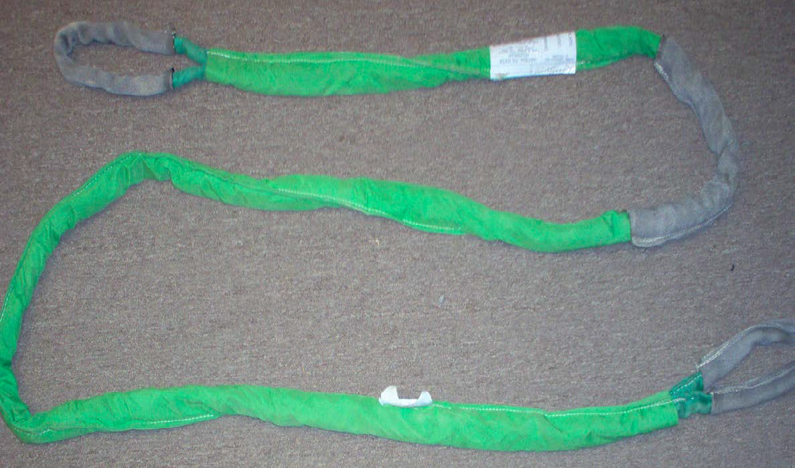
Polyester Round Sling
1
1
1. Identification Tag (At least one must be present and legible)

Slide 18
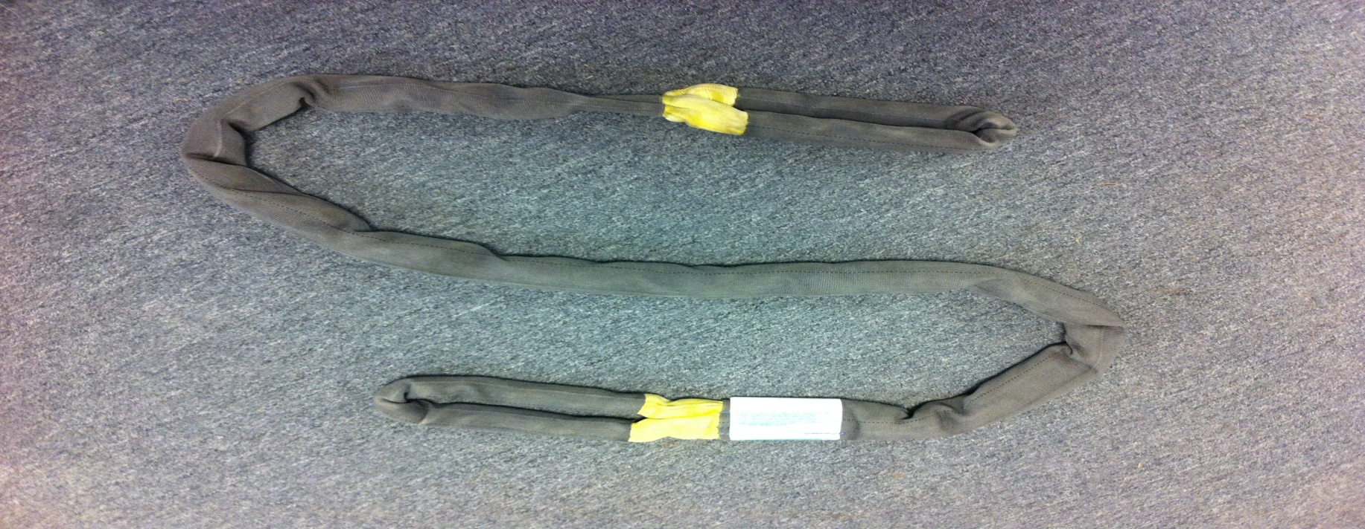
Polyester Round Sling
Rated capacity by hitch type
Length | Color | Choked | Vertical | Basket | Sling Weight
8’ | Green | 4,200 lbs | 5,300 lbs | 10,600 lbs | 4 lbs
17’ | Green | 4,200 lbs | 5,300 lbs | 10,600 lbs | 10 lbs
8’ | Yellow | 6,700 lbs | 8,400 lbs | 16,800 lbs | 5 lbs
17’ | Yellow | 6,700 lbs | 8,400 lbs | 16,800 lbs | 11 lbs
30’ | Red | 10,600 lbs | 13,200 lbs | 26,400 lbs | 26 lbs
65’ | Blue | 17,000 lbs | 21,200 lbs | 42,400 lbs | 75 lbs
70’ | Blue | 17,000 lbs | 21,200 lbs | 42,400 lbs | 81 lbs

Slide 19
A-22 Cargo Bag

Slide 20
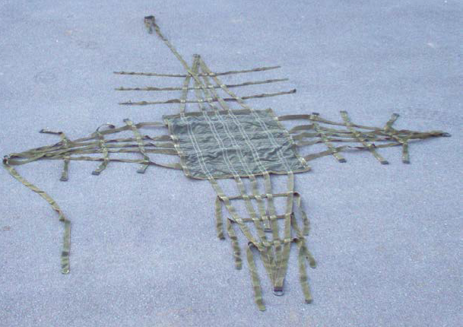
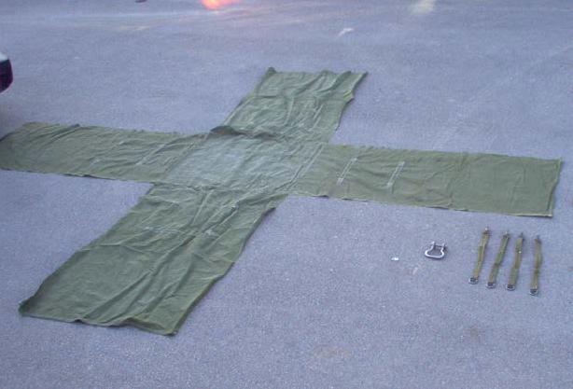
A22 Cargo Bag
1
2
4
5
1
3
2
6
4
7
Lateral Strap
188” Strap
Scuff Pad
D-Ring
Canvas Cover (Optional)
Medium Suspension Clevis- Rated capacity: 6,250 lbs
24” Suspension Web- Rated capacity: 550 lbs (each)

Slide 21
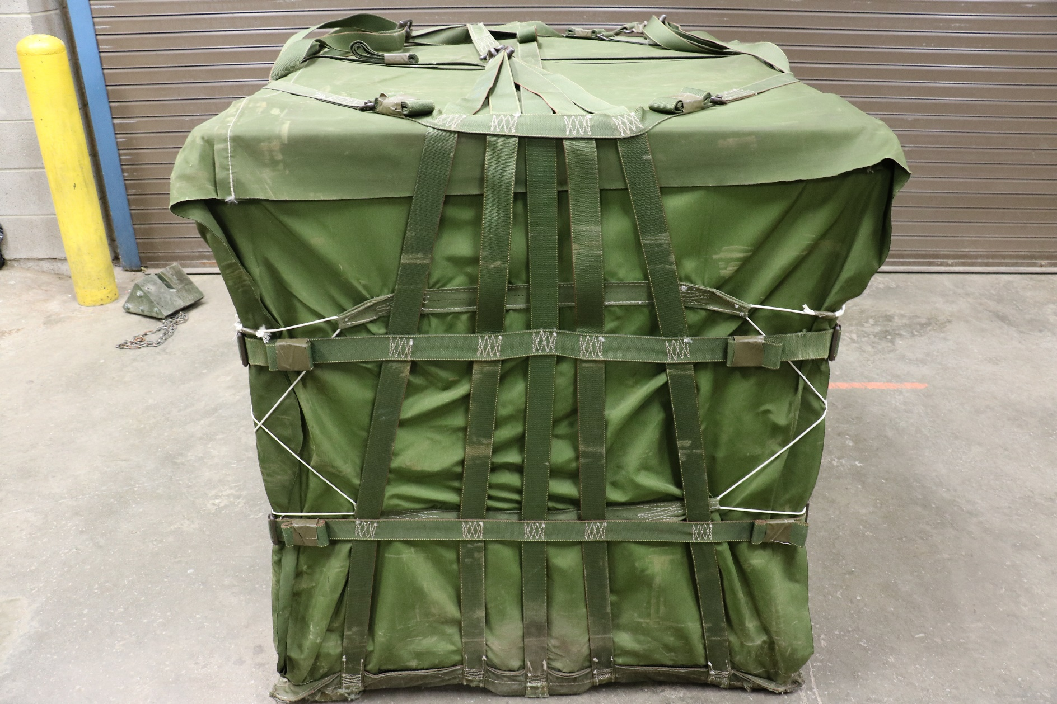
1
1
4
3
2
2
1
1
Lateral Strap
Lacing Cord
188” Strap
Canvas Cover (Optional)

Slide 22
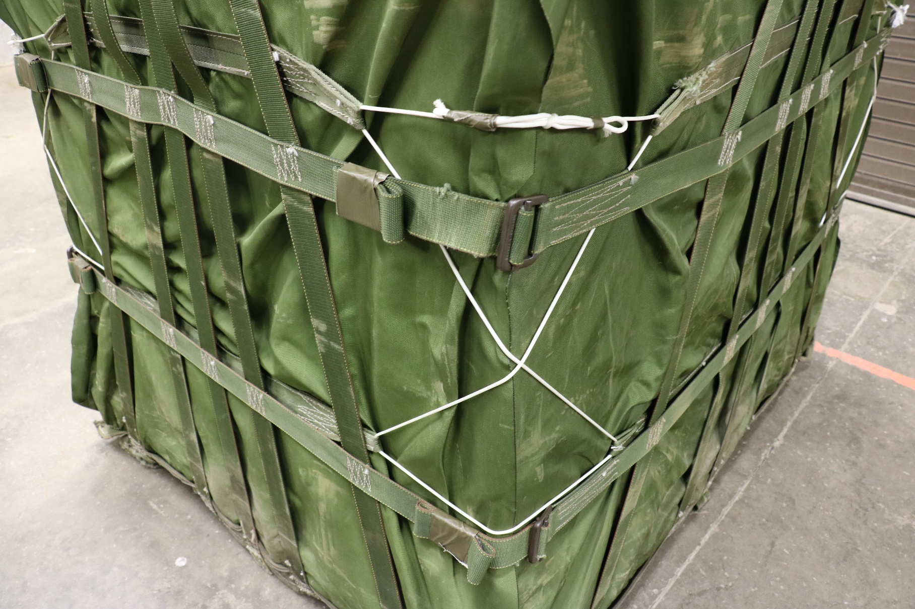
5
2
1
4
3
Lateral Strap
Lacing Cord
Friction Adapter
Excess Lateral Strap
Canvas Cover (Optional)

Slide 23
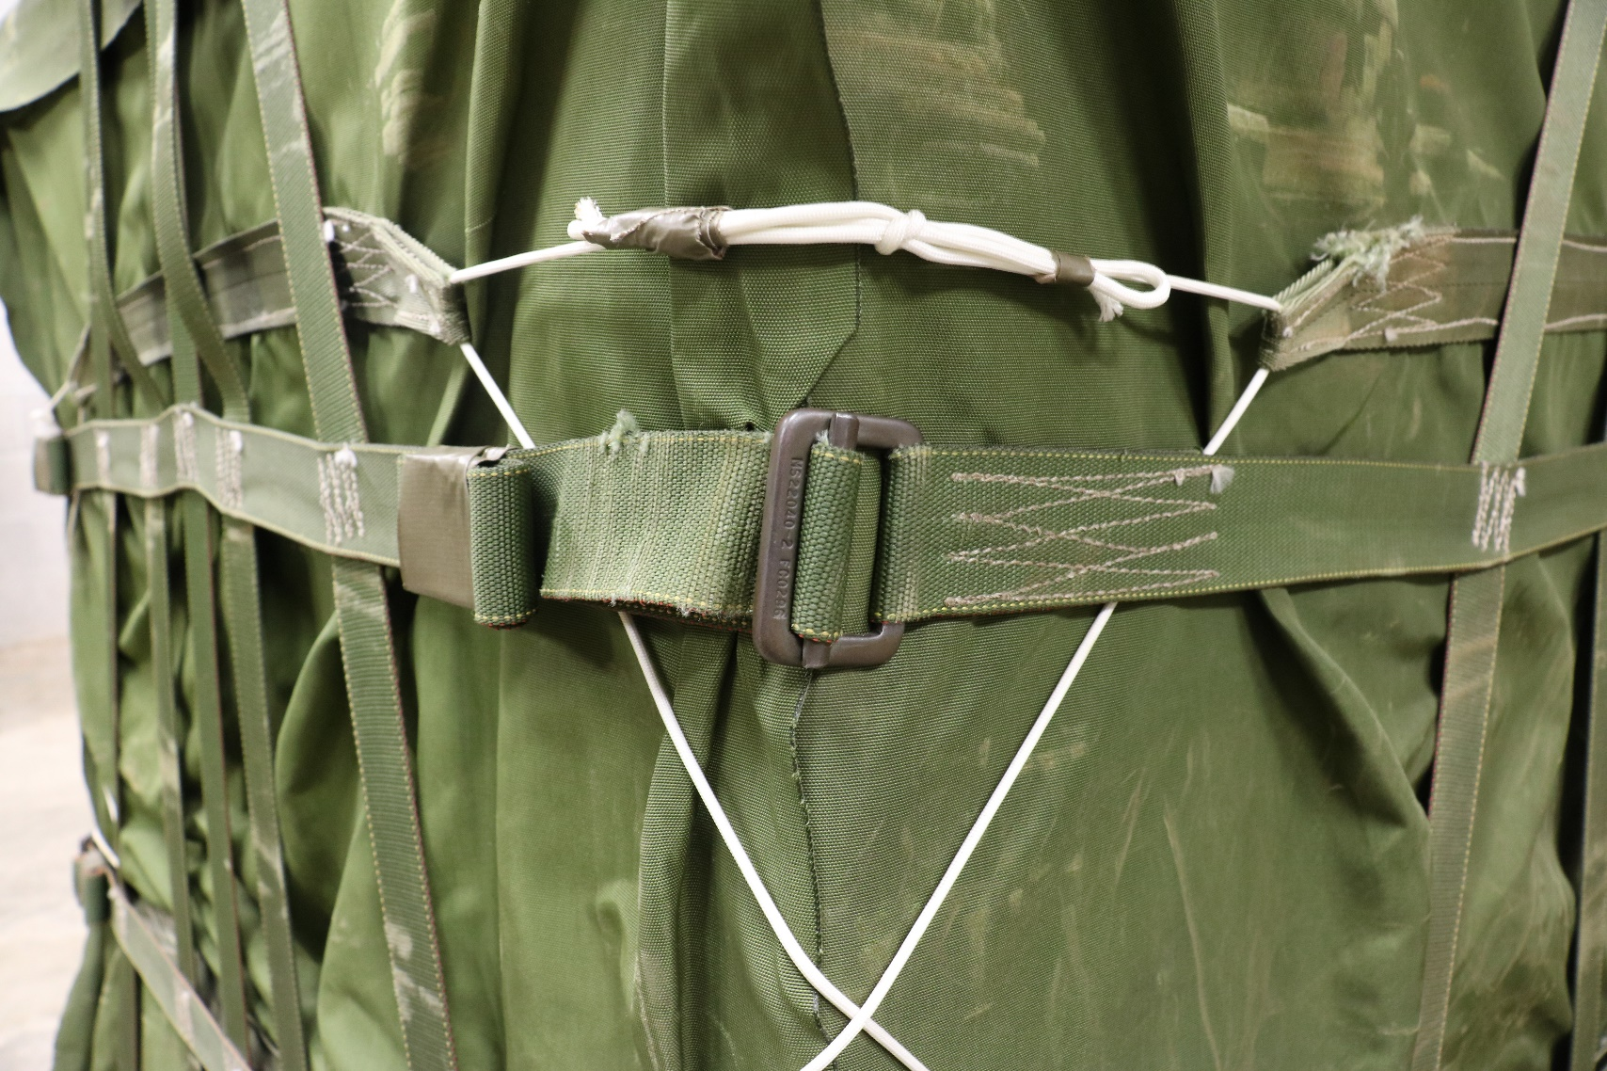
1
2
3
4
Lateral Strap
Friction Adapter
Excess Lateral Strap
Lacing Cord

Slide 24
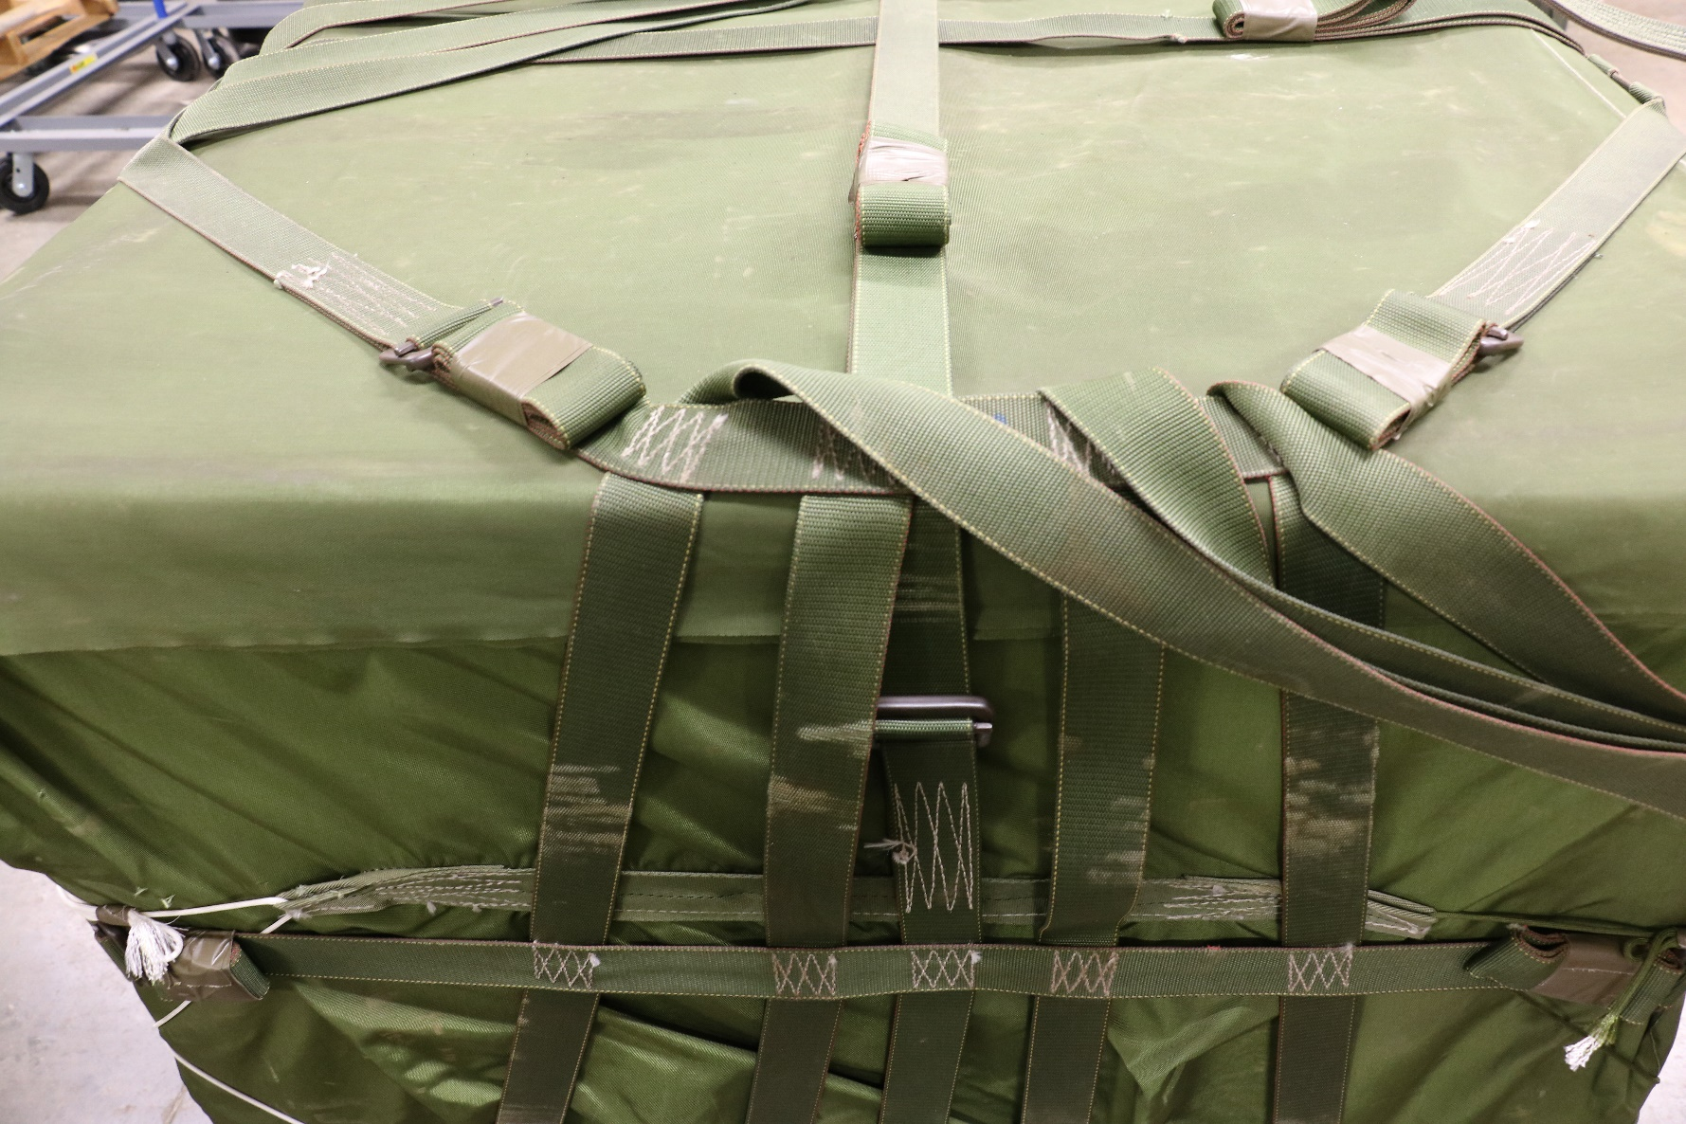
1
4
3
6
1
3
5
1
1
2
Lateral Strap
Friction Adapter
188” Strap
Excess 188” Strap
Lacing Cord
Canvas Cover (Optional)

Slide 25
1
2
3
Medium Suspension Clevis
D-Ring
24” Suspension Web- Rated Capacity: 550 lbs

