Slide 1


THE SABALAUSKI AIR ASSAULT SCHOOL
FY 26 AIR ASSAULT COURSE SCHEDULE

Slide 2
THE SABALAUSKI AIR ASSAULT SCHOOL
FY 26 AIR ASSAULT COURSE SCHEDULE

Slide 3

THE SABALAUSKI AIR ASSAULT SCHOOL
FY 26 PATHFINDER COURSE SCHEDULE

Slide 4
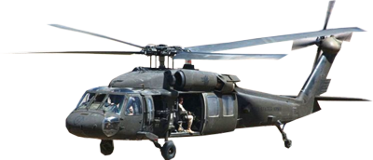
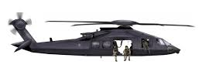
THE SABALAUSKI AIR ASSAULT SCHOOL
FY 26 FRIES/SPIES/RAPPEL MASTER COURSE SCHEDULE

Slide 5

THE SABALAUSKI AIR ASSAULT SCHOOL
FY 26 PRE RANGER COURSE SCHEDULE

Slide 6
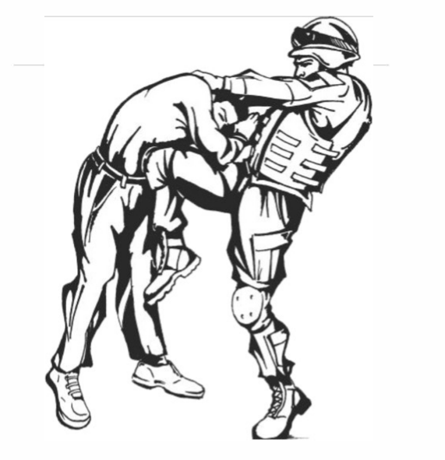
THE SABALAUSKI AIR ASSAULT SCHOOL
FY 26 MACP SCHEDULE

