Slide 1
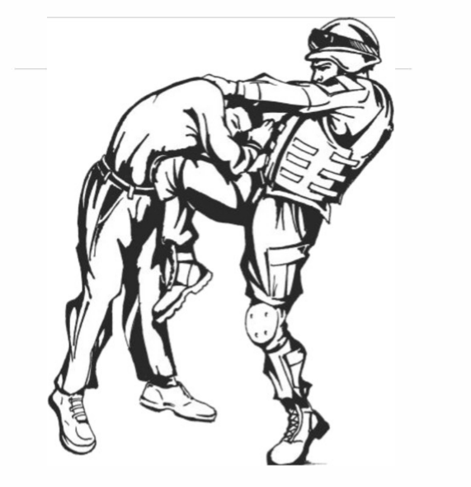
THE SABALAUSKI AIR ASSAULT SCHOOL
FY 26 MACP SCHEDULE

