Slide 1

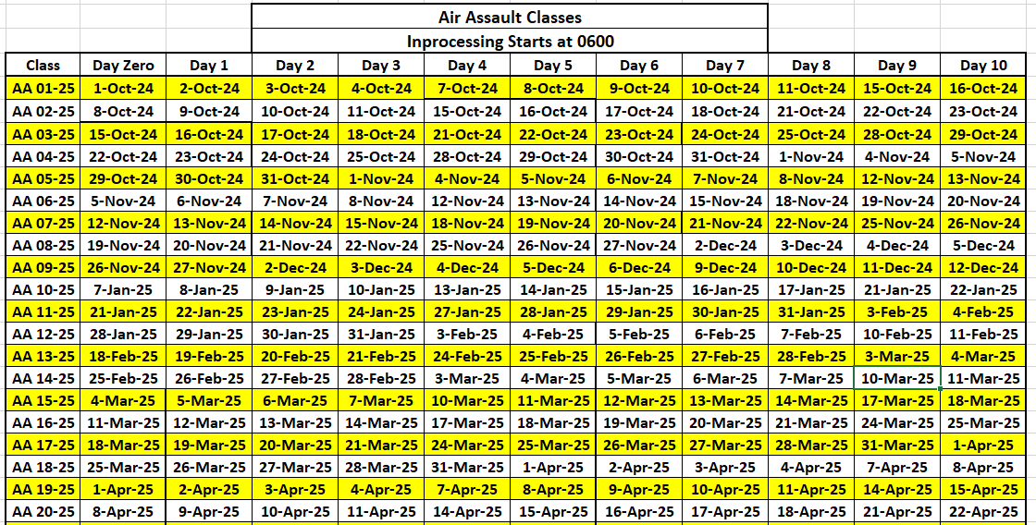

THE SABALAUSKI AIR ASSAULT SCHOOL
FY 25 AIR ASSAULT COURSE SCHEDULE

Slide 2
THE SABALAUSKI AIR ASSAULT SCHOOL
FY 25 AIR ASSAULT COURSE SCHEDULE
AA 21-25 | 15-Apr-25 | 16-Apr-25 | 17-Apr-25 | 18-Apr-25 | 21-Apr-25 | 22-Apr-25 | 23-Apr-25 | 24-Apr-25 | 25-Apr-25 | 28-Apr-25 | 29-Apr-25
AA 22-25 | 22-Apr-25 | 23-Apr-25 | 24-Apr-25 | 25-Apr-25 | 28-Apr-25 | 29-Apr-25 | 30-Apr-25 | 1-May-25 | 2-May-25 | 5-May-25 | 6-May-25
AA 23-25 | 29-Apr-25 | 30-Apr-25 | 1-May-25 | 2-May-25 | 5-May-25 | 6-May-25 | 7-May-25 | 8-May-25 | 9-May-25 | 12-May-25 | 13-May-25
AA 24-25 | 20-May-25 | 21-May-25 | 22-May-25 | 23-May-25 | 27-May-25 | 28-May-25 | 29-May-25 | 30-May-25 | 2-Jun-25 | 3-Jun-25 | 4-Jun-25
AA 25-25 | 27-May-25 | 28-May-25 | 29-May-25 | 30-May-25 | 2-Jun-25 | 3-Jun-25 | 4-Jun-25 | 5-Jun-25 | 6-Jun-25 | 9-Jun-25 | 10-Jun-25
AA 26-25 | 17-Jun-25 | 18-Jun-25 | 20-Jun-25 | 23-Jun-25 | 24-Jun-25 | 25-Jun-25 | 26-Jun-25 | 27-Jun-25 | 30-Jun-25 | 1-Jul-25 | 2-Jul-25
AA 27-25 | 24-Jun-25 | 25-Jun-25 | 26-Jun-25 | 27-Jun-25 | 30-Jun-25 | 1-Jul-25 | 2-Jul-25 | 3-Jul-25 | 7-Jul-25 | 8-Jul-25 | 9-Jul-25
AA 28-25 | 8-Jul-25 | 9-Jul-25 | 10-Jul-25 | 11-Jul-25 | 14-Jul-25 | 15-Jul-25 | 16-Jul-25 | 17-Jul-25 | 18-Jul-25 | 21-Jul-25 | 22-Jul-25
AA 29-25 | 15-Jul-25 | 16-Jul-25 | 17-Jul-25 | 18-Jul-25 | 21-Jul-25 | 22-Jul-25 | 23-Jul-25 | 24-Jul-25 | 25-Jul-25 | 28-Jul-25 | 29-Jul-25
AA 30-25 | 29-Jul-25 | 30-Jul-25 | 31-Jul-25 | 1-Aug-25 | 4-Aug-25 | 5-Aug-25 | 6-Aug-25 | 7-Aug-25 | 8-Aug-25 | 11-Aug-25 | 12-Aug-25
AA 31-25 | 5-Aug-25 | 6-Aug-25 | 7-Aug-25 | 8-Aug-25 | 11-Aug-25 | 12-Aug-25 | 13-Aug-25 | 14-Aug-25 | 15-Aug-25 | 18-Aug-25 | 19-Aug-25
AA 32-25 | 12-Aug-25 | 13-Aug-25 | 14-Aug-25 | 15-Aug-25 | 18-Aug-25 | 19-Aug-25 | 20-Aug-25 | 21-Aug-25 | 22-Aug-25 | 25-Aug-25 | 26-Aug-25
AA 33-25 | 19-Aug-25 | 20-Aug-25 | 21-Aug-25 | 22-Aug-25 | 25-Aug-25 | 26-Aug-25 | 27-Aug-25 | 28-Aug-25 | 29-Aug-25 | 2-Sep-25 | 3-Sep-25
AA 34-25 | 26-Aug-25 | 27-Aug-25 | 28-Aug-25 | 29-Aug-25 | 2-Sep-25 | 3-Sep-25 | 4-Sep-25 | 5-Sep-25 | 8-Sep-25 | 9-Sep-25 | 10-Sep-25
AA 35-25 | 2-Sep-25 | 3-Sep-25 | 4-Sep-25 | 5-Sep-25 | 8-Sep-25 | 9-Sep-25 | 10-Sep-25 | 11-Sep-25 | 12-Sep-25 | 15-Sep-25 | 16-Sep-25
AA 36-25 | 9-Sep-25 | 10-Sep-25 | 11-Sep-25 | 12-Sep-25 | 15-Sep-25 | 16-Sep-25 | 17-Sep-25 | 18-Sep-25 | 19-Sep-25 | 22-Sep-25 | 23-Sep-25
AA 37-25 | 16-Sep-25 | 17-Sep-25 | 18-Sep-25 | 19-Sep-25 | 22-Sep-25 | 23-Sep-25 | 24-Sep-25 | 25-Sep-25 | 26-Sep-25 | 29-Sep-25 | 30-Sep-25
AA 38-25 | 23-Sep-25 | 24-Sep-25 | 25-Sep-25 | 26-Sep-25 | 29-Sep-25 | 30-Sep-25 | 1-Oct-25 | 2-Oct-25 | 3-Oct-25 | 6-Oct-25 | 7-Oct-25
AA 39-25 | 30-Sep-25 | 1-Oct-25 | 2-Oct-25 | 3-Oct-25 | 6-Oct-25 | 7-Oct-25 | 8-Oct-25 | 9-Oct-25 | 10-Oct-25 | 14-Oct-25 | 15-Oct-25

Slide 3

THE SABALAUSKI AIR ASSAULT SCHOOL
FY 25 PATHFINDER COURSE SCHEDULE

Slide 4
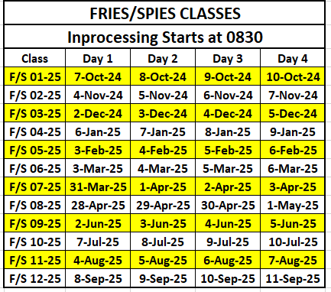
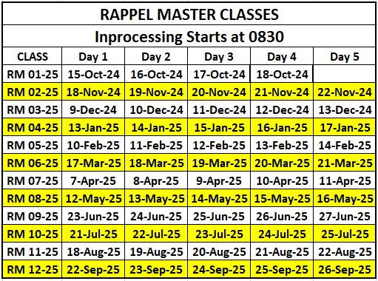
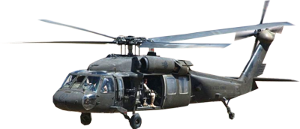
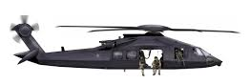
THE SABALAUSKI AIR ASSAULT SCHOOL
FY 25 FRIES/SPIES/RAPPEL MASTER COURSE SCHEDULE

Slide 5

THE SABALAUSKI AIR ASSAULT SCHOOL
FY 25 PRE RANGER COURSE SCHEDULE

Slide 6
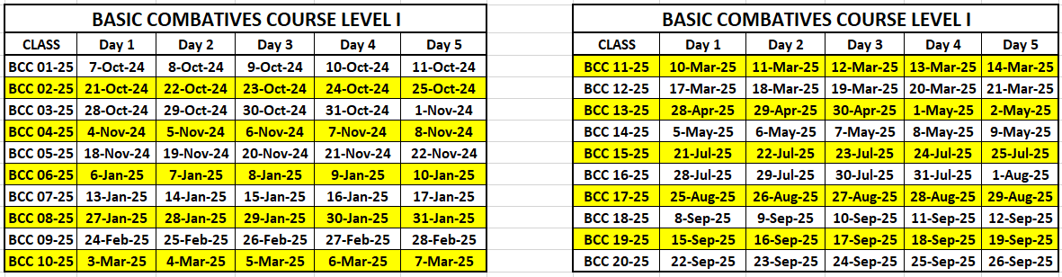
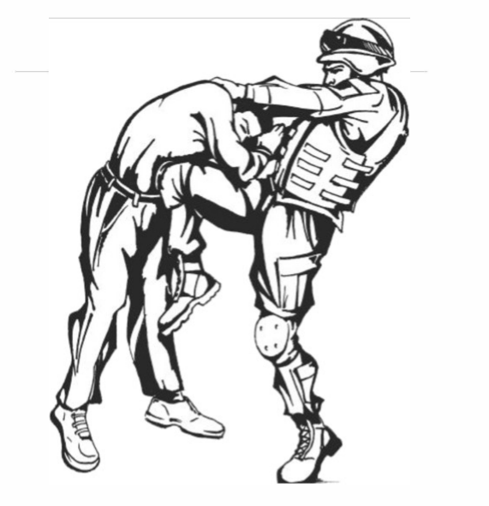
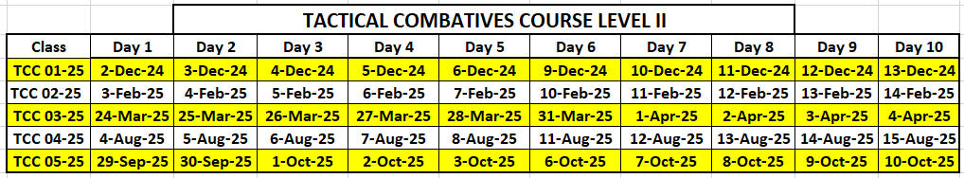
THE SABALAUSKI AIR ASSAULT SCHOOL
FY 25 MACP SCHEDULE

