Slide 1
Packing List Layout Brief
Team # Senior
101st Airborne Division (AASLT)

Slide 2
101st Airborne Division (AASLT)
THE SABAULASKI AIR ASSAULT SCHOOL STUDENT PACKING LIST
ALL ITEMS MUST BE IN COMPLIANCE WITH AR 670-1 AND SERVICEABLE **ALL ITEMS ARE REQUIRED TO BE STANDARD MILITARY ISSUED UNLESS MARKED WITH AN ASTERISK**
Carried Items
1x MOLLE Rucksack Large with frame (waist belt, and nametape sewn on top flap/Medium with frame, waist belt and nametape affixed)
1x IOTV/Plate Carrier with Front/Back ESAPI Plates, all Kevlar inserts, name and rank affixed
1x ACH, with chinstrap and proper padding with 2" masking tape (Front and Back)
1x Jacket, Wet Weather w/ rank (Slip-on/Pin-on)
1x Patrol Cap, with name and rank affixed
1x OCP Blouse (with all required patches affixed)
1x OCP trousers
1x Coyote Brown t-shirt (no logos, unit emblems, or writing)
1x Pair Boot Socks, Black/Brown/Green*
1x Pair of Earplugs with hard case (may be foam or flanged variety)*
1x Hi-Lighter
1x Black ink pen (Must be Black Ink)*
1x Gallon-sized Ziploc style bag*
1x APEL Approved eye protection or APEL Approved Goggles (must have clear lens)*
1x One-quart canteen with 2" masking tape affixed to front
1x One-quart canteen carrier
1x Headlamp OR Angle-Necked Flashlight, operational with batteries (must be red lens capable)*
Additional batteries for light source*
1x Black Fleece Watch Cap
1x Waterproof bag
1x Small Notebook (Must fit in Cargo Pocket)*
1x Pair of Running Shoes (Day 0 and 7 ONLY) *
1x Reflective Belt, Yellow
1x MRE, Complete (Day 0 only)
1x Leather gloves with double layer friction bearing surface w/ wool inserts (70% or higher)
1x Color Unit Patch with Velcro*aa) 1x Beret (enlisted with unit crest, officers with rank)bb) Air Assault Handbook (when issued)
Casualty Feeder Card (when issued)
Completed FC 4137 (All walk-ons) and DD-1610 (TDY Personnel)
Worn Items
OCP Blouse (with all required patches affixed)
OCP Trousers
Coyote Brown Belt*
Coyote Brown T-Shirt (no logos, unit emblems, or writing)
Boot Socks, Black/Brown/Green*
ID Tags (2 ID Tags, Long Chain, Short Chain)
ID Card (not expired or due to expire during the course)
Coyote Brown Combat Boots*
Army IPFU Shirt (Day 7 Only)
Army IPFU Shorts (Day 7 Only)
Additional Winter Items (01 OCT – 01 APR Only)
1x GEN III Grid Fleece Top (Waffle Top)
1x GEN III Grid Fleece Bottom (Waffle Bottom)
1x Pair of Winter Gloves*
Winter IPFU (Day 7 Only)
  Gloves*
  Fleece Cap
  Army IPFU Jacket
  Army IPFU Pants
  Army IPFU Shorts
  Army IPFU Shirt
  Army IPFU Long Sleeve Shirt
PROHIBITED ITEMS
Cell Phones
Knives/Gerber/Leatherman
GPS devices to include watches with storages capabilities (Whoop Band Aura Rings)
Tobacco products/Vape Devices/Nicotidine
Notes:
-Is there supposed to be a “;” separating ‘top flap’ and ‘Medium’?
-Recommend making Bold and Red to emphasize

Slide 3
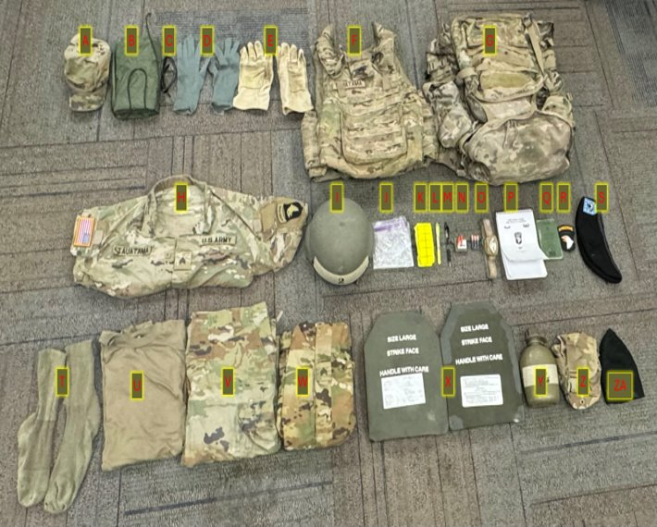
101st Airborne Division (AASLT)
THE SABAULASKI AIR ASSAULT SCHOOL STUDENT PACKING LIST
ALL ITEMS MUST BE IN COMPLIANCE WITH AR 670-1 AND SERVICEABLE
** ALL ITEMS ARE REQUIRED TO BE STANDARD MILITARY ISSUED UNLESS MARKER WITH AN ASTRISK**
CARRIED ITEMS:
A. Patrol Cap W/ rank and name affixed​
B. Wet weather bag W/ strings affixed​
C. Apel Approved Eye Pro protection or Apel approved Goggles (must have clear lense)​
d. Wool glove inserts​ (70% or higher)
E. Leather work gloves​
F. IOTV/Plate Carrier w/ all Kevlar inserts, name and rank affixed​
G. 1X MOLLE Rucksack​
i. Large with frame, waistbelt, sustainment pouches and ​
nametape sewn on top of flap​
ii. Medium with frame, waistbelt and nametape affixed​
H. OCP Blouse (with all required patches affixed)​
I. ACH W/ chine strap and required padding (7 Pads) and 2-inch masking tape on Front and Back of ACH​
J. Gallon-sized Ziploc style bag*​
K. Yellow reflective belt​
L. High Lighter​
M. Black ink pen​
N. Ear pro W/ hard case (Foamed or Flanged)*​
O. Headlamp or Angle-Necked Flashlight with batteries (Red Lens capable and Additional Batteries, enough to replenish headlamp and correct type of batteries specific to your headlamp)​
P. Air Assault Handbook​
Q. Small Notebook (must fit in cargo pocket)​
R. Color unit patch W/ Velcro*​
S. Beret (enlisted with unit crest, Officer with rank)​
T. Pair boot socks, Brown/Black/Green*​
U. Coyote Brown t-shirt (no logos, unit emblems, or written)​
V. OCP Trousers​
W. Wet weather top W/ rank slip on or pin on​
X. ESAPI Plates (2) ​
Y. One-Quart Canteen W/ 2inch masking tape affixed to the front​
Z. One-Quart Canteen carrier​
ZA. Black/Tan Fleece watch cap​

Slide 4
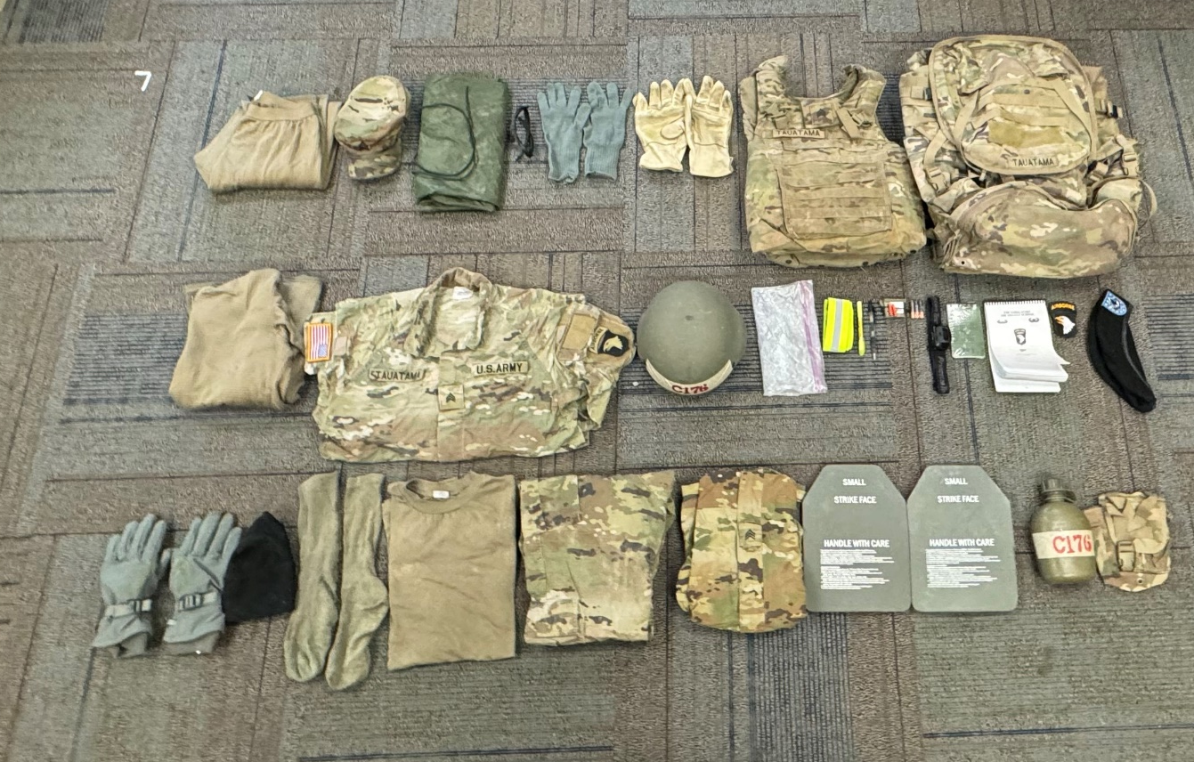
101st Airborne Division (AASLT)
THE SABAULASKI AIR ASSAULT SCHOOL STUDENT WINTER PACKING LIST
ALL ITEMS MUST BE IN COMPLIANCE WITH AR 670-1 AND SERVICEABLE
** ALL ITEMS ARE REQUIRED TO BE STANDARD MILITARY ISSUED UNLESS MARKER WITH AN ASTRISK**
H
CARRIED ITEMS:
A. Waffle Bottom
B. Patrol Cap W/ rank and name affixed
C. Wet weather bag W/ strings affixed
D. Apel Approved Eye Pro protection or Apel approved Goggles (must have clear lense)
E. Wool glove inserts (70% or higher)
F. Leather gloves with double layer friction bearing surface
G. IOTV/Plate Carrier w/ all Kevlar inserts, name and rank affixed
H. 1X MOLLE Rucksack
i. Large with frame, waistbelt, sustainment pouches and
nametape sewn on top of flap
ii. Medium with frame, waistbelt and nametape affixed
I. Waffle Top
J. OCP Blouse (with all required patches affixed)
K. ACH W/ chine strap and required padding (7 Pads) and 2-inch masking tape on Front and Back of ACH
L. Gallon-sized Ziploc style bag*
M. Yellow reflective belt
N. High Lighter
O. Black ink pen
P. Ear pro W/ hard case (Foamed or Flanged)*
Q. Headlamp or Angle-Necked Flashlight with batteries (Red Lens capable and Additional Batteries)
R. Small Notebook (must fit in cargo pocket)
S. Air Assault Handbook
T. Color unit patch W/ Velcro*
U. Beret (enlisted with unit crest, Officer with rank)
V. Cold Weather Gloves (BLACK, GREEN, TAN)
W. Fleece Watch Cap (tan or black)
X. Pair boot socks, Brown/Black/Green*
Y. Coyote Brown t-shirt (no logos, unit emblems, or written)
Z. OCP Trousers
ZA. Wet weather top W/ rank slip on or pin on
ZB. ESAPI Plates (2)
ZC. One-Quart Canteen W/ 2inch masking tape affixed to the front
ZD. One-Quart Canteen carrier
A
B
C
E
F
G
D
I
J
K
L
M
N
O
O
Q
R
S
T
T
ZA
ZB
ZC
ZD
Z
V
W
X
Y

Slide 5
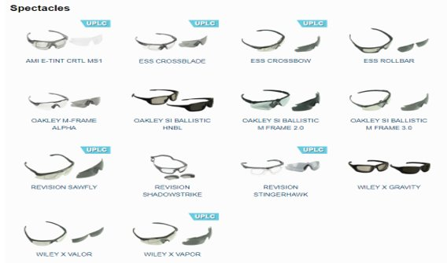
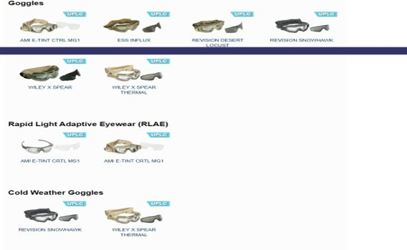
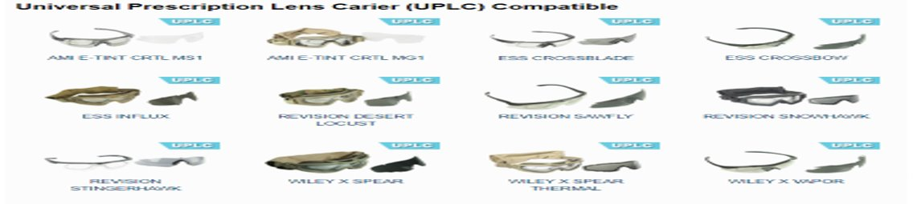
101st Airborne Division (AASLT)
Authorized Eye Pro

Slide 6
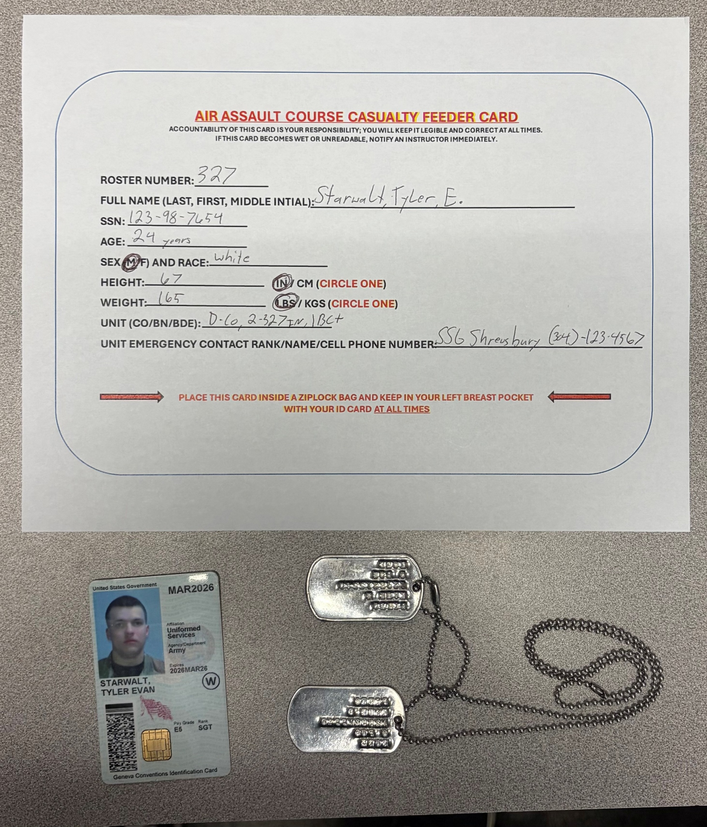
101st Airborne Division (AASLT)
Mandatory Safety Items
Required in all uniforms. Failure to have ID Card, ID Tags, or improperly filled out Casualty Feeder card will result in a Day 0 safety drop.
Notes:
Is that Starwalt’s actual SSN!?! Let’s not put that PII out for everyone to see.

Slide 7
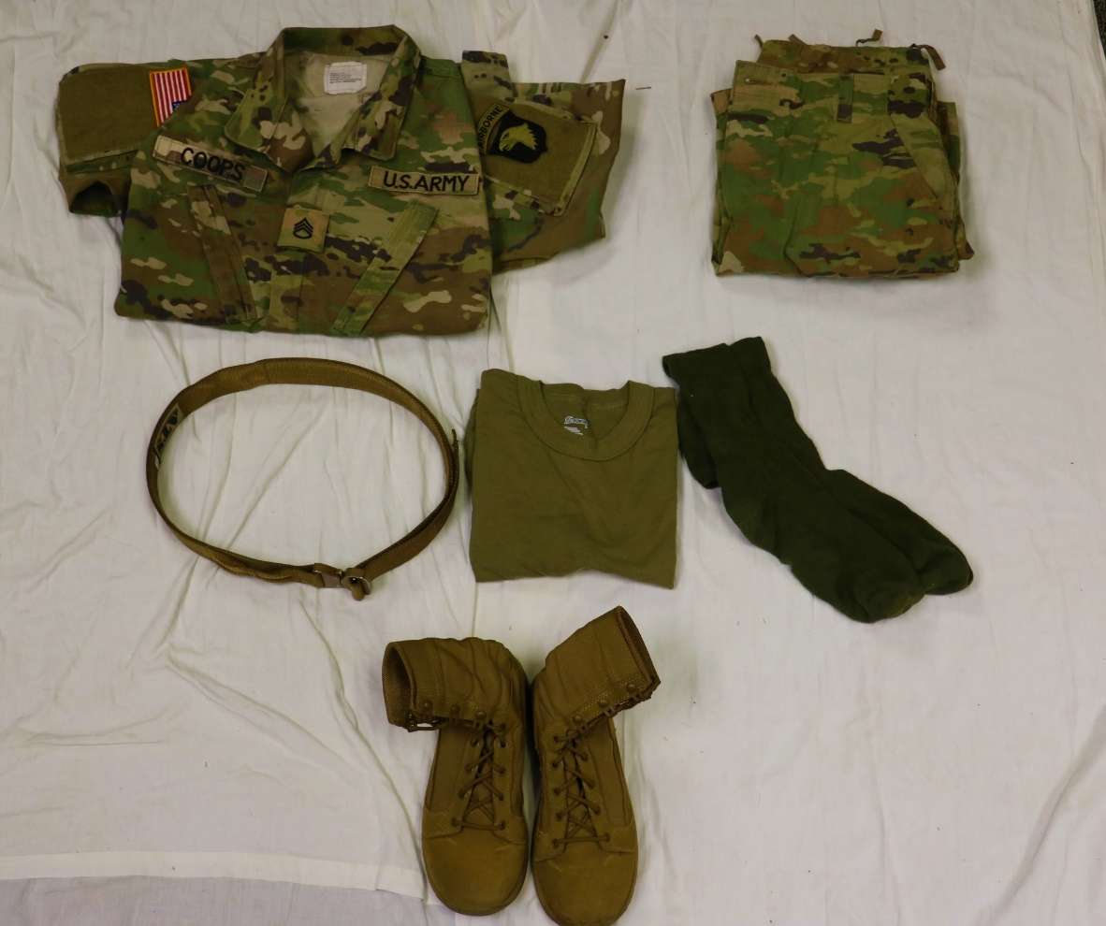
101st Airborne Division (AASLT)
Worn Items
All Patches must be affixed
AR 670-1 compliant belt
1x Pair of AR 670-1 compliant boot socks
No logos, unit emblems, or writing
AR 670-1 compliant Boots

Slide 8
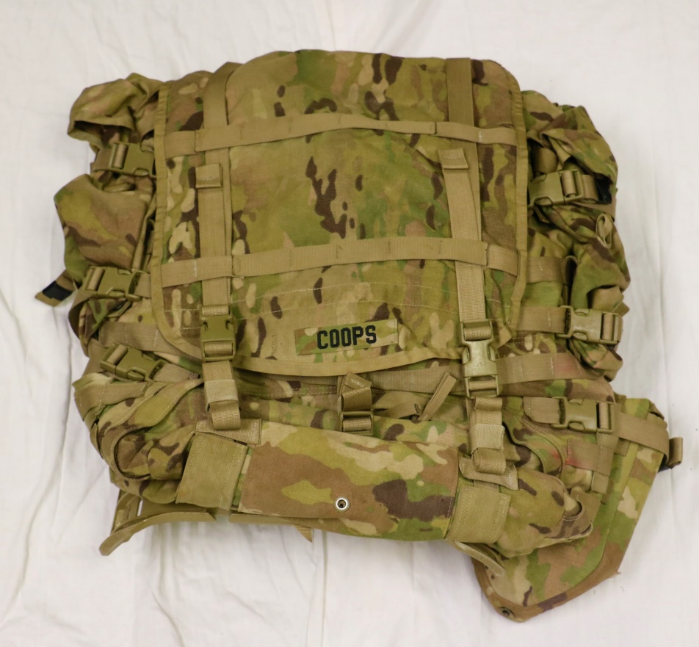
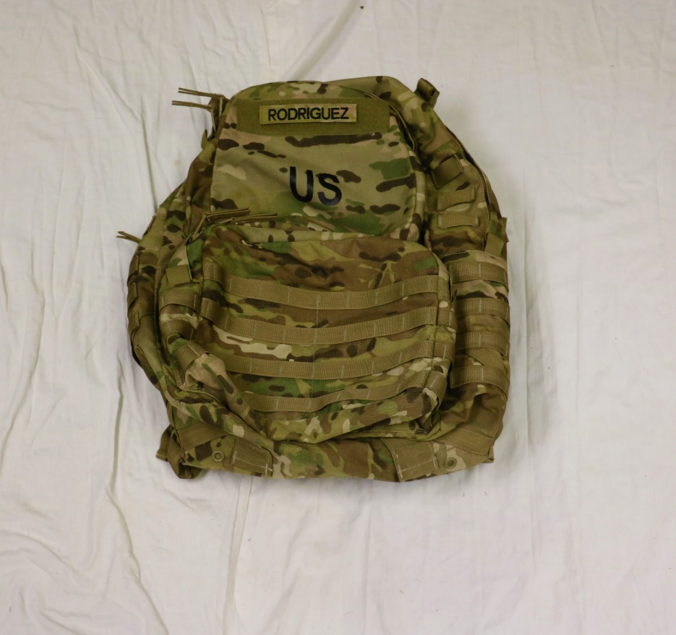
101st Airborne Division (AASLT)
MOLLE Rucksack
Nametape must be sewn on the Large MOLLE Rucksack as shown
Nametape must be affixed to the Medium MOLLE as shown

Slide 9
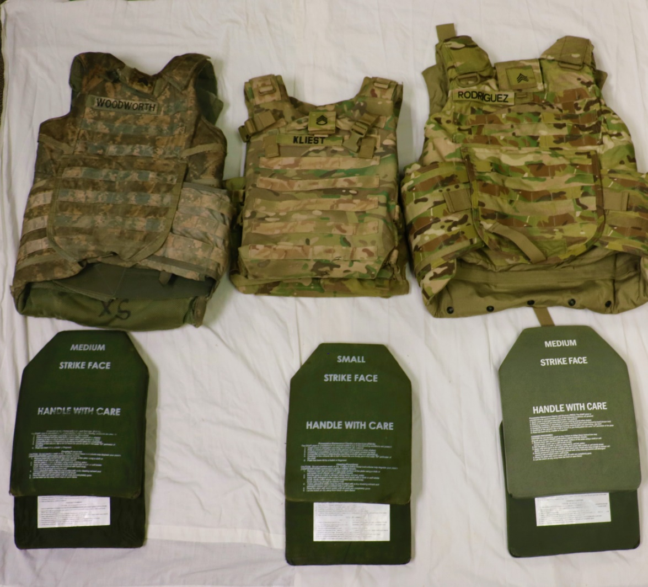
101st Airborne Division (AASLT)
IOTV / MSV
Issued IOTV / MSV must have front and back ESAPI plates and name and rank affixed.
NOTE: One of the issued plate carrier does not have a place to affix rank, nametape is still required
Notes:
-Which Plate Carrier doesn’t have a space for name and rank?

Slide 10
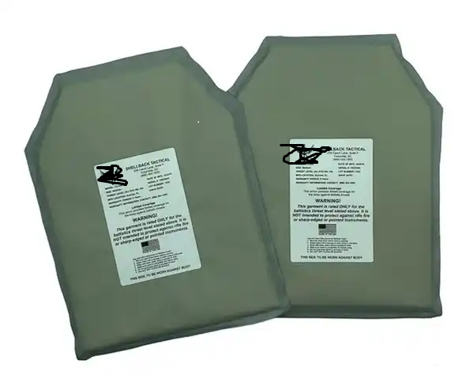
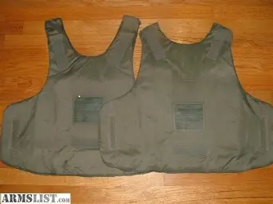
101st Airborne Division (AASLT)
IOTV INSERTS
IOTV 9mm Kevlar Inserts
Issued IOTV / MSV must have 9mm Kevlar Inserts
Notes:
-I’d recommend “Issued MSV / IOTV / Plate Carrier…”

Slide 11
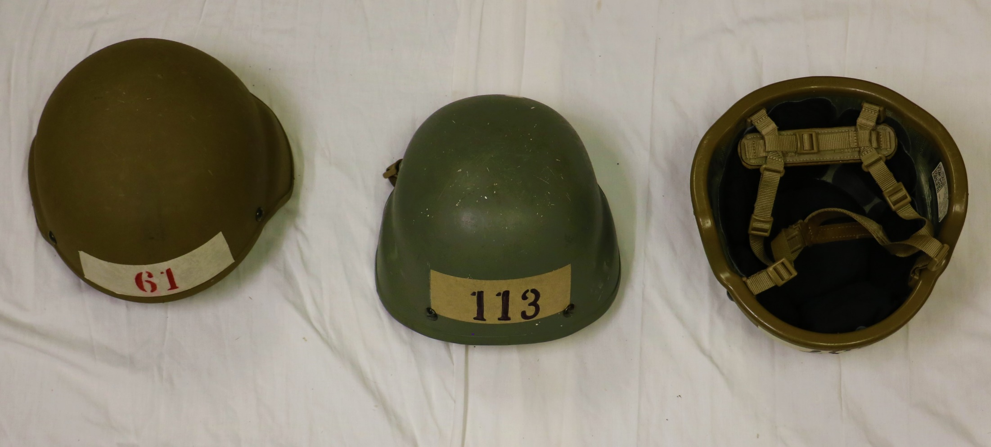
101st Airborne Division (AASLT)
ACH/ IHPS
Masking tape must be placed on the front and rear of the ACH
Masking tape dimensions: 6” wide by 2” tall
Must have appropriate padding and chinstrap

Slide 12
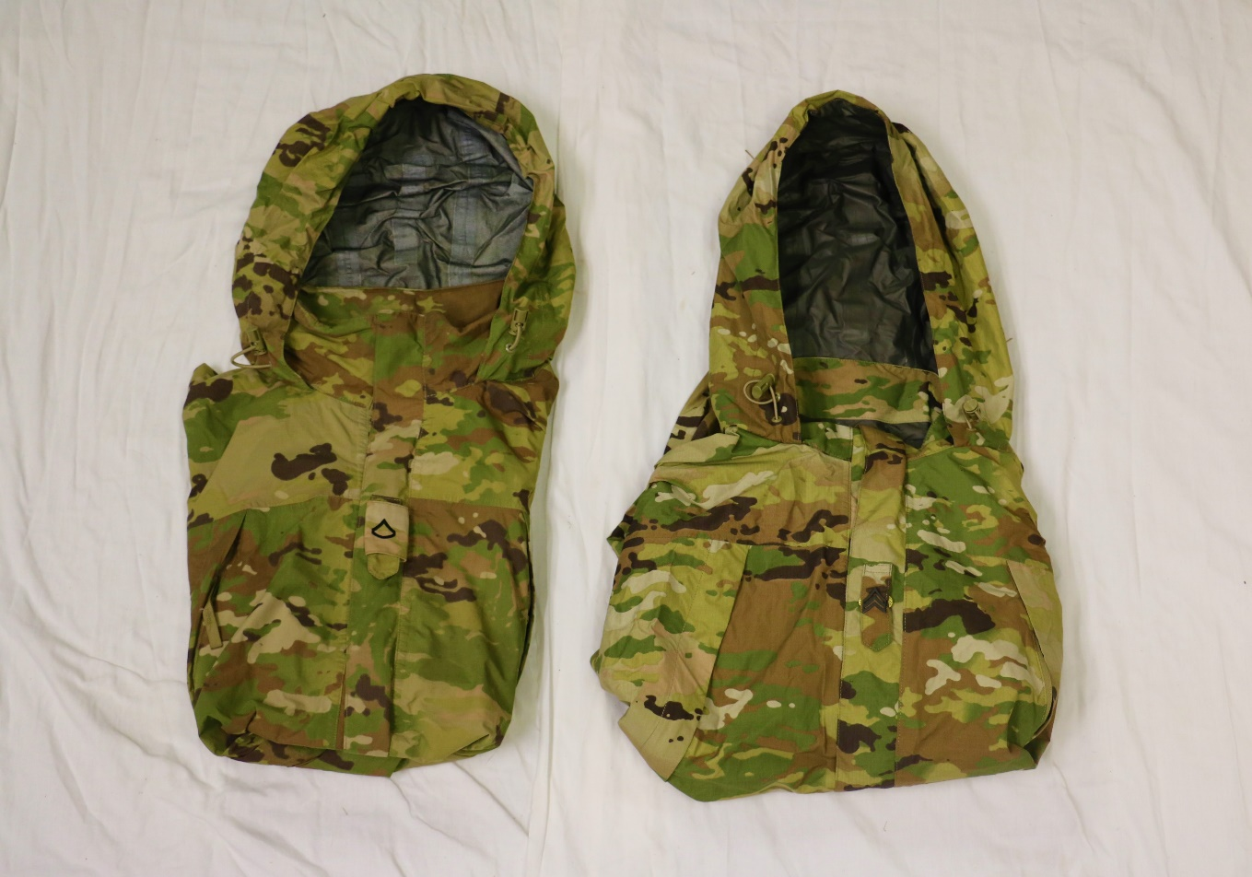
101st Airborne Division (AASLT)
Wet-Weather / Extreme Cold Weather Jacket
Slip on rank
Pin on rank
Rank must be present: Pin on or slip on are authorized

Slide 13
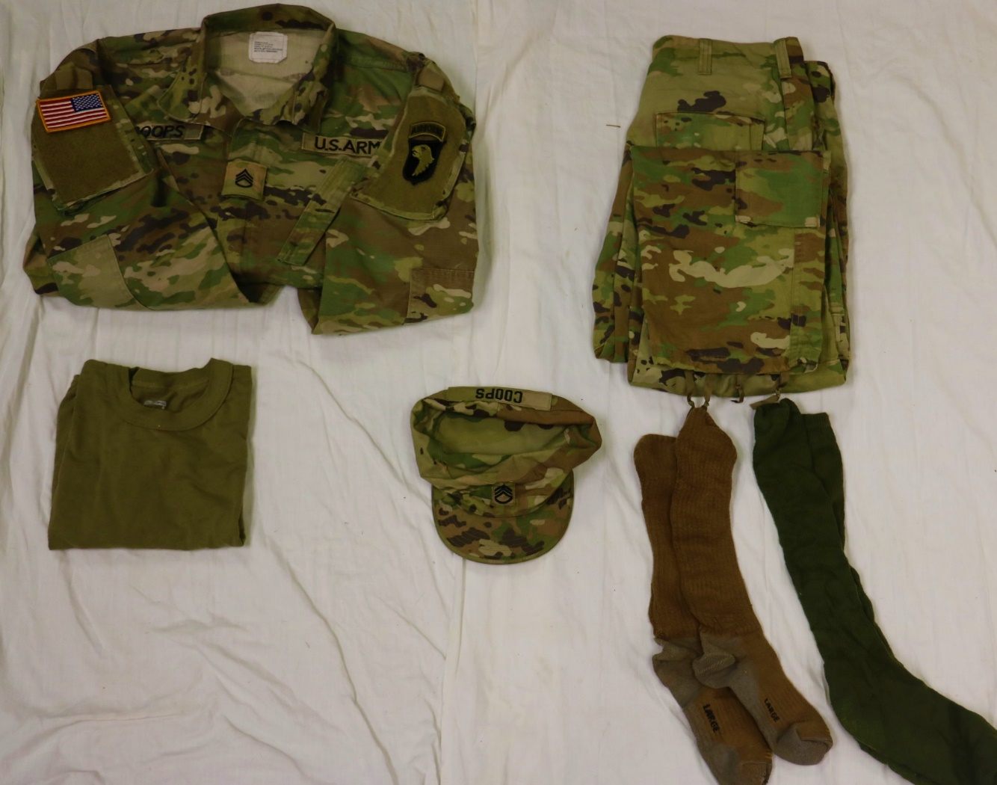
101st Airborne Division (AASLT)
Uniform Packed in Rucksack
All Patches must be affixed
No logos, unit emblems, or writing
Patrol cap must have nametape and rank affixed
1x Pair of AR 670-1 compliant boot socks

Slide 14
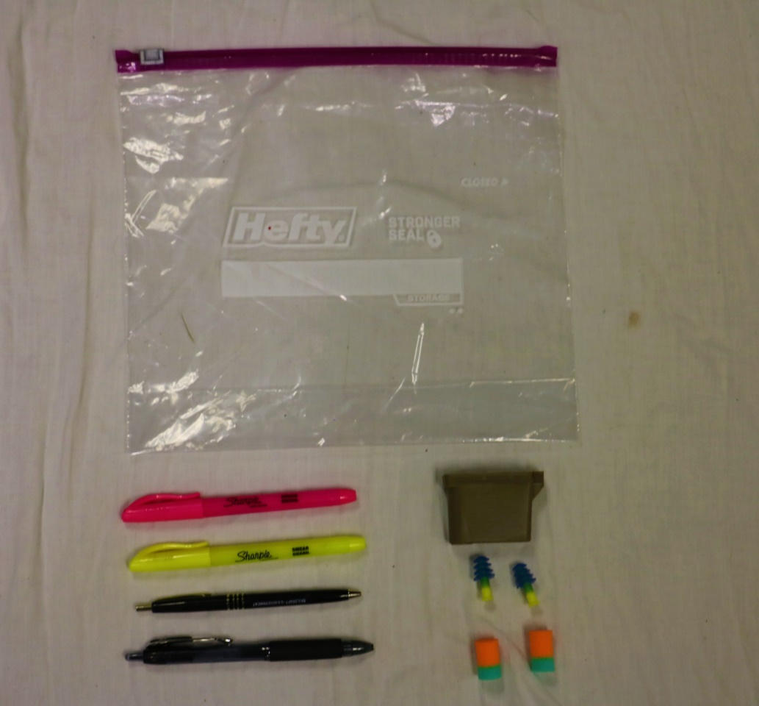
101st Airborne Division (AASLT)
Items Packed in Rucksack (1 of 3)
1-Gallon Sized Ziploc Bag
Must be black ink
Earplugs must have hard case
Note: Earplugs may be flange or foam

Slide 15
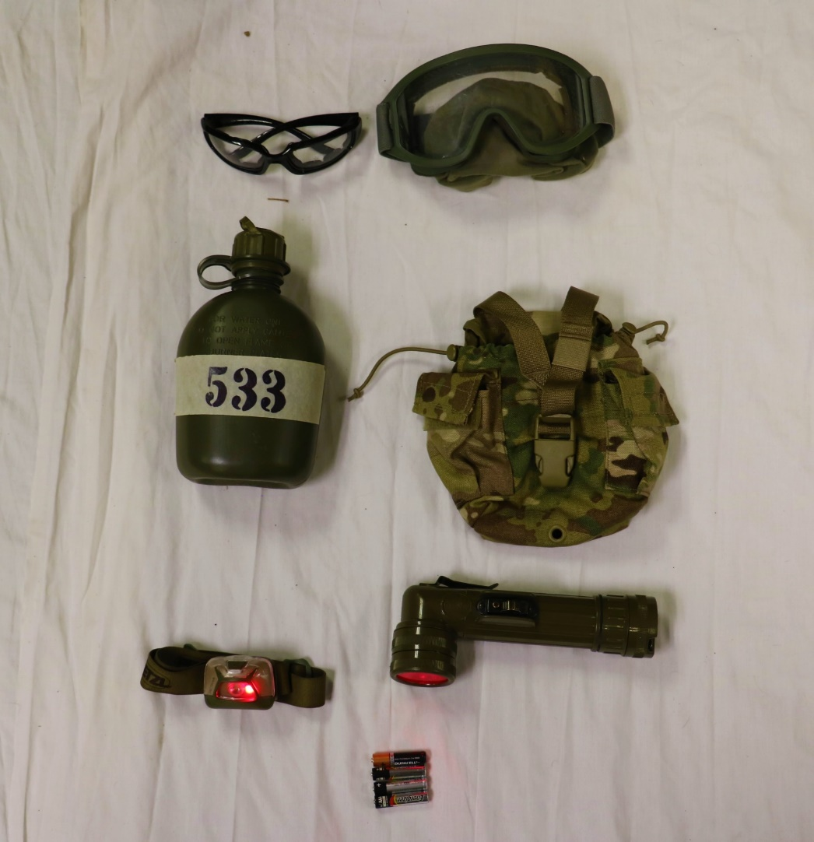
101st Airborne Division (AASLT)
Items Packed in Rucksack (2 of 3)
APEL Approved Eye Protection
Eye Pro OR Goggles
*Must have clear lenses*
Canteen must be full and have 2” masking tape
Dimensions: 2” Tall by 6” wide
Canteen Carrier
Red Lens Capable Flashlight
Headlamp OR L-Shape is authorized
NOTE: Additional Batteries must match flashlight

Slide 16
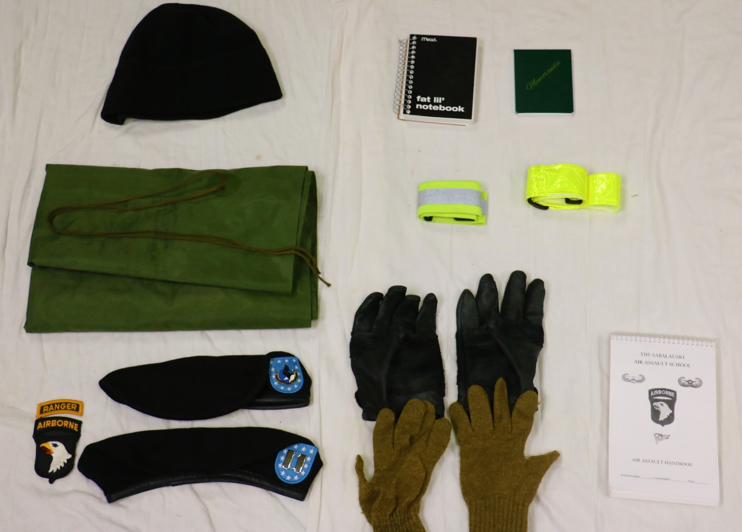
101st Airborne Division (AASLT)
Items Packed in Rucksack (3 of 3)
Must be black/tan
Must fit in cargo pocket
Must be yellow
Must have Velcro backing
Handbook:
*When Issued
Beret with appropriate items:
Enlisted: Unit Crest
Officer: Rank
Leather gloves with double friction bearing surface with inserts (70% or higher)
Must be AR 670-1 compliant

Slide 17
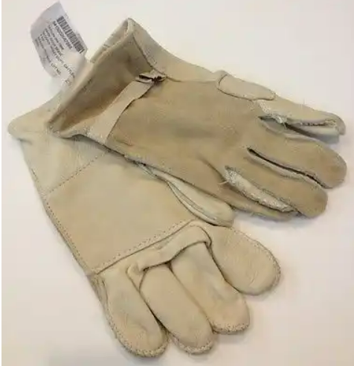
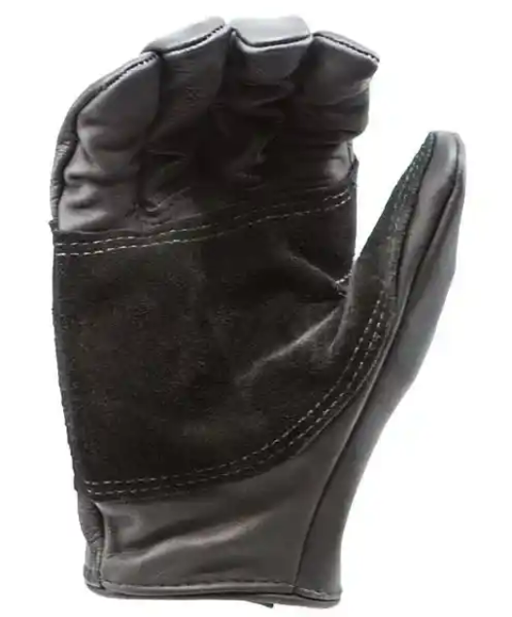
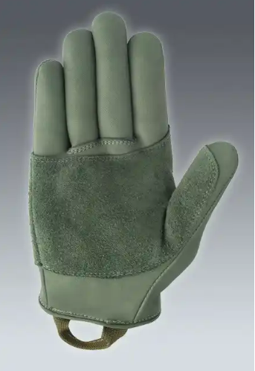
101st Airborne Division (AASLT)
Leather gloves with double friction bearing surface

Slide 18
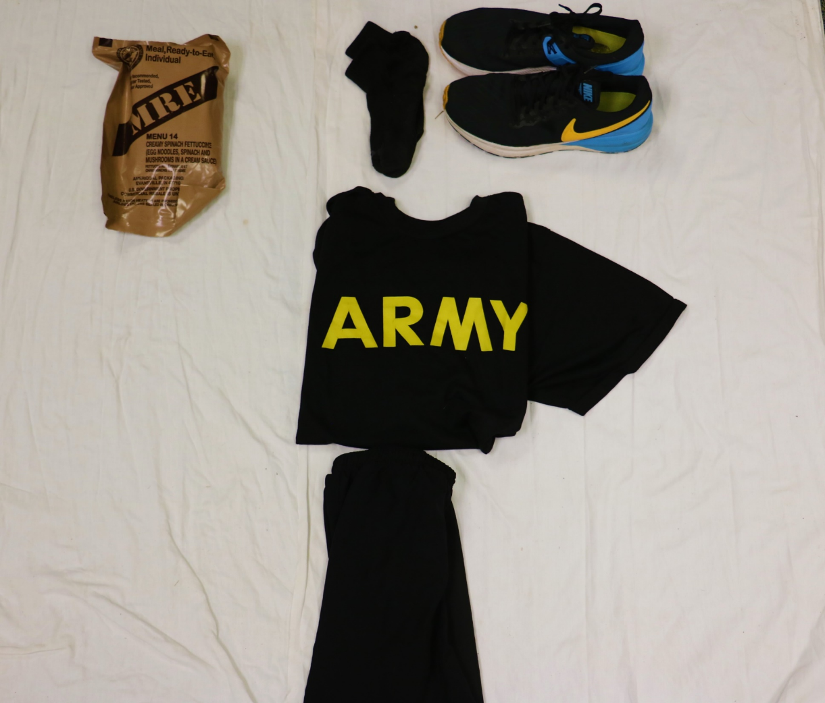
101st Airborne Division (AASLT)
Day 0 / Day 7 Items
Day 0 & Day 7
Day 0 Only
Day 7 Only
PT Socks
IPFU Complete

Slide 19
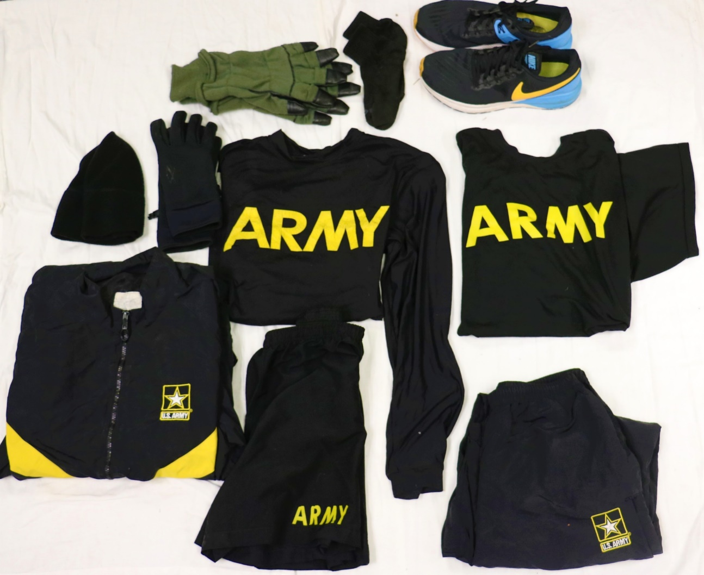
101st Airborne Division (AASLT)
Winter IPFU
Winter IPFU Complete:
(Day 7 Only)
IPFU Shorts
IPFU Short Sleeve Shirt
IPFU Long Sleeve Shirt
IPFU Jacket
IPFU Pants
Fleece Cap
Gloves
PT Socks
Running Shoes
**Additional Winter Items are required if Day 0 falls between 01 OCT through 01 April

Slide 20
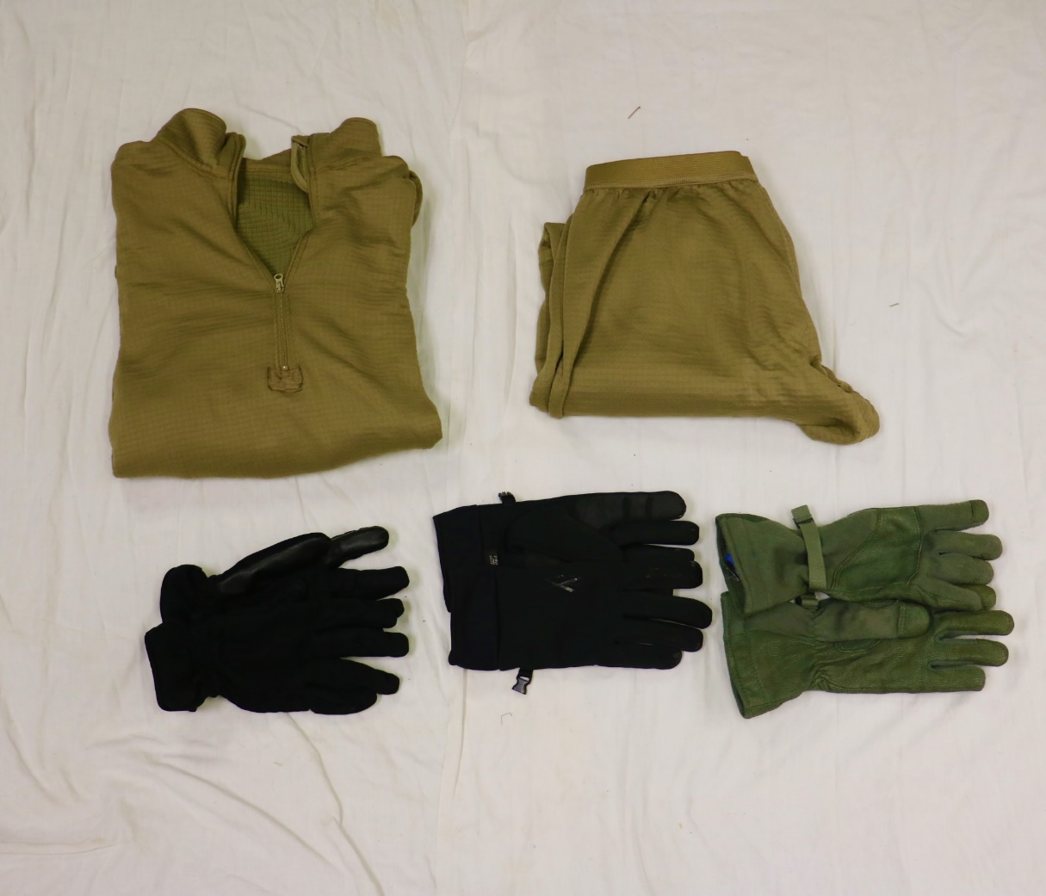
101st Airborne Division (AASLT)
Additional Winter Items
ECWCS Level II
(Waffle Top / Bottom)
AR 670-1 compliant gloves *Do not have to be military issue SUBDUED
**Additional Winter Items are required if Day 0 falls between 01 OCT through 01 April
Notes:
-I know winter gloves has been a little bit of an uncertainty. If we explicitly state ‘AR 670-1 compliant’ then we can enforce that. HOWEVER, we have to make sure the instructors know what that looks like so they can justifiably enforce it.

Slide 21
101st Airborne Division (AASLT)
PROHIBITED ITEMS
Cell Phones
Knives/Gerber/Leatherman/Lighters
GPS devices to include watches with storage capabilities (Whoop Bands and Aura Rings)
Headphones
Tobacco products/Vape devices/Energy Drinks, Nicotine pouches

Slide 22
101st Airborne Division (AASLT)
QUESTIONS

