Slide 1
PCF-RPA TRAINING
Requirement Process
Version Number
As of 02/13/2019

Slide 2
Training POCs
Director (787) 707-2489
Contracting Officer (787) 707-2487
Contract Specialist (787) 707-4528

Slide 3
RPA MISSION STATEMENT
Provide functionality within VCE-PCF that allows Contracting to define a virtual checklist and allow both Contracting and the Customer to collaborate / manage the documents needed establish a Complete / Actionable Requirement Package.

Slide 4
OBJECTIVES
Provide guidance in the following:
Importance of using Paperless Contract File (PCF)
PCF login Process
Requirement Package Assistance (RPA) TAB,
Provide guidance Upload, Update, Remove and delete documents.

Slide 5
IMPORTANCE OF PCF
Regulatory mandates-Compliance. Federal Acquisition Regulations (FAR), Subpart 4.5(a)—Electronic Commerce in Contracting.
Knowledge (DATA) retention
Ease communication within individuals
Conduct acquisition reviews using only data from the system of record
Maintain Log entries of execution timeframes
Eliminate physical space for filing cabinets and document storage.

Slide 6
PCF Log-in Process
There are two ways to Log In:
from VCE Modules Portal at https://vce.army.mil/Portal/Modules, or
using PCF direct link at: https://pcf.army.mil/

Slide 7
PCF Log-in Process: VCE Modules Portal

Slide 8
PCF Log-in Process: VCE Modules Portal cont.

Slide 9
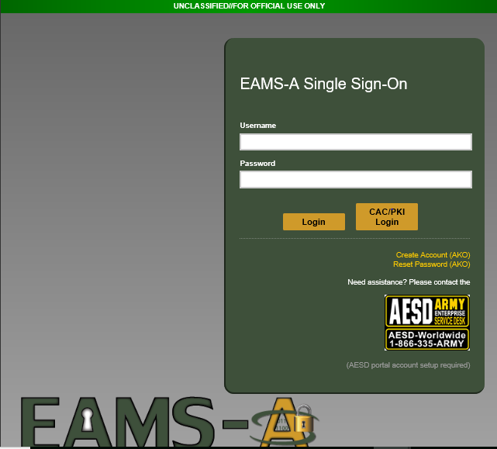
PCF Log-in Process: VCE Modules Portal cont.

Slide 10
PCF Log-in Process: VCE Modules Portal cont.

Slide 11
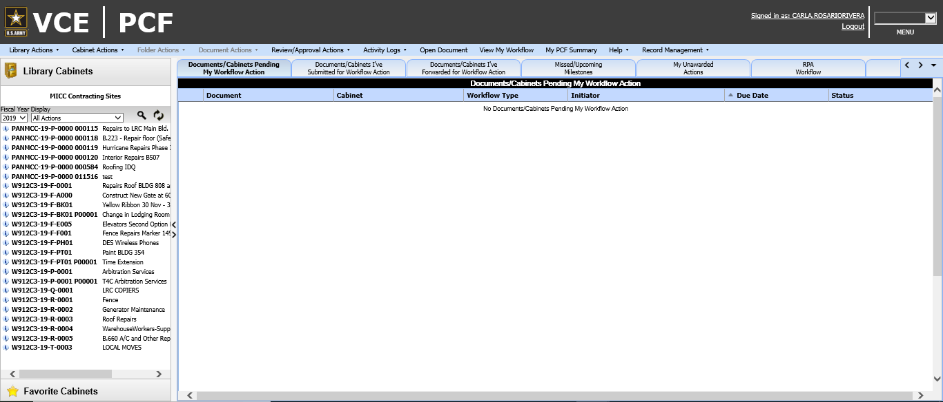
PCF Log-in Process: VCE Modules Portal cont.
PCF Main Page: Authorized view files are visible.

Slide 12
PCF Log-in Process: PCF direct Link

Slide 13
PCF Log-in Process: PCF direct Link cont.

Slide 14
PCF Log-in Process: PCF direct Link cont.
There is two screens that you may see.
Green screen AKO Login using CAC PKI or
PCF main page.
NOTE: If the individual had logged into AKO during his daily operations required by any other ARMY Page, it may take you directly to VCE PCF Main Page. Otherwise, it will take you to the green screen to AKO CAC/PKI Login.

Slide 15
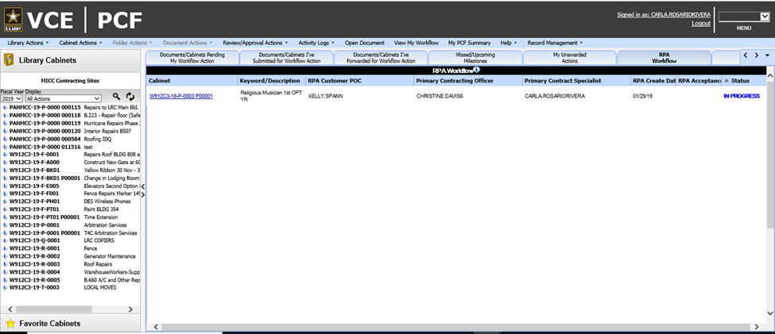
RPA Process

Slide 16
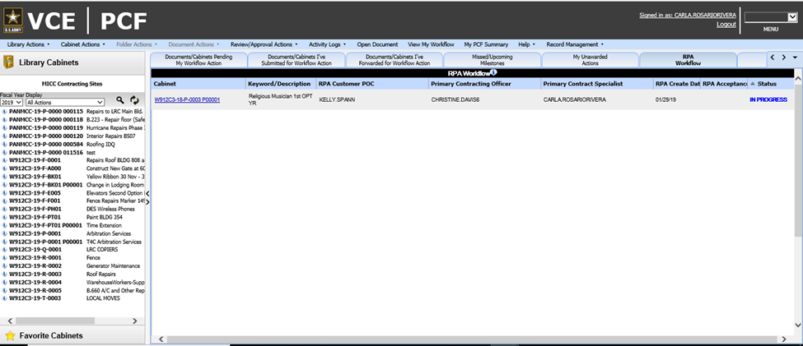
RPA Process cont.

Slide 17
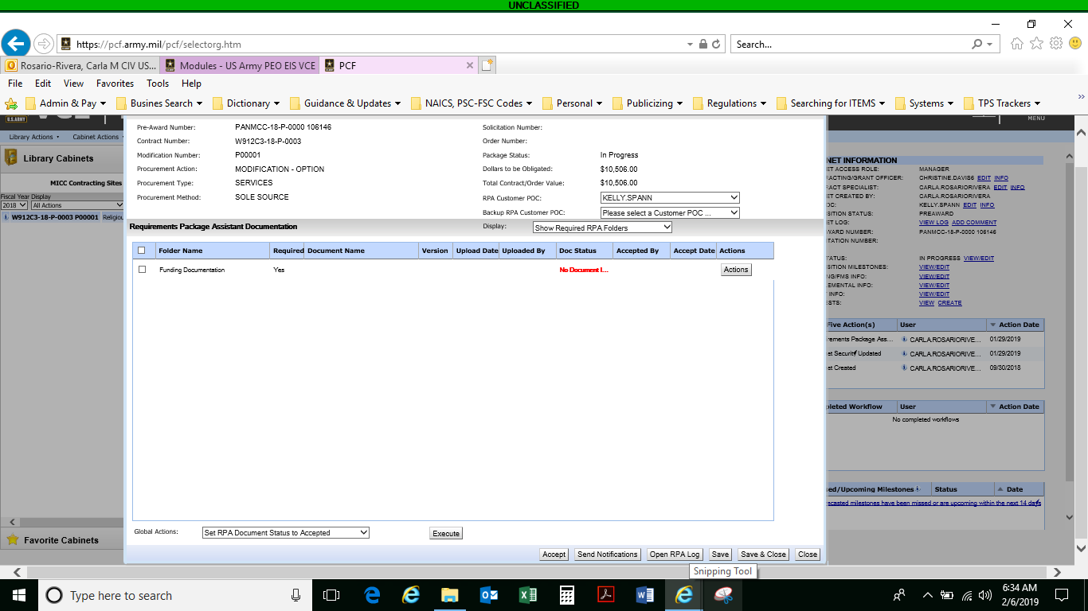
RPA Process cont.
Once Contract number is pressed, the RPA Documents request box becomes viewable. Here you will be able to see all required documents to process your requirement at MICC.

Slide 18
RPA Upload
If you already has the documents you will have two ways to upload
Directly to the PCF cabinet Folders, or
Upload via RPA document box

Slide 19
Upload Documents
Directly from PCF Cabinet
Select Folder you want to upload documents to,
On the top of the folder, Right Click
Options to upload becomes available

Slide 20
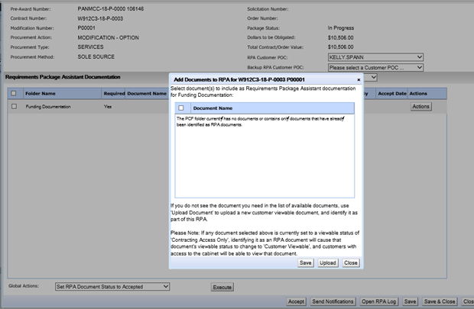
Submit Documents to RPA process
Action Button, Identify / Upload. If files show in the box you may select document from the list and safe.

Slide 21
Upload documents RPA Request box
If document are not listed inside the box just press upload.

Slide 22
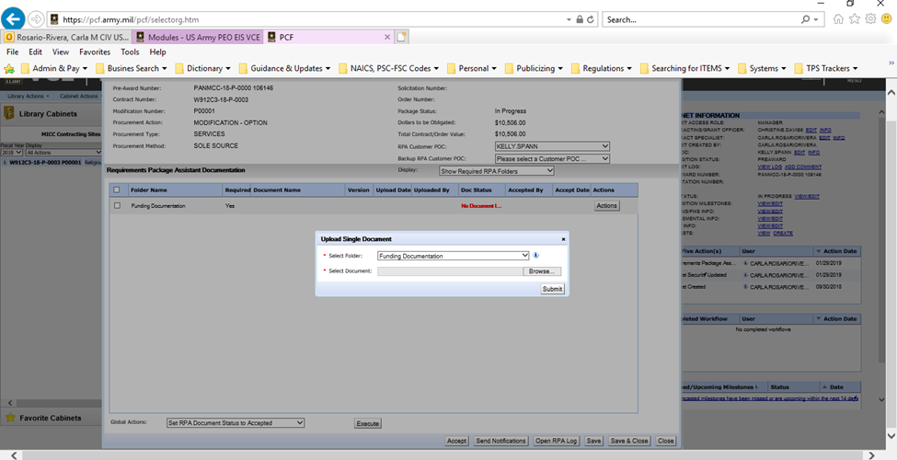
Upload documents RPA Request box cont.

Slide 23
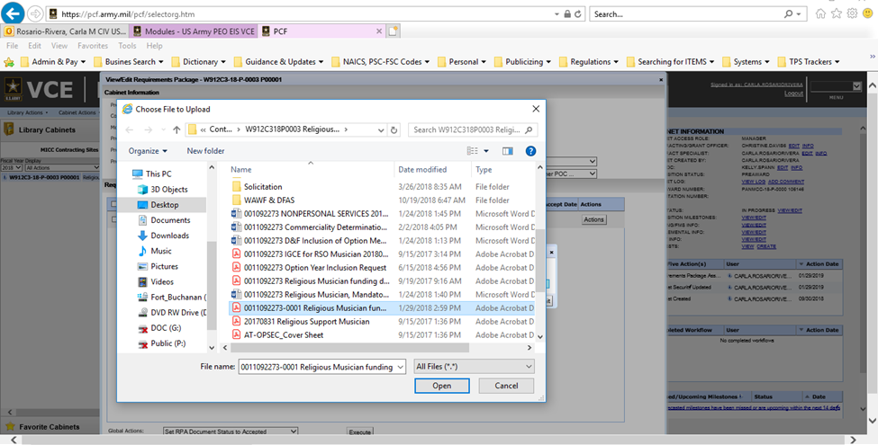
Upload documents RPA Request box cont.

Slide 24
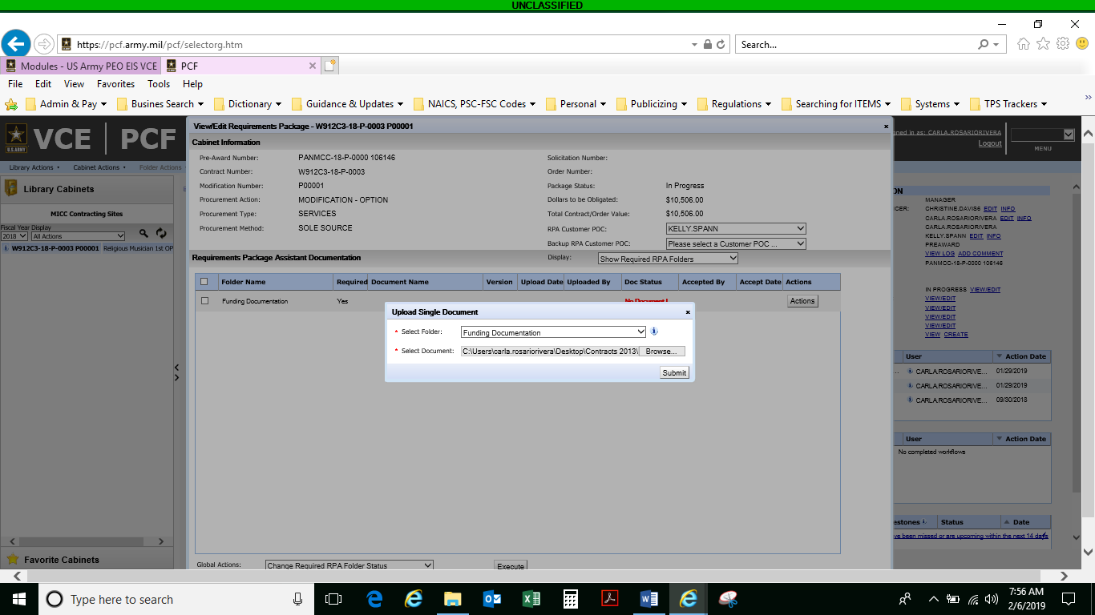
Upload documents RPA Request box cont.

Slide 25
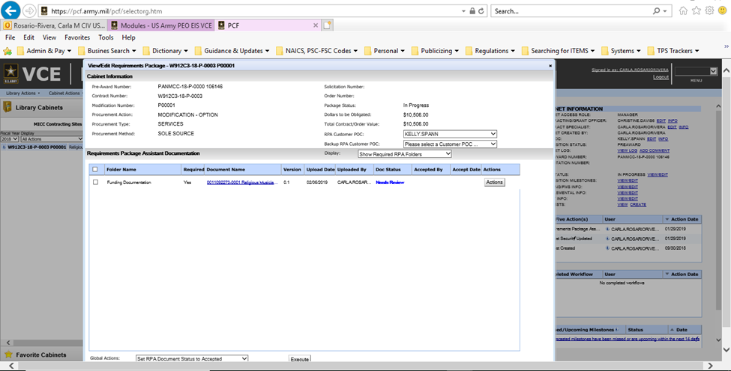
Upload documents RPA Request box cont.

Slide 26
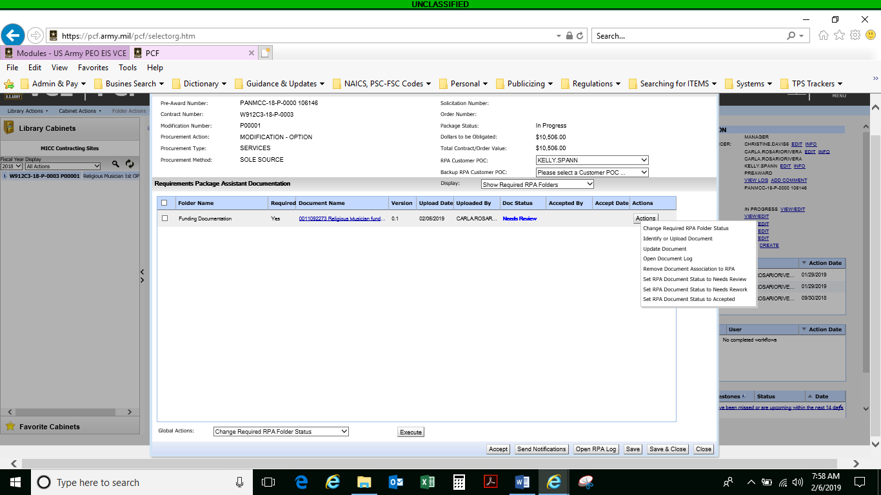
Upload documents RPA Request box cont.
Now you will be able to see additional status through the action button. Once the documents are correctly uploaded and status has change as required, press execute. Save & Close. It will take you to the Requirement cabinet folders.

Slide 27
Update RPA/File documents
OPTION #1
1) Inside the RPA box, select “Actions” and “update document”. Warning message will appear. Select “YES”

Slide 28
Update RPA/File documents Cont.
2) Browse updated document required to be uploaded in the computer

Slide 29
Update RPA/File documents Cont.
3) Search for Contract file Folder and Select copy that you want to upload. Press Open and Upload file.

Slide 30
Update RPA/File documents Cont.
OPTION # 2
1) Directly from Requirement Cabinet, Right Click on top of the document and select “Update Selected Document”. Warning message will appear. Select “YES” and follow steps 2 and 3 in Option 1 above

Slide 31
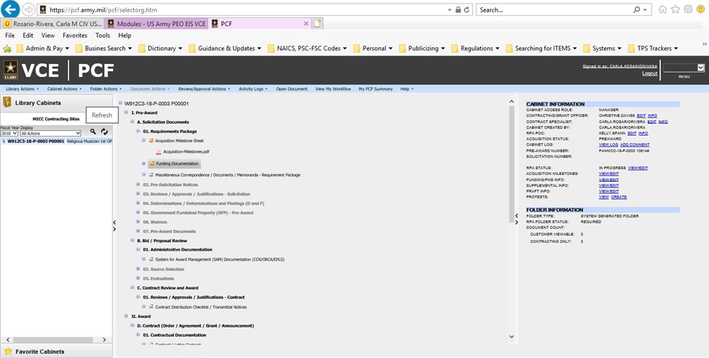
Upload documents RPA Request box cont.
Requirement cabinet folders

Slide 32
Return RPA

Slide 33
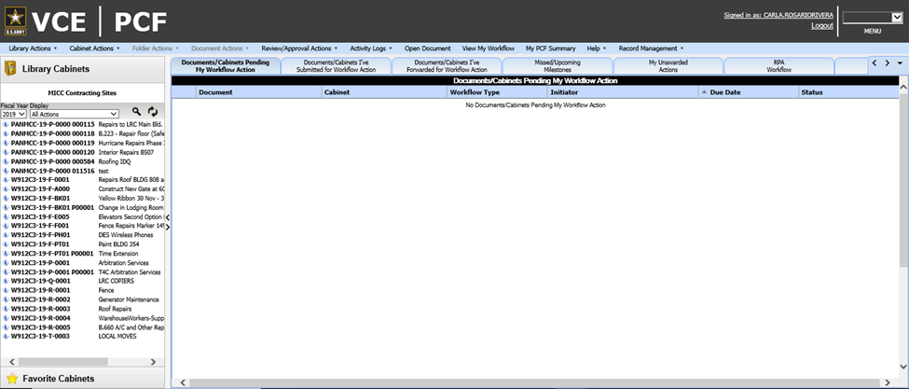
Return RPA Tab cont.
You may also Press refresh button, it will take you to the main PCF table. RPA tab will become available.

Slide 34
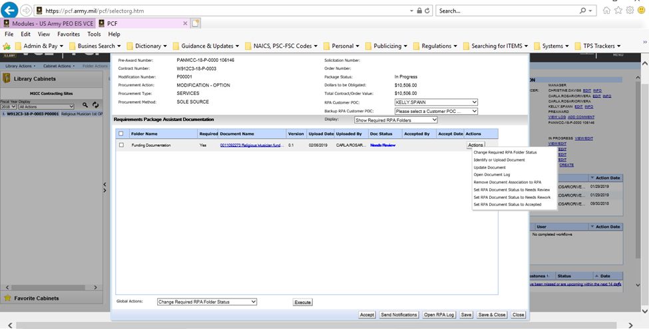
Remove file from RPA process

Slide 35
Remove file from RPA process cont.
NOTE: This action only remove the document from RPA process consideration and DOES NOT delete the document from file.

Slide 36
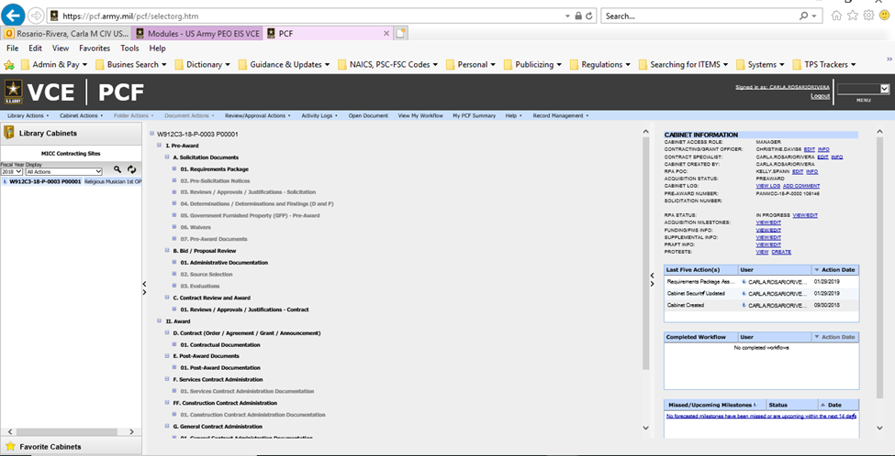
Delete file from Cabinet
If you upload the wrong document, there is only one way to effectively delete documents: Directly from requirement cabinet.

Slide 37
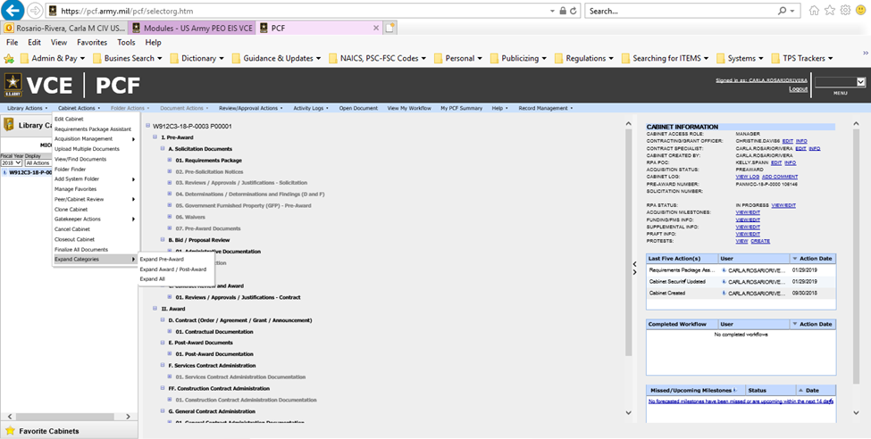
Delete file from Cabinet Cont.
Search the file to delete. Select Cabinet Actions, Expand Categories, expand all. This allow all document to be view.

Slide 38
Delete file from Cabinet Cont.

Slide 39
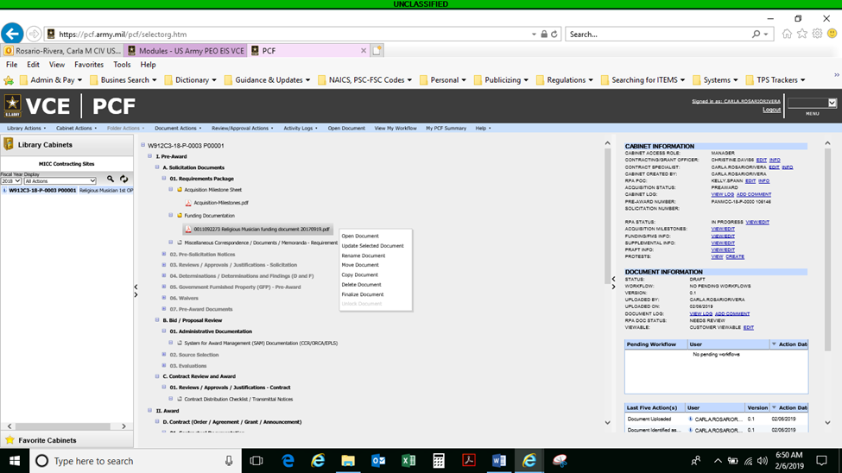
Delete file from Cabinet Cont.
Now that all document are viewable, select the document to be delete, right click on top of the document, from the options select delete.

Slide 40
Delete file from Cabinet Cont.

Slide 41
Delete file from Cabinet Cont.
If is only one document and has not been updated or just want to delete the last draft copy updated, select “delete this document DRAFT” and confirm deletion.
NOTE: It will only delete the last document uploaded, DOES NOT delete previous versions.

Slide 42
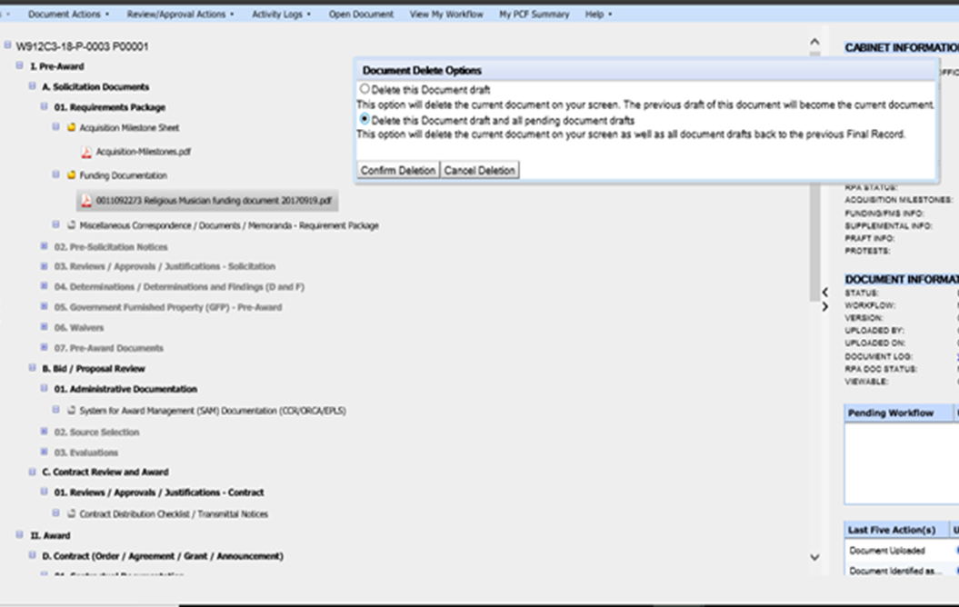
Delete file from Cabinet Cont.
If document to be delete needs to be removed entirely, then select “delete this document DRAFT and all pending document drafts” and confirm deletion. This will delete the document entirely from the folder and PCF cabinet.

Slide 43
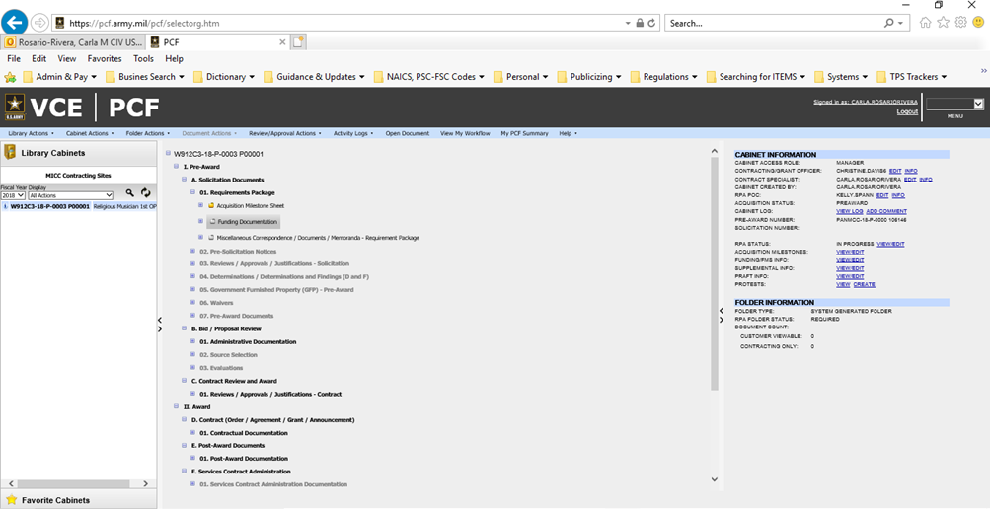
Delete file from Cabinet Cont.
Verify document has been deleted entirely, folder will change back from yellow to gray.
NOTE: If you only delete a version of the document, then the folder will remain yellow. Individual is responsible to ensure the last version in file is the correct one.

Slide 44
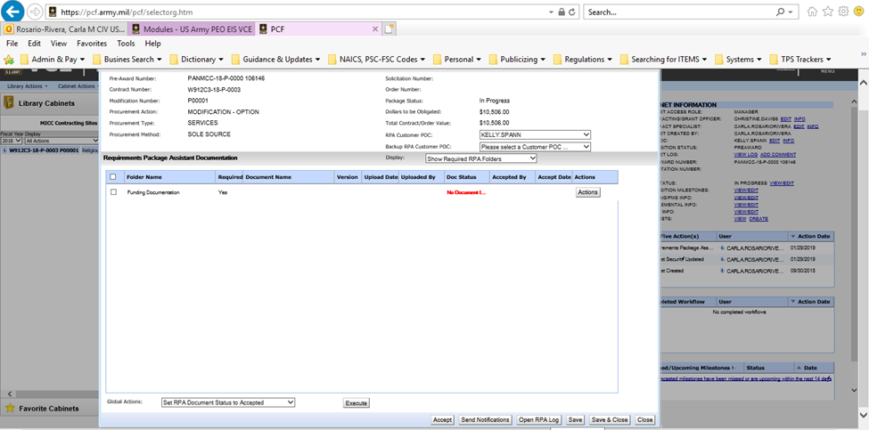
Delete file from Cabinet Cont.
If document was deleted from file and was in RPA process, then RPA document BOX and status will change back to “No document”

Slide 45
QUESTIONS?

