Slide 1
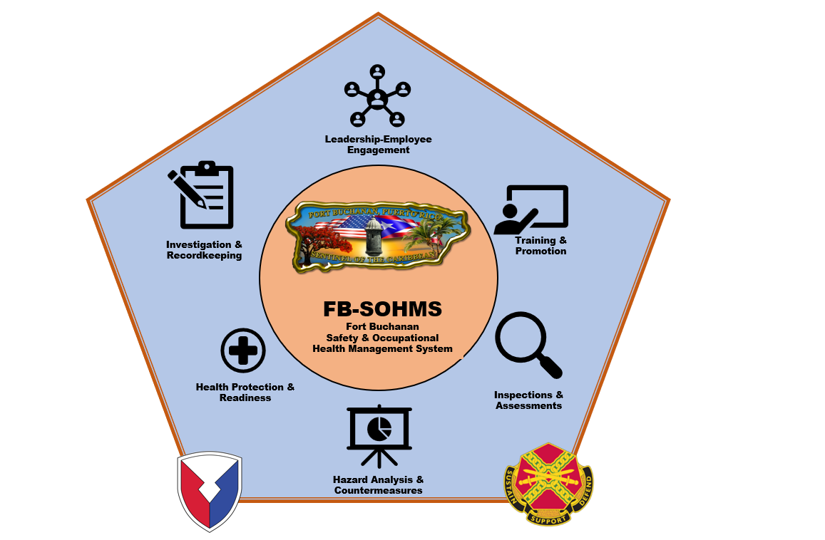
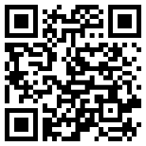
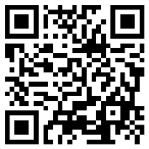
IMPORTANT THINGS TO KNOW
To Report a Mishap
How do I report workplace hazards?
Report the hazard to your supervisor, unit safety officer, or Installation safety manager. Discuss at safety committee meetings.
What about mishap reporting?
Report near misses to your supervisor. Reporting and investigating near misses can highlight otherwise overlooked workplace hazards.
To Report an Unsafe or Unhealthful Condition
How to stay actively engaged in your safety program:
Participate in workplace inspections, shadow a near miss or mishap investigation, participate in safety committees.
US ARMY GARRISON
FORT BUCHANAN
SAFETY AND OCCUPATIONAL HEALTH SAFETY MANAGEMENT SYSTEM
(FB-SOHMS)
CONTACT US
Installation Safety Office
Bldg. 390, 3rd floor, suite 312
Office: (787) 707-3853
Cellphone: (787) 600-4478
usarmy.buchanan.imcom-atlantic.list.safety@army.mil
Fort Buchanan Emergency Numbers
Police Emergency (787) 707-4911
Fire / Medical (787) 707-5911

Slide 2
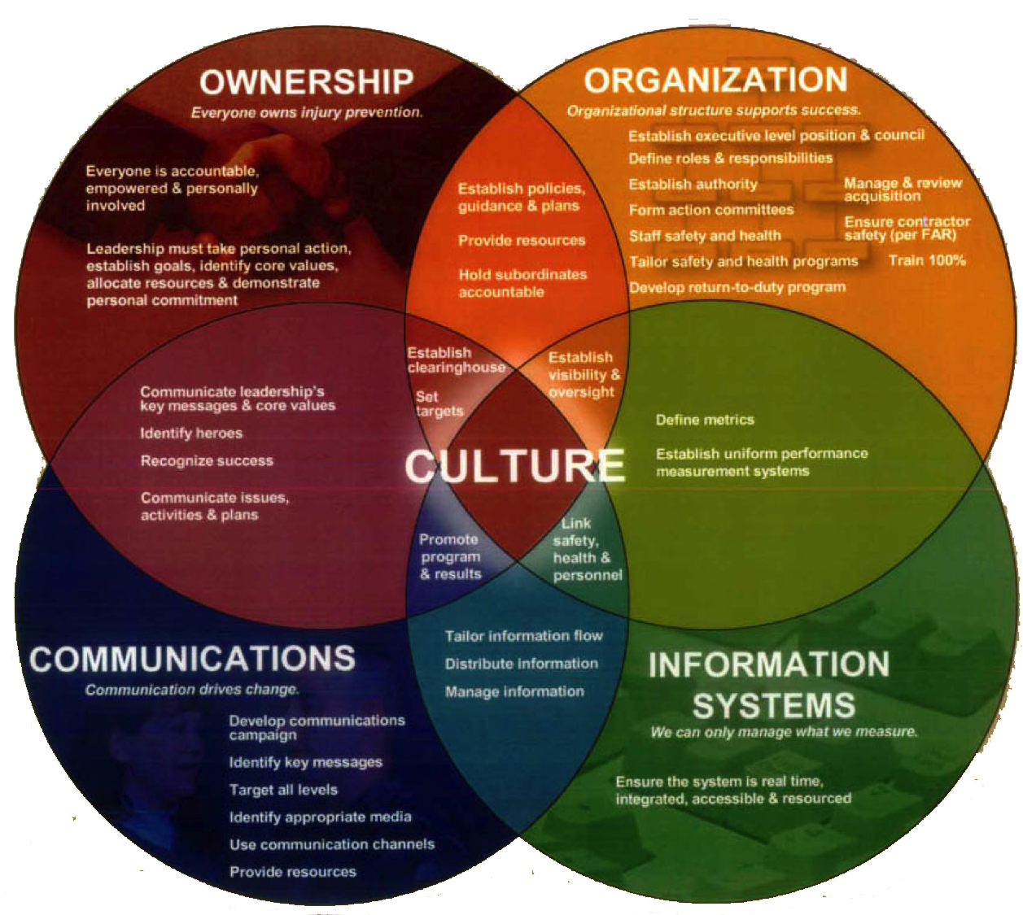
FB-SOHMS Capability Objectives
What is my role and how do I help achieve our goals?
FB-SOHMS is a proactive approach to enhancing workplace safety by identifying, evaluating, and mitigating potential hazards that may put employees at risk. By doing so, it fosters a healthier and more trustworthy work environment that encourages continuous learning and improvement. The program relies heavily on the active participation of frontline employees, who play a vital role in shaping a successful safety culture and driving better safety performance.
1. Leadership / Employee Engagement
Manager must provide visible leadership by:
Establishing clear lines of communication
Creating conditions to enable reasonable employee access to leaders without fear of reprisal
Setting the example of safe and healthful behavior
Protect personnel, equipment and facilities using the risk management process
Provide the resources needed to implement the SOH program
Ensuring the alignment of all personnel in support and understanding of the organization’s safety objectives.
2. Investigations & Recordkeeping
Providing effective written processes for reporting and conducting effective mishap and near-miss investigations.
3. SOH Training & Promotion
Identifying training needs and providing a training program with content relevant to the organization.
Managers and leaders act as role models to promote trust and openness around safety
4. Inspections & Assessments
Employee involvement and responsibilities:
Participate in the SOH problem identification and resolution
Notify supervisors of hazardous conditions and practices
Participate in committees, audits and investigations
Take immediate corrective action upon identification of a hazardous condition or act that could result in personal injury and / or damage to equipment
STOP any operation or process that would immediately endanger life, health or property
Performing inspections that identify safety hazards associated with unforeseen hazards.
5. Hazard Analysis & Countermeasures
Using a hazard identification and analysis system to identify, document and control occupational health hazards.
FB-SOHMS Cultural elements
Ownership-Everyone owns prevention efforts.
Organizational structure support.
Communication- Drives change.
Information Systems- Manage what we measure.
6. Health Protection & Readiness
Communicating safety issues and associated risk and ensuring all required health exams have been completed
You are our most valued resource!

