Slide 1
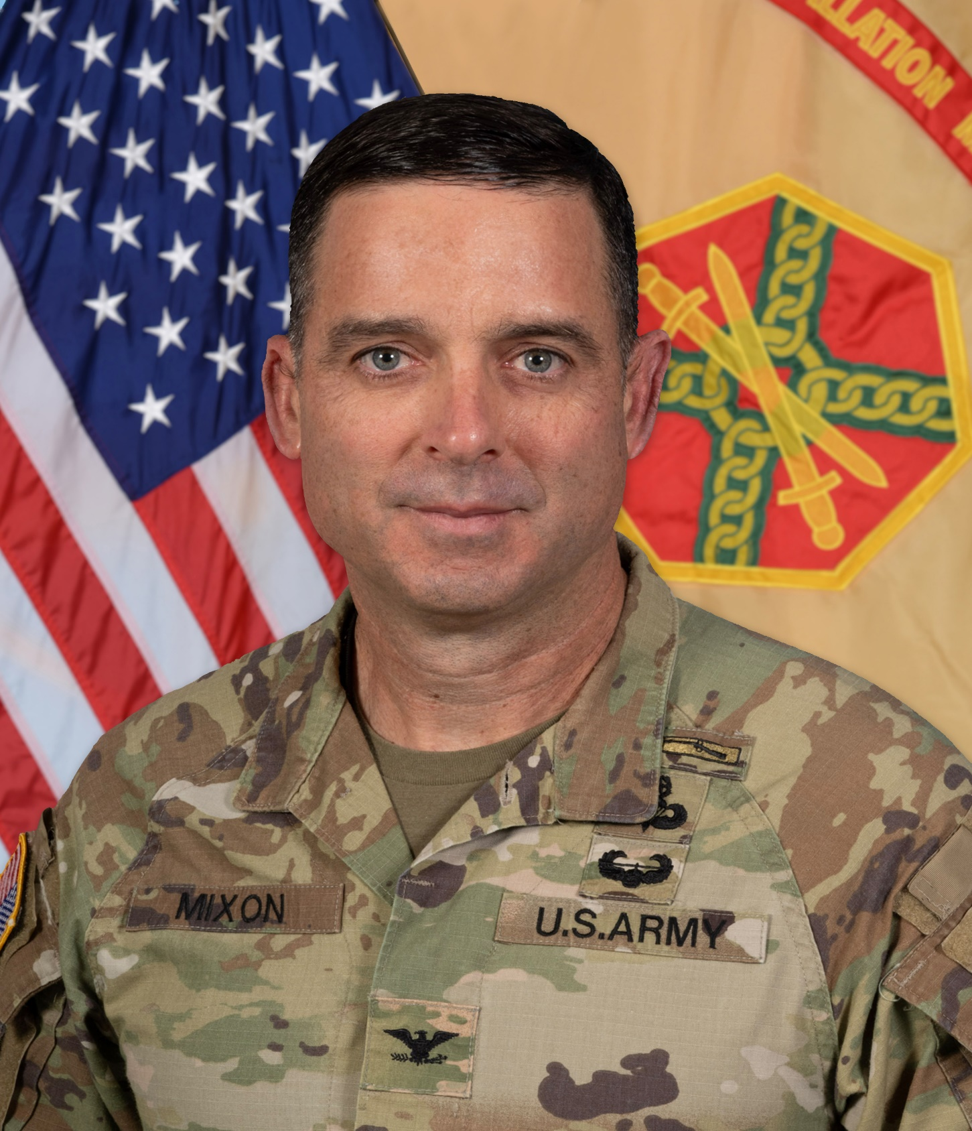
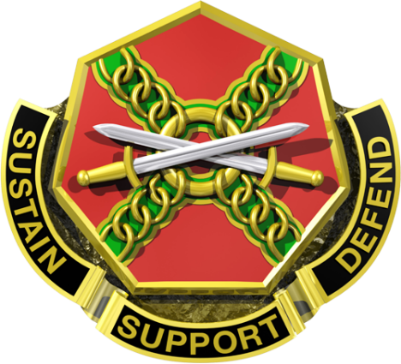
COL John Wilcox
Garrison Commander, Fort Liberty
COL Chad Mixon
Garrison Commander, Fort Liberty

