Slide 1
Munitions Constituents Sampling
Closed Castner Firing Range
Fort Bliss, TX
TPP Meeting
20 October 2010

Slide 2
Agenda
Defining the Problem
Project Objectives
Project Goals
Where do we plan to sample?
How do we plan to sample?
Schedule & Questions

Slide 3
Defining the Problem
Castner Range is a large site (7,007 acres)
Varied types of firing ranges and munitions types used from 1930s – 1960s
Heterogeneous distribution of munitions constituents (MC).
How to determine presence/absence of MC?
If presence of MC, how to determine nature and extent of contamination?
Unknown future land use
Many MMRP Sites around the country have the same problems.

Slide 4

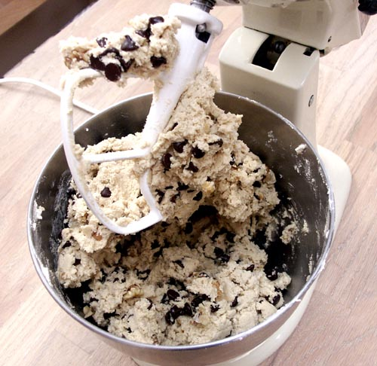
The Problem:
Heterogeneous Chunks (Chips)
Heterogeneous:
  Put 10 chips into a cookie recipe
  Bake 100 cookies
  Majority of cookies (samples) will have zero chips (underestimating chocolate concentration)
Homogeneous:
  Try it again but, this time, grind and blend the dough until the chocolate is evenly distributed throughout
  Every cookie (sample) will have a representative amount of chocolate (makes really bad cookies though)
4

Slide 5
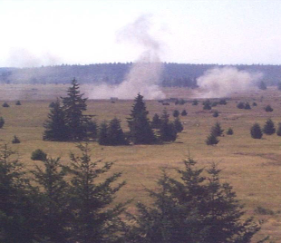
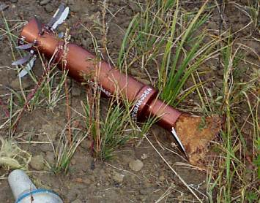
Munitions
Constituents (MC)
Energetics (examples):
  Nitramines (RDX)
  Nitroaromatics (TNT)
  Nitrate Esters (NG)
Metals (examples):
  Lead
  Antimony
  Zinc
  Copper

Slide 6
Heterogeneity of
Explosives in Soils
14 Samples from a 4 ft circle:
Range from
136 – 42,800 ug/kg
Mean = 14,900 ug/kg
Median = 1,220
Relative Standard Deviation = 120%
1.2% of area sampled
6

Slide 7
Project Goals
Implement and test the effectiveness of the Army’s Incremental (MI) Sampling Protocol on the Closed Castner Firing Range, Fort Bliss, TX
Gain regulatory acceptance of MI sampling approach and results
Characterize MC at Castner Range (will not be 100%)
Test some hypotheses about the MI sampling approach on Castner Range

Slide 8
Study Objectives
Collect data in a manner that allows for use under Texas Commission on Environmental Quality (TCEQ) Texas Risk Reduction Program (TRRP)
Determine presence or absence of munitions constituents (MC) (energetics and metals)
  If presence of MC, then determine nature and extent through comparison to TRRP Protective Concentration Levels (PCLs)
TCEQ accept sampling results for use in future investigation and remediation efforts
  Using Texas Accredited Laboratory
  Validating Data in accordance with TCEQ TRRP guidance document, TRRP-13 Review and Reporting of Chemicals of Concern (COC) Concentration Data

Slide 9
Proposed Study Questions
How to determine presence or absence of MC using a representative concentration approach?
Are MC present on Castner Range? If so, are they above regulatory concentrations?
What is the effect of sampling unit size on MI sampling results (MC concentrations)?
What is the correlation between Munitions and Explosives of Concern (MEC) and Munitions Debris (MD) density on MC concentrations?
What modifications to the Army MI Sampling Guidance would make implementation more effective and efficient in the context of an Military Munitions Response Program (MMRP) Remedial Investigation (RI)?

Slide 10
Sampling Strategy
Determine Sampling Design
  random sampling, biased sampling, stratified sampling, systematic sampling
Identify Sampling Units (number and size)
Determine appropriate PCLs and ecological benchmarks for metals
Implement Army’s Incremental Sampling Protocol and EPA Analytical Methods
(8330B and 6010B)
Use data to determine nature and extent of contamination

Slide 11
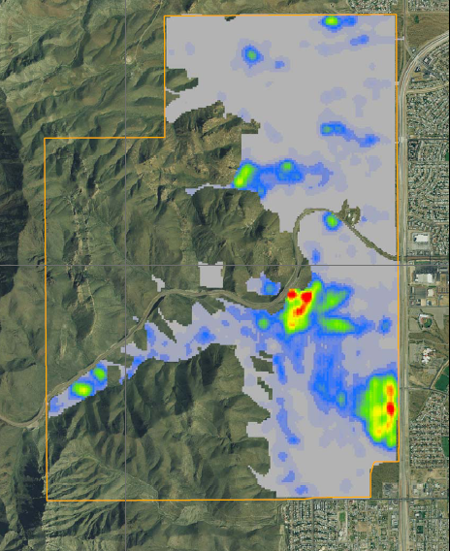
Sampling Area

Slide 12
Sampling Area Design
Stratify site into “like areas” using previously collected geophysical data
Low anomaly densities (unlikely to find MC): 0 - 300 anomalies per acre
Medium anomaly densities (may find MC): 300 - 700 anomalies per acre
High anomaly densities (likely to find MC): >700 anomalies per acre
Stratifying site increases validity of “homogeneity” assumption. Increases power of random samples. Increases accuracy of estimates. Answers study question #4.
Notes:
Stratifying the site to increase validity of “homogeneity” assumption. A key point is that this helps us use the geophysical data that has already been collected at the site, which maximizes the use of the dollars spent to date. This means that we are increasing the power of random samples. Increasing the accuracy of the estimates and reducing the possibility of having outliers in the data set. This simplifies and clarifies the evaluation process as we move forward.

Slide 13
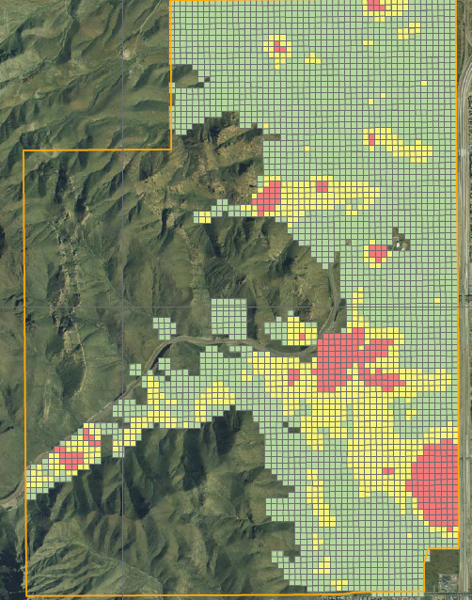
Stratified Sampling Area

Slide 14
Creating Sampling Units
Divided the accessible areas into 1-acre sampling units
  Approximately 3,700 possible sampling units
Randomly select 60 1-acre sampling units within each strata
  Low areas: 60 samples
  Medium areas: 60 samples
  High areas: 60 samples
Approach allows us to draw conclusions, with 95% confidence, that the sample results are representative of all the 1-acre sampling units within each strata (high, medium, & low)
  If no “detects” of MC in a strata, we are 95% confident there will be no detects of MC in at least 95% of the remaining of 1-acre parcels in that strata.
  If mean concentration of samples is X, we can be 95% confident that the actual mean concentration of all units within a strata is within ±2 standard errors of X.
Notes:
Why 1 acre parcels?
1 acre reflects pretty realistic parcel for sale/use.
Provides a large enough population of parcels within each strata to allow for statistically significant sample size.
Small sampling units allows for ease of sample collection
MIS was designed to be representative of relatively small sampling units (confidence of representativeness increases as sampling unit size decrease).
While we do look at whether a 1-acre sampling(decision) unit passes or fails, we are able to obtain a contamination concentration level for each sampling unit. When we look at the concentration levels, it is no longer a binomial (0,1) distribution.
For each strata, we will have 50 sampling(decision) units, each one with a concentration level attached for each contaminant of interest.
With 50 observations per strata, we have should more than enough data to construct a robust 95% confidence intervals for contamination levels.

Slide 15
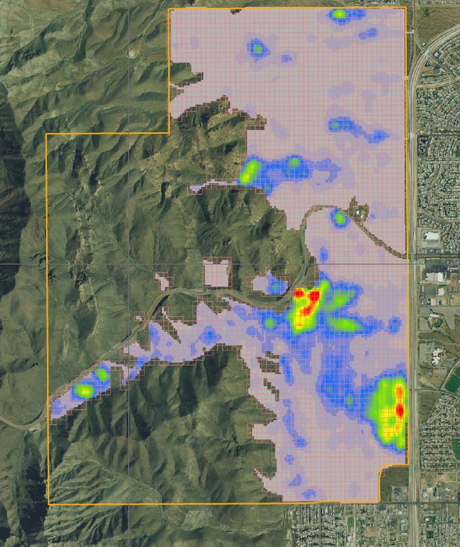
Sampling Units

Slide 16
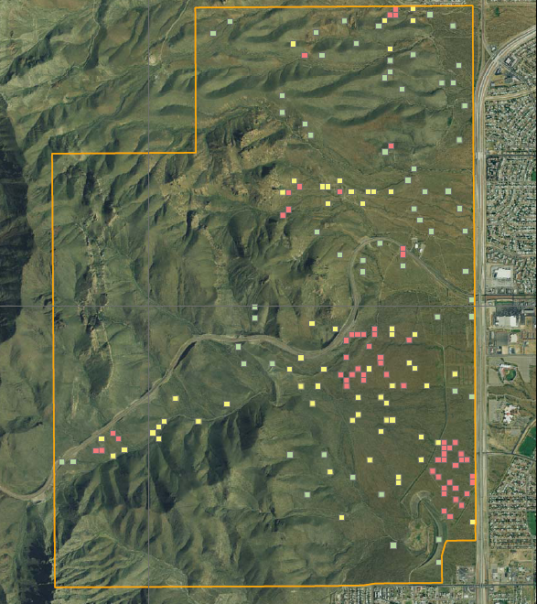
Stratified Sampling Units

Slide 17
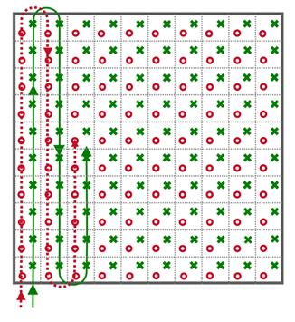
Sampling Effort #1
Take a 100-increment sample within each selected 1-acre sampling unit
  60 samples in low areas
  60 samples in med areas
  60 samples in high areas
10% Sample Replicates (triplicates)
Shallow surface soils (5cm)
Uniform sample depth
Uniform sample size
One MIS with Duplicate
Determines presence or absence of MC within each 1-acre sampling unit, within each strata, and within the site. Also, provides insight into nature and extent of MC.

Slide 18
Sampling Effort #2
A research effort to test sensitivity of sampling unit size on MI sampling results (MC concentrations)
Two approaches (still a work in progress and likely to change):
  Sample 10-acre sampling units that include previously sampled 1-acre units.
  Create “virtual” 10-acre sampling units incorporating 10 previously sampled 1-acre units.

Slide 19
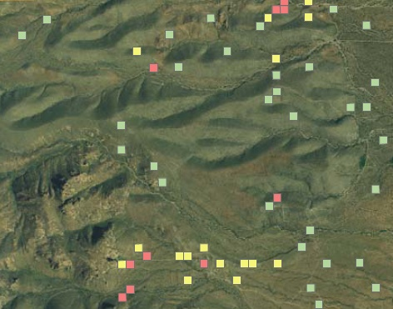

Sampling Effort #2:
Approach 1
Create 10-acre sampling unit including previously sampled 1-acre units
Sample 15, 10-acre units
  5 in “low” areas
  5 in “medium” areas
  5 in “high” areas
Take 10 increments per each 1-acre unit to make 100 increments per 10-acre sampling unit
Pros: Allows us to draw conclusions about contiguous areas.
Cons: Introduces variability associated with sampling units previously not sampled. (Not purely a test of the effect of sample unit size.)
19

Slide 20
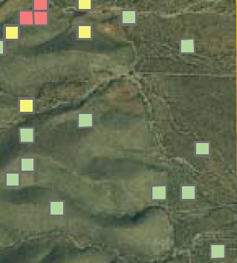
Sampling Effort #2:
Approach 2
Use previously studied
1-acre sampling units
Create 15, virtual 10-acre sampling units
  5 in “low” areas
  5 in “medium” areas
  5 in “high” areas
Take 10 increments per each 1-acre unit to make 100 increments per 10-acre sampling unit
Pros: Pure test of the effect of sample unit size on MIS results.
Cons: Does not allow us to draw conclusions about contiguous areas.

Slide 21
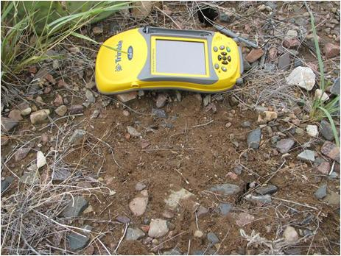
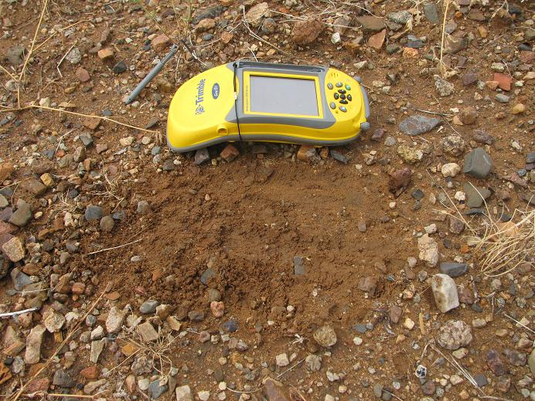
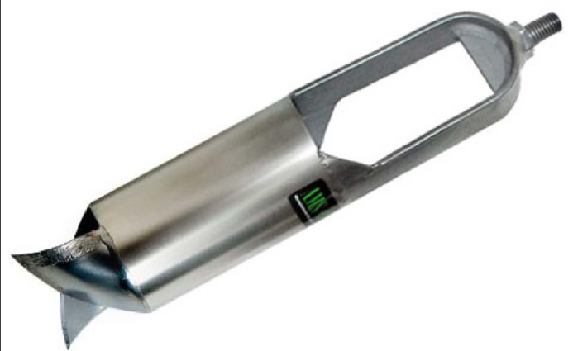
Sampling Tools
Sandy soil with lots of rock
Looking for tool ergonomically sound, standard size, & fast
Testing tools tomorrow
(21 Oct 2010)

Slide 22
Laboratory Analysis
Sampling for presence/absence of energetics and metals
  EPA Method 8330B (explosives)
  EPA Method 6010B
  (metals)
Using TX Accredited Laboratory

Slide 23
Data Screening
To define nature and extent, analytical results will be screened against the most current (March 2010) Protective Concentration Levels (PCLs)
Data initially screened against Tier 1 Residential PCLs for 30-acre source area (most conservative)
Select PCLs in accordance with TRRP using the lower of the:
  ^{Tot}Soil_{Comb} : Protective of the Total Soil Combined exposure pathway (includes direct contact with soils, ingestion of soils)
  ^{GW}Soil_{Ing:} Protective of pathway for leaching of soil contaminants to groundwater (assumes a Class 1 or 2 groundwater)
  ^{Air}Soil_{Inh-v}: Protective of the inhalation of contaminants in soil volatilizing into the air exposure pathway.
  For metals, compare value to background. If background higher, use background in lieu of TRRP PCLs.
Data, if detected concentrations exceed PCLs, will be compared to ecological benchmarks

Slide 24
Data Screening:
What does this mean?
We are going to compare our results two ways:
  Against TCEQ established levels (Protective Concentration Levels (PCLs)) including background for metals
  Ecological benchmarks if we have detections
If sampling results for individual sampling units exceed PCLs and/or background, review historical information and evaluate magnitude of exceedance before drawing conclusions.

Slide 25
TCEQ PCL Screening Levels

Slide 26
Schedule & Way Ahead
October – November 2010: Develop Work Plan and Quality Assurance Project Plan
  Sampling Approach
  Laboratory Standard Operating Procedures
  Data Validation Procedures
February 2011: Soil Sampling
March – May 2011: Analytical testing and report writing

Slide 27
Questions

