Slide 1
USAG Fort Bliss
Directorate of Human Resources /JMFGI
MOB/DEMOB/TRANSITIONS
Directorate of Human Resources/JMFGI
U.S. Army Installation Management Command
As of: 281500JUN2023

Slide 2
DHR/MPD Mobilization/Demobilization Brief
!!!HOT SUBJECTS !!!
DD 214s not Uploaded to iPERMS in a timely manner
IAW AR 635-8 ,Copy 2 (Service). If the DD Form 214 is prepared in TRANSPROC and digitally signed by the official authorized to sign (block 22), copy 2 will be automatically forwarded to the interactive Personnel Electronic Records Management System (iPERMS) on the first workday after the separation date. If signed after the separation date, the DD Form 214 will be forwarded to iPERMS on the next workday.
Soldiers/ Units receive a hard copy of the DD214 at validation from the S1 DEMOB team, ensuring safeguarding documents. Avoid scanning DD 214 into iPERMS until the individual can verify if iPERMS has updated the Soldier records from ISM/TRANSPROC to IPERMS to avoid duplicates in the system.
Directorate of Human Resources / JMFGI / 569-6044 / usarmy.bliss.imcom.list.dhr-mpd-jmfgi@army

Slide 3
DHR/MPD Mobilization/Demobilization Brief
!!!HOT SUBJECTS !!!
Transitional Assistance Management Program(TAMP) after the separation date known issues:
Once DEERS is updated, there is a delay with TRICARE seeing the eligibility for coverage. The only suggestion is for the SMs to continuously follow up with TRICARE to ensure the enrollment is correct. POC: Service and Support Division, Army Reserve G1,DEERS/ RAPIDS Program Manager Contractor, Phone: 910.570.8291 Call the DMDC/DEERS Support Office (DSO): (800) 538-9552. Keeping your DEERS records current helps speed your TRICARE medical benefits.
Email: DSO Support Office dodhra.knox.dmdc.mbx.dmdcbenesupport@army.mil
**DISCLAIMER: Do NOT send any documents containing personally identifiable information (PII) (e.g. DD214, Service Orders, SSN Cards, etc) via email as this is unsecured. In addition, it is a violation of DoD and DMDC policy (per OMB M-06-16 and NIST SP 800-53) and DODI 8500.2. Emails containing sensitive information will be deleted.
Soldiers need to register in DEERS to get TRICARE. (DEERS). TAMP eligibility can be viewed online via milConnect. Service personnel departments will provide information or assistance with your TAMP eligibility.
TAMP TRICARE Coverage During Terminal Leave
You aren’t eligible for TAMP while on Terminal Leave. During terminal leave, you get active-duty benefits, and your family members stay covered under TRICARE Prime, TRICARE Prime Remote, or TRICARE Select.
Directorate of Human Resources / JMFGI / 569-6044 / usarmy.bliss.imcom.list.dhr-mpd-jmfgi@army

Slide 4
DHR/MPD Mobilization/Demobilization Brief
!!!HOT SUBJECTS !!!
Smart Pay Travel Vouchers returned due to incorrect MOB/TCS orders Additional Duty Locations Missing
Units are required to request Amendments to MOB/TCS orders Add Other Duty Locations in the Theater of Operations. Once the ASCCs has validated the additional duty location information, they will generate a REQUEST in DAMPS-OCOTCS and forward the request to the GENERATOR of the installation that produced the original TCS order. The Installation Generator will review the request and GENERATE the amendment as appropriate. DAMPS-OCOTCS Team.
Base Funding of TCS orders by ASCCs. In those situations where IMCOM is the TCS order provider (MPD is issuing the orders) but NOT the funds source, TCS procedures are altered in accordance with the operational requirements of the funding command.
The ASCC may have special instructions or authorize expenses (such as rental cars, commercial air travel or IBA) that are not allowed on IMCOM funded, OCO-TCS orders. The ASCC determines what instructions it will allow, what review steps to impose and provides the funding line of account (LOA) for the operation or mission.
Directorate of Human Resources / JMFGI / 569-6044 / usarmy.bliss.imcom.list.dhr-mpd-jmfgi@army

Slide 5
DHR/MPD Mobilization/Demobilization Brief
!!!HOT SUBJECT !!!
Army Military Pay Office (AMPO) Support of Processing Absence/Leave Requests
For United States Army Reserve (USAR) Units Undergoing Demobilization Activities at Mobilization Force Generation Installation (MFGI)
ARMY RESERVE PAY MESSAGE 23-06 (CORRECTED) 21 Feb 23
POINTS OF CONTACT. Units and RPACs should contact the RD Finance Division in their region for questions concerning this message.
a. 63d RD – usarmy.usarc.63-rd.mbx.special-pay-inquiry@army.mil
b. 81st RD – usarmy.usarc.81-rd.mbx.financed@army.mil
c. 88th RD – usarmy.usarc.88-rd.mbx.finance-inquiries@army.mil
d. 99th RD – usarmy.usarc.99-rd.mbx.pay-support@army.mil
A list of all Reserve Pay messages is at
https://xtranet/usarc/g8/pay/Pay%20Messages/Forms/AllItems.aspx.
Directorate of Human Resources / JMFGI / 569-6044 / usarmy.bliss.imcom.list.dhr-mpd-jmfgi@army

Slide 6
DHR/MPD Mobilization/Demobilization Brief
!!!HOT SUBJECT !!!
MOBCOP/ DAMPS-OCOTCS Process
DRC/FMGI - Amend TCS orders in MOBCOP with the date the unit CAC/In-swipes back into Fort Bliss, TX.
Complete actions within one business day from CAC/In at Fort Bliss.
DEMOB Calculations/ Workbook
S1 DEMOB clerk - Receive final Workbook for review with Absence Request dates for each request-Chargeable-Absence, Non-Chargeable Absence, Administrative Absence, Parental Absence.
Review all calculations for PDRMA/ MPLP and Earned Leave (LMR) before unit CDR submits approval of Absence Request in IPPS-A.
Return any corrections to the unit POC for final approval, and request/ receive a courtesy copy of all IPPS-A Absence request to add to the FIN Packets.
Directorate of Human Resources / JMFGI / 569-6044 / usarmy.bliss.imcom.list.dhr-mpd-jmfgi@army

Slide 7
DHR/MPD Mobilization/Demobilization Brief
!!!HOT SUBJECT !!!
MOBCOP/ DAMPS-OCOTCS Process
DRC/FMGI - Amend TCS orders in MOBCOP with the date the unit CAC/In-swipes back into Fort Bliss, TX.
Complete actions within one business day from CAC/In at Fort Bliss.
DEMOB Calculations/ Workbook
S1 DEMOB clerk - Receive final Workbook for review with Absence Request dates for each request-Chargeable-Absence, Non-Chargeable Absence, Administrative Absence, Parental Absence.
Review all calculations for PDRMA/ MPLP and Earned Leave (LMR) before unit CDR submits approval of Absence Request in IPPS-A.
Return any corrections to the unit POC for final approval, and request/ receive a courtesy copy of all IPPS-A Absence request to add to the FIN Packets.
Directorate of Human Resources / JMFGI / 569-6044 / usarmy.bliss.imcom.list.dhr-mpd-jmfgi@army

Slide 8
DHR/MPD Mobilization/Demobilization Brief
!!!HOT SUBJECT !!!
DA 31s will not be accepted after 17 April 2023 for Reserve Soldiers, ALL absence request must be completed in IPPS-A IAW Army Reserves Message 23-06
IAW Army Reserves Message 23-06 Units are required to use IPPS-A for absence requests.
IRR, IMA, and IND deployers are assigned to a unit for Personnel and Pay support on their order. The unit assigned should have those Soldiers in their IPPS-A Pool throughout the mobilization. DRC (Fort Bliss) supports IPPS-A Absence Request for Individual DEMOB.
Chargeable-Absence, Non-Chargeable Absence, Administrative Absence, Parental Absence will require different absence request to be complete in IPPS-A. See IPPS-A user manual v6 for further instructions on completing request.
National Guard
National Guard has not been added to the R3 upgrade and will continue to use a similar system FTSMCS for leave processing as the primary leave reporting and tracking system.
FIN will continue to process National Guard DA 31s for leave as we currently process—no change to National Guard.
Directorate of Human Resources / JMFGI / 569-6044 / usarmy.bliss.imcom.list.dhr-mpd-jmfgi@army

Slide 9
DHR/MPD Mobilization/Demobilization Brief
Extensions/CO-ADOS
No in theater extension on same MOB orders authorized
Must have an approved CO-ADOS packet in hand prior to unit redeployment in order to remain behind, otherwise SM’s need to DEMOB with unit
REFERENCE: Appendix 16 to Annex T (ALARACT Policy Release of Reserve Component (RC) Soldiers from Theater).
Orders Extensions
Fort Bliss MFGI do not have the authority to extend anyone's orders.
Only the original orders issuing authority can extend orders.
For COADOS/ADOS orders RFIs: OCOIND (pentagon.mil) https://mobcop.aoc.army.pentagon.mil/cind/View/Security/Access.aspx
COADOS: usarmy.knox.hrc.mbx.g3-ados@army.mil /or 502-613-4911
Retiree Recall: usarmy.knox.hrc.mbx.g3-ados@army.mil /or 502-613-4911
OPADOS: usarmy.knox.hrc.mbx.g3-ados@army.mil C / or 502-613-4911
ADOS-RC HRC: usarmy.knox.hrc.mbx.g3-ados@army.mil / or 502-613-4911
MOB: usarmy.knox.hrc.mbx.g3-ados@army.mil / or 502-613-4911
SROTC: Contact your brigade S1 or USACC HQ
RCMC NG: Contact NG ng.ncr.ngb-arng.mbx.ngrcmc-mob-tng@mail.mil
Directorate of Human Resources / JMFGI / 569-6044 / usarmy.bliss.imcom.list.dhr-mpd-jmfgi@army

Slide 10
DHR/MPD Mobilization/Demobilization Brief
Military Parental Leave Program (MPLP) Policy Updates
Directive-Type Memorandum 23-001 – “Expansion of the Military Parental Leave Program”
ALARACT 007/2023 – EXPANSION OF THE MILITARY PARENTAL LEAVE PROGRAM (MPLP) IMPLEMENTATION GUIDANCE
AMDR 2022 Contains MOB/DEMOB Process and Best Practices.
Directorate of Human Resources / JMFGI / 569-6044 / usarmy.bliss.imcom.list.dhr-mpd-jmfgi@army

Slide 11
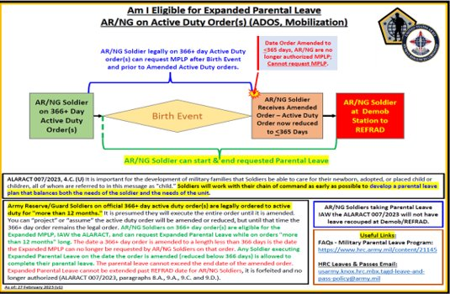
DHR/MPD Mobilization/Demobilization Brief
Directorate of Human Resources / JMFGI / 569-6044 / usarmy.bliss.imcom.list.dhr-mpd-jmfgi@army

Slide 12
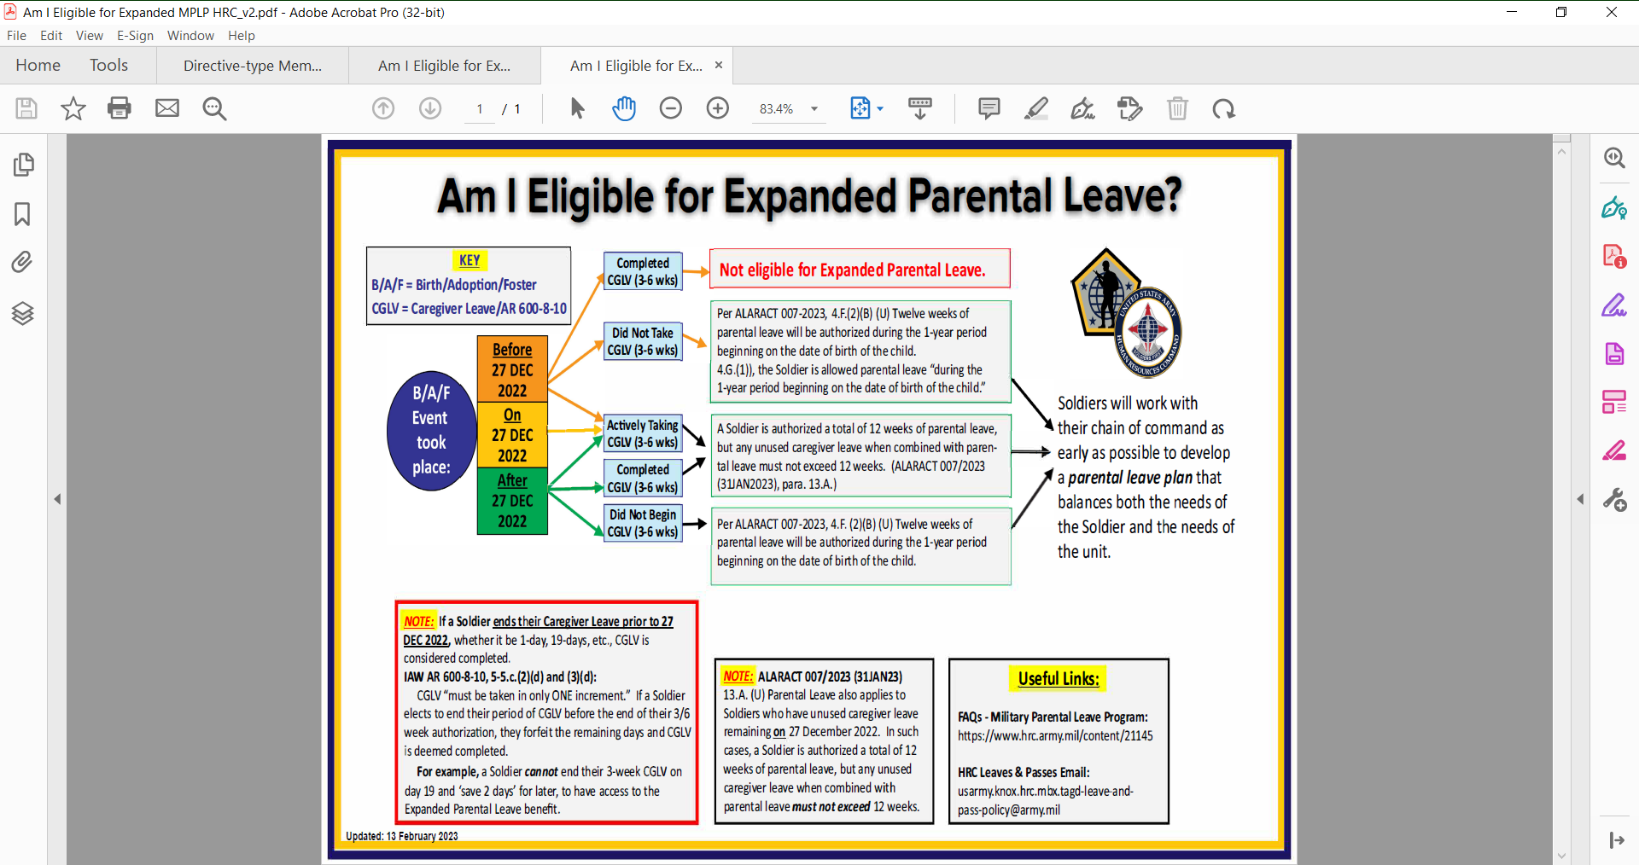
DHR/MPD Mobilization/Demobilization Brief
Directorate of Human Resources / JMFGI / 569-6044 / usarmy.bliss.imcom.list.dhr-mpd-jmfgi@army

Slide 13
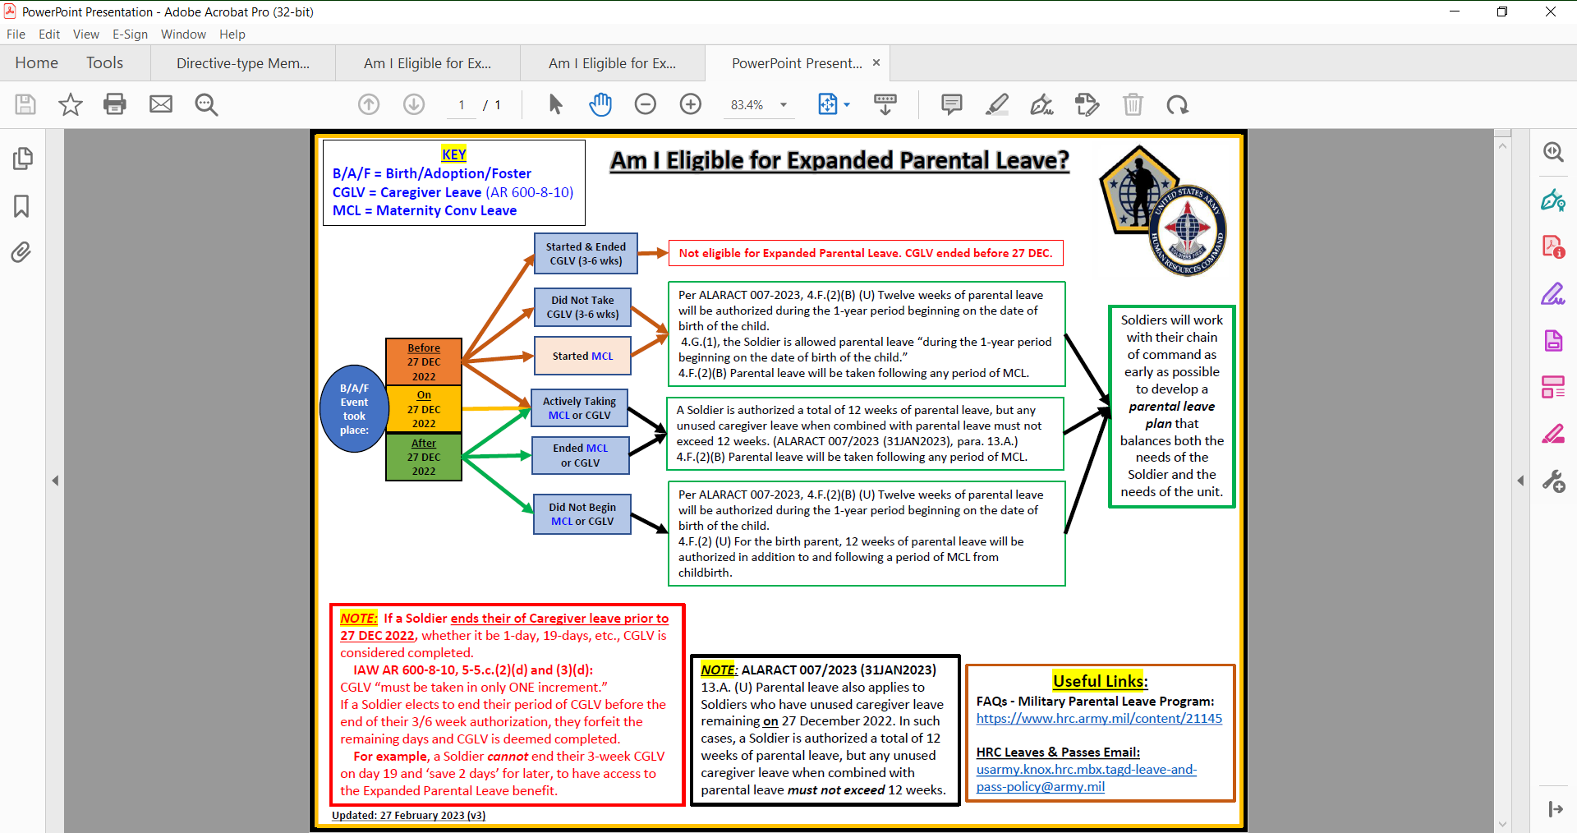
DHR/MPD Mobilization/Demobilization Brief
Directorate of Human Resources / JMFGI / 569-6044 / usarmy.bliss.imcom.list.dhr-mpd-jmfgi@army

Slide 14
DHR/MPD Mobilization/Demobilization Brief
TAB 4
Transitions DD214 Check List
(Due NLT D-60 to POCs in OPORD/Task tracker)
Create 1 folder for each Soldier, All copies must be legible.
Ensure to upload an individual Soldier’s documents as one individual PDF file.
When uploading files to the TEAMS FOLDER, Create a Unit Folder and Upload files by individual Soldiers with their own folders- All alphabetically.
Drop the information to the Folder –Label (Transitions) Folder-Unit Name/Soldiers Name, when uploading files include a unit roster (alphabetically). (Upload to - TEAMS, DEMOB-Folder#2, Transitions/Unit Folder /Individual Soldiers Folder. (PDF Documents)
Current MOB and TCS orders
Promotion/Demotion orders, if different from rank on MOB orders
Any other Title 10 MOB orders connecting to this MOB
IAW AR 635-5, all prior DD-214s/DD-220s/Discharge certificates/NGB 22s for all prior active service times
Certificate or DA 638, not both THIS INCLUDES AWARDS FOR CURRENT MOBILIZATION
Certificates for 40 + hour classes completed during this mobilization
Current NGB 23 or 5016 (Retirement points) within mobilization order’s dates
  If not available:
    Enlistment or extension contracts (only page 4/1 and 4/2 required)
    Oath of office (when first commissioned)
Directorate of Human Resources / JMFGI / 569-6044 / usarmy.bliss.imcom.list.dhr-mpd-jmfgi@army

Slide 15
DHR/MPD Mobilization/Demobilization Brief
UCMJ orders Process
The authority for involuntary retention and recall of Reserve Component (RC) Soldiers on Active Duty (AD) is 10 U.S.C. § 802 (UCMJ, Article 2). Costs (to include pay and allowances, and all authorized travel) associated with disciplining USAR Soldiers, when involuntarily ordered to AD or involuntarily retained on AD by a Regular Army (RA) commander, will be paid from Military Personnel, Army appropriations (see AR 27-10, para. 20-2e).
See UCMJ 2-7 Retention and recall Actions
Unit commanders must submit a complete UCMJ packet via email to the servicing MPD. For Soldiers that processed through. For Soldiers that processed through Fort Bliss MFGI, email packets to usarmy.bliss.imcom.list.dhr-mpd-jmfgi@army.mil and at Office: (915) 568-5060.
Packets must include the following: A memorandum of endorsement from the GCMCA. If the GCMCA holds the rank of 0-6, please include the appointment orders as GCMCA. 2. Soldier’s current orders (unit mobilization orders with annexes or individual orders with any amendments).
A signed DA Form 4187(IPPS-A PAR) by the commander to include reasons/justification, projected date of demobilization, requested number of days for retention (up to 179 days on first order), unit name and UIC for Soldier during duration of the extension, and point of contact and phone number for the owning unit and Judge Advocate.
Directorate of Human Resources / JMFGI / 569-6044 / usarmy.bliss.imcom.list.dhr-mpd-jmfgi@army

Slide 16
DHR/MPD Mobilization/Demobilization Brief
UCMJ orders Process Cont.
3.(c) When the UCMJ actions are complete, the local Judge Advocate will forward a copy of the following documents (as applicable) to the Mobilization Station MPD in order to close the Soldier's case:
1. Statement of Trial Results or Recordings of Proceeding under Article 15.
2. Charge Sheet.
3. Confinement Order.
4. DD Form 214 or complete Chapter packet
5. Request for Prison Transfer
6. Request for Orders (DA Form 2446)
7. DA Form 4187 ( IPPS-A PAR) reflecting duty status change
NOTE: Once the trial is complete and the Soldier is sentenced to a CONUS confinement facility, the local Judge Advocate must immediately request through the mobilization station, MPD movement orders format 405/410 using a DA Form 2446 in order for the Soldier to PCS to a CONUS confinement facility.
Directorate of Human Resources / JMFGI / 569-6044 / usarmy.bliss.imcom.list.dhr-mpd-jmfgi@army

Slide 17
DHR/MPD Mobilization/Demobilization Brief
Soldier Recovery Unit (SRU)
Soldier Recovery Unit (SRU)
All Soldiers arriving at demobilization station and determined by military medical authority to have an LOD wound, illness, injury, or aggravated pre-existing medical condition incurred during the current deployment will be evaluated for SRU placement or remote medical management (RC Soldiers only). Consolidated guidance at: http://wct.army.mil/ - provides information on SRU.
Medical Retention Processing (MRP). If, during the course of a contingency mobilization or during demobilization processing, it becomes evident that a Soldier has incurred or aggravated a duty-related medical condition, the Soldier may be transitioned from operational mobilization orders to MRP-E (ARNG only) or SRU-E (USAR only) orders for evaluation into SRU or remote medical management. Eligibility criteria and application instructions are prescribed in AR 40-58.
Only Soldiers who require complex medical management will be eligible for SRU through packet approval routing with the Army Senior Commander as the decision authority. If approved, USAR and ARNG Soldiers will be placed on an SRU order.
SRU -12301(h) orders , must be back-to-back with MOB order, ensure there is no gaps or overlapping dates on 12301(h) order and MOB orders. Further details on SRU process is in the AMDR 2022.
ARCP Eligibility Criteria-https: www.arcp.army.mil/eligibility-criteria/
Directorate of Human Resources / JMFGI / 569-6044 / usarmy.bliss.imcom.list.dhr-mpd-jmfgi@army

