Slide 1
U.S. Army Financial Management Command
Army Military Pay Office – PCS In-processing via Smart Voucher
9875 Michic Place
Bldg 219
Fort Belvoir VA 22060
Version 1.1
As of 13 NOV 20
Notes:
[Next Slide]

Slide 2
IN PROCESSING Smart Voucher
Create DD form 1351-2 within smart voucher
Upload Complete set of PCS Orders
Upload Completed PCS DA form 31
Other Supporting Documents may include
a. TLA documents
b. TLE documents
c. Receipts for reimbursable expenses
Note: The DD form 1351-2, PCS Orders and PCS DA form 31 are the documents the technician will use to process Soldiers arrival transaction and change the zip code (BAH) to the new duty station

Slide 3
Key Supporting Documents Required
PCS Orders and Amendments
DD Form 1610 and Amendments, (if TDY enroute)
DD Form 1351-2 - Travel Voucher (will be created within the Smart Voucher System, directions are later in the brief)
DA Form 31 - Leave Request Form
Receipts for any reimbursable expense $75.00 and over
Lodging/Hotels regardless of cost
Airfare
Excess Baggage
Notes:
Here's a list of the forms and documents most Soldiers will need to settle any travel entitlements and ensure their pay and entitlements reflect their current location and duty status.
If you have questions on any of these, be sure to ask your DMPO representative who is monitoring this briefing presentation.

Slide 4
Smart Voucher Instructions
Instructions for Completing
PCS Travel Voucher
via Smart Voucher

Slide 5
Smart Voucher Information
SmartVoucher is a self contained system that allows travelers to complete travel voucher submissions and routes them to the finance office for review and subsequent routing to DFAS-Rome for final computation, audit and payment. Payments are made to the government travel card (if chosen by the traveler) and to the traveler.
Once the finance office reviews the voucher and everything is correct your documents will be downloaded to process all required changes to your military pay account, to include BAH; no further action is required unless there are any additional documents that were not included.

Slide 6
Smart Voucher Instructions
Information Required:
New unit of assignment (as reflected on your PCS order)
Date of marriage
Date(s) of birth of child(ren)
E-mail address (add dfas-smartdocs@mail.mil to your address book and review your spam folder for notifications
A separate voucher (Supplemental voucher) is required to be completed for dependents period of travel if the Soldier moved his dependents to the new duty station and did not accompany them
A separate voucher (Supplemental voucher) is required for POV drop-off and/or pick-up if the trip was done separately from the actual PCS travel (example, soldier reported to Fort Belvoir/Myer 1 JUL and POV pick-up took place 15 JUL

Slide 7
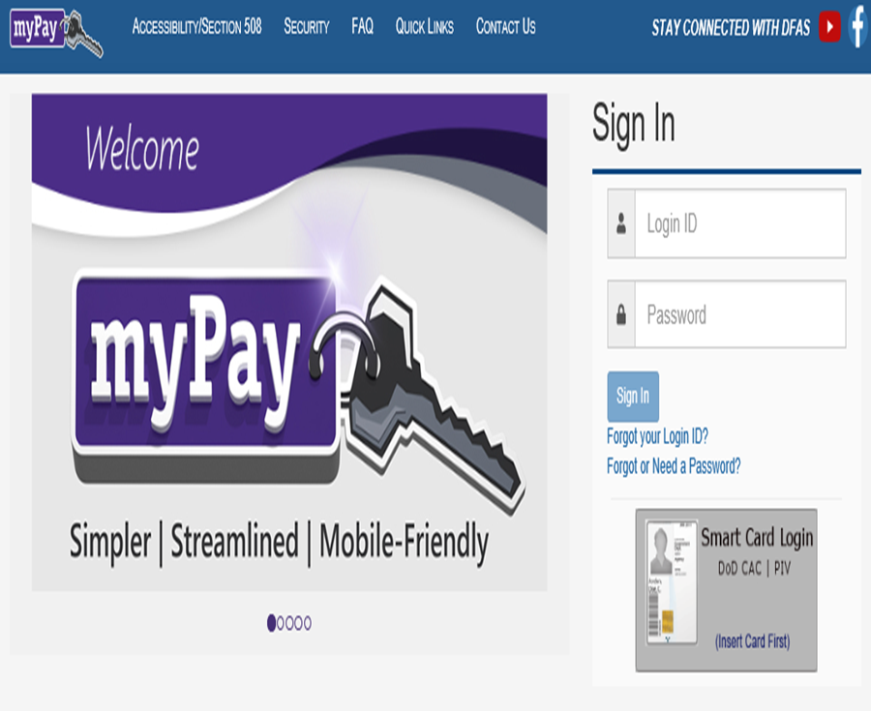
Smart Voucher Instructions
Go to https://mypay.dfas.mil/#/ – do not log in
Select “Quick LinVA”

Slide 8
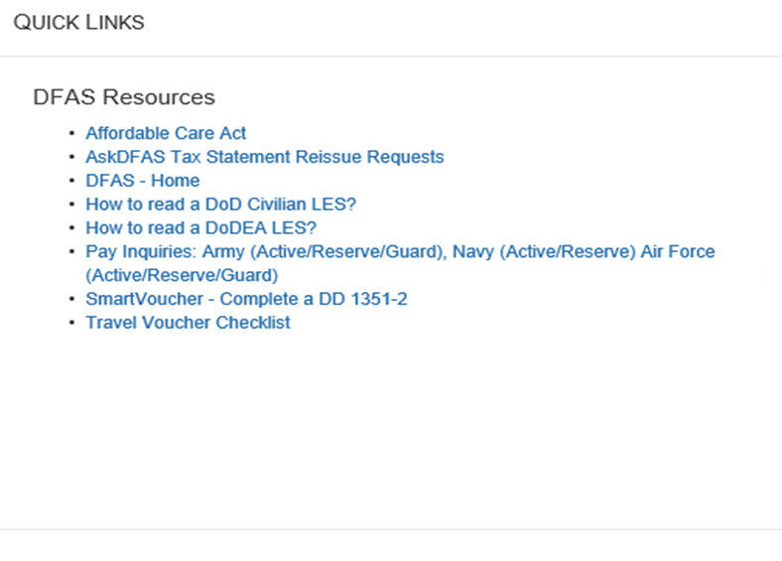
Smart Voucher Instructions
Under DFAS Resources, select “Smart Voucher – Complete a DD Form 1351-2”

Slide 9
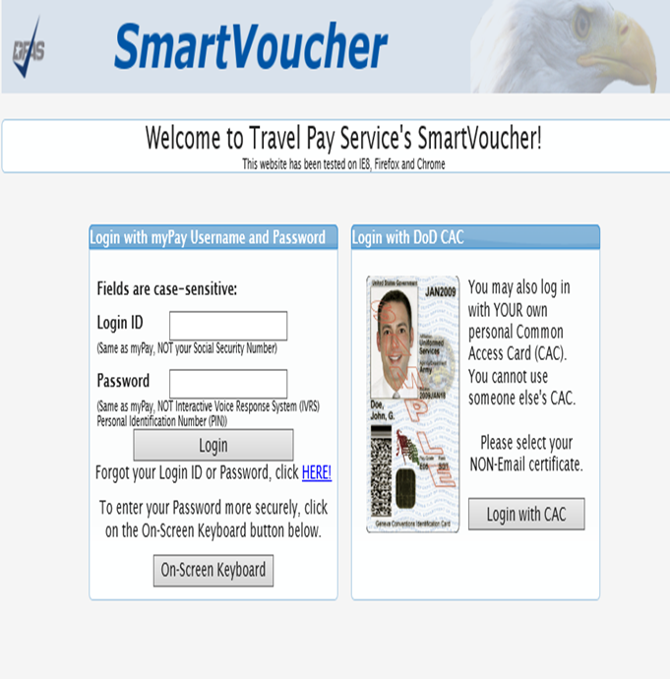
Smart Voucher Instructions
Log in with your credentials
Click “I Agree” twice
Click “Login with CAC”
Make sure it is NOT your email certificate

Slide 10
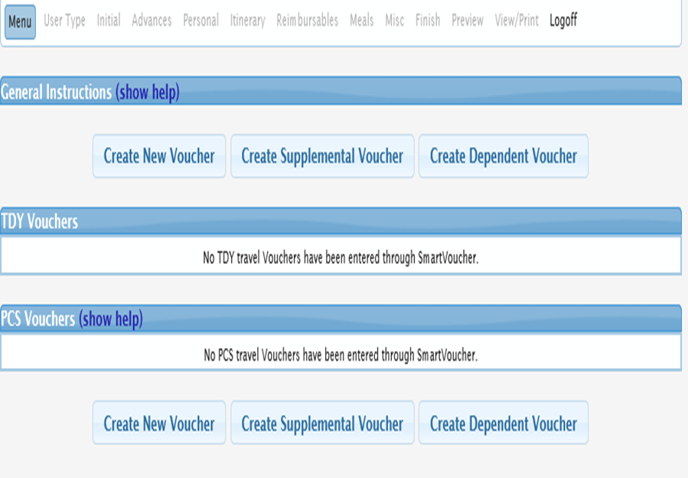
Smart Voucher Instructions
Smart Voucher homepage
Able to view old vouchers and create new vouchers
Navigate through the voucher using the menu at the top of the page
Click on “Create New Voucher”
Click on “Create Dependent Voucher” if your dependents traveled separately

Slide 11
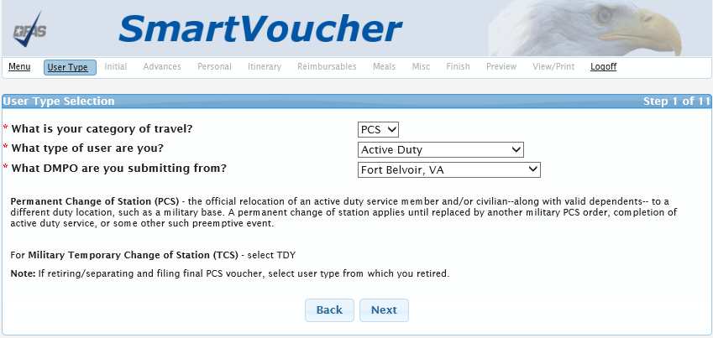
Smart Voucher Instructions
Category of travel will be “PCS”
Type of user is “Active Duty”
Select “Fort Belvoir, VA” as your AMPO (Finance Office)
Select “Next”

Slide 12
Smart Voucher Instructions
If your dependents traveled with you and they are here, select “Yes” for claiming dependents.
If your dependents traveled separately or are arriving at a later date, this voucher will be for your travel only. Another voucher for your dependents will be completed upon their arrival.
Separate vouchers are needed for any dependent that traveled to/from a separate location or during a different timeframe. You may use the "Create Dependent Voucher" feature found on the Menu screen to begin a dependent travel claim.

Slide 13
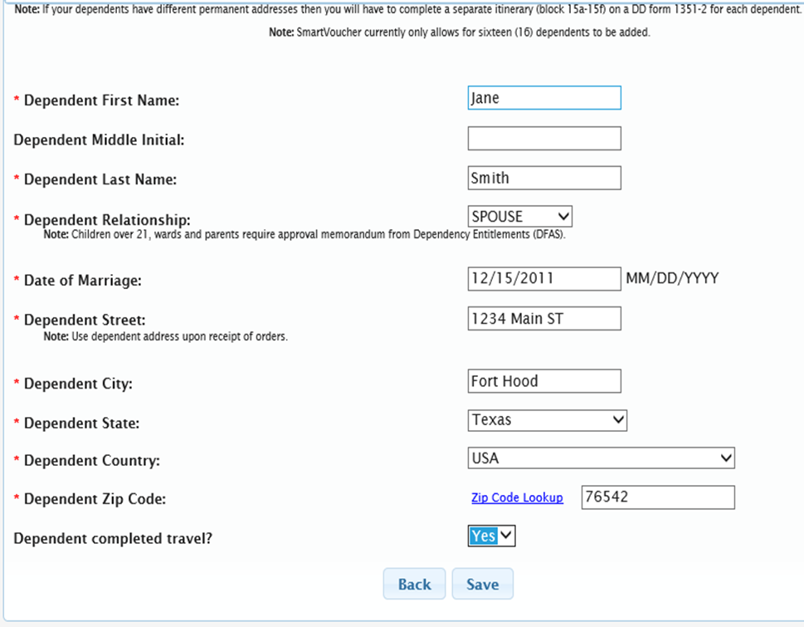
Smart Voucher Instructions
Each dependent who traveled with you will be entered on separate pages
Dependent Street, City, State, Country and Zip Code is your OLD address (address at last duty station) OR your dependent’s address when you received your orders
Don’t forget to mark off “Yes” if your dependent completed travel
Click “Save” to add another dependent

Slide 14
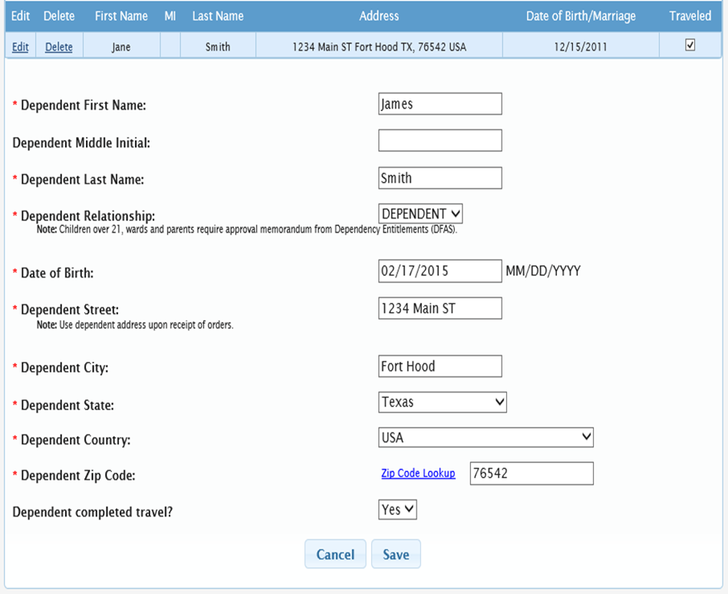
Smart Voucher Instructions
Click “Add Dependent”
Address will automatically populate
Again, don’t forget to mark “Yes” for completed travel
In order to get reimbursed for all dependent travel, you need to list ALL dependents that moved with you
Once they are all listed and saved, select “Next”
If you are claiming a secondary dependent, the approval memo from DFAS is required

Slide 15
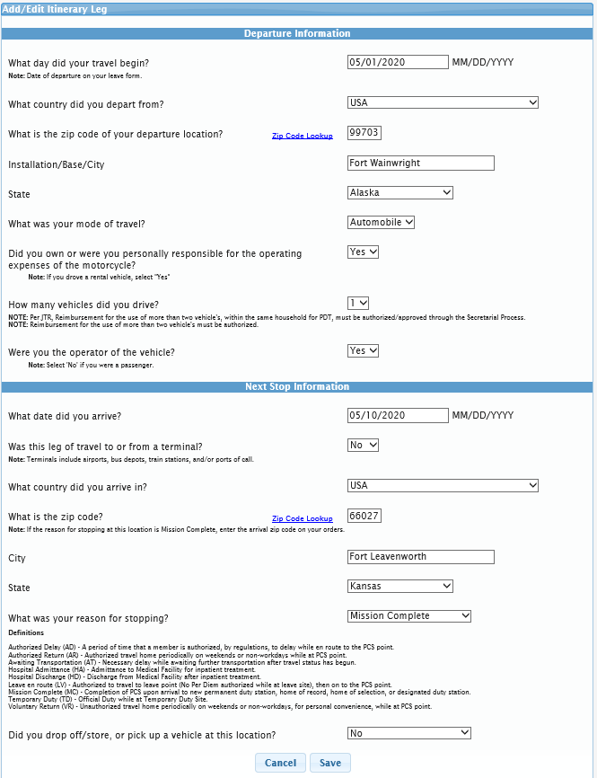
Smart Voucher Instructions
POV Drivers Only
If you drove from your last duty location to Fort Belvoir, this is what your Next Stop should look like
Mode of travel: “Automobile”
Were you personally responsible for the operating expenses? “Yes”
How many vehicles did you drive? 1 or 2
Were you the owner/operator? “Yes”
Arrival country: USA
Arrival city: is always duty location on your orders
State: duty location on your orders Zip: on your Orders
Reason for stopping: “Mission Complete”
Arrival Date is the day you physically arrived
Click “Save”

Slide 16
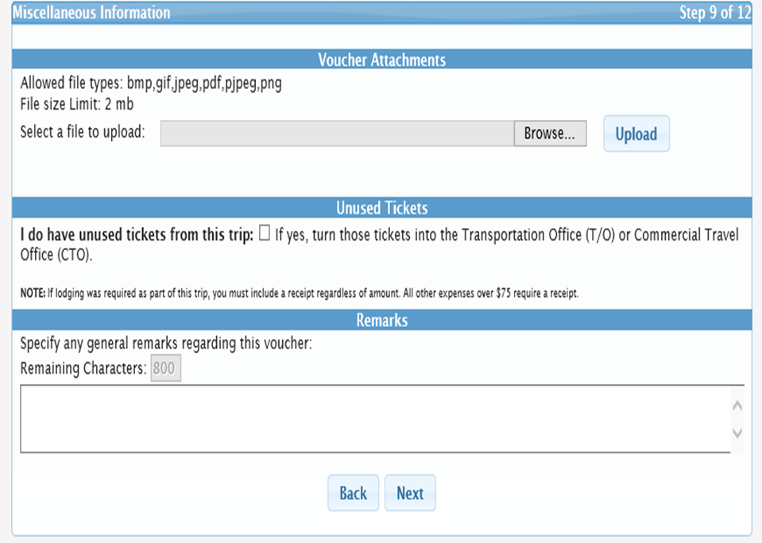
Smart Voucher Instructions
Attach the PCS order(s), DA31, and all receipts required
Specify if you have any unused plane tickets; this may be left blank
Specify any general remarks

Slide 17
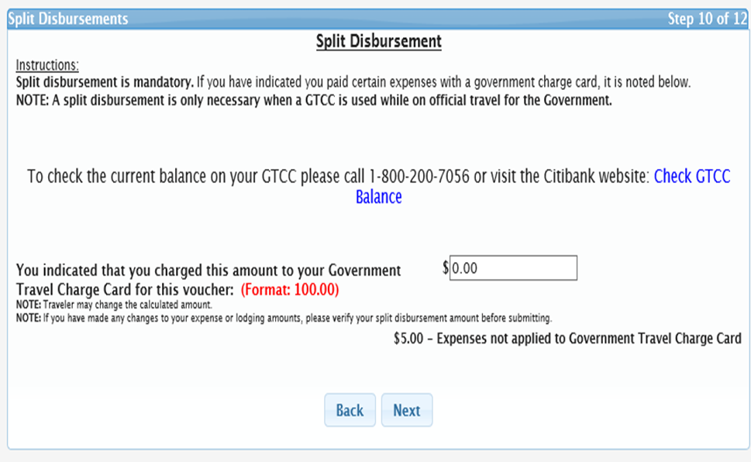
Smart Voucher Instructions
Split Disbursement is used if you have a GTCC and used it
You can opt to have a specified amount go straight to your GTCC
Select “Next”

Slide 18
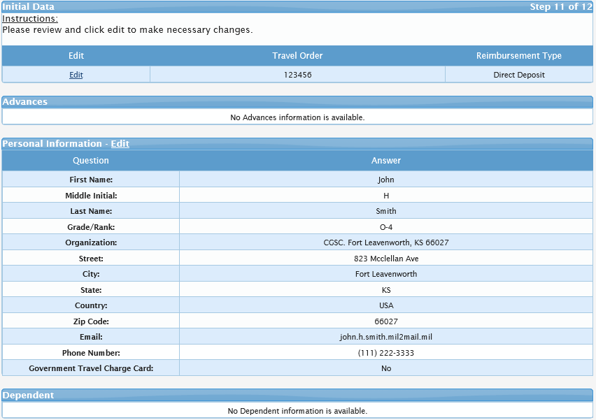
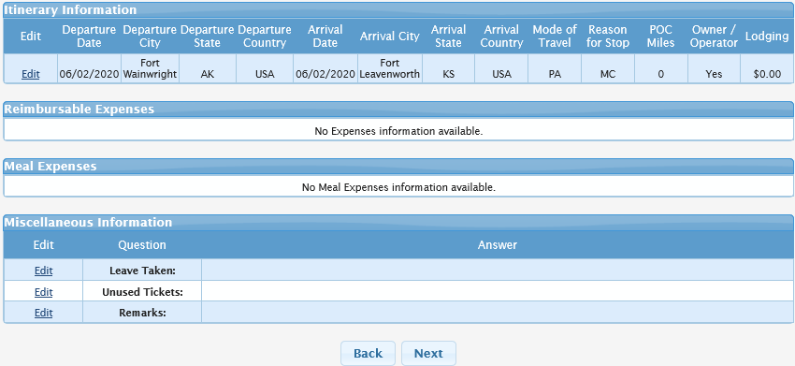
Smart Voucher Instructions
Verify all of your information then select “Next”

Slide 19
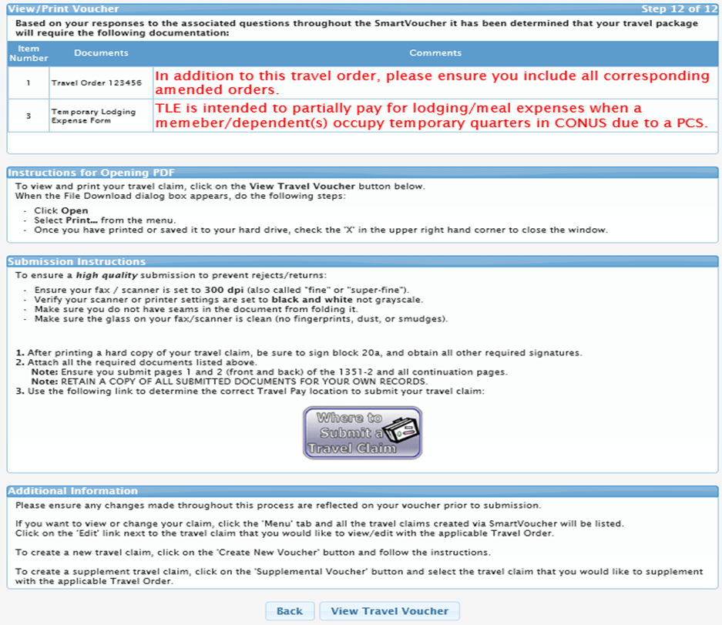
Smart Voucher Instructions
Review these comments. If you need any supporting documents, Smart Voucher will let you know what is needed.
Click on “View Travel Voucher” to preview what your Smart Voucher will look like.

Slide 20
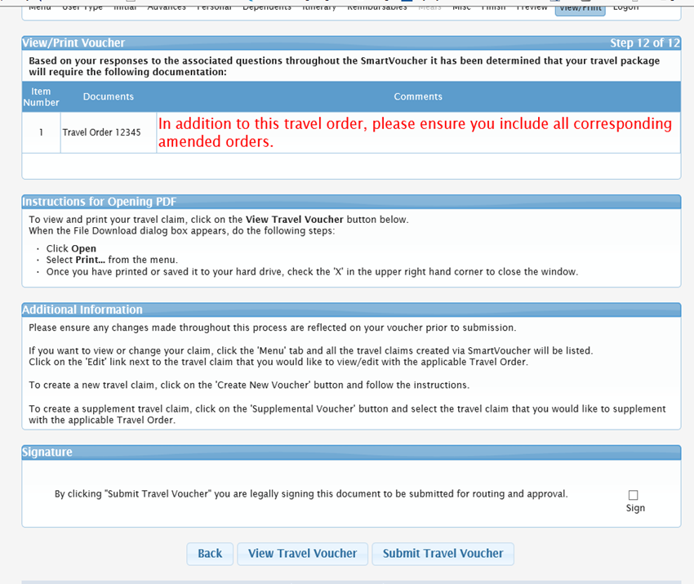
Smart Voucher Instructions
- Check the sign box (if you are unable to check the box go back to the “User Type” tab and verify you chose Fort Belvoir under the “What AMPO are you submitting from?” option
- Click submit travel voucher.

Slide 21
Smart Voucher Concerns
Missing Complete Set of PCS Orders
DA form 31 missing information
a. signature from sign out date, sign in date and approved extension
b. Soldier departs duty station(on travel voucher) prior to the start date of leave
on the DA form 31
c. Dates on the DA form 31 and DD form 1351-2 do not match
DD form missing information
a. “X” member/employee
b. block # 6 and #13 are the same address even though dependents PCS’ed with
the Soldier to the new duty station (if dependent travel and Soldier’s travel dates are
different, the Soldier can do two separate travel vouchers
c. Smart voucher rejected back to the Soldier however the Soldier is not making necessary
corrections and resubmitting the travel voucher via smart voucher

Slide 22
Smart Voucher Concerns continued
d. Uploading more documents than necessary
e. Uploading pictures of documents that are usually distorted and not legible
f. Missing zero balance receipts for TLE and TLA payments
g. Missing DFAS form 9098 TLE: https://www.dfas.mil/MilitaryMembers/travelpay/forms/

Slide 23
AMPO Points Of Contact
AMPO Director: Douglas (Doug) J Madej douglas.j.madej.civ@mail.mil 703 805-5318
AMPO Deputy Director: Jacqueline L Haylock jacqueline.l.haylock.civ@mail.mil 703 805-3724
AMPO DDO/Financial Analyst: Barbara J Smith barbara.j.smith1.civ@mail.mil 703 805-3531
Supervisors:
Faith Kerr faith.r.kerr.civ@mail.mil 703 805-3872
Separations
Processing
Reserve
MilPay Review
Mercedes Case Mercedes.r.case.civ@mail.mil 703 805-3855
Customer Service
Debt Management
In/Out Processing
FLPB
Notes:
Here's a list of the forms and documents most Soldiers will need to settle any travel entitlements and ensure their pay and entitlements reflect their current location and duty status.
If you have questions on any of these, be sure to ask your DMPO representative who is monitoring this briefing presentation.

Slide 24
U.S. Army Financial Management Command Army Military Pay Office
Notes:
This concludes your DFAS military pay and travel entitlement briefing.
We hope you have found it useful in preparing to settle your travel vouchers and keeping your pay information accurate.
Your monitor is available to answer any questions you might have.
Thank you.

