Slide 1

EVENT
DATE
TIME
LOCATION
UNIT
OTHER INFORMATION

Slide 2

Event
Date
Time
Location
Further Info
INSERT LOGO
HERE

Slide 3
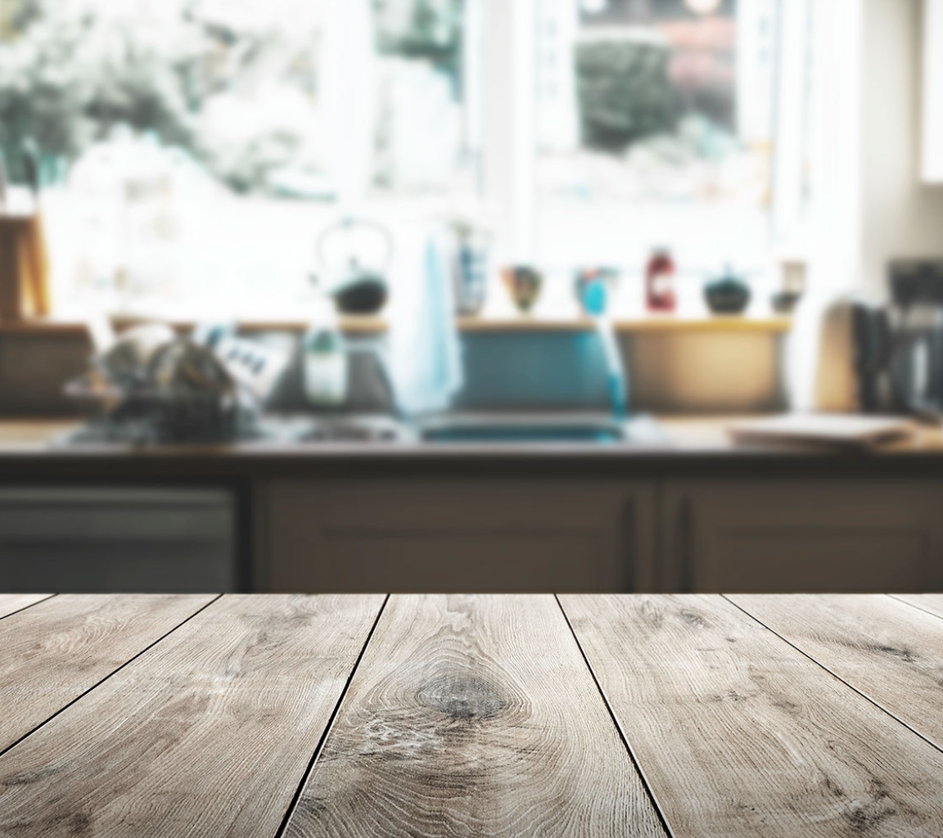
Event
Date
Time
Location
Further Info
INSERT LOGO
HERE

Slide 4

Event
Date
Time
Location
Further Info
INSERT LOGO
HERE

Slide 5

Event
Date
Time
Location
Further Info
INSERT LOGO
HERE

Slide 6

Event
Date
Time
Location
Further Info

Slide 7
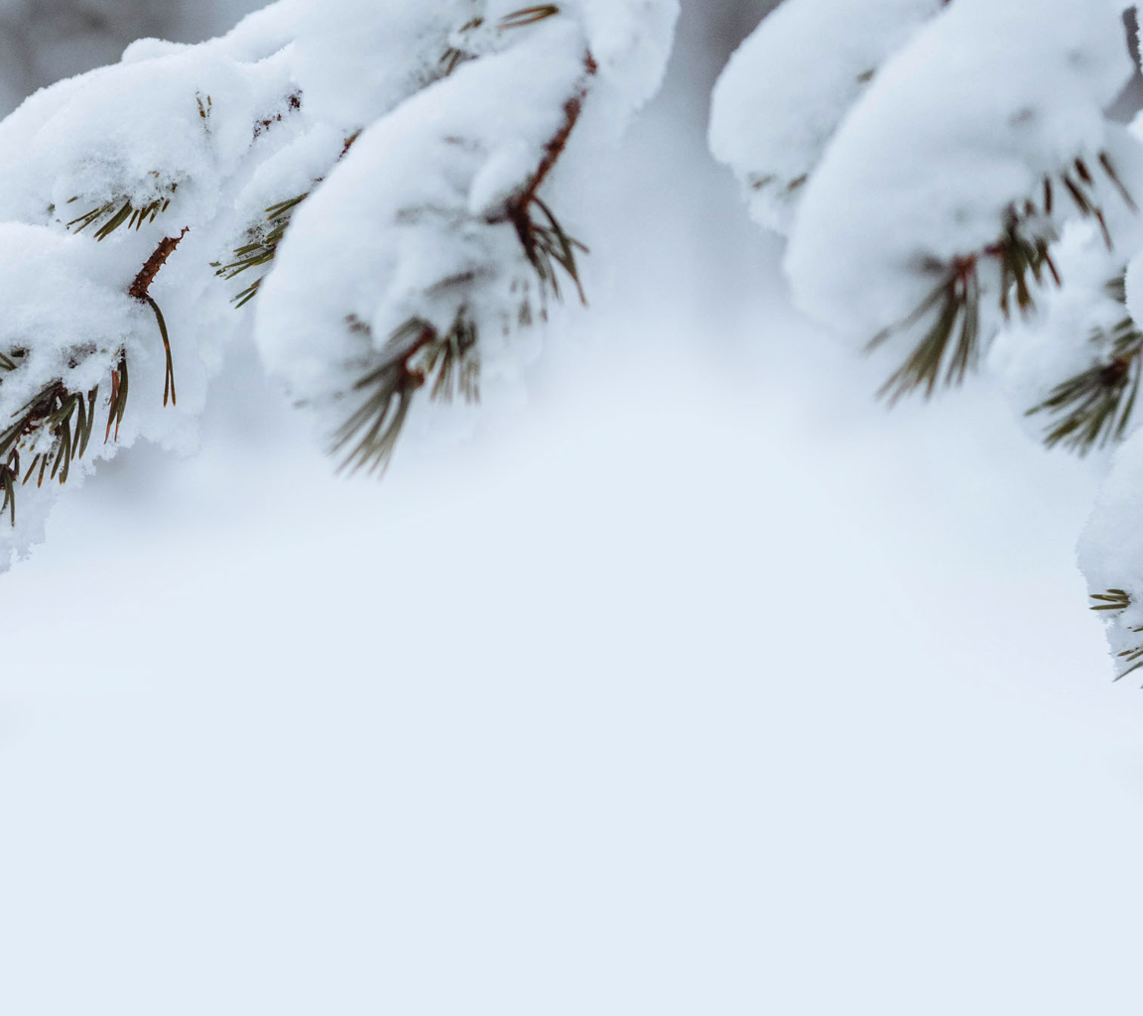
INSERT LOGO
HERE
Event
Date
Time
Location
Further Info

Slide 8
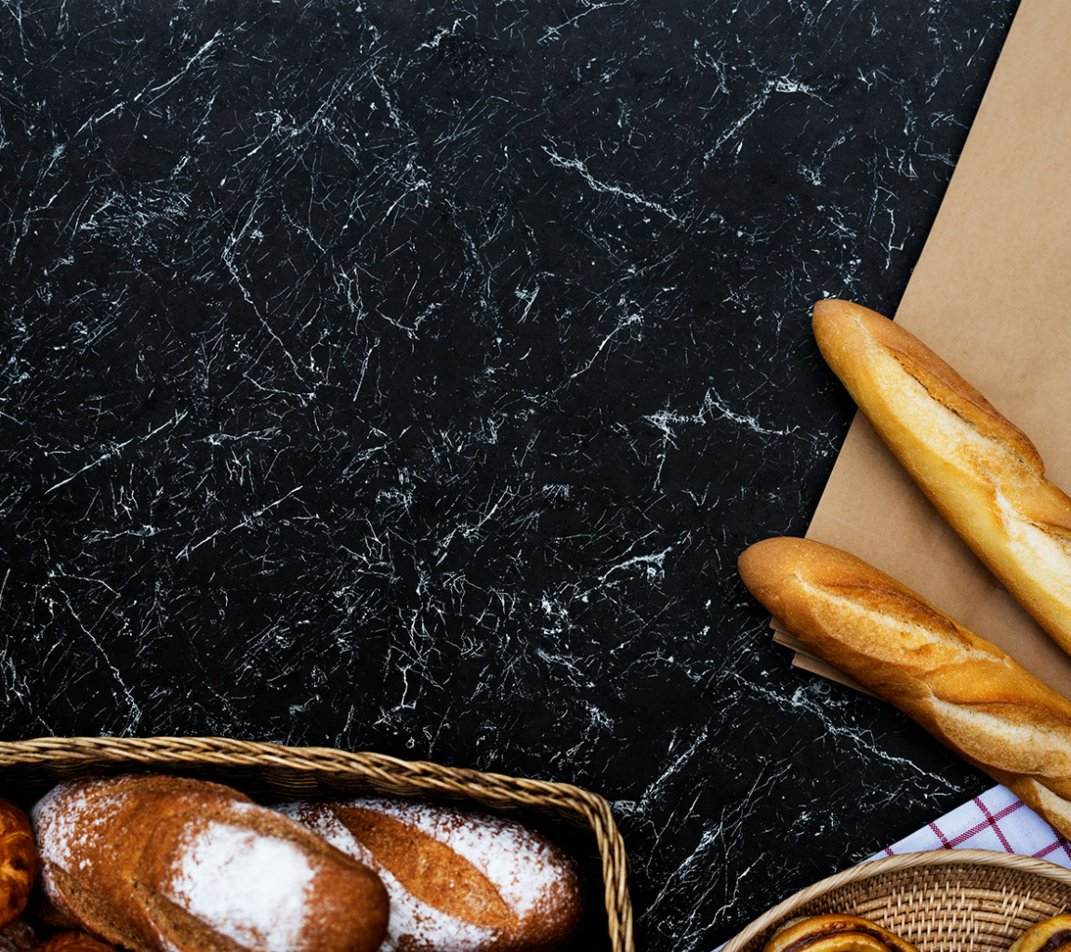
Event
Date
Time
Location
Further Info

Slide 9
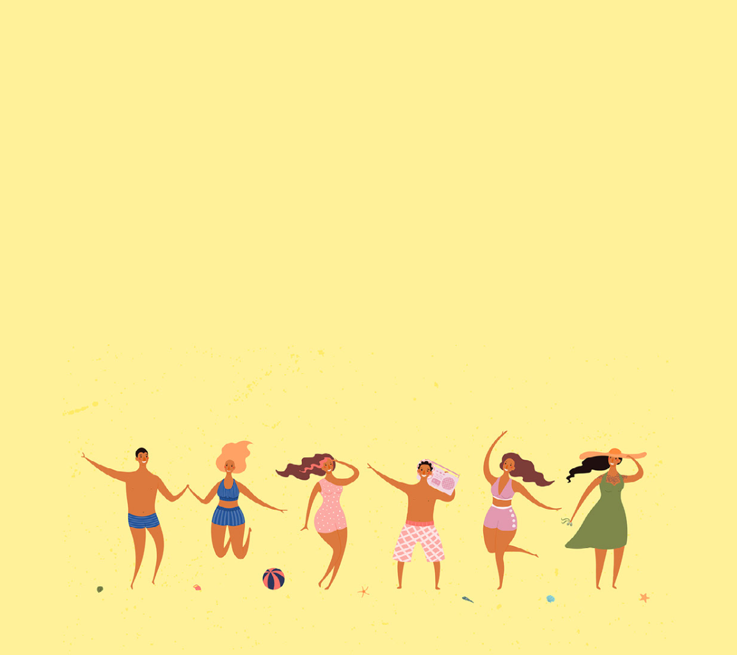
SUMMER FUN DAY
Date
Time
Location
Further Info

Slide 10

Event
Date
Time
Location
Further Info

Slide 11
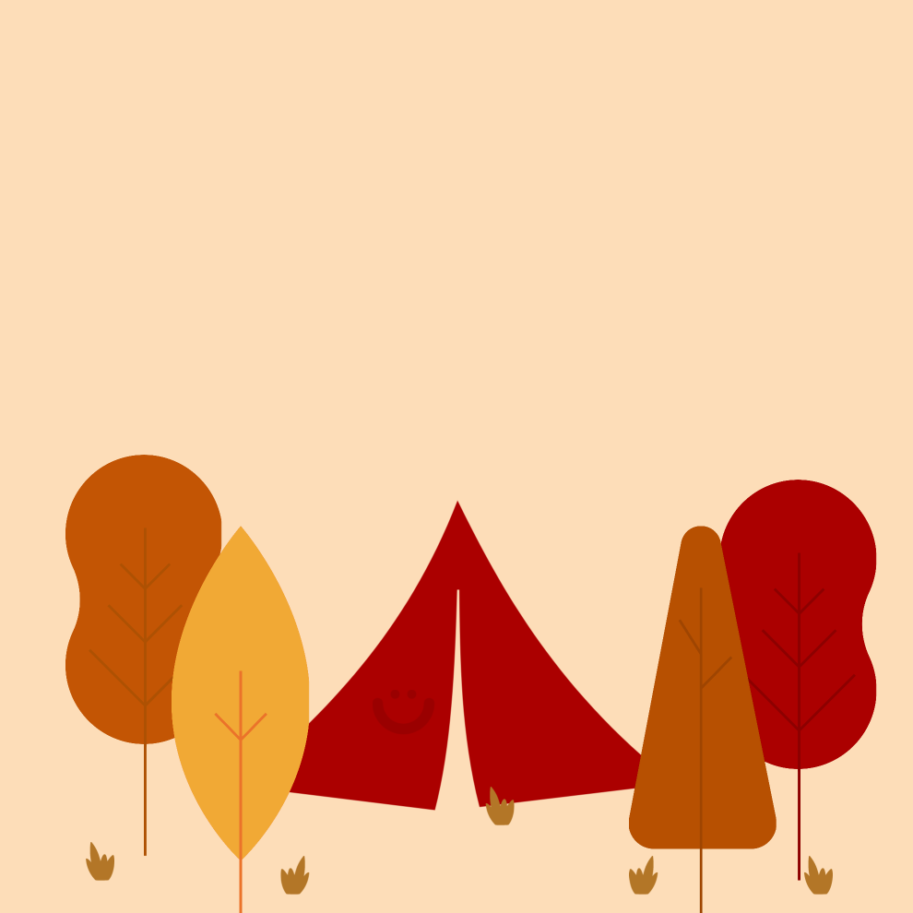
Event
Date
Time
Location
Further Info

Slide 12

Event
Date
Time
Location
Further Info

Slide 13

COLOR RUN
Feb. 11
grafenwoehrmwr.com/register
REGISTER NOW

Slide 14
SAFETY FIRST
Watch your step
Wear glasses
Watch your head
Wear a helmet
BE SAFE

Slide 15
ONE COMMUNITY ROAD CLOSED APRIL 20

Slide 16
FREECYCLE CENTER
SAVE RESOURCES
FREE
SIMPLE
SUSTAINABLE

Slide 17
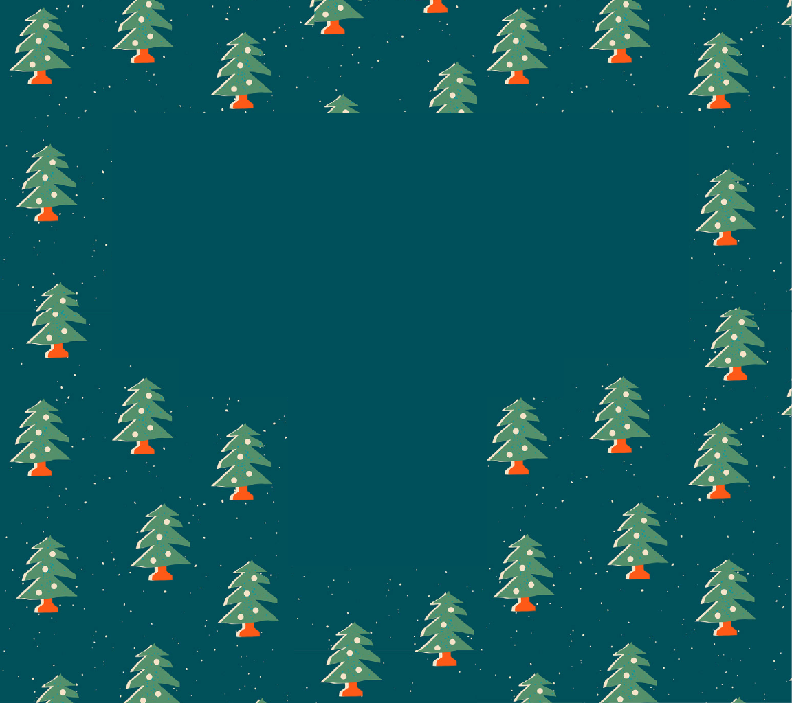
EVENT NAME
TIME
DATE
LOCATION
INSERT LOGO
HERE

Slide 18

EVENT NAME
TIME
DATE
LOCATION

Slide 19

Happy Holidays
Event
Date
Time
Location
Further Info

Slide 20

Event
Date
Time
Location
Further Info

