Slide 1
Army Community Service Overview
USAG BAVARIA ARMY COMMUNITY SERVICE
Version # 1
As of 04 JUNE 2020
Roswitha Ebnet
Relocation Readiness Program Manager
USAG BAVARIA / DFMWR / ACS

Slide 2
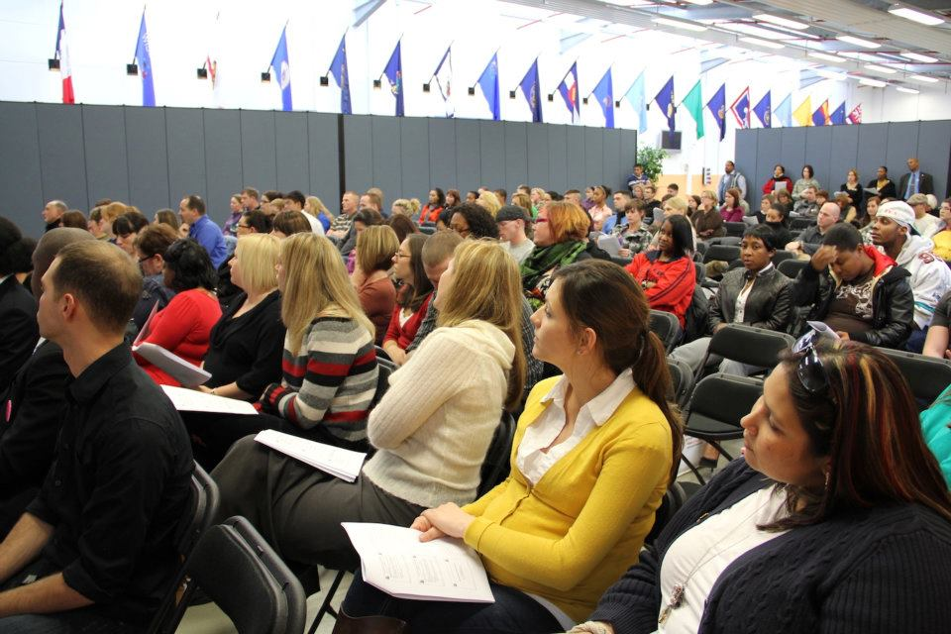
Army Family Action Plan (AFAP)
AFAP is a process that invites community members to be
agents of change by improving programs and services,
changing policies and regulations, and amending laws
PROVEN RESULTS
90% AFAP issues worked locally
61% active HQDA AFAP issues
impact all services
316 legislative or policy changes
212 new/improved programs or services

Slide 3
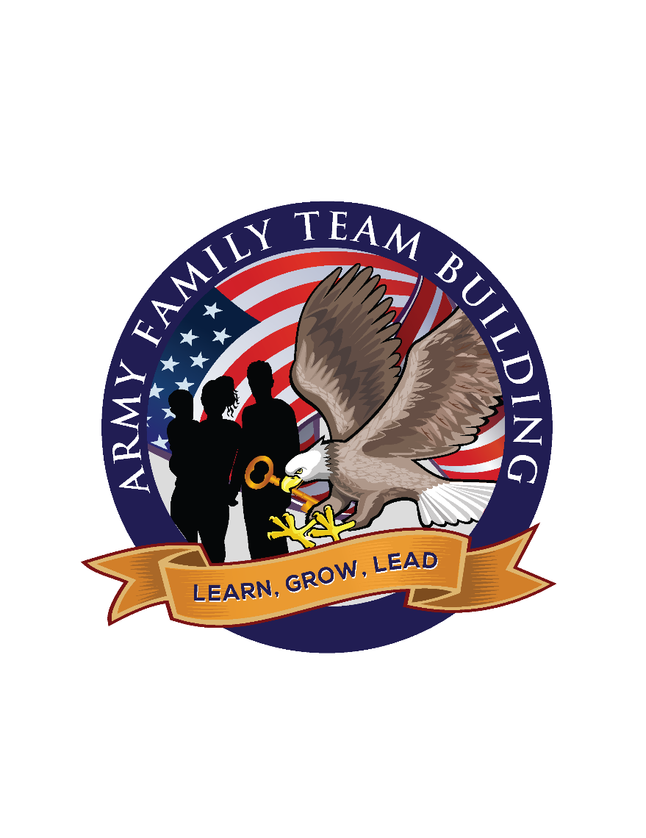
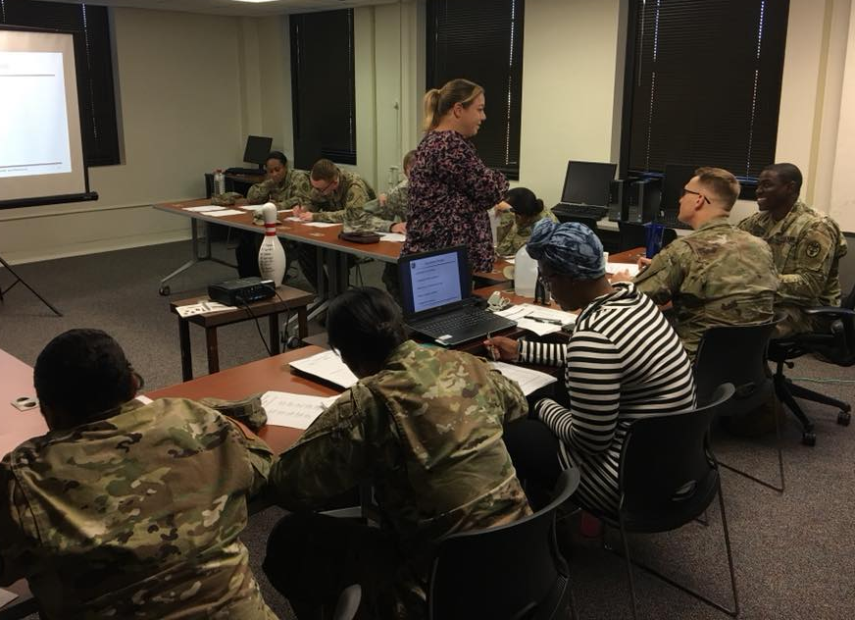
Army Family Team Building (AFTB)
The Army Family Team Building (AFTB) program is a volunteer led organization with a central purpose: provide training and knowledge to Soldiers and Family Members to support the total Army effort
Positive impact on Soldier, Family and Unit Readiness
Informed, prepared and empowered Families
Realistic expectations about the military
Increased knowledge about the Army’s culture
Less confusion and frustration for Soldier and Family

Slide 4
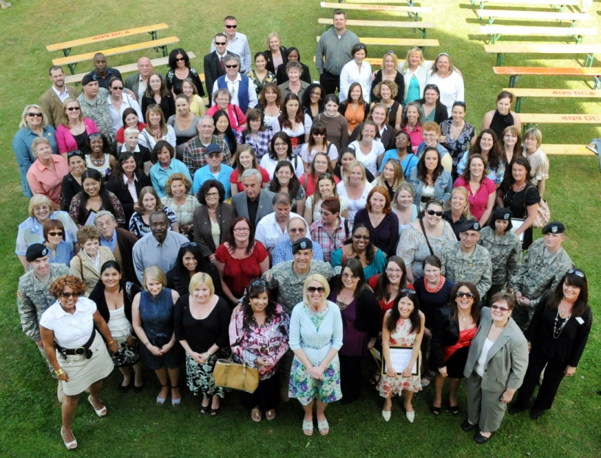
Army Volunteer Corps (AVC)
The Goal of the AVC program is to promote and strengthen volunteerism by uniting community volunteer efforts, supporting professional management, enhancing volunteer career mobility and establishing volunteer partnerships to support individual personal growth and life-long volunteer commitment
Volunteer Management Training - How to recruit, retain, record keeping, revitalizing, recognizing and dismissing volunteers
Organizational Point of Contact (OPOC) Training - Provides all new OPOC’s an overview on how to enter volunteer position descriptions, certify volunteer hours and approve volunteer applications in the Volunteer Management Information System (VMIS)
Recognition - Every spring the Volunteer Coordinator plans and executes a Volunteer Recognition Ceremony to honor all registered community volunteers

Slide 5
Employment Readiness Program (ERP)
SERVICES OFFERED
● Individual Career Counseling
● Weekly Job Listing - distributed through E-Mail and community venues
CLASSES
USAjobs - Explains the new Federal Application Process
● Resume Writing
● Career Planning
● Interview Skills
● Professional Networking
Let’s Talk Jobs
● Open forum for community to discuss employment questions with
ERP Manager, CPAC and NAF
Career Fairs 101
● Explains what to expect and how to prepare for a job fair
GED Preparation
● Assist Spouses to get ready for the GED Exam
Spouse Employment
● My Career Advancement Account Scholarship (MyCAA) Program
https://mycaa.militaryonesource.mil/mycaa/resources

Slide 6
Exceptional Family Member Program (EFMP)
● Ensuring Soldiers with special needs Family Members
are assigned to installations that can provide the services
needed
● Synchronizes support services
● EFMP information and referral
● Individualized assistance
● Compassionate reassignments, curtailments, extensions
● RESPITE CARE PROGRAM
● EFMP Commander Education Program
● Monthly support groups and recreational activities

Slide 7
Family Advocacy Program (FAP)
● FAP contributes to force readiness and mission accomplishment by
providing a resource for commanders and Families to use for the
education and prevention of Family violence
● The FAP is composed of two parts: PREVENTION and TREATMENT
ACS
FAP
Clinical
FAP
Focuses on treatment of individuals who have been involved in an incident
Behavioral Health Clinics
Rose Barracks Bldg 260
Tower Barracks Bldg 436
Focuses on prevention and education which is done through community outreach and a variety of classes and services
Army Community Service
Rose Barracks Bldg 322
Tower Barracks Bldg 244

Slide 8
Family Advocacy Program (FAP)
● Victim Advocacy Program
● Emergency Placement Care
● Crisis Intervention
● Stress and Anger Management
● Marriage and Enrichment:
“It Takes Two”
● 24 Hour Crisis Hotline 09662-83-3218
● Military Police 09662-83-114

Slide 9
New Parent Support Program (NPSP)
A PROGRAM DESIGNED FOR PARENTS WITH
CHILDREN AGES 0 THROUGH 3
HOME VISITATIONS
Individualized and confidential in-home advice for all
your parenting needs
EDUCATION
Prenatal Training, Parent/Child Interactive Playgroups,
Parenting Classes
SUPPORT
Individualized lactation support, learn nurturing
parenting skills, referrals to other community agencies
that may be helpful depending on your Family’s needs
and various support groups offered depending on
Garrison community needs

Slide 10
Financial Readiness Program (FRP)
Goal: To provide Service Members and their military Families with the
financial tools that will increase their financial capability
Personal Financial Counseling
● Budgeting, Debt Management, Spending Plans
● Family Subsistence Supplemental Allowance (FSSA)
● Consumer Advocacy Services
Financial Planning Classes
● Financial Fitness Classes and Unit Training Requests
Emergency Food Assistance
Credit Report Review and Repair
● Security clearance assistance
● Increase credit score techniques

Slide 11
Army Emergency Relief (AER)
MISSION:
Provide EMERGENCY Financial Assistance
TYPES OF ASSISTANCE AVAILABLE
● Interest free loan
● Grant, if repayment of loan will cause undue hardship
● Part loan and part grant
SCHOLARSHIPS
● MG James Ursano scholarships: for dependent children
● Spousal Scholarships: for spouses, Surviving Spouses
ASSISTANCE FOR RETIREES !

Slide 12
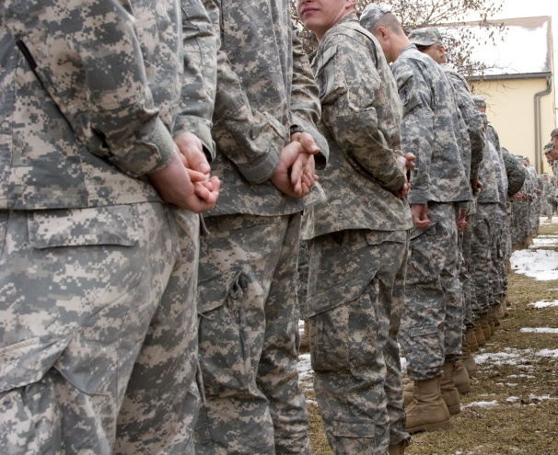
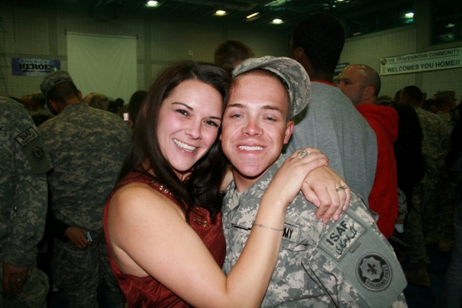
Mobilization, Deployment & Stability Support Operations (MD&SSO)
CLASSES
SFRG/CCFR Training
- SFRG Foundations
- SFRG Leader
- SFRG Key Contact
- SFRG Informal Funds
- Care Team Training (by request)
• SFRSA Training
ADDITIONAL SERVICES
Deployment Cycle Support
The Unit Service Coordinator (USC) program is a program implemented to assist commanders and rear-detachment commanders with meeting the needs of their Soldiers and Families. The USC for each unit will serve as the units single point of contact to coordinate ACS services and make sure command teams get what they need for Family Programs. Our USC will be promoting and distributing materials for ACS events/activities. USCs can also attend SFRG steering committees to serve as an ACS Subject Matter Expert (SME).

Slide 13
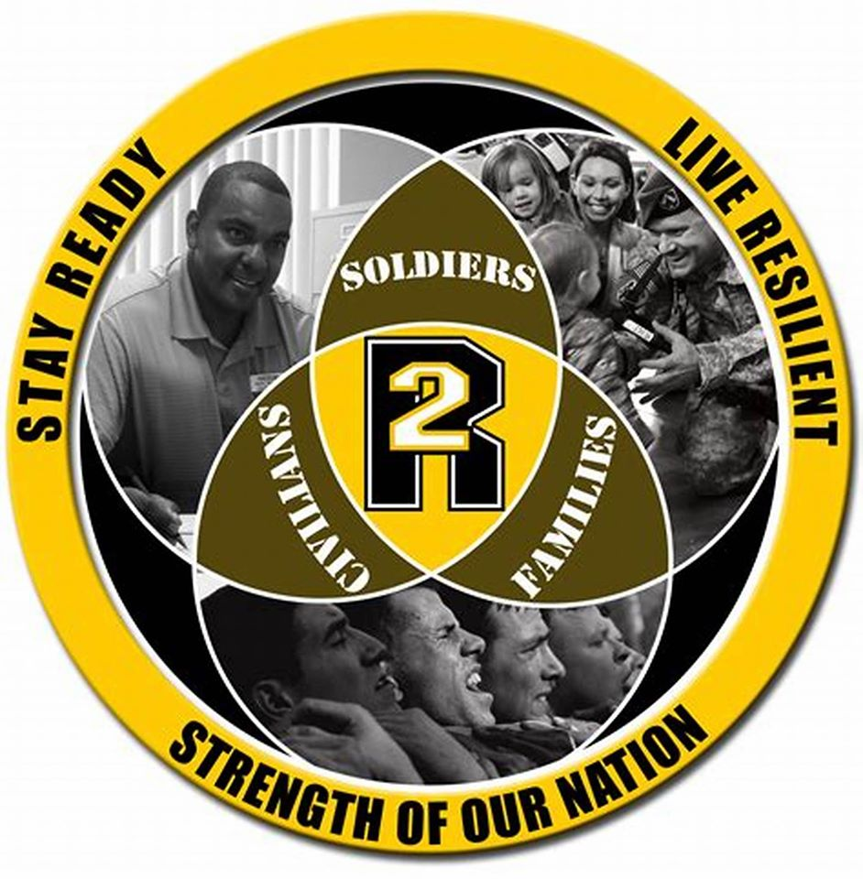
Resilience Training for Civilians and Family Members
ACS has trained
Master Resilience Trainers (MRTs)
who provide pre & post deployment resilience training for
Family Members and Civilians.
Join us for Spouse Resiliency Workshops !

Slide 14
Relocation Readiness Program
CLASSES
● Newcomer Orientations
- Windshield Tour
- Welcome to Bavaria
- Historical City Tours: Amberg & Weiden
- A Globetrotter’s Guide to Germany
● German as a Second Language
● Host Nation Orientation
● Soldier, Civilian and Spouse Sponsorship
Training
● Foreign-Born Spouses
- English as a Second Language
- Citizenship and Immigration
● Hearts Apart for Spouses of deployed Soldiers
- Spouse Resiliency Workshops
- De-Stress with ACS
● Successful PCS Moves 101
ADDITIONAL SERVICES
● THE LENDING CLOSET: While without household goods you may borrow the following items up to 60 days for free: pots and pans, dinnerware and silverware, small kitchen appliances such as coffee makers, toasters and microwaves, irons and ironing boards, strollers, pack ‘n’ plays, and more
● WELCOME PACKETS: ACS provides you with community information, such as bus schedules, maps
and community resources. Just stop by and pick one up !

Slide 15
Survivor Outreach Services (SOS)
What is it ?
Survivor Outreach Services is the official Army program designed to provide long term support to surviving Families of Fallen Soldiers. SOS provides dedicated outreach and support to Survivors, regardless of the deceased service members’ (DSM) Army component, duty status, location or manner of death
SOS serves Active Component, Army National Guard and US Army Reserve. Survivors are serviced by the closest SOS support office
Who is eligible for our services ?
SOS is available to all Survivors (spouses, children, parents, siblings, grandparents, other family members and friends) grieving the loss of a service member, regardless of how they died

Slide 16
Survivor Outreach Services (SOS)
SOS FLOW CHART
Casualty Occurs
Casualty Notification Officer
Primary Next of Kin (PNOK)
Casualty Assistance Officer
Survivor Outreach Services Support Coordinator
Financial Counselors

Slide 17
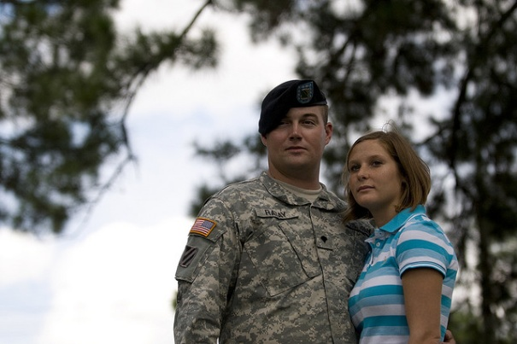
Military & Family Life Counseling (MFLC) Program
Military & Family Life Counselors (MFLCs) provide
non-medical, short term, situational, problem-solving
counseling services to individuals, couples, Families,
units and FRG groups
You can address relationships, stress management,
grief after loss, occupational and other individual and
Family issues and it provides crisis intervention when
needed. Services are confidential and private except
for duty-to-warn situations. MFLCs are mandated
reporters of child abuse, domestic violence and other
duty-to-warn mandated situations
They are Master or Ph.D level licensed clinical
counselors and work with existing Military Family
support programs to complement services provided on
the installation

Slide 18
Military & Family Life Counseling (MFLC) Program

Slide 19
Army Community Service
ACS Hours of Operation
ROSE BARRACKS TOWER BARRACKS HOHENFELS GARMISCH
7:30am – 4:00pm 7:30am – 4:00pm 7:30am – 4:00pm 7:30am – 4:00pm
Bldg 322 Bldg 244 Bldg 10 Bldg 203
(CIV) 09662.83.2650 (CIV) 09641.70.526.4403 (CIV) 09472.83.4860 (CIV) 08821.750.3777
(DSN) 476.2650 (DSN) 526.4403 (DSN) 466.4860 (DSN) 440.3777
Closed all day on weekends and Federal Holidays
& the first Monday of the month (8:00am-12:00pm)

Slide 20
ARMY COMMUNITY SERVICE
QUESTIONS ?

