Slide 1
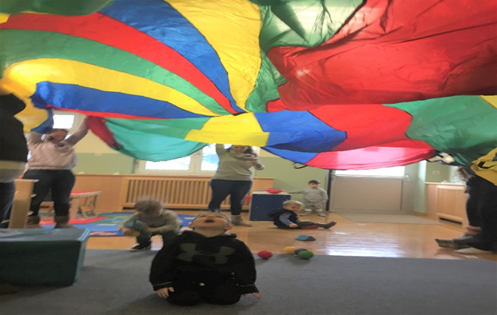
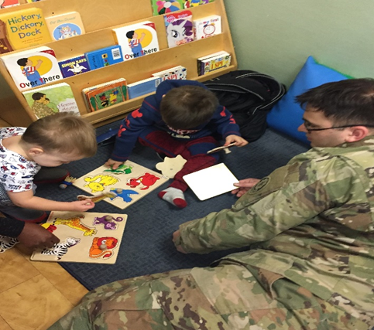
WELCOME TO BAVARIA!
As a family with special needs you will need to reconnect the medical and or educational services you had at your previous duty station for your family member with special needs.
Services are a little different OCONUS therefore, the Army Community Service (ACS) Exceptional Family Member Program (EFMP) office is here to assist you in the process of locating and reconnecting services.

Slide 2
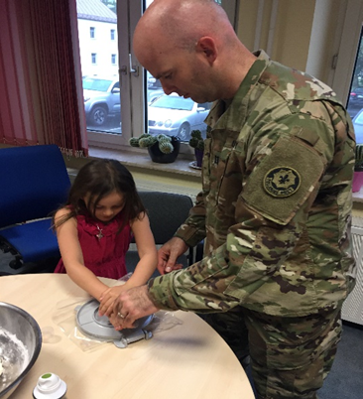
ACS EFMP
We understand you have just arrived and need a little time to adjust to the area, get a telephone, find a place to live and get settled.
The ACS EFMP offices will assist you by doing an initial EFMP Family Needs Assessment to review your family’s special needs, locating resources in the community and offering referrals to programs and agencies that can support your family’s needs.
Below is contact information for the ACS EFMP Staff:
• TB Bldg. 244: Aracelis Cotto-Santos, CIV 09641-70-526-4406; DSN: 526-4406
aracelis.cotto-santos.civ@mail.mil
• RB Bldg. 322: Monique O’Neil, CIV 09662-83-2650; DSN 476-2650;
monique.y.oneil.civ@mail.mil
• Hohenfels Bldg. 10: Connie McCreary CIV: 09672-70-84908; DSN: 522-4908
connie.a.mccreary.civ@mail.mil
• Garmisch: Bldg. 203 : Allie Vallery: CIV: 08821-750-3572; DSN: 440-3572;
allie.m.vallery.civ@mail.mil

Slide 3
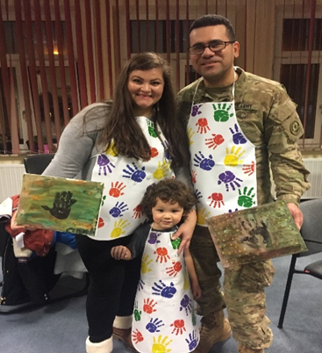
The Medical EFMP Case Coordinators
The Medical EFMP Case Coordinators assist you by assisting in the enrollment, dis-enrollment and update process for EFMP. Additionally, they are a key part of the Command Sponsorship process.
Medical EFMP Case Coordinators are located at the Grafenwoehr, Vilseck and Hohenfels Clinics. Families in Garmisch will use the Hohenfels POC.
Below is contact information for the MTF EFMP Case Coordinators at each clinic:
• Grafenwoehr Health Clinic: Michelle Brown; Phone: CIV 0697-1946-43292; DSN 590- 3292 Tower Barracks Bldg. 475 michelle.s.brown32.civ@mail.mil
• Vilseck Health Clinic: Ms. Crissy Johnson; Phone: CIV 06371-9646-2304; DSN 590- 2304 Rose Barracks Bldg. 225 crissy.a.johnson.civ@mail.mil
• Hohenfels Health Clinic: Ms. Amy Smith; Phone: CIV: 06371-9464-3343; DSN: 314-590-
3343; Hohenfels bldg.51 amy.l.smith32.civ@mail.mil

