Slide 1
Child & Youth Services (CYS) Overview
Core Programs
MilitaryChildCare.com
Child Development Program
CDC / Full Day / Part Day / Part Time / Strong Beginnings Pre-K / Hourly / Respite / Special Openings
Family Child Care Program
Full Day / Part Time / Hourly / Shift Care
Extended Hours / Long Term / Weekend Care
School-Age Program
Before & After School Program / School-Out Days Summer Camps / Tech & Homework Lab
Youth Program
After School / Summer Camps / Evening & Weekend
Field Trips / Workforce Prep / Tech & Homework Lab
Youth Sports & Fitness
Team Sports / Individual Sports / Fitness & Health Outreach / Volunteer Coaching
Parent & Outreach Services Phone: 09662-832760
Instructional Classes (SKIESUnlimited)
Kids-on-Site
Registration and Enrollment – Parent Central
School Support Services
School Liaison Officer (SLO)
School Transition Services
MilitaryChildCare.com (MCC) is a Department of Defense (DoD) website that provides a single online gateway for military families seeking child care.
Registration: Parent Central Services
usarmy.bavaria.imcom-fmwrc.list.cyss-info@mail.mil
Civ: 09662-832760 DSN:476-2760
B224, Rose Barracks
Items needed for CYS Services registration:
Allergy/Asthma Action Plan
Immunizations/Shot Record
2 Local Emergency Designees
Family Care Plan
Health Assessment
Home/Work/Cell Phone Numbers
LES/Pay Stub
Mailing/Physical Address
Unit Name and Address
Visit CYS Services Webpages: https://grafenwoehr.armymwr.com/

Slide 2
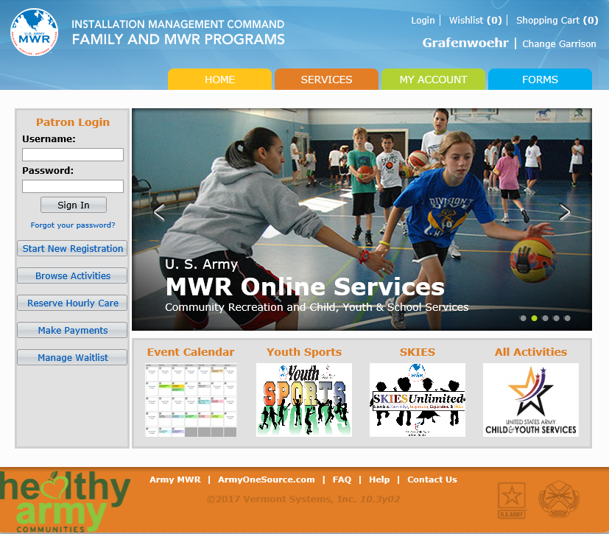
CYS
Online Enrollment
SKIES:
Music Lessons (Piano, Flute, Guitar)
Martial Arts
Dance (Ballet, Tap, Jazz)
Indoor Soccer
Basketball
Horseback Riding (English Style)
Youth Sports & Fitness
Football
Cheerleading
Soccer
Basketball
Wrestling
Baseball
Softball
T-Ball
Track and Field
https://webtrac.mwr.army.mil/
Volunteer Coaches needed to coach all sports
usarmy.bavaria.id-europe.list.cyss-youth-sports@mail.mil
CYS Jobs https://www.usajobs.gov
Visit CYS Services Webpages: https://grafenwoehr.armymwr.com/

Slide 3
School Liaison Officer
Required Documents for Registration:
• Orders pinpointing to USAG Bavaria
• SEALED school records OR contact information of
previous school
• Immunization records
• Birth certificate or passport required only for Sure Start, Kindergarten and 1st grade
School Office Hours:
School Year: 0730-1530 M-F
1 Hour Early Dismissal every Thursday
Vilseck Elementary School (VES)
Sure Start (Pre-School) to 5th Grade
VilseckES.Registrar@dodea.edu
+49 (0)9662 83 2812/2673 DSN: (314) 476-2812/2673
Grafenwoehr Elementary School (GES)
Kindergarten to 5th Grade
GrafenwoehrES.Registrar@dodea.edu
+ 49 (0) 9641 83 7133 DSN: (314) 475-7133
Netzaberg Elementary School (NES)
Sure Start (Pre-School) to 5th Grade
netzabergesregistrar@dodea.edu
+ 49 (0) 9645-917-9184 DSN: (314) 472-9184
Netzaberg Middle School (NMS)
6th to 8th Grade
NetzabergMS.Attendance@dodea.edu
+ 49 (0) 9645-917-9229 DSN: (314) 472-9229
Vilseck High School (VHS)
9th to 12th Grade
Contact VHS Counselor before quarantine
Provide a copy of transcripts and school records
VilseckHS.Registrar@dodea.edu
+ 49 (0) 09662-83-2864 DSN: (314) 476-2864
LINK to DoDEA ONLINE registration:
www.dodea.edu/DORS
Alert! Mass Warning Notification System,
sends registered users emergency warnings and other critical information
Login to self-registration: https://alert.csd.disa.mil/
SLOs are knowledgeable about school-related issues
Serve as primary advisor to the Commander on matters relating to
schools
Inform and assist parents with school transition challenges
Assist parents prior to arrival, while at installation, and when
preparing to depart
Bavaria Grafenwoehr SLO website:
https://grafenwoehr.armymwr.com/programs/school-liaison-officer-slo
SLO Email: usarmy.bavaria.imcom-europe.list.bavaria-slo@mail.mil
SLO Phone: Local: 011-49 9641-70-526-9042 DSN: (314) 526-9042

Slide 4
School Meal Program (AAFES)
The Exchange School Meal Program provides wholesome, nutritious meals to eligible students. They follow the same USDA guidelines as schools throughout the United States and provide Free and Reduced-Price Meals for students who qualify under Federal Guidelines.
The U.S. Department of Agriculture recently granted a waiver to the DoD School Food Authorities to provide free school meals through June 30, 2021. Participants are required to have a DoDEA student ID number and student meal account.
4 Steps To Setting Up A School Lunch Account
1. Register each student
Obtain a 10-digit DoDEA student ID# for all children from the school registrar.
2. Set up a lunch account with AAFES Exchange
Visit your AAFES EXCHANGE Customer Service Center or the School Cafeteria to set up an account for each student.
A 6 digit pin number will be assigned for your child to use to deduct cost of meals, ala carte items and beverages. All students, even those eligible for Free & Reduced price meals & Sure Start, need a lunch account.
3. Set up a My Payments Plus (MPP) account www.MyPaymentsPlus.com.
For more information, visit: https://www.aafes.com/about-exchange/school-lunch-program
You can find menus, as well as nutrition and allergen information at:
https://www.aafes.com/Images/Community/schoollunch/MenuNutrition2020.pdf
SLO Email: usarmy.bavaria.imcom-europe.list.bavaria-slo@mail.mil
SLO Phone: Local: 011-49 9641-70-526-9042 DSN: (314) 526-9042

Slide 5
Bavaria District Student Transportation
DoDEA does not own buses or employ drivers, but contracts with host-nation commercial companies for transportation services.
Buses are not the yellow vehicles familiar to American children, but European-style tourist or city transit coaches.
Drivers are not required to speak English, only the host-nation language.
The driver’s job is to operate the bus safely, not to enforce good order and discipline. Parents are responsible for their children’s behavior on the bus. Misbehavior results in disciplinary action, including temporary or permanent suspension of bus privileges.
Bus Routes – Transportation office responsibility
Establish and optimize all routes based upon passenger locations, stops and school locations.
Each route will be under 60 minutes in duration if at all possible.
The bus companies safely transport students to and from their designated schools and alternate educational sites for classes and authorized school activities.
Rose Barracks School Transportation Office (VHS)
Local: +49 (0)9662 83 2422
DSN: (314) 476-2422
Rose Barracks School Transportation office (VES)
Local: +49 (0)9662 83-2812 ext. 7418
DSN: (314) 476-2812 ext. 7418
Netzaberg/Grafenwoehr School Transportation office (NMS)
Local: + 49 (0)9645-917-9184 ext.5040
DSN: (314) 472-9184 ext.5040
Adjustments to Schedule:
Severe Weather
Early Dismissal (Thurs)
Breakdowns on route
SLO Email: usarmy.bavaria.imcom-europe.list.bavaria-slo@mail.mil
SLO Phone: Local: 011-49 9641-70-526-9042 DSN: (314) 526-9042

