Slide 1
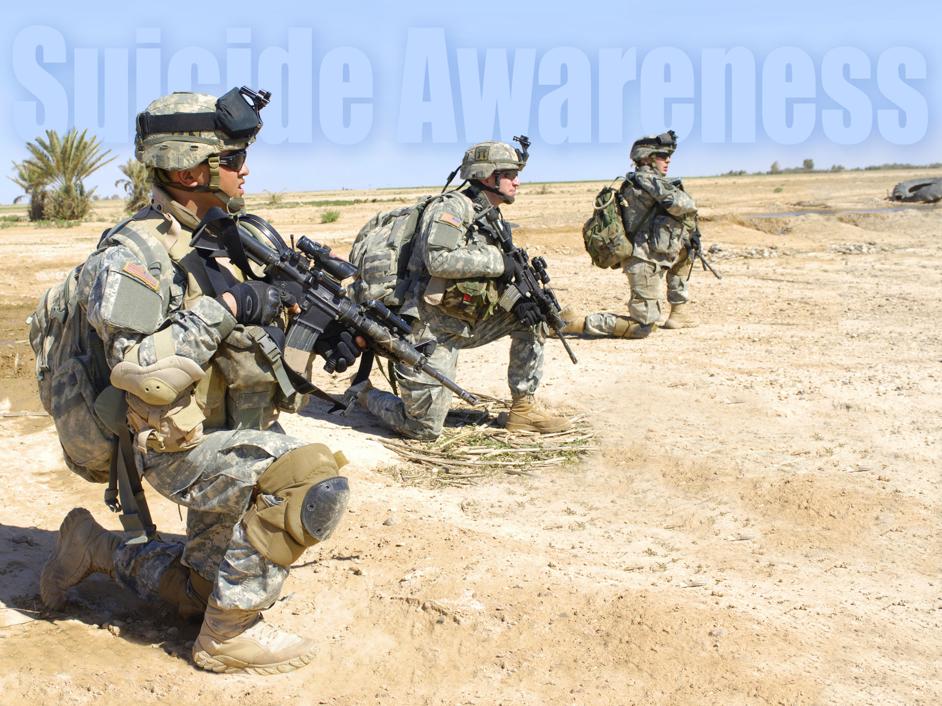
Suicide Awareness for Soldiers

Slide 2
Intervention

Slide 3
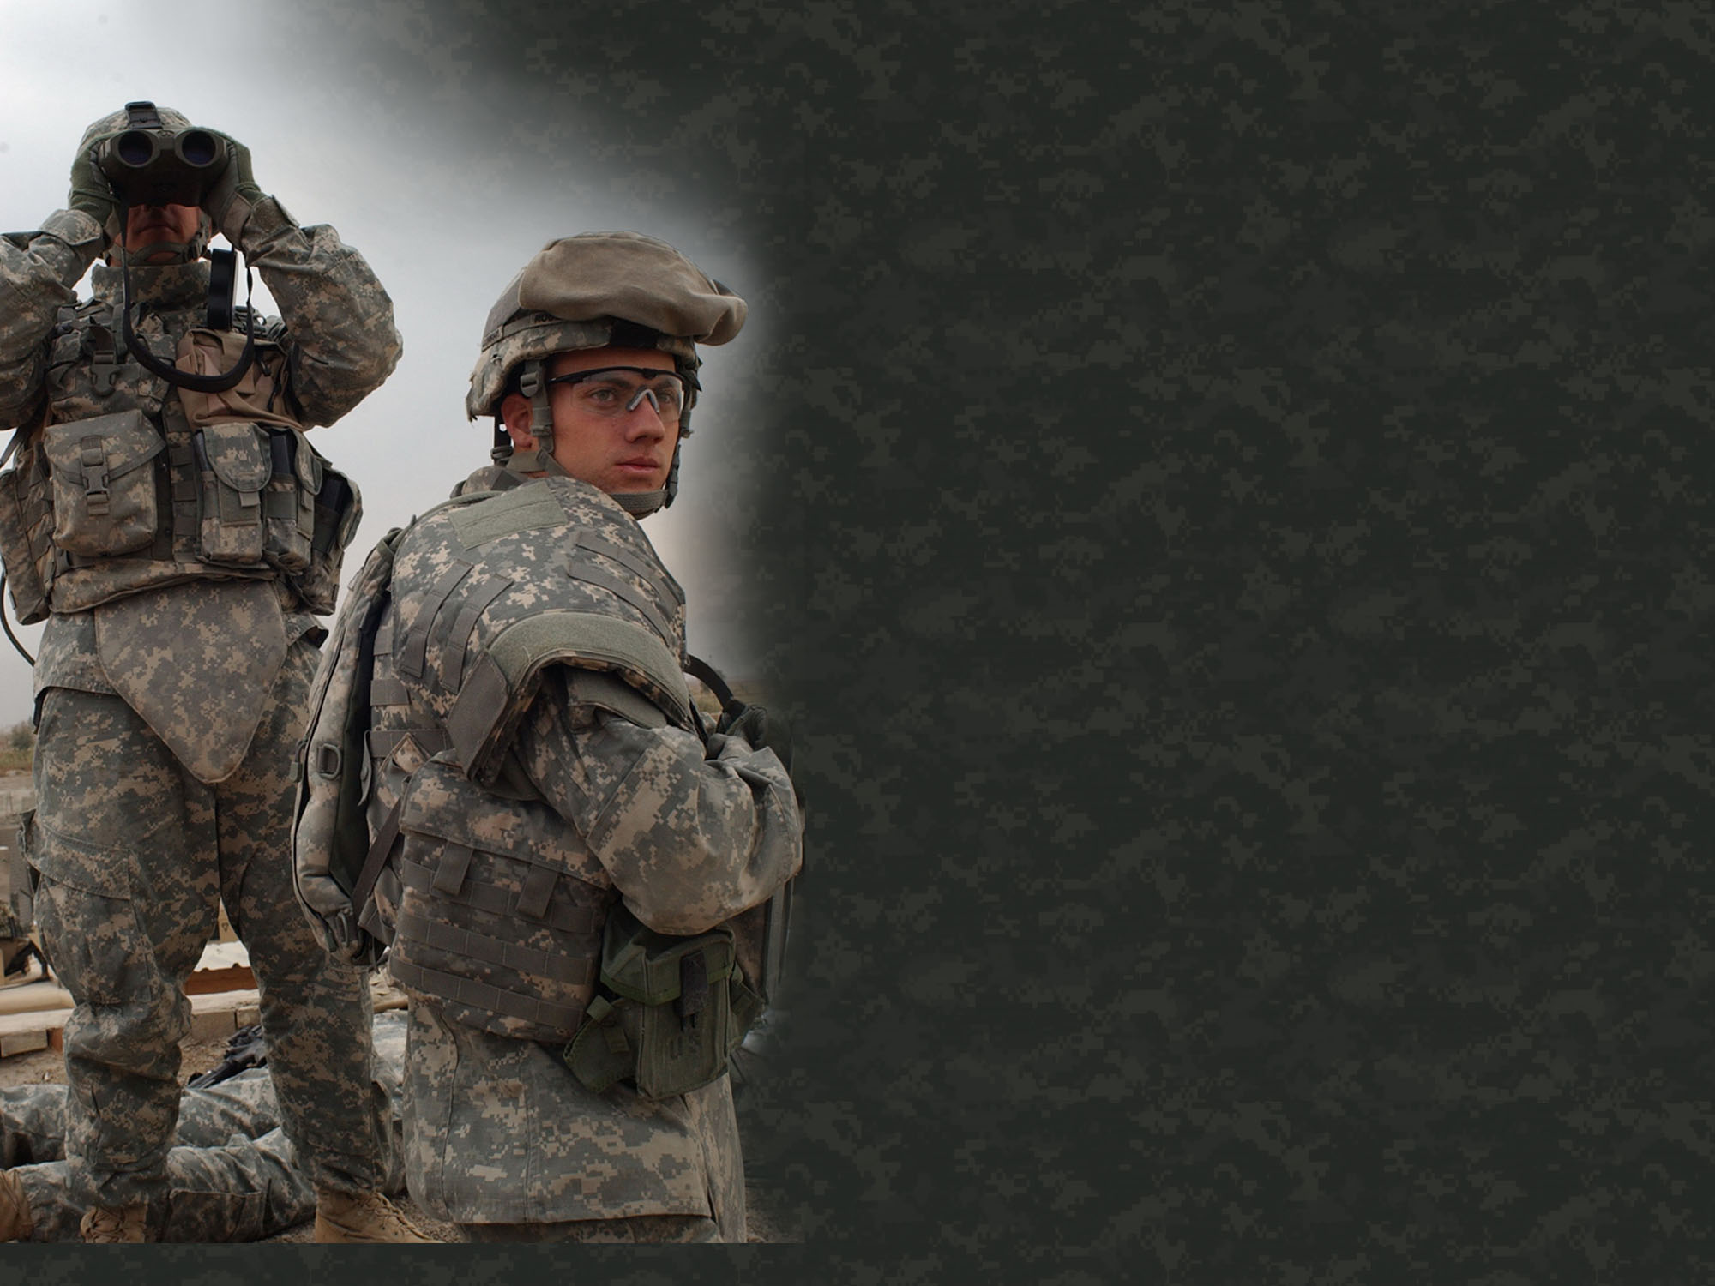
Resources
National Suicide Prevention Lifeline 24/7: Dial 118 or +49 (0) 9641-70-569-118 https://suicidepreventionlifeline.org
www.militaryonesource.com or 1-800-342-9647
http://www.preventsuicide.army.mil.
Military Crisis Line 24/7: Dial 118 or +49 (0) 9641-70-569-118 https://veteranscrisisline.net/get-help/military-crisis-line

Slide 4
Other Local Resources
Chaplain Crisis Line: (DSN) 526-3025
09641-70-526-3025
Behavioral Health Clinic:
+49 (0) 6371-9464-2300
Military Police Emergency: 114 +49 (0) 9662-83-110
USAG BMC IOC: (DSN) 475-7226
09641-83-7226

Slide 5
What Activities Protect Us Against Depression & Suicide?

Slide 6
Living Well
Physical Fitness
Friendships & Community
Sunlight
Sleep
Proper Nutrition / Fish Oil
Purpose
Serving Others
Thankfulness
Disciplined Thought / Meditation
Religious Practice

Slide 7
Marriage Stability
Purpose
Suicide
Religious Practice
Depression
Sickness
Stress
Alcohol

Slide 8
1100: Netzaberg Chapel
www.facebook.com/ChapelNetz

Slide 9
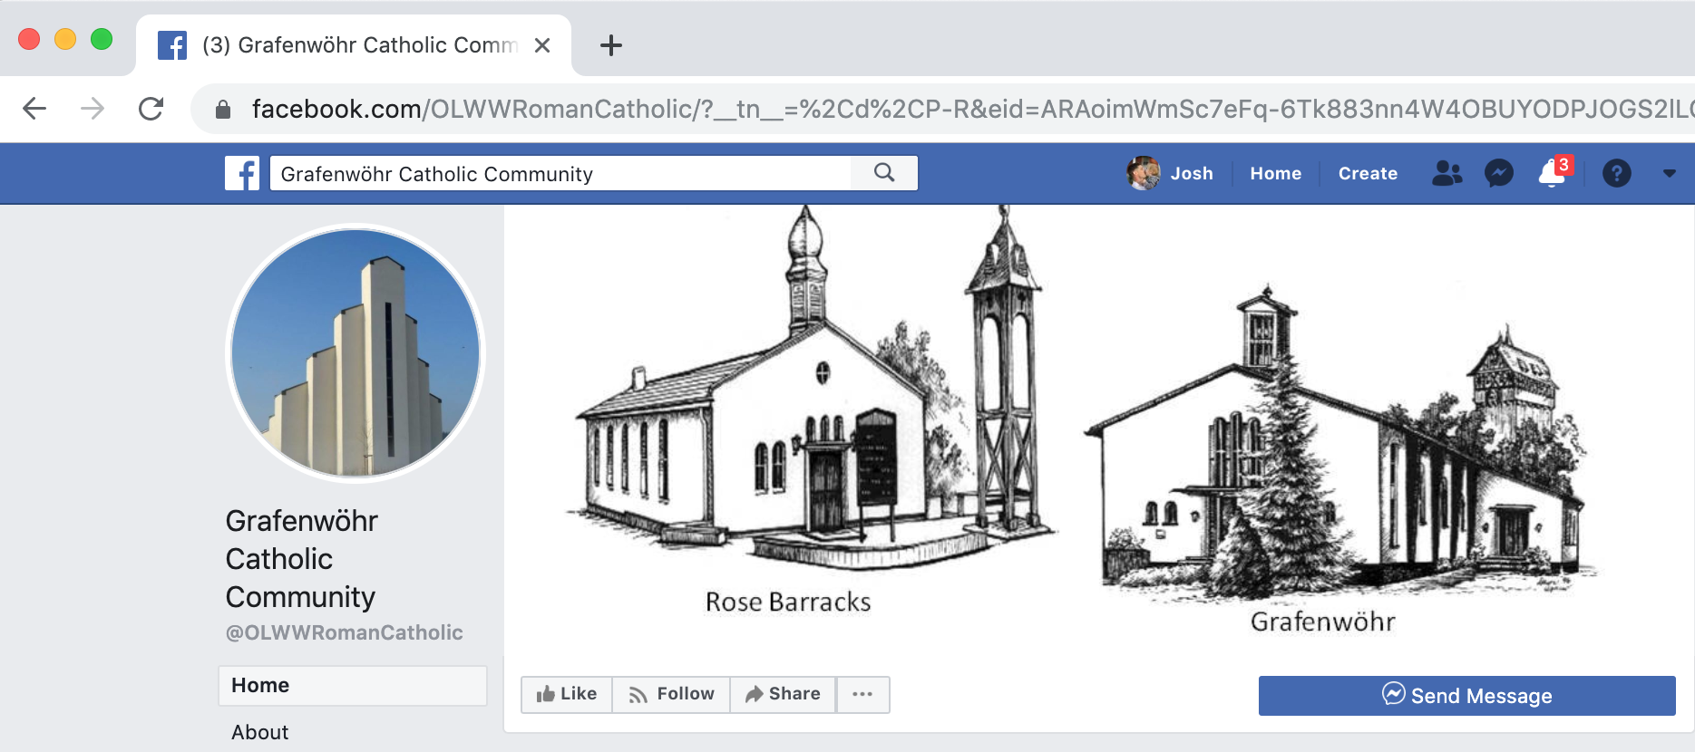
Catholic - 0830: Netzaberg Chapel
1130: Rose Barracks

Slide 10
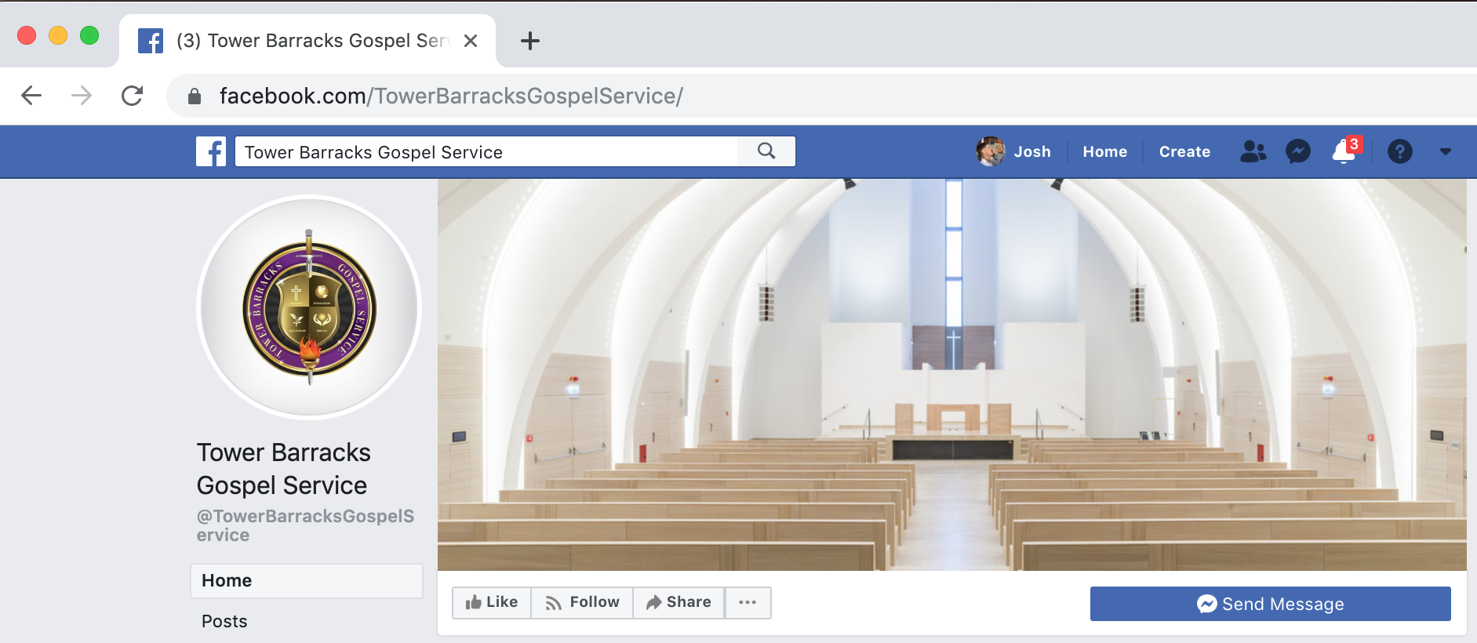
Gospel - 1300: Netzaberg Chapel
www.facebook.com/TowerBarracksGospelService

Slide 11
NETZABERG
CHAPEL
Sunday
Catholic 0830
PX 0800
DFAC 0815
Chapel Netz 1100
PX 1020
DFAC 1030
Gospel 1300
DFAC 1205
PX 1215
+
X
+
CHAPEL BUS
DFAC
Grafenwohr
PX

Slide 12
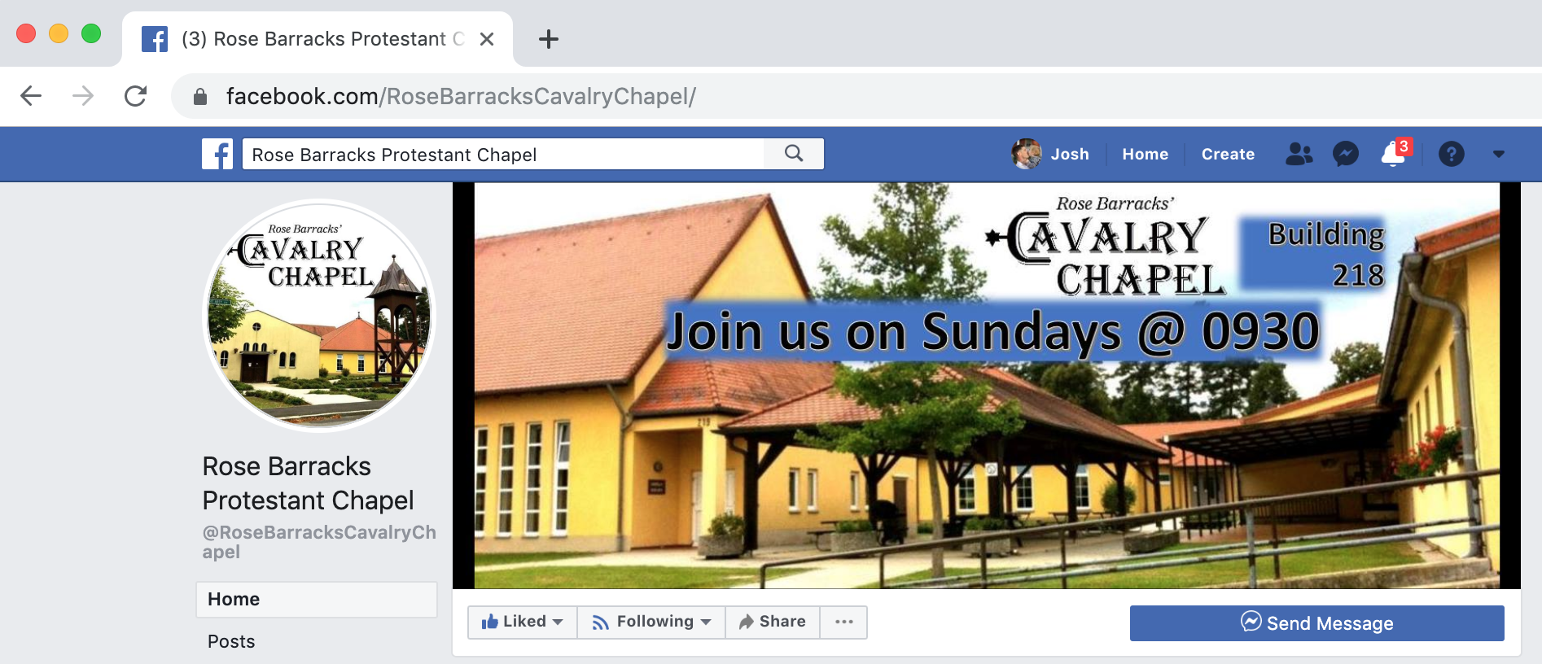
0930: Rose Barracks
www.facebook.com/RoseBarrackCavalryChapel

Slide 13
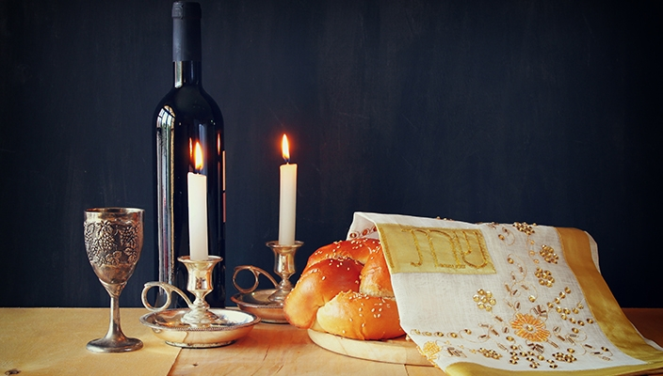
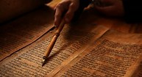
Shabbat
Torah Study
1st & 3rd Friday’s 1800 (6pm) Thursday’s 1200
Building 142 Tower Barracks Chapel, Grafenwoehr
POC: CH (LTC) Henry “Ari” Soussan DSN 569-7053
Cell: 0179-4090016
Henry.C.Soussan2.mil@mail.mil

Slide 14
Worship Opportunities
Netzaberg Chapel
Catholic Confession SUN 0730
Catholic Mass SUN 0830
Chapel Netz SUN 1100
Gospel Service SUN 1300
Rose Barracks Chapel
Eastern Orthodox SUN 0900 (smaller Chapel)
Calvary Chapel SUN 0930
Catholic Confession SUN 1100
Catholic Mass SUN 1130
Catholic Daily Mass TUE/THU/FRI 1205
Seventh Day Adventist SAT 1030
Tower Barracks Chapel
Jewish Service 1st & 3rd FRI 1800
Catholic Daily Mass TUE/FRI 1200

Slide 15
