Slide 1
In-Processing Brief
Army Substance Abuse Program (ASAP)
USAG Bavaria
Version Number Version #1
As of 28 MAY 2020

Slide 2
AGENDA
ASAP Mission Statement
ASAP vs SUDCC
ASAP Programs & Services
Substance Abuse Prevention and Education
Suicide Prevention Program
Employee Assistance Program (EAP)
Risk Reduction Program
Drug Testing Program
What is a Standard Drink?
Know the Law
DUI
Low-Risk Drinking Guidelines
SUDCC Contact Information
ASAP Contact Information

Slide 3
ASAP Mission Statement
The Army Center for Substance Abuse Programs (ACSAP) mission is to strengthen the overall fitness and effectiveness of the Army's workforce, to conserve manpower, and to enhance the combat readiness of Soldiers.

Slide 4
ASAP vs SUDCC
Army Substance Abuse Program (ASAP) | Substance Use Disorder Clinical Care (SUDCC)
Army Material Command (AMC) Garrison function Prevention Services Substance Abuse Training and Education Suicide Prevention Employee Assistance Program (EAP) Risk Reduction Drug Testing Program Commander’s Ready & Resilient Council (CR2C) | Medical Command (MEDCOM) MEDDAC-B function (Behavioral Health) Clinical Services Referrals (DA Form 8003) Assessment Rehabilitation Team Meetings (RTM) Treatment Individual Counseling Group Counseling Referral for higher level of care Aftercare / Follow-up Services

Slide 5
Substance Abuse Prevention & Education
Substance Abuse Training & Education
Available for military, civilians, contractors, and host nationals
Training required annually
Conducted face-to-face (only)
Duration, location, and means for training are determined by Commander
Provide educational resources relating to alcohol and drugs (i.e. pamphlets, booklets)
Prime for Life
Evidenced-based training
2 day workshop (12 hours of drug and alcohol education)
Used primarily to supplement a SUDCC enrollment
Open to self-referral
½ day workshop (4.5 hours of drug and alcohol education)
Used as a prevention tool - targeting young or new soldiers
Open to self-referral
Community Education, Outreach, & Campaigns

Slide 6
Suicide Prevention Program
Suicide Prevention Training
Available for military, civilians, contractors, and host nationals
Training required annually
Conducted face-to-face (only)
Duration, location, and means for training are determined by Commander
Provide educational resources relating to suicide prevention (i.e. pamphlets, booklets)
Ask, Care, Escort (ACE)
Available for military, civilians, contractors, and host nationals
90 minutes
ACE-Suicide Intervention (ACE-SI)
Available for junior level leaders, from team leader through company commander
4 hours
Every unit must maintain a minimum of 2 ACE-SI facilitators (certified through ASAP)
Applied Suicide Intervention Skills Training (ASIST)
Available for military, civilians, contractors, and host nationals – priority goes to “gatekeepers”
2 day workshop
Community Education, Outreach, & Campaigns

Slide 7
Employee Assistance Program (EAP)
The EAP program is a benefit to employees designed to help them and their family members resolve personal problems that may be causing a negative impact on the employee’s performance. EAP also provides consultation and support to supervisors/managers
EAP is available to:
DA Civilians (AF & NAF)
US Contractors
Host National Employees
Military Retirees
Family Members of the above and Military Family Members
Two Types of Referrals - Self-referral & Supervisor Referral
EAP services include: Non clinical screenings, short-term, solution focused counseling, resource information, referrals, supervisor/manager consultation and support, and follow-up services
ALL SERVICES ARE CONFIDENTIAL

Slide 8
Risk Reduction Program
Unit Risk Inventory (URI) and Reintegration Unit Risk Inventory (R-URI)
Recommended Annually, after Change of Command, and 30 days prior to deployment, or at Commander’s request
Required 90-120 days post deployment (R-URI)
Anonymous
Risk Reduction Command Consultation
Convened after data collected from the URI
Provide results analyses of the URI to the Command Team
Installation Prevention Team (IPT) meetings
Commander’s Risk Reduction Toolkit (CRRT)
Tool to help the Command Team to gain insight into high risk behavior trends of individual soldiers and unit

Slide 9
Drug Testing Program
Commander’s Drug Testing Program
2 Unit Prevention Leaders (UPL) / 1 Battalion or Squadron Prevention Leader (BPL/SPL)
E-5 or above for Co level
E-5 promotable or above (recommend E-7) for BPL/SPL
Must complete 3-Day UPL Certification Course (locally offered by ASAP) and pass final exam
Mandatory Random Testing:
Back to back (Monday/Friday)
Weekend/Holiday
During field exercise
End of duty day
Other Tests:
Follow-up Testing
Unit Sweep
Probable Cause
Rehabilitation Testing
If enrolled in SUDCC, rehabilitation testing required 1x monthly – or more per recommendation of SUDCC provider

Slide 10
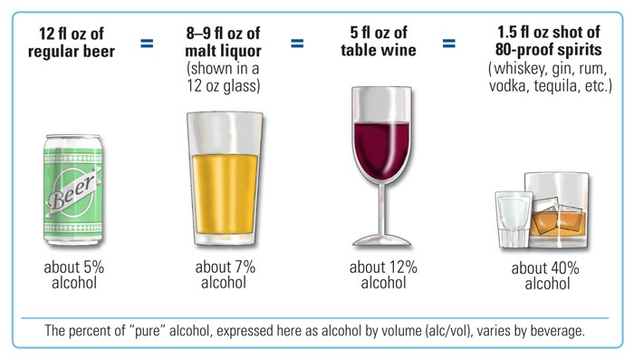
What is a Standard Drink?

Slide 11
Blood Alcohol Content (BAC)

Slide 12
Low Risk Drinking Guidelines
USAREUR LAWS | GERMAN LAWS
If you are 21 years or younger and have any alcohol you will lose your license for 30 days. | Drunk driving (BAC = .05) is a felony punishable with imprisonment of up to 5 years and a large fine if persons or property are endangered.
If you flee the scene of an accident you will lose your license for 6 months | When test is ministered, regardless of the delay, the results can be used against the driver to suspend or revoke the driver’s certificate of license.
Driving While Intoxicated: .05 to .079 BAC AER 190-1 | Driver should not drink alcohol for at least 6 hours after an accident.
Drunk Driving: .08 BAC or higher UCMJ (Article 113) | Drivers who refuse to submit to or complete chemical tests will have their certificate of license revoked indefinitely.

Slide 13
Driving Under the Influence (DUI)
According to German DUI laws, violating 0.05% blood alcohol concentration or driving under the influence will result in the following consequences:
First Offense | 500 Euro fine, two point reduction and one-month driving suspension.
Second Offense | 1000 Euro fine, two point reduction and a three-month driving suspension.
Third Offense | 1500 Euro fine, two point reduction and a three-month driving suspension.
Additional Consequences | Death, UCMJ (i.e. Chapter 14), extra duty, a referral to SUDCC, reduction in rank and pay, driving suspension on post, taxi fare, etc.
Details at www.army.mil/a/232252

Slide 14
Low Risk Drinking Guidelines
Standard Drink | EXPLANATION
0 | If you have been diagnosed with alcoholism or dependency, while on duty, on-call, MOS specific, pregnant/nursing, taking medication, driving/operating machinery, babysitting/childcare, etc.
1 | Standard drink per hour
2 | Standard drinks per day (not to exceed 14 SDUs per week)
3 | Maximum standard drinks on any given day

Slide 15
SUDCC Contact Information
Hohenfels, Building 51
Mon-Fri Hours: 0730-1630
DSN: 314-590-3300 / 06371-9464-3300
Rose Barracks, Building 260
Mon-Fri Hours: 0730-1630
DSN: 314-590-2300 / 06371-9464-2300
Tower Barracks, Building 621
Mon-Fri Hours: 0730-1630
DSN: 314-475-1710 / 09641-83-1710
*NOTE: SUDCC is embedded within Behavioral Health Clinics

Slide 16
ASAP Contact Information
USAG Bavaria ASAP Tower Barracks, Building 555
Mon-Fri Hours: 0730-1630
DSN: 314-569-7904/ CIV: 09641-70-569-7904
DSN: 314-569-7906 / CIV: 09641-70-569-7906
USAG Bavaria EAP Tower Barracks, Building 555
Mon-Fri Hours: 0730-1630
DSN: 314-569-7900/ CIV: 09641-70-569-7900
*NOTE: USAG Bavaria ASAP and EAP provides services to Tower Barracks, Rose Barracks, Hohenfels, and Garmisch

