Slide 1




U.S. Army Garrison Bavaria
Army Continuing Education Center
Education Services
In-processing Brief

Slide 2
U.S. Army Garrison Bavaria
Army Continuing Education Center
Education Centers
Tower Barracks (Grafenwoehr)
Buildings 538 & 549
Hours: 0730 – 1630
DSN: 475-7239 / CIV: 09641-83-7239
Education Counseling
TABE Testing Only
Computer Lab
College Representatives
Classrooms
Rose Barracks (Vilseck)
Building 223
Hours: 0730 – 1630
DSN: 476-2753 / CIV: 09662-83-2753
Education Counseling
Testing
Computer Lab
College Representatives
Classrooms

Slide 3
U.S. Army Garrison Bavaria
Army Continuing Education Center
Education Centers
Hohenfels
Building 351
Hours: 0730 – 1630
DSN: 522-2259 / CIV: 09472-708-2259
Education Counseling
Testing
Computer Lab
College Representatives
Classrooms
Garmisch
Building 203
Hours: 1600-1700
DSN: 440-3560 / CIV: 08821-750-3560
Education Counseling

Slide 4
U.S. Army Garrison Bavaria
Army Continuing Education Center
How to Individually In-Process with the Education Center …
Call your respective Education Center and schedule an appointment with an Education Counselor!
Be sure to bring your in-processing paperwork to your appointment!

Slide 5
U.S. Army Garrison Bavaria
Army Continuing Education Center
Scheduling an Appointment
To schedule an appointment with an Education Counselor, call your respective Education Center
OR
Email our group box:
usarmy.bavaria.id-europe.mbx.aces@mail.mil

Slide 6
U.S. Army Garrison Bavaria
Army Continuing Education Center
Contact Information
Rose Barracks Education Center
Building 223
DSN: 476-2753 / CIV: 09662-83-2753
Tower Barracks Education Center
Buildings 538 & 549
DSN: 475-7239 / CIV: 09641-83-7239
Hohenfels Education Center
Building 351
DSN: 522-2259 / CIV: 09472-708-2259
Garmisch Education Center
Building 203
DSN: 440-3560 / CIV: 08821-750-3560
Email: usarmy.bavaria.id-europe.mbx.aces@mail.mil
Facebook: https://www.facebook.com/USAG.Bavaria.Education.Centers
Education Center website: https://home.army.mil/bavaria/index.php/edcenter

Slide 7
U.S. Army Garrison Bavaria
Army Continuing Education Center
Why is Education Important?
Promotion – You can receive two promotion points for every one semester hour your complete
Better opportunities – the more educated you are, the more opportunities you have
Retention in the midst of downsizing!
Self-Esteem – feels great accomplishing such a huge goal

Slide 8
U.S. Army Garrison Bavaria
Army Continuing Education Center
Counseling Services
  We can help you …
  Set and reach education goals.
  Understand how college works.
  Choose a degree plan.
  Choose a school.
  Verify school accreditation.
  Submit your Joint Services Transcript (JST).
  Use Tuition Assistance (TA).
  Learn about financial aid & scholarships.
    Learn about GI Bill benefits.
Spouses:
We have information about scholarships and MyCAA.
You have access to most of the same services as your soldiers, so come see us!

Slide 9
U.S. Army Garrison Bavaria
Army Continuing Education Center
HOW WOULD YOU LIKE AN EXTRA $4000 PER FISCAL YEAR?

Slide 10

U.S. Army Garrison Bavaria
Army Continuing Education Center
TA
CA
$4,000 cap
There are two ways to utilize benefits your benefits!

Slide 11
U.S. Army Garrison Bavaria
Army Continuing Education Center
Tuition Assistance (TA)
  Tuition Assistance (TA) program provides financial assistance for voluntary off-duty education programs.
  For academic programs to pursue, Certificate’s, Associate’s, Bachelor’s, or Master’s degree
  TA is available for courses that are offered in the classroom or by distance learning and is part of an approved academic degree or certificate program

Slide 12
U.S. Army Garrison Bavaria
Army Continuing Education Center
Tuition Assistance (TA)
  Available after graduating from Advanced Individual Training, Warrant Officer Basic Course, or Basic Officer Leaders Course.
  TA covers …
    $250 per Semester Hour (SH)
    16 SH per Fiscal Year or $4000 (whichever comes first)
  If you use TA for any part of your bachelor’s degree, you are eligible to use TA for your master’s degree after graduating from Advanced Leaders Course, Warrant Officer Advanced Course, or Captain Career Course.
  Officers incur a 2-year ADSO from the last day of the last class using TA.

Slide 13
U.S. Army Garrison Bavaria
Army Continuing Education Center
TA First Course Rule
  If you’ve never attended college, you are required to take your first course with one of our garrison schools.
    Central Texas College
    University of Maryland Global Campus- Europe
    Embry-Riddle Aeronautical University
  You may take the course online or onsite.
  If you intend to pursue a degree or certificate with a different school, you should ensure your first course will transfer.

Slide 14
U.S. Army Garrison Bavaria
Army Continuing Education Center
Tuition Assistance Recoupment
The following may result in recoupment:
  Withdrawing from courses
  Failing courses (undergraduate: D, F / graduate: C, D, F)
  Unresolved incomplete grades
Military Withdrawals may stop recoupment!
Qualifying reasons include unanticipated military duties, emergency leave, etc.
(Requires DA 7793 form signed by Company Commander.)

Slide 15
U.S. Army Garrison Bavaria
Army Continuing Education Center
To begin using TA, you will need to set up a GoArmyEd account. This is what you will use to request TA.

Slide 16
U.S. Army Garrison Bavaria
Army Continuing Education Center
New GoArmyEd Users
New users must create an account to use GoArmyEd
  Go to goarmyed.com, choose “create or reactivate account option”
Once logged in, select “Request TA Access” link (popup blocker MUST be OFF)
Complete the VIA questionnaire
Choose a career goal, degree, and school
  Selecting the “Search for degrees and school not listed” link will allow you to search for a particular school and degree at the same time.
  Ensure you are choosing the correct location (i.e. University of Maryland Global Campus- Europe)
Review your selection, then click “Submit” at the bottom of the page.
An Army Education Counselor will review and process your request within one business day. You will be notified when your request has been processed.

Slide 17
U.S. Army Garrison Bavaria
Army Continuing Education Center
Requesting Tuition Assistance
You must use GoArmyEd to request TA and register for ALL classes
  Self-pay classes, face-to-face classes, distance learning classes, etc.
You MUST request TA and receive approval before class start date.
  Minimum of 5-10 business days before the start of class for most schools.
You can enroll as early as 60 days prior to the start of class.
You must drop or withdraw through GoArmyEd.
  Check drop/refund deadline before withdrawing

Slide 18
U.S. Army Garrison Bavaria
Army Continuing Education Center
Credentialing Assistance (CA)
  CA program provides funding for voluntary off-duty courses and/or exams leading to an industry-recognized academic or vocational credential
    Professional license or certification
  CA covers …
    Classroom/Online learning/training, exams, materials and all required fees (books, manuals, supplies, study guides, recertification)

Slide 19
U.S. Army Garrison Bavaria
Army Continuing Education Center
Credentialing Assistance (CA)
  Credential MUST be listed in Army COOL to pursue
    https://www.cool.osd.mil/army
  Soldier must meet basic TA eligibility and have an active GoArmyEd account.
  Officers incur a 2-year ADSO when using CA for training purposes (excludes CA for examination purposes only).

Slide 20
U.S. Army Garrison Bavaria
Army Continuing Education Center
Credentialing Assistance Recoupment
  Soldiers will be subject to reimbursing the Army for CA if they:
    Fail or withdraw from a course of instruction
    Fail an exam
    Fail to sit for the exam in the timeframe required to earn the credential
    Recoupment must be paid off completely to begin using Credentialing Assistance again.

Slide 21
U.S. Army Garrison Bavaria
Army Continuing Education Center
Would you like a way to receive college credit for training you have already done?

Slide 22
U.S. Army Garrison Bavaria
Army Continuing Education Center
Joint Services Transcript (JST)
Lists college credit recommendations for your military training.
Access your JST and submit it to schools free at http://jst.doded.mil
Your school will evaluate your JST and may award credits.
You can turn these credits into promotion points by bringing an unofficial college transcript to your Education Center.

Slide 23
U.S. Army Garrison Bavaria
Army Continuing Education Center
CLEP/DSST
Why spend weeks taking a college course if you already know the information?
Receive college credit for passing online multiple choice exams.
The first attempt in each subject is FREE for Active Duty Service members!
Spouses & dependents pay $117 per test.
Contact your local Education Center for study resources.
Find more information at http://www.dantes.doded.mil/examinations/earn-college-credit/clep.html

Slide 24
U.S. Army Garrison Bavaria
Army Continuing Education Center
Testing Centers
Academic Testing
  Admissions tests: SAT
  Certification testing
  Test of Adult Basic Education (TABE)
Army Personnel Tests
  AFCT
  Language (DLAB, DLPT)
  SIFT
  ECLT
  (Digitally signed 4187 required for these tests.)
  National Testing Center
  College credit tests (CLEP, DSST)
  GMAT
  GED
  ASE Certification Testing
  IT and other certification testing

Slide 25
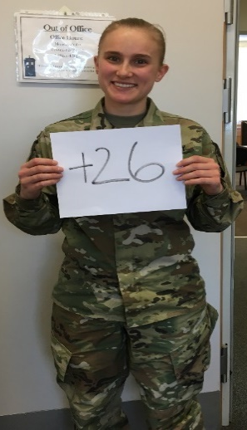
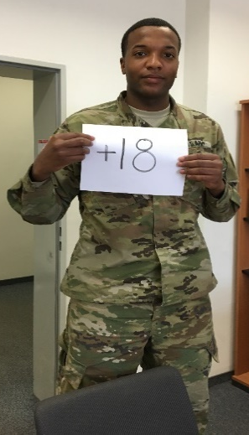
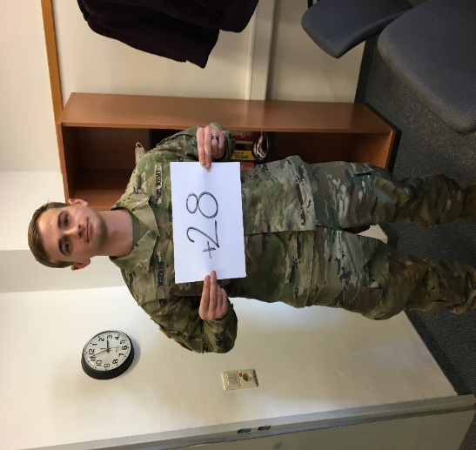
U.S. Army Garrison Bavaria
Army Continuing Education Center
FAST Class
Ten days of on-duty instruction
FAST Class can help you …
  Increase your General Technical (GT) score
  Improve job performance
  Prepare for more advanced schooling
  Increase reenlistment options
  Enhance trainability
AFCT can only be taken every 6 months. Your most recent score is your official GT score.
Contact your local Education Center for schedule!

Slide 26
U.S. Army Garrison Bavaria
Army Continuing Education Center
Did you know that using tuition assistance does not affect your VA benefits?
VA Benefits include:
Montgomery GI Bill
Post 9/11 GI Bill
Top-Up (using your GI Bill alongside your TA)

Slide 27
U.S. Army Garrison Bavaria
Army Continuing Education Center
Montgomery GI Bill
Must pay $1,200 (usually $100/month during your first year of service) to have access to this GI Bill
Pays out …
  36 months of benefits
  Monthly flat rate directly to the Soldier / Veteran / Student who then pays for tuition and books
  Current rate is $2,050/month
Honorable discharge required

Slide 28
U.S. Army Garrison Bavaria
Army Continuing Education Center
Post-9/11 GI Bill
No financial contribution required, based on active duty service
36 months of entitlement
Tuition and Fees
  Public/In-state school: 100% tuition is paid directly to school
  Private/Technical/Foreign: $25,162.14/year
Monthly Housing Allowance
  Based on E5 w/dependents, zip code of school, and enrollment status
  Must be enrolled full time with one face-to-face class to receive maximum benefit
  Fully online $916.50, Foreign: $1,833.00
$1,000/year book stipend based on enrollment
Does not expire
Can transfer benefits, if eligible

Slide 29
U.S. Army Garrison Bavaria
Army Continuing Education Center
Are there any benefits that are available to my spouse?

Slide 30
U.S. Army Garrison Bavaria
Army Continuing Education Center
My Career Advancement Account Scholarship
(MyCAA)
Up to $4,000 of financial assistance to eligible military spouses, $2,000 cap per fiscal year
Eligibility: Spouse of AD Service Member / National Guard / Reserves in pay grades:
  E-1 to E-5
  W-1 to W-2
  O-1 to O-2
Pursue a license, certification, or associate’s degree
http://www.militaryonesource.mil/

Slide 31
U.S. Army Garrison Bavaria
Army Continuing Education Center
Bavaria Community and Spouses’ Club
Scholarships
Eligibility:
  Graduating high school senior
  Family Member of an active, retired, or deceased U.S. military Service Member
  DoD civilian whose family resides within USAG-Bavaria Military Community at the time the scholarship is awarded
  Used for tuition, books and fees, certificate, or other professional programs
http://www.bavariacsc.com/scholarships-and-welfare.html

Slide 32
U.S. Army Garrison Bavaria
Army Continuing Education Center
Spouse Relicensing Reimbursement
Army Spouses are eligible for a reimbursement of up to $2,500 in professional relicensing expenses through Army Emergency Relief when they move to another state.
Spouses who are eligible for the reimbursement will need their Soldier to apply for the reimbursement at their command.
AER will provide a loan for the initial $500 up front, if the costs exceed $500, they'll be able to apply through AER for additional funds.

Slide 33
U.S. Army Garrison Bavaria
Army Continuing Education Center
Contact Information
Rose Barracks Education Center
Building 223
DSN: 476-2753 / CIV: 09662-83-2753
Tower Barracks Education Center
Buildings 538 & 549
DSN: 475-7239 / CIV: 09641-83-7239
Hohenfels Education Center
Building 351
DSN: 522-2259 / CIV: 09472-708-2259
Garmisch Education Center
Building 203
DSN: 440-3560 / CIV: 08821-750-3560
Email: usarmy.bavaria.id-europe.mbx.aces@mail.mil
Facebook: https://www.facebook.com/USAG.Bavaria.Education.Centers
Education Center website: https://home.army.mil/bavaria/index.php/edcenter

Slide 34
U.S. Army Garrison Bavaria
Army Continuing Education Center
Check out our four on-post Garrison Colleges and Universities!
You are not limited to Garrison schools. Contact an Education Counselor for more online programs.
*Please note that due to COVID restrictions, some of our Garrison schools are working virtually*

Slide 35




Career and Technical Education
Central Texas College programs
prepare you for a successful
military-to-civilian life transition
and school-to-work transition.
You can choose from certificate programs
or two-year associate degree programs.
No Application fee.
Transfer up to 45 semester hours
of military credit!
VoTech Programs
Applied Management/Military Science Management
Automotive Mechanic/Technician
Child Development
Criminal Justice
Fire Protection
Hospitality Management
Homeland Security and Emergency Management
Tower Barracks/Grafenwoehr
DSN: 475-8314
CIV: 09641-83-8314
grafenwoehr@europe.ctcd.edu
Rose Barracks/Vilseck
DSN: 476-2362
CIV: 09662-83-2362
vilseck@europe.ctcd.edu
  Stay in Touch!
  Contact your Site Coordinator
Apply to CTC
www.ctcd.edu
Get a career that works wherever you go!

Slide 36
Over 40 undergraduate and graduate programs are available to you overseas through on-site, online, and hybrid classes.
Associate degree programs include:
Business and management
Psychology
Foreign language studies
And many more
Why choose UMGC Europe?
Grafenwoehr: Tower Barracks, Bldg. 549
Mon-Fri, 0800-1700
CIV +49-(0)9641-83-5226
grafenwoehr-europe@umgc.edu
Vilseck: Rose Barracks, Bldg. 223
Mon-Fri, 0800-1700
CIV +49-(0)9662-70-2003
vilseck-europe@umgc.edu
A UMGC degree can help you gain the confidence you need to succeed in your career.
Founded in 1947, UMGC was first to serve warriors overseas - since 1949
Career-relevant academics
Dedicated to the military and other busy professionals
Member of the respected University System of Maryland
Regionally accredited by the Middle States Commission on Higher Education
Bachelor’s degree programs include:
Business administration
Criminal justice
Cybersecurity management
Homeland security
And many more
Master’s degree programs include:
Business administration (MBA)
Cybersecurity technology (MS and certificate)
Information technology (MSIT and certificates)
Management (MSM and certificates)

Slide 37

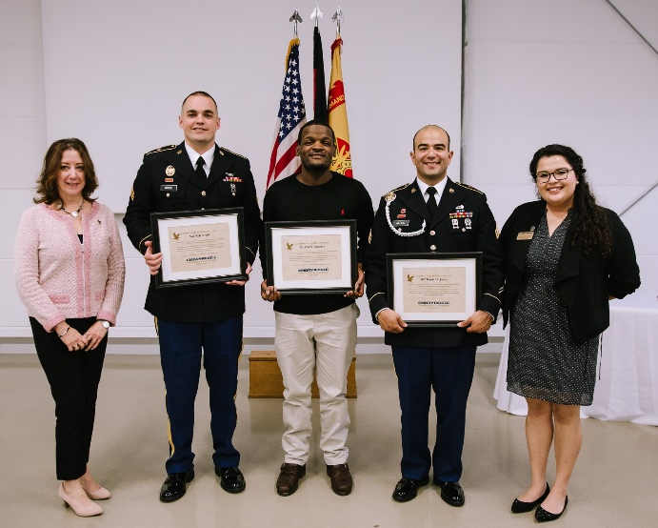
Associates, Bachelors, & Masters degrees are offered through ERAU Worldwide
Our curriculum is designed to fit into the busy lifestyles of our military affiliated students:
  12 start terms for undergraduate courses per year
  10 start terms for graduate courses per year
  Allows students to stagger courses and accelerate their degree
Grafenwoehr l Vilseck l Hohenfels
Contact information:
DSN: 476-3605 / CIV: 09662-83-3605
Graf-Vilseck@erau.edu
Worldwide Fields of Study:
Aeronautics
Aviation Maintenance
Unmanned Systems
Aviation Security
Human Factors
Aviation Business Administration
Technical Management with specializations in areas like:
  Project Management
  Information Security and Information Systems
  Occupational Safety and Health
  Engineering Sciences
  Facilities and Construction Management
  Logistics and Supply Chain Management

Slide 38


Slide 39
U.S. Army Garrison Bavaria
Army Continuing Education Center
Please give us a call if you have any questions or to schedule your inprocessing appointment!
Welcome to USAG Bavaria!

