Slide 1
Warrant Officer Recruiting Team Europe
44 SPECIALTIES – 17 BRANCHES
WWW.GOWARRANTNOW.COM

Slide 2
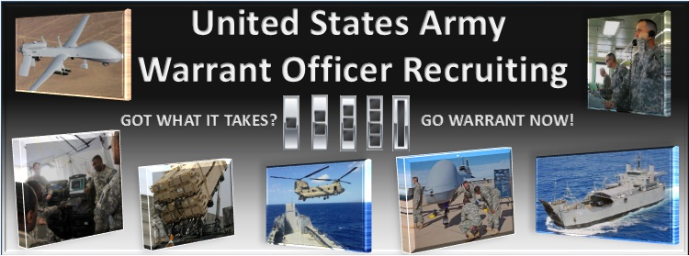
Warrant Officer Recruiting Mission
The Warrant Officer Recruiting Company is tasked with recruiting HIGHLY QUALIFIED in-service applicants who demonstrate character, competence, and commitment to serve as capable Army Warrant Officers.

Slide 3
Applicant Characteristics We take all services!!
Independent Operator
Leader
Self Confident
Dependable
Technically/Tactically Proficient
Ethical and Moral
Decision Maker
Self Sufficient
Mature
Able to Grasp Complex Problems
Mentally and Physically Strong

Slide 4
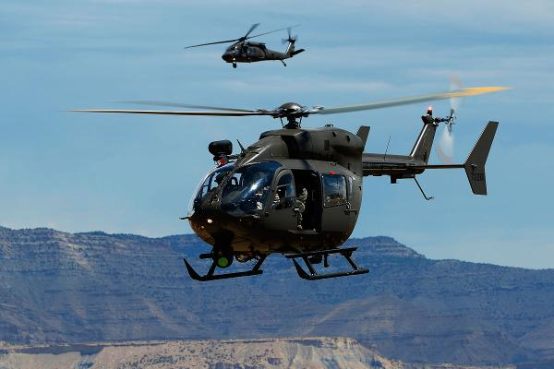
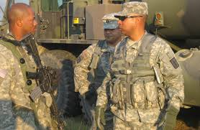
Warrant Officer Jobs
Technicians
17 Branches, 44 Specialties
Usually SGT or higher
Most require completion of ALC
Must meet MOS prerequisites
Aviators
1 Branch, 1 Specialty - 153A
Open to all MOSs and ranks
Passing SIFT Score (40+)
Class I Flight Physical required

Slide 5
Administrative Requirements
US Citizenship No Waiver
General Technical (GT) Score of 110 or higher No Waiver
High School Graduate or have a GED No Waiver
FINAL Secret or Top Secret Security Clearance No INTERIM; No Waiver
Must Have ≥ 12 Months Remaining on Enlistment Contract *ETP Avail
Pass Commissioning Physical for Tech or Flight Physical for Aviators *Waiver/ETP Avail
Age: Technicians < 46 yrs / Aviators < 32 yrs at time packet is boarded *ETP Avail
Active Federal Service: Technicians < 12 yrs / Aviators < 8 yrs at time the DA 61 is signed by applicant *ETP Avail
Pass the Standard 3-event Army Physical Fitness Test (APFT) and Meet Height/Weight Standards

Slide 6
Warrant Officer MOSs
WO MOS MOS Description Enlisted Feeder MOSs
120A Construction Engineering Technician 12H, K, N, P, Q, R, T, W
125D Geospatial Engineering Technician 12Y, 35F, G
131A Field Artillery Technician 11B, C,13B, J, F, M, R, 19D
140A Command and Control Systems Technician 14E, G, H, P, S, 15P, Q, 17E
140K Air and Missile Defense Tactician 14E, H, T
140L Air and Missile Defense Technician 14E, H, T, 94S
150A Air Traffic Control Technician 15Q
150U Tactical Unmanned Aerial Systems Technician 15E, 15W
151A Aviation Maintenance Technician CMF 15 MOS (Except 15P, Q)
153A Rotary Wing Aviator All MOSs
170A Cyber Operations Technician All MOSs
170B Electronic Warfare Technician 25E, 17E, 13Fw/ASI 1J
255A Information Services Technician All MOSs
255N Network Management Technician All MOSs
311A CID Special Agent 31D, 31B with ASI V5
350F All Source Intelligence Technician 35F
350G GEOINT Imagery Technician 35G
351L Counterintelligence Technician 35L
351M Human Intelligence Collection Technician 35M
351Z Attaché Intelligence Operations Technician All MOS w/ SQI 7
352N SIGINT Analysis Technician 35N, P
Historically Critical Mission
Open to ALL MOSs provided prerequisites are met

Slide 7
Warrant Officer MOSs
WO MOS MOS Description Enlisted Feeder MOSs
352S Signals Collection Technician 35S
353T MI Systems Maintenance/Integration Technician 35T
420A Human Resources Technician 42A
740A Chemical, Biological, Radiological and Nuclear Tech 74D
880A Marine Deck Officer All MOSs
881A Marine Engineering Officer All MOSs
882A Mobility Officer All MOSs
890A Ammunition Warrant Officer 89A, B, D
913A Armament Systems Maintenance 91A/F/G/M, ASI A8, K8, J3
914A Allied Trades Warrant Officer 91E, X
915A Automotive Maintenance Warrant Officer 91A, B, H, M, P, S, X
919A Engineer Equipment Maintenance Warrant Officer 91B, C, D, H, J, L, X
920A Property Accounting Technician 92Y
920B Supply Systems Technician 92A, 68J
921A Airdrop Systems Technician 92R
922A Food Service Technician 92G, 68M
923A Petroleum Systems Technician 92F, L, W
948B Electronic Systems Maintenance 94D, E, F, H, M, R, W, Y, Z
948D Electronic Missile Systems Maintenance 94A, M, P, S, T, X, Z

Slide 8
Please reach out to us with any questions
CW4 Jason Buzzard
U.S. Army Warrant Officer Recruiter
EUCOM/AFRICOM/CENTCOM Region
Building 621 Room 228
Tower Barracks, Grafenwoehr
DSN: 314-569-2884
COMM: 09641-70-5692884
Jason.t.buzzard.mil@mail.mil
SFC Arsalan Khan
Station Commander
Warrant Officer Recruiting 9S8H
Tower Barracks, Building 621, Room 227
Grafenwohr, Germany
GOV Cell +49 1622 630 398
arsalan.a.khan2.mil@mail.mil
gowarrantnow.com
https://www.facebook.com/GoWarrant/

