Slide 1
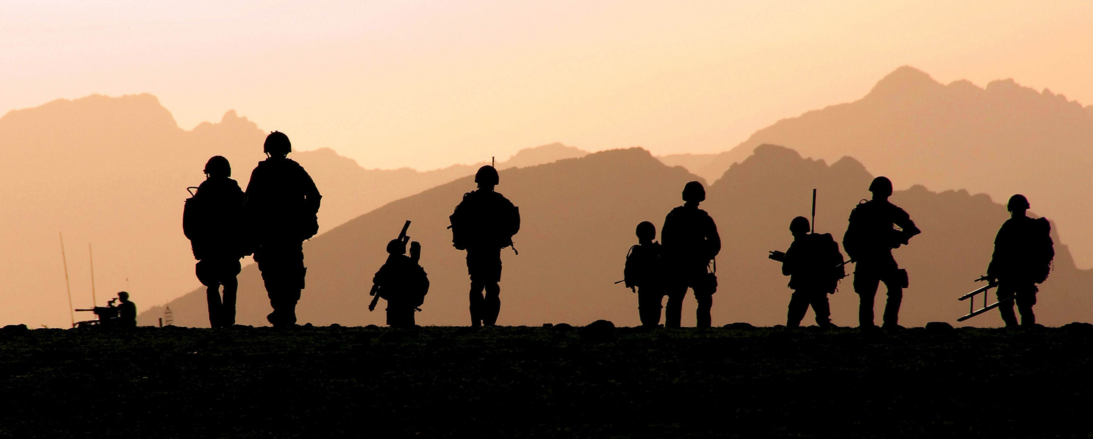
USAG Bavaria Initial Brief
Notes:
State: Welcome to the Army’s Annual Sexual Harassment/Assault Response & Prevention (SHARP) Refresher Training.

Slide 2
Bavaria 24/7 SHARP Hotline
09641-70-569-4567
DSN 314-569-4567 or
53-SHARP (74277)
DoD Safe Helpline
0611-143-537-7233 or
DSN 537-SAFE (7233)
safehelpline.org

Slide 3
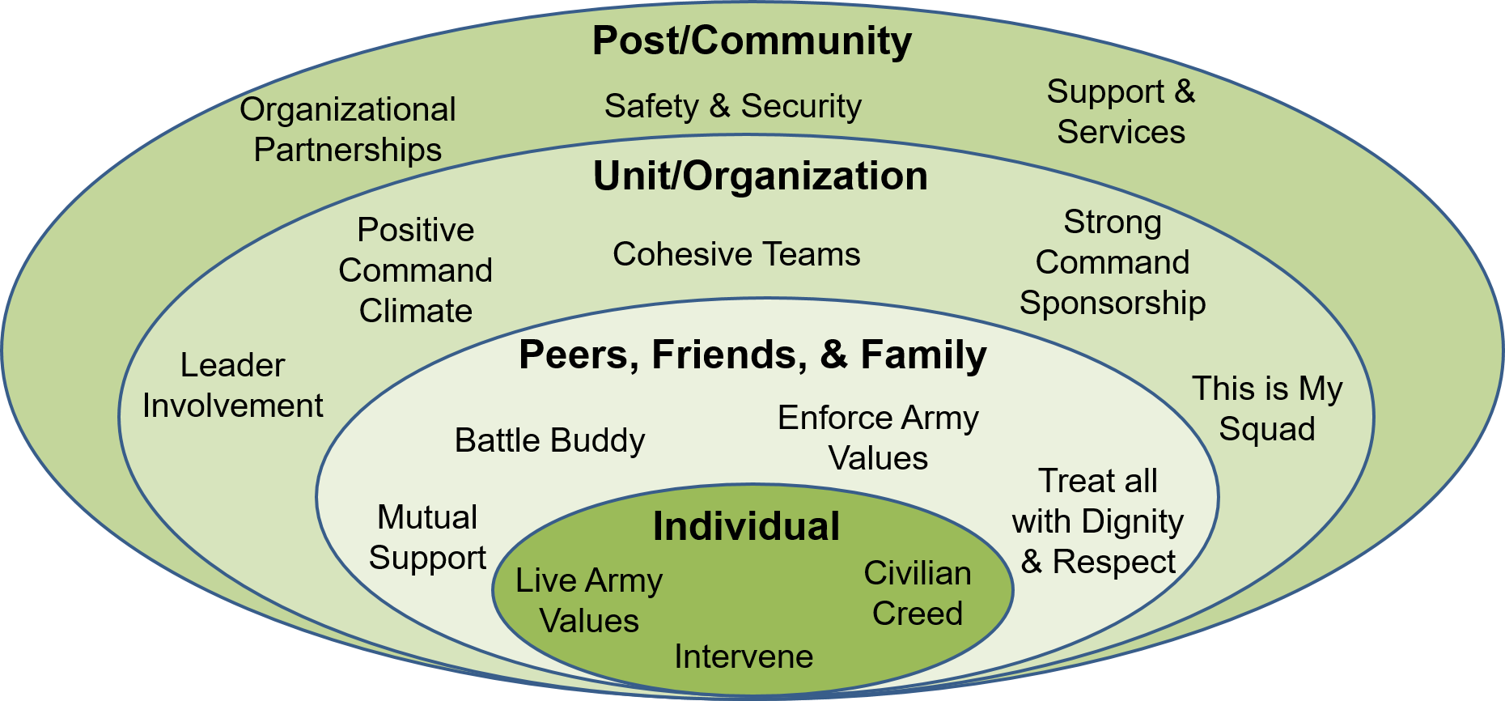
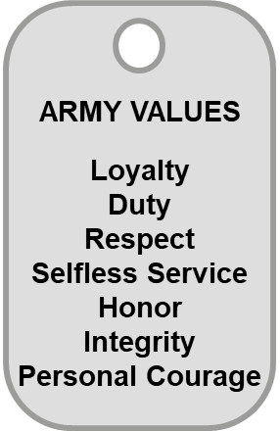
Prevention
Prevention is a team effort that starts with YOU
Everyone plays an important role at every level within our units, organizations, and communities
“Our Army’s people are our greatest strength and our most important weapon system.
We must take care of our people and treat each other with dignity and respect.”
– GEN James C. McConville
Chief of Staff of the Army
Notes:
Key Takeaway: Prevention requires a comprehensive approach. It takes everyone and it starts with YOU, as an individual doing your part.
State: You are vital to the success of the prevention approach by living the Army Values, intervening early and often, and embodying the military and Civilian Creeds.
State: Groups of peers, friends, and family take care of each other. This may be correcting behaviors from individuals in the group that are contrary to our standards, or providing support and protection for each other.
State: Cohesive units and organization ensure the well-being of all members, and are vital to mission success. As stated in ADP 6-0, Mission Command, “In a positive command climate, the expectation is that everyone lives by and upholds the moral principles of the Army Ethic. The Army Ethic must be espoused, supported, practiced, and respected.” Leaders must set and uphold standards, and implement practices that build teamwork and address behaviors that lead to sexual harassment and sexual assault.

Slide 4
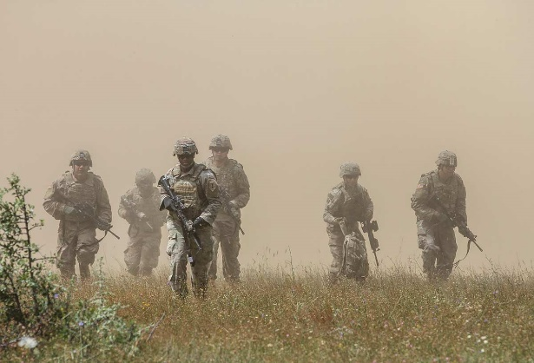
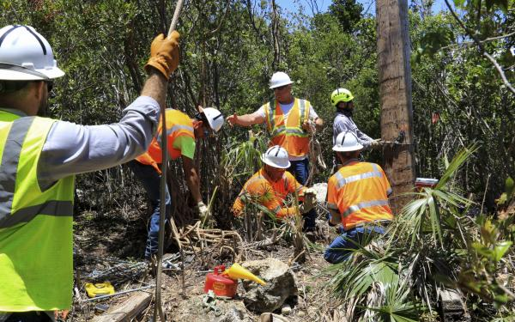
What YOU and others can do
Treat everyone with respect
Achieve consent
Communicate your boundaries
You have the right to say “No”
Drink responsibly – have a plan
Travel with friends or in a group
Safeguard each other
Intervene – if you see something, step up and take action
Notes:
Key Takeaway: Including proactive actions in your daily life, such as those listed on this slide, can help prevent sexual harassment and sexual assault.
State: Here are some of the actions that you can take to prevent sexual harassment and sexual assault.
Ask: What are other actions that you might take to prevent sexual harassment and sexual assault?
Background: The audience may come up with some great ideas, allow for discussion before proceeding. The instructor can also mention some of the following actions if time permits and if necessary:
You have the right to say “No” even if you:
First say “Yes,” and then change your mind
Previously was intimate with the person
Were kissing or “making out”
Other safety tips:
Always have extra money to get home; have a plan for someone you can call if you need help
We have all heard that you should have a designated driver. Another prudent measure might be to have a “designated thinker.”
If you feel uncomfortable, scared, or pressured, act quickly to end the situation; say, “Stop it,” and leave or call for help
Be aware of your surroundings at all times
Do not allow yourself to be isolated with a person you do not know or trust
Walk only in lighted areas after dark
Keep the doors to homes, barracks, and cars locked
Know where accessible and serviceable phones are located or if you carry a cell phone, make sure it is always charged
Make note not to go down a road of victim blaming. Everyone has a right to go out and enjoy themselves.

Slide 5
Bystander Intervention Process
Notice the event
Interpret the event as a problem
Accept personal responsibility for doing something
Decide how to intervene (3Ds)
Direct
Distract
Delegate
5. Take Action!
Notes:
Key Takeaway: See something, do something – take action!
Ask: Why is it important that we have a good working knowledge of the Bystander Intervention Process?
State: The Bystander Intervention Process is a valuable tool if you have a good understanding of how and when to properly implement it.
State: The five intervention steps are as follows:
Step 1: Notice the event
• Is the behavior appropriate?
• Is the behavior sexual harassment?
• Is it possible for an individual to harass someone and not realize it?
Step 2: Interpret the event as a problem
• Is the observed event consistent with Army Values?
• Does the event warrant intervention?
Step 3: Accept personal responsibility for doing something
• How could my inaction impact my fellow Soldiers? Work climate?
• How does it impact mission accomplishment?
Step 4: Decide how to intervene
• Evaluate the situation and determine the best course of action and the ideal person to intervene. (i.e., is the situation safe to intervene; would another Soldier intervening be more effective?)
• Utilize the 3Ds effectively. We will discuss the 3Ds in more detail on the next slide.
Step 5: Take Action - Bottom-line: Do something to stop the negative behavior or action!

Slide 6
Bystander Intervention 3Ds
YOU are the change agent that can advance the program by intervening using the 3Ds:
Direct:
Address the perpetrator
Remove either party from the situation/hostile environment (potential victim or perpetrator)
Have personal courage to intervene
Distract:
Anything that distracts perpetrator
Change the subject
Ask either person to go do something
Or say: “I think someone is coming”
Delegate:
Delegate the intervention to others
Have friends, squad/section members, or co-workers take either person out of the situation
Send someone for help to intervene (Chain of Command, MPs, etc.)
Notes:
Key Takeaway: You are the change agent that can prevent an incident by intervening using the 3Ds.
Note: Review and discuss the 3Ds, provide examples to clarify the desired action.
Note: Present Vignette 1 from the optional vignette packet. Promote discussion with the training audience and recall the information presented in the last few slides regarding consent and reporting.

Slide 7
Definition of Sexual Harassment
Conduct that:
involves unwelcome sexual advances, requests for sexual favors, and deliberate or repeated offensive comments or gestures of a sexual nature when:
Submission to such conduct is made either explicitly or implicitly a term or condition of a person's job, pay, or career;
Submission to, or rejection of such conduct by a person is used as a basis for career or employment decisions affecting that person; or
Such conduct has the purpose or effect of unreasonably interfering with an individual's work performance or creates an intimidating, hostile, or offensive environment; and
is so severe or pervasive that a reasonable person would perceive, and the victim does perceive, the environment as hostile or offensive.
Any use or condonation, by any person in a supervisory or command position, of any form of sexual behavior to control, influence, or affect the career, pay, or job of a member of the armed forces or a civilian employee of the Department of Defense.
Any deliberate or repeated unwelcome verbal comment or gesture of a sexual nature by any member of the armed forces or civilian employee of the Department of Defense.
USC Title 10, Section 1561
Notes:
Key Takeaway: You must comprehend how the Army defines Sexual Harassment.
State: We've talked about the impacts of sexual harassment and sexual assault on individuals and units. Now let's look at the Army’s definition of sexual harassment.
Note: Review the complete definition and be prepared to provide clarifying examples.

Slide 8
Categories of Sexual Harassment
Verbal
Telling sexual jokes
Using sexually-explicit profanity or threats, sexually- oriented cadences, or sexual comments
Whistling in a sexually- suggestive manner
Describing certain attributes of one’s physical appearance in a sexual manner
Using terms of endearment such as bae, boo, honey, hunk, snack, stud, sweetheart, etc
Nonverbal
Staring at someone, “undressing someone with one’s eyes,” blowing kisses, winking, or licking one’s lips in a suggestive manner
Displaying inappropriate printed material (e.g., sexually oriented pictures or cartoons)
Using sexually-oriented screen savers on one’s computer
Sending unsolicited sexually-oriented texts, notes, letters, e-mails, etc
Posting sexually-oriented comments or images to social media
Playing inappropriate music
Physical Contact
Touching, patting, pinching, bumping, or grabbing
Cornering or blocking a passageway
Providing unsolicited back or neck rubs
Kissing
Notes:
Key Takeaway: You need to fully understand the three categories of sexual harassment in order to intervene when necessary.
State: The Categories of Sexual Harassment helps us to identify potential sexual harassment behaviors. These behaviors are separated into three categories in AR 600-20—verbal, nonverbal, and physical contact. Let’s take a moment to define each of these categories.
State: Sexually explicit comments or sounds made aloud by individuals and overheard by others or explicit behavior, can create a hostile environment.
Ask: What are some examples of verbal sexual harassment?
Note: Allow a few Soldiers and Army Civilians to answer.
State: Sexually suggestive actions or body movements made by individuals can create a hostile environment when observed by others.
Ask: What are some examples of nonverbal sexual harassment?
Note: Allow a few Soldiers and Army Civilians to answer.
Ask: What are some examples of sexual harassment through physical contact?
Note: Allow Soldiers and Army Civilians to answer.
State: Remember, intentionally touching another person’s vulva, penis, scrotum, anus, groin, breast, inner thigh, or buttocks without consent, if the intent is to abuse or humiliate another person or gratify the sexual desire of any person is “sexual contact” and is classified as sexual assault. Accidental touching of some of these body parts would not be sexual assault. Touching someone to gratify or cause another person sexual gratification is considered sexual assault, not sexual harassment.
Note: Improper touching that is not sexual contact may be an assault consummated by a battery in violation of Article 128, UCMJ.
Note: Consent is a defense to a charge of sexual assault, not an element of the offense.

Slide 9
Types of Sexual Harassment
Quid Pro Quo
Hostile Environment
Reference: AR 600-20
Notes:
Key Takeaway: There are two types of sexual harassment
State: AR 600-20 outlines two types of sexual harassment—quid pro quo and hostile environment. Let’s take a moment to define these terms.
State: We will discuss the details of quid-pro-quo and hostile work environment on the next couple slides.

Slide 10
Army Policy on Sexual Harassment
Unacceptable and will not be tolerated
Destroys teamwork and negatively affects combat readiness
Army leadership:
Must create an environment conducive for productivity and respect
Set the standard to Soldiers and Army Civilians to follow
A successful mission is achieved in an environment free of sexual harassment
Prevention is the responsibility of every Soldier and Army Civilian
Reference: AR 600-20
Notes:
Key Takeaway: The Army policy is that sexual harassment is unacceptable and will not be tolerated.
State: Let’s discuss the Army’s policy on sexual harassment. You should become familiar with this policy and be able to explain it.
Ask: What does this mean for all of us?
Note: Allow one or two responses and then provide a brief restatement with some of the information below.

Slide 11
Army Policy on Sexual Harassment, (Continued)
Army Soldiers
Policy applies on/off the installation - 24/7
Complainants are encouraged to confront subject/offenders
Army policy does not require complainants of sexual harassment to confront the subject/offender
File formal complaints with the brigade level SARC or higher
Family members 18 and over, are eligible to file complaints with a SARC. Family members under 18 file with Family Advocacy Program (FAP)
Reference: AR 600-20
Notes:
Key Takeaway: Army policy applies 24/7, on- and off-post.
State: The Army’s policy on sexual harassment is built upon existing civil rights but has some important distinctions; let’s discuss these briefly now.
Note: Review each policy bullet.
State: It is important to remember, harassment based on sexual orientation is an EO issue, but sexual harassment is a SHARP issue regardless of orientation.
Note: The Feres Doctrine prohibits service members from suing the government for acts by an individual acting in their official capacity.

Slide 12
Army Policy on Sexual Harassment (Continued)
Army Civilians
Army Civilian complainants have the right to pursue administrative remedies through the Equal Employment Opportunity (EEO) complaint process
Army Civilian complainants have the right to sue
Although Army policy does not require complainants of sexual harassment to confront the subject/offender, complainants are highly encouraged to do so
Civilians are protected from retaliation (reprisal) for their EEO activity under federal law
Reference: AR 690-600
Notes:
Key Takeaway: Army Civilians must comply with Army Regulations regarding sexual harassment complaints.
State: The SHARP Program has not replaced the EO and EEO Programs; Army Civilian sexual harassment response is still the responsibility of the EEO Program.
State: Army Civilians
• Army Civilian complainants have the right to pursue administrative remedies though the EEO process. Army Civilians are also encouraged to notify their Commander or Supervisor of sexual harassment concerns.
• Army Civilians complainants have the right to sue through the administrative process provided in 29 Code of Federal Regulations (CFR) Part 1614.
• Complainants are encouraged to confront the subject/offender also; however, supervisors and managers are responsible for confronting subject/offenders once they know of the harassment.
State: Remind the audience that Civilians can get more information on sexual harassment from someone who works in EEO. Refer to AR 690-600, EEO Discrimination Complaints, for additional information. DoD contractors should contact the EEO Office or their Human Resource Departments for assistance with sexual harassment complaints.

Slide 13
Reporting Options – Military
Anonymous: Encourages the reporting of incidents while maintaining anonymity
Informal:
Direct approach - Confront the harasser (in person, email, or text)
Third-party - Ask someone else to talk to the harasser
Chain of Command - Report the behavior to your immediate supervisor
Formal:
Filed in writing using DA Form 7279, CDR is notified
Soldiers have 60 calendar days to file a formal complaint
References: AR 600-20/ DoDI 1020.03
Notes:
Key Takeaway: Soldiers have three options to resolve sexual harassment complaints.
State: Now that we have learned to define and recognize sexual harassment, let’s examine reporting options when you encounter these behaviors.
State: Once sexual harassment behavior is identified, the behavior must stop. We will discuss some ways to make this happen through:
Anonymous Complaint
Direct Approach
Third-Party
Chain of Command
File a Formal Complaint
Anonymous Complaint
State: This approach encourages reporting of sexual harassment allegations or incidents yet allows the individual reporting the sexual harassment to remain anonymous.
Direct Approach
State: This approach involves confronting the offender (in person, email, or text) and informing the person that the behavior is not appreciated or is not welcomed and that it must stop. The following tips may make the direct approach more effective:
Use common courtesy.
Confront the individual privately, if safe to do so.
Focus on the behavior and its impact.
Write down thoughts and specific examples before approaching the offender.
Third-Party
State: This approach involves requesting assistance from another person. Ask someone else to talk to the offender, to accompany the complainant, or to intervene on behalf of the complainant to resolve the conflict.
State: Considerations for using the third-party approach include: Observers of the behavior should consider having a partner when addressing the offender. As a team, the two can inform the offender of the behavior and its impact.
Chain of Command
State: Report the behavior to your immediate supervisor, or others in the chain of command, and ask for assistance in resolving the situation. Your chain of command should discuss the two types of military complaints: formal and informal. So far, we've discussed informal responses. Reporting to the chain of command may result in an investigation and inquiry.
Informal military complaints include: Direct, third party and chain of command (previous mentioned techniques); are not subject to a timeline; are not done in writing on an official document (DA Form 7279).
Formal Complaint
State: Formal complaints are subject to a timeline, filed using a DA Form 7279 (Equal Opportunity Complaint Form); sworn to the accuracy of the information and filed through the brigade level SARC or higher (for a listing of alternative agencies see AR 600-20, Appendices C-1&2), and requires specific actions such as reprisal plans and notifications.
State: Soldiers have 60 calendar days from the date of the latest incident in which to file a formal complaint. A commander can request a Commander’s Inquiry (pursuant to AR 15-6) to be conducted beyond the 60-calendar day window.
NG NOTE: In the ARNG, for Title 32 status, the form used is National Guard Bureau (NGB) Form 333, Discrimination Complaint in the Army and Air National Guard. The complainant should file his or her complaint with the commander at the lowest echelon of command at which the complainant may be assured of receiving a thorough, expeditious, and unbiased investigation of the allegations. Depending on the various aspects of the complaint and individuals involved, that lowest-level commander may not be the immediate company - or even battalion-level commander of the complainant.

Slide 14
Reporting Options - Civilians
Formal reports of sexual harassment:
May be raised to Command and/or EEO personnel
Must contact the EEO Office within 45 calendar days of becoming aware of the sexual harassment, to initiate the complaint process (Command/Supervisor notification does not count toward the 45-day time limit)
Reference: AR 690-600
Notes:
Key Takeaway: If an Army Civilian opts to not use informal or anonymous reporting options, they can contact the EEO office and seek further assistance.
State: When an Army Civilian files a complaint of sexual harassment, it is filed against the Secretary of the Army. The individual must contact the EEO office within 45 days of the incident of sexual harassment to initiate the complaint process. If the sexual harassment is ongoing, the most recent incident must have occurred within 45 days of contact with the EEO office.
Note: Notification of supervisors or commanders is not considered notification to the EEO office for purposes of the 45-calendar day time limit.
State: The first phase of the EEO complaint process is referred to as the “pre-complaint” process, which is set in motion when an individual contacts an EEO official and clearly exhibits an intent to proceed with an EEO complaint.
State: Any Army Civilian employee under the direct supervision of a commanding officer or officer in charge of a military unit, vessel, facility, or area of the Army may use an alternate procedure for addressing allegations of sexual harassment:
Title 10 United States (U.S.) Code Section 1561 is a Civilian option for addressing sexual harassment concerns involving military commands.
It is separate from the Army’s EEO complaint procedure.
Generally, both (EEO and U.S. Code Section 1561) procedures can be conducted simultaneously.

Slide 15
Potential Consequences for Sexual Harassment (Military)
Administrative
Administrative reduction
Administrative withholding of privileges
Admonition
Adverse performance evaluations
Bar to re-enlistment
Discharge from service
Mandatory counseling
Rehabilitative transfer to another unit
Relief for cause
Reprimand
Uniform Code of Military Justice (UCMJ) Details
Offense | Article | Maximum Assessment
Violation of a General Regulation | 92 | Dishonorable Discharge, 2 years confinement, and forfeiture of all pay and allowances
Cruelty and Maltreatment of Subordinate | 93 | Dishonorable Discharge, 1 year confinement, and forfeiture of all pay and allowances
Provoking Speeches or Gestures | 117 | 6 months confinement and forfeiture of 2/3 of pay for 6 months
Stalking | 130 | Dishonorable Discharge, 3 years confinement, and forfeiture of all pay and allowances
Indecent Language | 134 | Bad Conduct Discharge, 6 months confinement, and forfeiture of all pay and allowances
Notes:
Key Takeaway: There are consequences for your actions.
State: The Army policy on sexual harassment is built upon existing civil rights and EEO laws but has some important distinctions; let’s discuss these briefly now.
Policy applies on and off the installation, 24 hours a day
Military complainants do not have the right to sue the subject/offender
Complainants are encouraged to confront subject/offenders; however, supervisors/managers are responsible for promoting an environment free of sexual harassment.
When necessary, leadership should confront subject/offenders once they know of a sexual harassment incident.
Although a best practice is to advise the subject/offender that the comments or conduct is unwelcome, Army policy does not require complainants of sexual harassment to confront the subject/offender.
Formal Sexual Harassment complaints are filed with the brigade level SARC or higher
Soldiers have 60 calendar days from the date of the alleged incident in which to file a formal complaint.
Commanders have the full range of administrative actions available to them to deal with offenders of the Army’s sexual harassment policy—these ramifications hold true for Soldiers sexually harassing other Soldiers, Army Civilians or Family Members. Let’s take a moment to review these actions as well as applicable UCMJ articles and punishments.
Administrative punishments available to commanders to deal with sexual harassment offenders include:
• Mandatory counseling by a member of the chain of command, presumably their company commander
• Administrative Separation (chapter)
• Bar to re-enlistment
• Adverse performance evaluations and/or specific comments concerning nonsupport of Equal Opportunity (EO)/EEO Programs on evaluation reports
• Relief for cause
• Administrative reduction
• Admonition
• Reprimand
• Administrative withholding of privileges
• Rehabilitative transfer to another unit
Note: Please refer to these resources for additional information on these topics:
http://www.gpo.gov/fdsys/pkg/USCODE-2011-title5/html/USCODE-2011-title5-partIII-subpartF-chap75.htm
http://www.apd.army.mil/cpol/ar690-700/ar690-700-751/penalty.html
State: If administrative actions fail to correct the behavior, or the behavior is serious and constitutes a violation of the UCMJ, the commander may consider further action under the appropriate article(s) of the UCMJ.

Slide 16
What is Sexual Assault?
Sexual assault is a crime
Sexual assault is defined as: Intentional sexual contact characterized by the use of force, threats, intimidation or abuse of authority or when the victim does not or cannot consent
The term includes a broad category of sexual offenses of the following specific UCMJ offenses: rape, sexual assault, aggravated sexual contact, abusive sexual contact, or attempts to commit these offenses
Reference: DoDI 6495.02, Change 3
Notes:
Key Takeaway: Sexual assault is a crime and degrades the unit’s mission readiness and destroys the element of mutual trust throughout the organization.
Note: The definition of sexual assault is defined in DoDI 6495.02.
Additional Training Resources:
What Would You Do? (Soldier), 4:54, https://www.milsuite.mil/video/23712
What Would You Do? (Civilian), 3:29, https://www.milsuite.mil/video/23703

Slide 17
Definition of Consent
The term “consent” means a freely given agreement to the conduct at issue by a competent person.
An expression of lack of consent through words or conduct means there is no consent
Lack of verbal or physical resistance or submission resulting from the use of force, threat of force, or placing another person in fear does not constitute consent
A current or previous dating or social or sexual relationship by itself, or the manner of dress of the person involved with the accused in the conduct at issue, does not constitute consent
A sleeping, unconscious, or incompetent person cannot consent
All the surrounding circumstances are to be considered in determining whether a person gave consent
Reference: Manual for Courts-Martial, Article120(g)(7)
Notes:
Key Takeaway: Consent enables a safe, positive interpersonal relationship.
Ask: What is consent?
Note: Generate discussion. You may show the "Cheeseburger Consent Video" to get students thinking about consent. The cheeseburger is an analogy for a sex act. Once you've discussed the previous question and video, proceed to the UCMJ definition of consent.
State: This slide displays the definition of consent from the 2019 version of the Manual for Courts-Martial.
Background:
Lack of consent may be inferred based on the circumstances of the offense. All the surrounding circumstances are to be considered in determining whether a person gave consent, or whether a person did not resist or ceased to resist only because of another person’s actions.
Alcohol and Consent Talking Points
-Sexual acts/contact with a person when you know, or reasonably should have known, that the person is incapable of consenting due to impairment by a drug or intoxicant (alcohol) is a crime.
-The UCMJ provides that a person is incapable of consenting when they are incapable of apprising the nature of the conduct or physically incapable of declining participation or communicating unwillingness to engage in the sexual conduct.
-There is NO specified amount of alcohol that renders a person incapable of consenting under the law.
-It is incorrect to say that a person who has consumed any alcohol is incapable of consenting.
-It is incorrect to say that a person with a certain BAC level is incapable of consenting.
-Every report of a sexual assault that involves alcohol and the ability to consent will depend on the unique facts and circumstances of that case. There is NO bright line rule. (A bright-line rule, or bright-line test, is a clearly defined rule or standard, composed of objective factors, which leaves little or no room for varying interpretation. The purpose of a bright-line rule is to produce predictable and consistent results in its application).
-Providing inaccurate information on alcohol and consent at training has real consequences, including the overturning of sexual assault convictions, the disqualifications of panel (jury) members who have attended training where inaccurate information was provided, and promoting false beliefs in Soldiers who attend training that they have committed, witnessed or been the victim of a sexual assault.
-Training should provide the legal standard (incapable of consenting) and should focus on both the risks of sexual conduct with an intoxicated person and the benefits of healthy and consensual sexual interactions based on mutual consent.
Note: If time permits, present Vignette 3 and/or Vignette 4 from the optional vignette packet. Promote discussion with the training audience and recall the information presented in the last few slides regarding consent.
Additional Training Resources:
Consent, 1:50, https://www.milsuite.mil/video/23679
Cheeseburger Consent, 0:58, https://www.milsuite.mil/video/23716

Slide 18
Army Policy on Sexual Assault
Sexual assault is a criminal offense
Sexual assault degrades mission readiness
Every Soldier who is aware of a sexual assault should immediately (within 24 hours) report incidents
Sexual assault is punishable under laws:
Soldiers (UCMJ)
Army Civilians (Federal/State)
Those who commit sexual assault offenses will be held appropriately accountable
All victims of sexual assault will be treated with dignity, fairness, and respect
This policy applies to both on- and off-post, 24/7
Reference: AR 600-20
Notes:
Key Takeaway: The Army policy states that sexual assault is a criminal offense, unacceptable, and will not be tolerated.
State: Now that we defined sexual assault, let’s take a look at the Army’s policy on sexual assault. The Army’s sexual assault policy applies without regard to a person’s rank, age, or gender. Sexual assaults are criminal offense and will not be tolerated in our Army.
Note: Reemphasis the bullets on the slide and then have the Soldiers and Army Civilians summarize/state what the policy means to them.
State: While AR 600-20 states that every Soldier should immediately report of sexual assault, only members of the chain of command have mandatory reporting responsibilities under DoDI 6495.02 and AR 600-20.
Note: In situations that a victim confides in a battle buddy or family member, those individuals are not required to report if the victim intends to file a restricted report. However, a victim’s leadership (chain of command or NCO support channel) are always required to report regardless of the victim’s wishes. The resulting report will be unrestricted.
The Army will treat every reported sexual assault seriously by following proper guidelines. The information and circumstances of the allegations will be disclosed on a need-to-know basis only.
State: This policy applies—
(1) Both on and off post and during duty and non-duty hours.
(2) At working, living, and recreational environments (including both on- and off-post housing).

Slide 19
Restricted vs. Unrestricted Reporting
Restricted Report | Unrestricted Report
Benefits Access to medical, advocacy, legal, and counseling services Receive the Sexual Assault Forensic Examination (SAFE) Control the release of personal information Can change to Unrestricted Report at any time Special Victims’ Counsel | Benefits Access to medical, advocacy, legal, and counseling services Receive the SAFE Alleged offender may be held accountable Command support Can receive protective order (Military Protective Order [MPO] or Civilian Protective Order [CPO]) Special Victims’ Counsel
Limitations The alleged offender will not be held accountable Ineligible for expedited transfer or reassignment No command support Cannot receive a protective order | Limitations More people will know about the sexual assault Investigation may require discussion of personal matters Cannot change to Restricted Report
Notes:
Key Takeaway: It is important to understand the benefits and limitations of the Restricted and Unrestricted Reporting options.
State: Next, let's review ways to report sexual assault crimes.
State: As most of you know, there are two reporting options for victims of sexual assault. However, there are differences to these options based on law, policy, and guidance.
Restricted Reporting
State: Restricted Reporting allows Soldier, or his/her family member (dependents) 18 years of age or older and who are eligible for treatment in the military healthcare system (DoDI 6492.02, paragraph 2a (3) has the additional limit), who is a sexual assault victim to confidentially disclose details of his/her sexual assault to specifically identified personnel without triggering an investigative process. Restricted Reporting also allows a victim medical treatment, counseling, and the right to consult with a Special Victim Counsel, and advocacy services. In addition, sexual assault can be reported to the Sexual Assault Response Coordinator (SARC), a Victim Advocate (VA), or to healthcare personnel.
Note: Victims of a sexual assault which was perpetrated by a Domestic Partner or someone with whom the victim shares a child, falls within the Family Advocacy Program (FAP) - not SHARP.
Note: Victims that receive counseling associated with sexual assault are not required to report those counseling sessions on the SF 86, Questionnaire for National Security Positions. (DoDI 6495.02, Ch3, Enclosure 2, para 6)
Background: With regard to Restricted Reports, the Sexual Assault Forensic Examination (SAFE) kit will be retained for ten years in a location designated by the Army.
Unrestricted Reporting
State: Unrestricted Reporting allows a victim who desires medical treatment, counseling and advocacy services, and an official investigation of the sexual assault, to use current reporting channels (for example, the chain of command or law enforcement) or to report the incident to a Sexual Assault Response Coordinator (SARC), Victim Advocate (VA), or to healthcare personnel.
State: Filing an Unrestricted Report will initiate an official investigation. Details of the sexual assault are limited to personnel with a legitimate need to know.
Note: DoD Civilians and their adult Family members (dependents) when stationed outside the continental U.S. (OCONUS) and U.S. Citizen contractor personnel when authorized to accompany Armed Forces in a contingency operation OCONUS are eligible for treatment in the military healthcare systems and will be authorized limited SHARP or SAPR services.
Both Restricted and Unrestricted Reports
State: The SARC will retain the Victim Reporting Preference Statement (DD Form 2910) for 50 years from the date the victim signs the DD Form 2910. DD Form 2911, DOD SAFE Report shall be retained for 50 years IAW DoDI 5505.18. Restricted reports are filed locally and unrestricted reports are entered into the Defense Sexual Assault Incident Database (DSAID) where it will be retained for the 50 year period.
Additional Training Resources: Sexual Assault Reporting 101, 4:37, https://www.milsuite.mil/video/23690

Slide 20
Restricted vs. Unrestricted Reporting, (Continued)
Restricted Report | Unrestricted Report
Who can accept a report: Sexual Assault Response Coordinator (SARC) SHARP Victim Advocate (VA) Healthcare Personnel | Who can accept a report: Commander CID JAG IG SARC VA Healthcare Personnel
Limitations Chaplains and Special Victim Counsel – cannot file a report, but information shared remains confidential | Limitations More people will know about the sexual assault Investigation may require discussion of personal matters Cannot change to Restricted Report
If someone in the victim’s chain of command has knowledge of the sexual assault, the option for a restricted report is no longer available and they are required to take action
Notes:
Key Takeaway: (Same as previous slide)There are differences in who can accept reports of sexual assault as it relates to Restricted or Unrestricted Reports.
State: If someone in the NCO support chain or officer chain of command knows of a sexual assault, prior to the victim making a report, the option for a restricted report is no longer available.
State: To make a Restricted Report, the victim MUST notify one of the following personnel and ONLY these personnel:
Sexual Assault Response Coordinator (SARC)
Victim Advocate (VA)
Healthcare Personnel (Healthcare Personnel will contact their SARC who will fill in the DD Form 2910).
State: A Special Victim Counsel will also be provided to Soldiers and their family members (dependents). DoD Civilians stationed OCONUS are also generally eligible for Special Victim Counsel services.
State: The following individuals are eligible to file Restricted Reports:
Active duty military personnel of the Armed Forces.
Reserve and National Guard performing federal duty (active duty training or inactive duty training and members of the National Guard in Federal (Title 10) status).
Soldiers and family members (dependents) 18 years of age or older who are eligible for treatment in the military healthcare system and are victims of sexual assault (Department of Defense Directive (DoDD) 6495.01
State: A victim may convert a Restricted Report to an Unrestricted Report at any time.
Note: Once a Soldier signs a DD Form 2910 with the SARC or VA, and elects a Restricted Report, only that Victim may change it to an Unrestricted Report. For example: A Soldier reports a Sexual Assault to the VA on Monday morning, elects a Restricted Report and signs a DD Form 2910. The Commander is “informed” of a sexual assault from someone other than the SARC, and he/she notifies CID. If CID contacts the SARC or VA, the report is still restricted and the SARC cannot divulge any information that would violate the Victim/Victim Advocate Privilege established by Military Rule of Evidence (MRE) 514. CID will, however, continue to investigate the report.
Note: While the Service Members are exempted from mandatory reporting IAW NDAA 2016, Army Civilians are not exempt from mandatory reporting. If the victim first reports to a civilian facility or civilian authority, it is possible that the jurisdiction may require mandatory reporting of the sexual assault to local law enforcement.

Slide 21
Army Civilian Sexual Assault Reporting/Resources
 | SARC/ VA |  | DD Form 2910 |  | Emergency Medical Care @ MTF | Chaplain | Special Victim Counsel
CONUS
Army Civilian |  |  |  |  | X | X | X³
Army Civilian who is a SM’s dependent 18 years old and older | X |  |  | X | X | X | X
Army Civilian’s dependents 18 years old and older |  |  |  |  | X⁴ | X | X³
Contractor |  |  |  |  | X | X
OCONUS
Army Civilian | X¹ | X² |  |  | X | X | X³
Army Civilian who is a SM’s dependent 18 years old and older | X | X |  |  | X | X | X
Army Civilian’s dependents 18 years old and older | X¹ | X² |  |  | X | X | X³
Contractor | X¹ | X² |  |  | X | X | X³
Only option is Unrestricted Report
Veterans are provided free confidential counseling and treatment at the Veterans Affairs Medical Center (VAMC)
Crime Victims Compensation (SARC & VA can provide contact information)
SARC & VA are always available to:
Discuss options
Provide POCs for local civilian resources
Provide referrals to Employee Assistance Program (EAP) and Equal Employment Opportunity (EEO) offices
References:
DoDI 6495.02 Sexual Assault Prevention & Response Program Procedures, Change 3, 24 May 17
DoDD 6495.01 Sexual Assault Prevention & Response (SAPR) Program, Change 1, 30 Apr 13
Army Directive 2017-16 Civilian Employee Eligibility for the Special Victims Counsel Program
¹ Limited SARC & VA services (During emergency medical care & SAFE Exam)
² Can only file an unrestricted report
³ SVC representation only when subject is subjected to the UCMJ
⁴ If incident occurred on the military installation
Notes:
Key Takeaway: There are different resources available to Army Civilians, depending on if you are CONUS/OCONUS. It is important to note that Civilians only have the option to file Unrestricted.
State: Veterans are provided free, confidential (private) counseling and treatment for both mental and physical health problems linked to Military Sexual Trauma (MST). IAW DODI 6495.01 Sexual Assault Prevention and Response (SAPR) Program, emergency care means:
Background:
Emergency: A situation that requires immediate intervention to prevent the loss of life, limb, sight, or body tissue to prevent undue suffering. Regardless of appearance, a sexual assault victim needs immediate medical intervention to prevent loss of life or undue suffering resulting from physical injuries, internal or external, sexually transmitted infections, pregnancy, or psychological distress. Sexual assault victims shall be given priority as emergency cases regardless of evidence of physical injury.
Emergency Care: Emergency medical care includes physical and emergency psychological medical services and a SAFE consistent with the U.S. Department of Justice, Office on Violence Against Women, “A National Protocol for Sexual Assault Medical Forensic Examinations, Adults/Adolescents”
Note: An Army Civilian’s Dependent 18 years old and older can receive emergency medical care at an MTF if the sexual assault incident occurred on the installation. If the incident occurs off the installation, they should use the closest civilian hospital for emergency care. If emergency medical care is performed at the MTF, they may be charged for these services.

Slide 22
Potential Consequences for Sexual Assault (Military)
UCMJ Details
Offense | Article | Maximum Consequences
Prohibited activities with military recruit or trainee by person in position of special trust | 93a | Dishonorable Discharge (mandatory upon conviction), 3 years confinement, forfeiture of all pay and allowances
Wrongful broadcast or distribution of intimate visual images | 117a | Proposed: Dishonorable Discharge (mandatory upon conviction), 2 years confinement, forfeiture of all pay and allowances
Rape | 120 | Dishonorable Discharge (mandatory upon conviction), life in prison without parole, forfeiture of all pay and allowances
Sexual Assault | 120 | Dishonorable Discharge (mandatory upon conviction), 30 years confinement, forfeiture of all pay and allowances
Aggravated Sexual Contact | 120 | Dishonorable Discharge, 20 years confinement, forfeiture of all pay and allowances
Abusive Sexual Contact | 120 | Dishonorable Discharge, 7 years to life confinement, forfeiture of all pay and allowances
Other Sexual Misconduct (Indecent Viewing, Indecent Recording, Indecent Broadcasting, Indecent Exposure, and Forcible Pandering) | 120c | Dishonorable Discharge, 1-20 years confinement, forfeiture of all pay and allowances
Domestic Violence | 128b | Proposed: Dishonorable Discharge (mandatory upon conviction), additional 3 years confinement, forfeiture of all pay and allowances
Retaliation | 132 | Dishonorable Discharge, 3 years to life confinement, forfeiture of all pay and allowances
Notes:
Key Takeaway: Here are the applicable UCMJ articles and potential punishments for sexual assault.
State: Sexual assault includes a broad category of sexual offenses consisting of the following specific UCMJ offenses: rape, sexual assault, aggravated sexual contact, abusive sexual contact, or attempts to commit these offenses.
Note: When OCONUS, Soldiers can be prosecuted under Host Nation laws if requested by the host nation.

Slide 23
Army Policy on Retaliation
No Soldier may retaliate against a victim, an alleged victim or another member of the Armed Forces based on that individual’s report of a criminal offense.
All reports of retaliatory behavior must be investigated, including actions against other individuals (for example, Family members) intended to harm or influence a Soldier
Allegations of retaliation will be investigated by the Inspector General (IG)
IAW Army Directive 2015-16, allegations of retaliation against a victim, witness, intervener, SARCs, VAs, or first responders should be referred to a battalion or higher commander to develop a plan to immediately address the issue and forward the plan to the SARB chair.
IAW DODI 6495.02, Service members may request a review from a general or flag officer (G/FO) if they experience retaliation, reprisal, restriction, ostracism, or maltreatment involving an administrative separation within one year of the final disposition of their sexual assault case.
IAW 6495.02, Sexual assault victims have the right to communicate with a G/FO if they believe there were impacts to their military career because they reported a sexual assault.
Notes:
Key Takeaway: If you feel that you are being retaliated against, immediately contact your SARC/VA.
State: No soldier may retaliate against a victim, an alleged victim or another member of the Armed Forces based on that individual’s report of a criminal offense.
State: Allegations of retaliation should be referred to a battalion or higher commander and investigated by CID and the Installation Law Enforcement as well as the Unit Commander.
State: IAW Army Directive 2015-16, allegations of retaliation against a victim, witness, intervener, SARCs, VAs, or first responders should be referred to a battalion or higher commander to develop a plan to immediately address the issue and forward the plan to the SARB chair.
State: IAW DODI 6495.02, Service members may request a review from a general or flag officer (G/FO) if they experience retaliation, reprisal, restriction, ostracism, or maltreatment involving an administrative separation within one year of the final disposition of their sexual assault case.
State: IAW 6495.02, Sexual assault victims have the right to communicate with a G/FO if they believe there were impacts to their military career because they reported a sexual assault.

Slide 24
Call to Action
We (Soldiers and Army Civilians) are professionals, guided in everything we do by the Army Ethic. We are certified and bonded with other Army professionals through a shared identity and service within a culture of trust.
Treat everyone with dignity and respect
Intervene! – Direct, Distract, or Delegate
Do your part to keep each other and our Army safe
Notes:
Key Takeaway: Do your part to keep each other and our Army safe!
State: In this lesson we:
Described the impact of sexual harassment and sexual assault on the Army
Discussed prevention practices and the bystander intervention process
Discussed sexual harassment
Discussed sexual assault
Discussed sexual assault victims’ rights (confidentiality, expedited transfer, protective orders, Special Victims Counsel)
Defined the Army’s policy on retaliation
Think back to the beginning of the lesson. Now that we covered all the material, do you understand how important maintaining a professional environment, free of sexual harassment and sexual assault, is to conducting training and operations? Our units cannot be completely ready to train and achieve mission success, if we are adversely impacted by incidents of sexual harassment or sexual assault.

Slide 25
Resources
Chaplain, minister, or spiritual leader
Behavioral health counseling
Special Victim Counsel
ATN - https://atn.army.mil/sexual-harassment-assault-response-and-prevention/sharp-training
Office of Personnel Management (OPM) website (for Army Civilians) - http://www.opm.gov/policy-data-oversight/worklife/reference-materials/resource-list.pdf
DoD Safe Helpline — contact them at 877-995-5247 or safehelpline.org, which offers support services to men and women
Military One Source: http://www.militaryonesource.mil/ or 800-342-9647 (Mandatory Reporting Responsibility)
Mobile Technology: We Care App, Battle Buddy App, Circle of 6 App, 360 App
Outside Resources: Rape Abuse and Incest National Network (RAINN)
Notes:
State: This is a list of some resources available to victims of sexual assault and sexual harassment. Although this is not an extensive list, it provides an excellent starting point. It is also helpful for general information purposes.
Add provision for local organization in instructor notes if the instructor knows the status of the MOU.
Note: Instructors giving this in a deployed environment or during pre-deployment training should add any additional resources specific to the deployment area.
Additional Training Resources:
Victim Resources, 4:18, https://www.milsuite.mil/video/23688

Slide 26
7th ATC SHARP PM- Ms. Trinity Peterson
Bldg. 501, Rm 8. Hasting St., Tower Barracks
DSN 314-569-0160 / CIV 09641-70-569-01560
GOV CELL +49 (0) 162-296-5520 (text/signal)
trinity.t.peterson.civ@mail.mil
USAG Bavaria SARC – Mr. Larry Cannon
Bldg. 501, Rm 9. Hasting St., Tower Barracks
DSN 314-569-0157 / CIV 09641-70-569-0157
GOV CELL +49 (0) 162-296-0718 (text/signal)
larry.b.cannon.civ@mail.mil

Slide 27
Bavaria 24/7 SHARP Hotline
09641-70-569-4567
DSN 314-569-4567 or
53-SHARP (74277)
DoD Safe Helpline
0611-143-537-7233 or
DSN 537-SAFE (7233)
safehelpline.org

