Slide 1
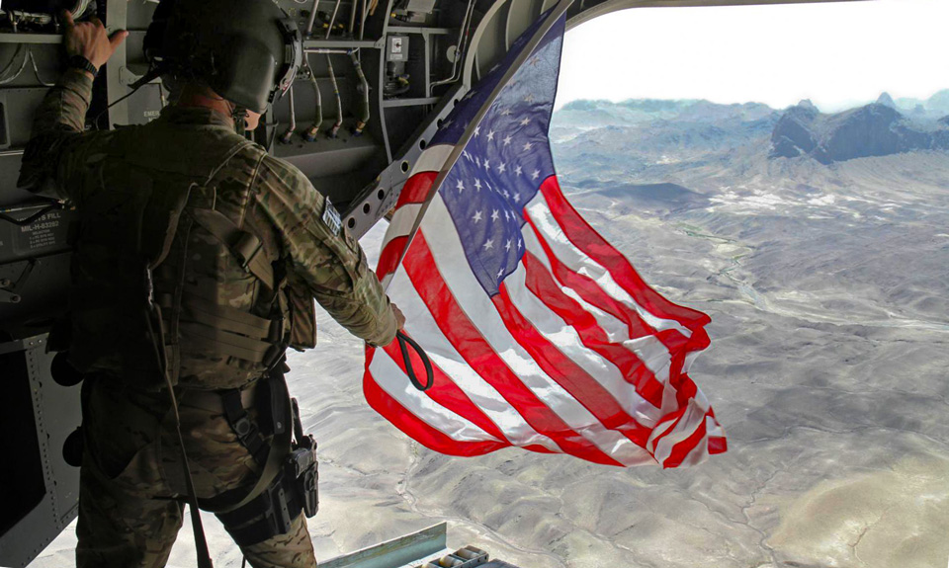



USAG Bavaria
D,FMWR- ACS
Mark D. Moll
Chief,ACS
USAG Bavaria
Version Number 2
As of 01 June 2020
UNCLASSIFIED

Slide 2

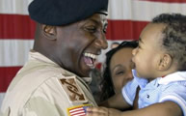
Military and Family Life Counselor Program
Provides non-medical, short term, situational problem-solving counseling services to individuals, couples, families, units, and FRG Groups.
Confidential and Free
Rose Barracks:
01736045200
Tower Barracks
01724964406
01629531853
Hohenfels
01525-280-5059
01520-522-1471
Unit
2CR: 0174-886-4024
173rd: 0174-147-6832
18th MP BDE: 01741476846

Slide 3
Army Community Service (ACS) MFLC Program
Mission
Due to COVID – 19 Protective Measures and Restrictions face to face consultations are limited.
Call one of the numbers provided to schedule a tele-health appointment or telephone consultation.
Currently only the MFLC at Rose Barracks is conducting Face to Face sessions by appointment.
If you assigned to one of the units listed please contact the unit number to schedule a session

Slide 4
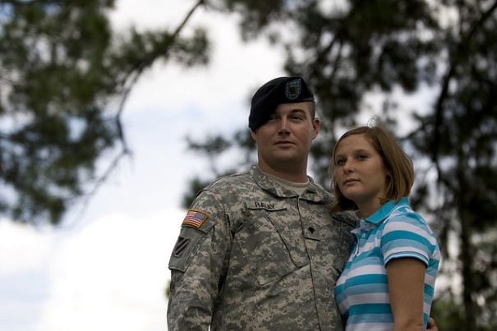
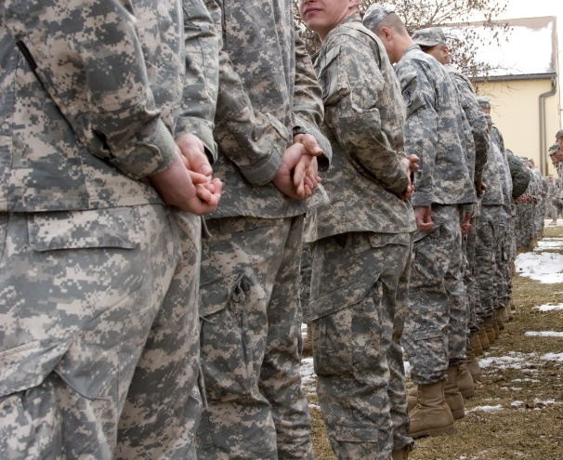

Army Community Service (ACS) MFLC Program
Military & Family Life Counselors (MFLCs)
MFLCs provide non medical, short term, situational, problem-solving counseling services to individuals, couples, Families, units and FRG Groups.
You can address relationships, stress management, grief after loss, occupational and other individual and Family issues, and it provides crisis intervention when needed. Services are confidential and private except for duty –to-warn situations. MFLCs are mandated reporters of child abuse, domestic violence and other duty-to-warn mandated situations.
They each have a Master or Ph.D level licensed clinical counselors that works with existing Military Family support programs to complement services provided on the installation.

Slide 5
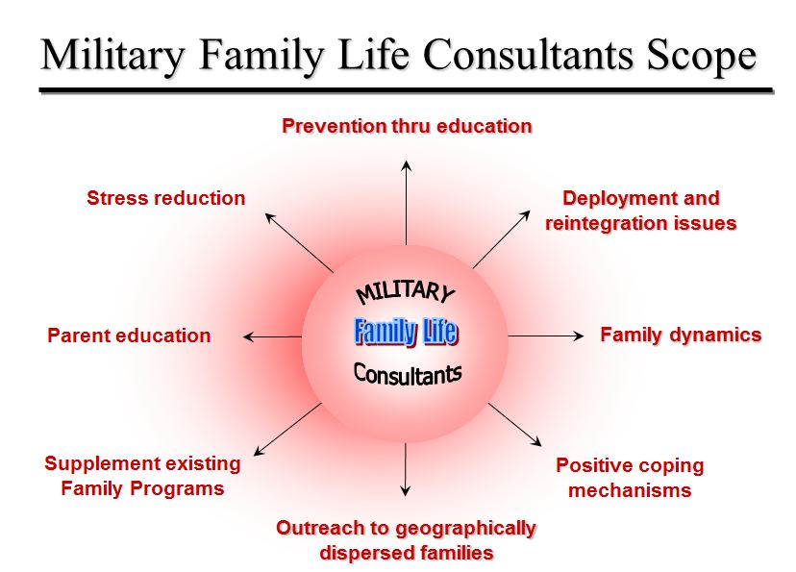
Army Community Service (ACS) MFLC Program
Military Family Life Counselors Scope

