Slide 1
Provost Marshal Office
In-processing Brief

Slide 2
AGENDA
GERMAN POLICE / MILITARY POLICE JURISDICTION
VEHICLE REGISTRATION
DRIVING IN EUROPE
TRAFFIC VIOLATIONS / DD FORM 1408
DRINKING AND DRIVING (DUI/DWI)
ACCESS TO ARMY INSTALLATIONS
OUTPROCESSING THE DES
EMERGENCY PHONE NUMBERS

Slide 3
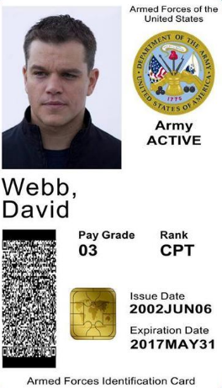
German Police and Military Police
A highly disciplined, well trained and professional Police force
German Police work closely
with U.S. MP; you must follow German Police commands and directives off post
(MUST IDENTIFY)
German Police may draw blood if suspicion of DUI/DWI exists
Will detain service member until MP arrive

Slide 4
Vehicle Registration
Vehicle Registration:
Temporary Tags are only authorized for up to 30 days or until the day you pass inspection.
Failure to return temp tags within the 30 days, or date of inspection, will result in loss of registration privileges:
For every day late = two days of registration privileges suspended
30+ days late = 60 days plus fees
Vehicle must pass inspection before permanent USAREUR plates issued
Military Police are updated daily on overdue temp and permanent plates
Citation will be issued
Plates will be removed from vehicle
YOUR VEHICLE MUST BE REGISTERED AT ALL TIMES!
Operational or Non-Operational

Slide 5
Vehicle Registration
Tower Barracks, Bldg. 301
DSN 475-7254/6477, CIV 09641-83-7254/6477
Admin office Hours of operation: Mon - Fri 8 a.m. - 11 a.m. & 11:45 a.m. - 3:30 p.m.
Closed on American and German holidays.
Closed at noon the last work-day of month for inventory.
Hohenfels, Bldg. 90b
DSN 466-4916, CIV 09472-83-4916
Admin office Hours of operation: Mon - Fri 8 – 11:30 a.m. & 12:30 – 3:15 p.m.
Closed U.S. & German holidays; Closed at noon the last work day of the month.
Garmisch
Artillery Kaserne, Bldg. 202
DSN 440-3608, CIV 08821-750-3608
Admin office Hours of operation: Mon, Tue, Thu, Fri appointment only; Wed 8 - noon & 1 - 3:15 p.m. Closed U.S. & German holidays

Slide 6
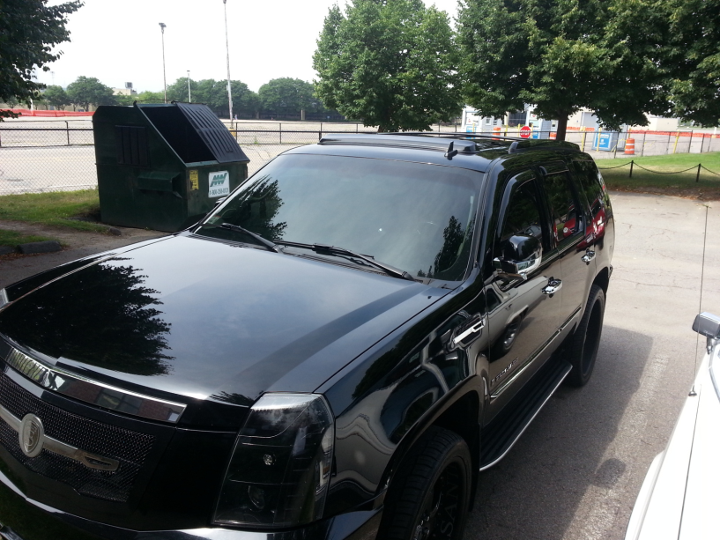
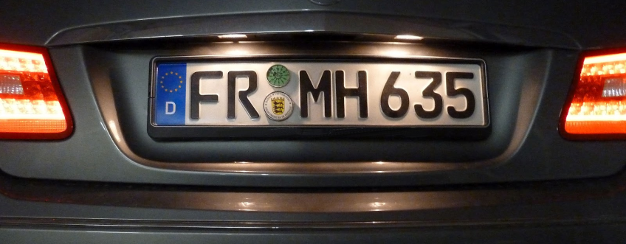
DRIVING IN EUROPE 1 / 2
* After market window tint is illegal on front windows and windshield
* Vehicles can not have US Forces affiliation shown i.e. ERB window, dealership name, etc.
* Winter tires/AS are required when snow/ice is present on the road, M/S rated tires are acceptable. Winter Tires must have 6 mm tread depth, AS tires at least 4 mm.
* License plates must be secured in bracket or
screws. No 550 cord or Zip Ties

Slide 7
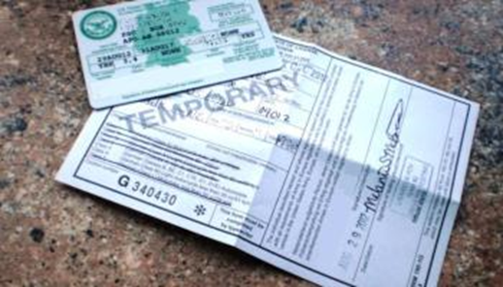
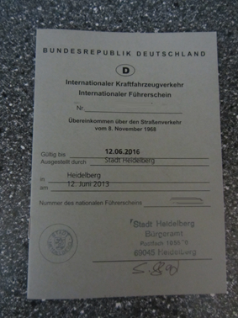
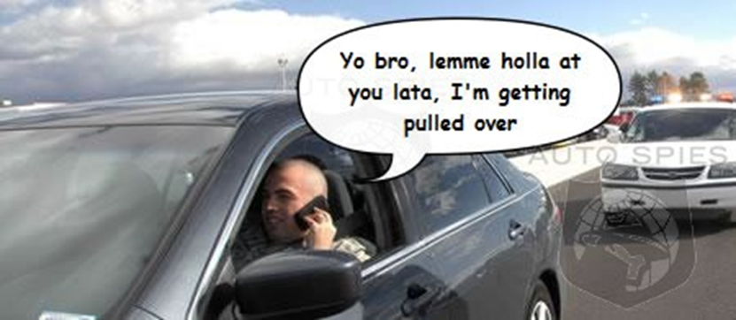
DRIVING IN EUROPE 2 / 2
License Requirements
USAREUR Driver’s License
Vehicle Accidents
off post report immediately to the German Police, and then report to MP Station
Failure to report will result in being titled with either “Failure to report an accident” or “Fleeing the scene of an accident”
* Cell phone use (without a hands free device) is prohibited; mandatory 7 day drivers license suspension

Slide 8
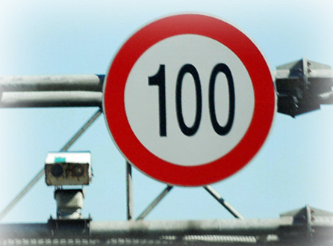
Traffic Violations
Inside city limit the speed limit is 50 KPH (note: there are dedicated 30 KPH zones within some city limits)
Outside city limits the speed limit is 100 KPH
Autobahn recommended speed limit is 130 KPH, above
that you may be held liable if accident occurs, even if
you are not at fault
Look out for posted speed zones, cameras are used by German Police to catch violators
On post, if speed limit is not posted, the speed limit is 30 KPH
Display Parking Disc when in timed parking
Speeding tickets range from 15 - 680 euros!
Parking tickets up to 30 euros!

Slide 9
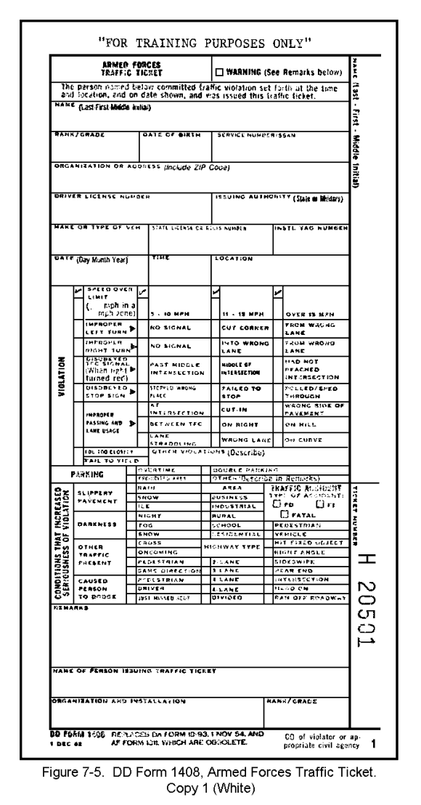
DD Form 1408
USAREUR has a drivers points system
12 points in one year or 18 points in
two years will result in a suspension of your
license
Commanders will assess points accumulated
off post and on post together

Slide 10
Operating Under Influence
.05 G/100ML (BAC) TO .079 G/100ML (BAC) = DWI - AER 190-1
3 Month Suspension of Drivers License
Assessment of 6 Traffic Points
.08 G/100ML (BAC) or higher = Drunken Driving - ART 113 UCMJ
1 Year Suspension of Drivers License
Assessment of 6 Traffic Points
SM under 21 with ANY BAC up to .049 G/100ML (BAC) while driving will receive 30 day suspension (60 day for 2nd, 90 day for 3rd offense)
Operating a POV with a BAC .05 or more for a second offense within the last 5 year period is an automatic 5 year revocation

Slide 11
ACCESS TO ARMY INSTALLATIONS 1 / 2
Escorted-Visitor Paper Pass
DOD ID Card Holders who are 18 years or older and Military Spouses under the age of 18 are authorized sign in privileges.
Sponsors that are living in Government Quarters will be allowed to obtain a 72 hour Escorted-Visitor Paper Pass
Sponsors that are not living in Government Quarters (i.e. Single Soldier Barracks) will be allowed to obtain a 24 hour Escorted-Visitor Paper Pass.
Sponsors Responsibility
Ensure that their visitors are physically escorted at all times.
Visitors will physically be signed out 24 hours or 72 hours from the date and time the Escorted-Visitor Paper Pass issued at the gate that was issued.
Sponsors or Visitors failing to comply will result in the revocation of their sign-in privileges. First offense 30 days, second offense 120 days and third offense 1 year.

Slide 12
ACCESS TO ARMY INSTALLATIONS 2 / 2
Access Roster
All DOD ID card holders (CAC and dependent) registered in IACS with Visitor-Sponsor Privileges may submit an Access Roster Request using AE Form 190-16F. It is limited to 30 days per person within a 12-months period.
Sponsors may submit access roster requests to the IACS Office at Bldg. 244 on Tower Barracks or the IACO’s office at Bldg. 2099 on Rose Barracks.
All access rosters requests must be submitted at least three working days prior to the effective date, weekly on Tuesdays and Fridays.
Access rosters are posted at all Access Control Points on Tower and Rose Barracks.

Slide 13
MP Station and MP Admin
Rose Barracks, Bldg. 2099
DSN 476-3398/3397, CIV 09662-83-3397/3398
Admin office Hours of operation: Mon - Fri 8 a.m. - 11 a.m. & 11:45 a.m. - 3:30 p.m.
DSN: 476-1580, CIV 09662-83-1580
Closed on American and German holidays.
Hohenfels, Bldg. 10
DSN 466-2812/2713, CIV 09472-83-2812/2817
Admin office Hours of operation: Mon - Fri 8 – 11:30 a.m. & 12:30 – 3:15 p.m.
DSN, 522-1580, CIV 09742-83-1580
Closed U.S. & German holidays; Closed at noon the last work day of the month.
Garmisch
Artillery Kaserne, Bldg. 202
DSN 440-3801/3827, CIV 08821-750-3801-3827
Admin office Hours of operation: Mon, Tue, Thu, Fri appointment only; Wed 8 - noon
DSN 440-3801/3827, CIV 08821-750-3801-3827
Closed U.S. & German holidays

Slide 14
Emergency Phone Numbers
Military Police (Emergency) | DSN 114 CIV 09641-83-110
Military Police | DSN 476-3398/3397, CIV 09662-83-3398/3397
Fire Dept. (Emergency) | DSN 112 CIV 09641-83-112
German Police | CIV 110
Military Life Counselor | CIV 0152-0293-4290 CIV 0152-0241-5226
Suicide Prevention Hotline | DSN 118 CIV 09641-83-118
Sexual Assault Hotline | DSN 475-4567 CIV 09641-83-4567
Domestic Violence Hotline | 01622-96-0661
American Red Cross | 1-877-272-7337
Call a DSN phone from a Cell Phone | Dial 09461 70 + Full DSN

