Slide 1
In-Processing Training Center (ITC) Brief
Grafenwoehr Criminal Investigation Division (CID) Office
Notes:
LAST UPDATED: 1 JAN 2019
-Italic writing indicates “Notes” to presenter.
*Bold writing indicates information to be presented to audience.

Slide 2
Introduction
CID is responsible for conducting criminal investigations in which the Army is, or may be, a party of interest.
Criminal investigations include, but not limited to, Drugs, Sexual Assaults, Fraud, Deaths, Larceny of GOVT Property; which occur on and off military reservations and when appropriate, with local, state and other federal investigative agencies.
Notes:
Introduces Themselves.
Read CID responsibility and investigative range bullets.
Speaker explains what the CID means to them and how it impacts the community.

Slide 3
Drug Investigation Facts
1 Jan 18 – 31 Dec 18
Approx. 33% of Total Cases were Drug Related.
Approx. 49% of Drug Cases Involved THC.
Approx. 27% of Drug Cases Involved MDMA.
1 Jan 19 – 11 May 20
Approx. 41% of Total Cases were Drug Related.
Approx. 37% of Drug Cases Involved THC.
Approx. 33% of Drug Cases Involved MDMA.
* Remaining drug cases included, but not limited to: CBD Oil, Cocaine, LSD, Steroids, and Heroin.
- Cannabidiol (CBD) is a chemical occurring in a cannabis plants, which still contains an amount of THC. CBD Oil is Prohibited!
Notes:
- Read facts and be energetic, passionate, etc. Make it known there is a problem!
*Drugs continue to be an issue in our ranks as you can see by the statistics.
*Brief CBD Oil is illegal.

Slide 4
Drug Investigation Facts
CBD products in all forms are prohibited
for use by DOD personnel!
Notes:
- Read facts and be energetic, passionate, etc. Make it known there is a problem!
*Drugs continue to be an issue in our ranks as you can see by the statistics.
*Brief CBD Oil is illegal.

Slide 5
Article 120, 117a, and 128 UCMJ Cases
(Sex related offenses)
1 Jan 18 – 31 Dec 18
Approx. 26% of Total Cases were Article 120 UCMJ Cases.
1 Jan 19 – 11 May 20
Approx. 17% of Total Cases were Article 120 UCMJ Cases.
Notes:
Read facts and be energetic, passionate, etc. Make it known there is a problem!
Explain Article 117a; Broadcasting images without consent, although you had consent to have images.
* Article 120 cases include; Sexual Assaults, Abusive Sexual Contacts, Digital Broadcasting w/out consent, etc.
* Article 117a – Wrongful broadcast or distribution of intimate visual images.

Slide 6
Article 117a and 128 UCMJ Cases
Article 117a – Wrongful broadcast or distribution of intimate visual images.
If you receive sexually explicit images from someone and then, without consent of that person, SEND OR SHOW those images to a third party, you have just committed an article 117a offense (reference “Marines United” case / revenge porn)
Article 128 - Assault
NEW! Article 128b – Domestic Violence instances involving Strangulation and Suffocation are now worked by CID
If you are involved in a domestic dispute and there is a report of “hands around the neck” or “choking”, CID will open an investigation into Aggravated Assault.
Notes:
Read facts and be energetic, passionate, etc. Make it known there is a problem!
Explain Article 117a; Broadcasting images without consent, although you had consent to have images.
* Article 120 cases include; Sexual Assaults, Abusive Sexual Contacts, Digital Broadcasting w/out consent, etc.
* Article 117a – Wrongful broadcast or distribution of intimate visual images.

Slide 7
BAH Fraud Cases
Cases are identified through audits and informants. (ALL geographic bachelors records will be reviewed; if your spouse lives in Ft. Polk, DO NOT claim they live in Manhattan – this is fraud)
*Commanders: as you certify your UCFR monthly, pay attention to it. If you have a PFC making more than you, probably look into it
Tainted Claim Rule: will be held liable for total amount paid to you during the period of the fraudulent claim, even if entitled a portion. This means forfeiture of 100% of BAH allowance during the period fraudulently claimed. (you will not only pay back the difference of Ft. Polk and Manhattan BAH rates, you will pay back all of it)
Notes:
- Speakers reads and discusses each bullet.

Slide 8
BAH Fraud Cases
Update DA Form 5960 as dependents relocate to prevent BAH fraud; must be recertified yearly by the service member. This is done in your annual iPerms records review: you will validate your pay and allowances are correct.
BLUF: BAH Fraud offenders get caught. Don’t commit BAH fraud. If you “made a mistake” on your DA 5960 as you in processed, go back and FIX IT today.
Notes:
- Speakers reads and discusses each bullet.

Slide 9
Death and Other Cases
1 Jan 18 – 31 Dec 18
Approx. 1% of total were death cases.
Approximately 40% of total cases were requested assistance from other CID Offices across the Army, documented reports, and other investigations within CID’s purview.
1 Jan 19 – 11 May 20
Approx. 3% of total were death cases.
Approximately 38% of total cases were requested assistance from other CID Offices across the Army, documented reports, and other investigations within CID’s purview.
Notes:
Read facts and be energetic, passionate, etc.
Death cases are investigated thoroughly, regardless of the circumstances. They are time consuming as any other case may be. This includes suicides.
- Briefly talk about suicides and how they impact family, friends, and unit readiness.

Slide 10
Making Smart Decisions (Prevention)
“No” means “No” and “Stop” means “Stop”
A sexual act can initiate consensually, but consent can be revoked at any time (Youtube search “Tea and Consent” for a great video explanation of consent).
Drink Responsibly; Science supports alcohol is not an excuse!
You CAN consume alcohol and consent, one beer does not disable you from making an adult decision
Take care of your Soldiers and friends
You see something, intervene immediately.
Notes:
When someone says “no” or “stop” the first time, that is where all actions stop. Pursuing action after that is where people get in trouble.
Caring for each other the same way we would care and protect our immediate family members should be the same. Ask yourself, “would I let my younger sibling do this?” or “would I want this to occur to my younger sibling?” If the answer is “no” or “probably not” or any hesitated type answer, then intervene!
Many cases include the report of alcohol consumption prior to the incident occurring. Drink responsibly means know your limits, don’t try to exceed your limits, and know when to stop. There is no need to impress anybody when consuming alcohol as it will not further your career. It is important to understand alcohol is not an excuse of why an incident occurred as is consuming alcohol is not a crime, but the actions of one will be questioned.

Slide 11
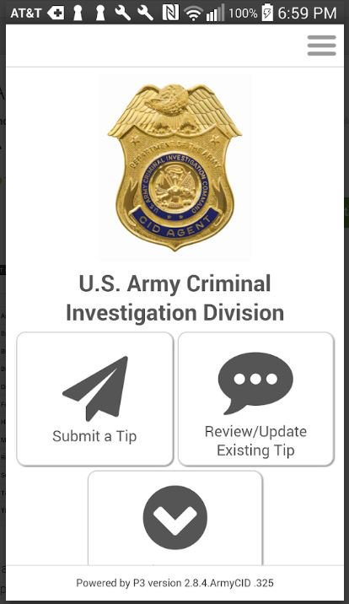
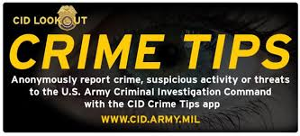
Informants
Army Values
See Something Say Something!
http://www.cid.army.mil/report-a-crime.html
“CID Crime Tip” phone application, allows for totally anonymous reporting
Notes:
Speaker talks about Integrity and Personal Courage (Recommend having volunteers describe Integrity and Personal Courage in their own words), subsequently tie the two Army Values into being our responsibility to report misconduct.
Speaker talks about Crime Tips (P3).

Slide 12
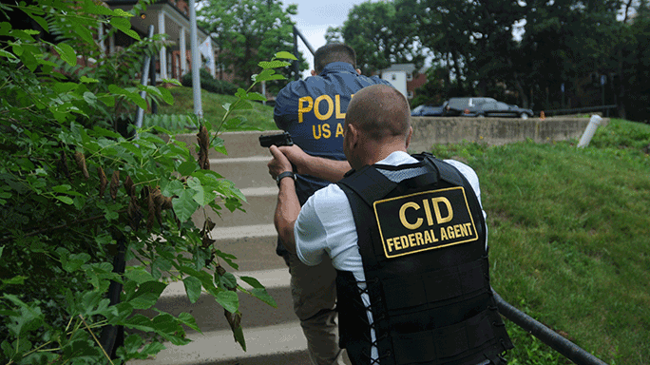
Interested in Joining CID?
Visit: https://www.cid.army.mil/
Pre-req’s:
-MUST be 2/3 of OCONUS
tour complete
-BLC complete
-Minimum 60 College Semester Hours
-Must be able to take 3 event
APFT
-Not color blind (no exceptions)
Come by BLDG 540 on Tower Barracks
for more information
Notes:
- Do Not Provide Office Numbers! Explain to them the website has details on the above which gets updated as changes are made and the website is where the process begins. .
- Discuss Training Benefits:
-Warrant Officer Opportunity for Forensic Science Officer (FSO), Digital Forensic Examiner (DFE), or Polygraph Examiner.
-Partnership with higher learning institutions.
-Worldwide Executive Protection.

Slide 13
Closing / Contact Information
ON POST
Military Police (Emergency): DSN 114 / CIV 09641-83-110
Fire Dept. (Emergency): DSN 112 / CIV 09641-83-112
Ambulance (On-Post Emergency): DSN 112 / CIV 09641-83-112
OFF POST
German Police: CIV 110
German Fire Dept.: CIV 112
Ambulance (Off-Post Emergency): CIV 112
NON-EMERGENCY
MP Station: DSN 314-476-3398/3397
From Cell Phone: 0-9662-83-3398/3397
MP Station Location: Building 2099, Rose Barracks, APO, AE 09112
Notes:
- Information for the audience.
- Ask for questions.

