Slide 1

7th ATC Office of the
Inspector General

Slide 2

AGENDA
IG Functions
Going to see the IG
Why do people come to the IG?
What can the IG do for me?
What gets Soldiers into trouble?
Contact Information
Questions
Notes:
Assistance, Investigations, Inspections, Teaching and Training
Most people come to see the IG due to a miscommunication, misperception, or unmet expectation
Confidentiality
Excused absences during duty hours in order to come see the IG

Slide 3
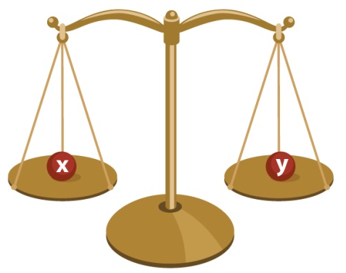
U.S. ArMY ig system
IG Mission:
“Determine the state of the command’s discipline, efficiency, economy, morale, training, and readiness as directed by the commander”
AR 20-1, paragraph 1-4b.
derived from 10 USC 3020
Perform as fair, objective, and impartial fact-finders and problem solvers
ASSISTANCE
A delicate balance …
TEACHING
AND
TRAINING
FAIR AND
IMPARTIAL
FACT-FINDER
EXTENSION OF
COMMANDER
INTEGRITY
. . . but a very clear
distinction
INVESTIGATIONS
INSPECTIONS
“The Inspector General is an extension of the eyes, ears, voice, and conscience of the Commander.”

Slide 4
Why People Come to the IG
Perception that nothing is being done to help
Believe the chain of command does not care
Leadership is slow in responding to concerns
Feel they may be a victim of reprisal
Want to prevent an action (i.e. UCMJ) by the unit
Think coming to the IG will scare their leadership
IGs are fair & impartial fact finders

Slide 5
IG Assistance
IGs assist with…
IGs don’t…
Pay issues
Harassment/Maltreatment
Commander/Leader actions
Policy issues
Counseling
Personnel Management
Family support
Whistleblower reprisal
Command climate
Transgender policy
Recommend punishment
Interpret law
Establish command policy
Exercise Directive Authority
Take sides
Change established redress procedures
  Court Martial
  Non-judicial punishment
  Promotions/Reductions
  Separations/Discharges
  Property Loss Investigations
  Claims
  Evaluations/Relief for Cause
Equal Opportunity complaints
Criminal allegations
Reprisal = When a management official takes (or threatens to take) an unfavorable personnel action against an individual, or withholds (or threatens to withhold) a favorable personnel action, because that individual made or was thought to have made a protected communication or disclosure.

Slide 6
These can get you in trouble
MISCONDUCT
ABUSE OF AUTHORITY
COMMANDER’S DECISIONS/ACTIONS
REPRISALS
HARASSMENT/BULLYING
INAPPROPRIATE RELATIONSHIP
NONSUPPORT
Notes:
REPRISALS: Our office exclusively handles reprisals and whistleblower complaints for this theater. Unfortunately we see a fair amount of cases involving leaders who reprise against Soldiers. Simply put, a Reprisal occurs when Soldier receives an ADVERSE PERSONNEL ACTION as a result of a communication to a MEMBER OF CONGRESS, DoD law ENFORCEMENT OFFICIAL, an IG, an EO REPRESENTATIVE, or a MEMBER OF THE CHAIN OF COMMAND. Examples of adverse personnel actions could be an admonishment, an adverse counseling statement, or a flag. It is important as leaders to focus on solving the Soldier’s problem not making it personal because he or she is seeking assistance from someone else. Almost always you won’t have a problem if your actions are based on the Soldier’s conduct or behavior.
LAWYERS & ETHICS COUNSELORS: They are our best friends and I strongly encourage you rely on them for support.

Slide 7
Family Support (1 of 2)
Nonsupport
#1 Issue dealt with by Inspectors General worldwide
Defined as: Soldier who fails to provide adequate support to their dependents or family members IAW AR 608-99
Involves complex issues of:
  US and International court documents
  Complex custody agreements
  Paternity questions
  DEERs enrollment (ID Cards)
  Command Sponsorship issues
Leaders need to:
  Recognize the immediate needs of the dependent(s), and urgency in establishing the facts
  Ensure Soldiers understands their obligation to communicate with and support dependent as outlined in AR 608-99
  Understand their roles and responsibilities what Leaders are required to do (vetting of documents, counseling)
  Seek assistance from your experts: LEGAL, HR
Army Directive 2020-04
Notes:
5/18/2020
7

Slide 8
Who Else Can Help?
Chain of Command
EO/EEO
MPs/CID
Staff Judge Advocate
Hospital/TMC OICs or Patient
Representatives
CPAC/Management Employee
Relations (MER)
Chaplain
Community Agencies (ACS, Red
Cross)
Online Regulations and Policies
YOU!!!!!!!!!!! Good leaders research issues for themselves and their subordinates
Give the chain of command
an opportunity to solve the problem first!

Slide 9
IGation
Contact Information
Building 621, Room 111
Tower Barracks
DSN PHONE # 526-4499
Building 166, Room 110
Rose Barracks
DSN PHONE # 5299-4491

