Slide 1
US ARMY SPECIAL OPERATIONS
SPECIAL FORCES
SPECIAL OPERATIONS
AVIATON REGIMENT
PSYCHOLOGICAL OPERATIONS
CIVIL AFFAIRS
SPECIAL OPERATIONS RECRUITING TEAM EUROPE
BUILDING 621, Room 231 Grafenwöhr, APO-AE 09114
DSN: (314) 569-2881 / (314) 569-2882 / (314) 569-2883 / (314) 569-2865

Slide 2
Qualifications Special Forces
Qualifications
Male/Females PFC to SFC
YG17/18 1LT’s
GT/CO: 105+ (no waivers)
PFA: 49+PU,59+SU,15:12-2MI run
Government Travel Card
Pass a complete SF physical
Not flagged or pending UCMJ
Application
Volunteer Statement
APFT (with pull-ups annotated in remarks)
SF physical
SRB
DTS Screenshot
SPECIAL OPERATIONS RECRUITING TEAM EUROPE
BUILDING 621, Room 231 Grafenwöhr, APO-AE 09114
DSN: (314) 569-2881 / (314) 569-2882 / (314) 569-2883 / (314) 569-2865

Slide 3
Qualifications Psychological Operations
Qualifications
Males/Females PFC to SGT
YG16/17 1LT’s
GT: 105+ (no waivers)
DLAB 75+ (DLPT 1+/1+ or higher in a target language)
Government Travel Card
Airborne Qualified or willing to volunteer for Airborne training
Eligible for a security clearance
Application
Volunteer Statement
APFT (with pull-ups annotated in remarks)
SF physical
SRB
DTS Screenshot
SPECIAL OPERATIONS RECRUITING TEAM EUROPE
BUILDING 621, Room 231 Grafenwöhr, APO-AE 09114
DSN: (314) 569-2881 / (314) 569-2882 / (314) 569-2883 / (314) 569-2865

Slide 4
Qualifications Civil Affairs
Qualifications
Males/Females SPC & SSG (DOR/TIS dependent)
YG16/17 1LT’s
GT: 107+ (no waivers)
DLAB 65+ (waiverable)
Government Travel Card
At least an Interim Secret Security Clearance
Completed BLC (waiverable)
Application
Volunteer Statement
APFT (with pull-ups annotated in remarks)
SF physical
SRB
DTS Screenshot
SPECIAL OPERATIONS RECRUITING TEAM EUROPE
BUILDING 621, Room 231 Grafenwöhr, APO-AE 09114
DSN: (314) 569-2881 / (314) 569-2882 / (314) 569-2883 / (314) 569-2865

Slide 5
Qualifications 160th SOAR
Volunteers preferred
Secret (or higher) clearance
Must be a U. S. citizen
Must be financially stable
Excellent physical condition
GT Score 100 or higher
Airborne is MOS dependent
Mission/Team oriented
Highly qualified in MOS
Be within 18 months to PCS
SPECIAL OPERATIONS RECRUITING TEAM EUROPE
BUILDING 621, Room 231 Grafenwöhr, APO-AE 09114
DSN: (314) 569-2881 / (314) 569-2882 / (314) 569-2883 / (314) 569-2865

Slide 6
Qualifications 160th SOAR
160TH SOAR Packet Requirements
160th Application
Updated SRB
Last 3 APFT score cards
2 photos in summer PT uniform (front and side view)
Last 3 NCOER’s (NCO’s only)
DD Form 2992 (15U, 15T, 15R)
DA Form 759 (15U, 15T, 15R)
SPECIAL OPERATIONS RECRUITING TEAM EUROPE
BUILDING 621, Room 231 Grafenwöhr, APO-AE 09114
DSN: (314) 569-2881 / (314) 569-2882 / (314) 569-2883 / (314) 569-2865

Slide 7
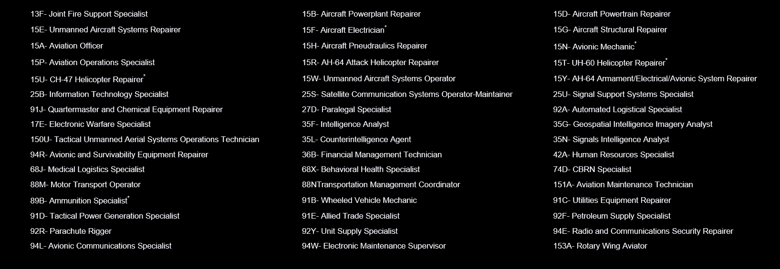
Authorized MOS’s
SPECIAL OPERATIONS RECRUITING TEAM EUROPE
BUILDING 621, Room 231 Grafenwöhr, APO-AE 09114
DSN: (314) 569-2881 / (314) 569-2882 / (314) 569-2883 / (314) 569-2865

Slide 8
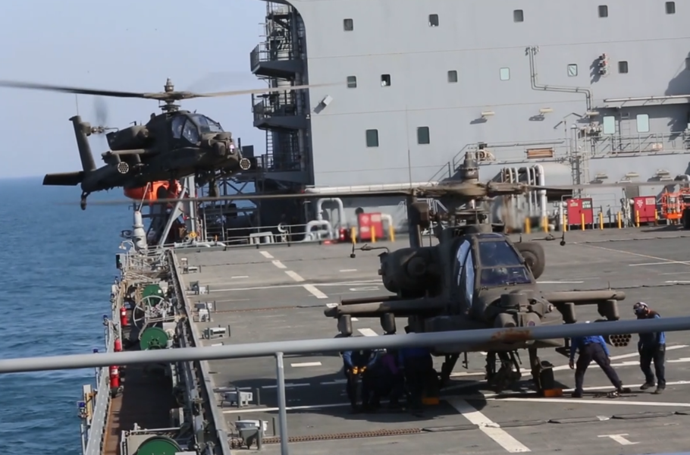
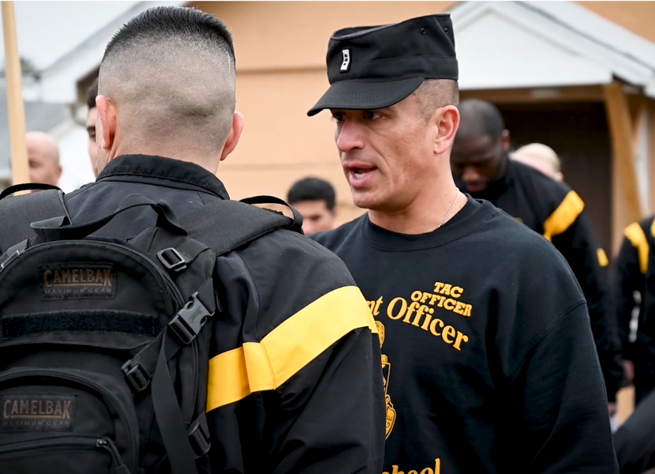
General Requirements
Aviator
<8 Years Active Federal Service
Any MOS/Rank can Apply
Qualifying SIFT Score (40+)
<32 years old by board convene date
Pass a Class 1A flight physical
(Note: Vision 20/50 or better)
Technician
<12 Years Active Federal Service
Usually SGT or higher Appointment prior to age 46
Most require ALC
Pass Qualifying Physical
Prerequisites are determined by proponents
WARRANT OFFICER RECRUITING
BUILDING 621, Room 228 Grafenwöhr, APO-AE 09114
DSN: (314) 569-2884

Slide 9
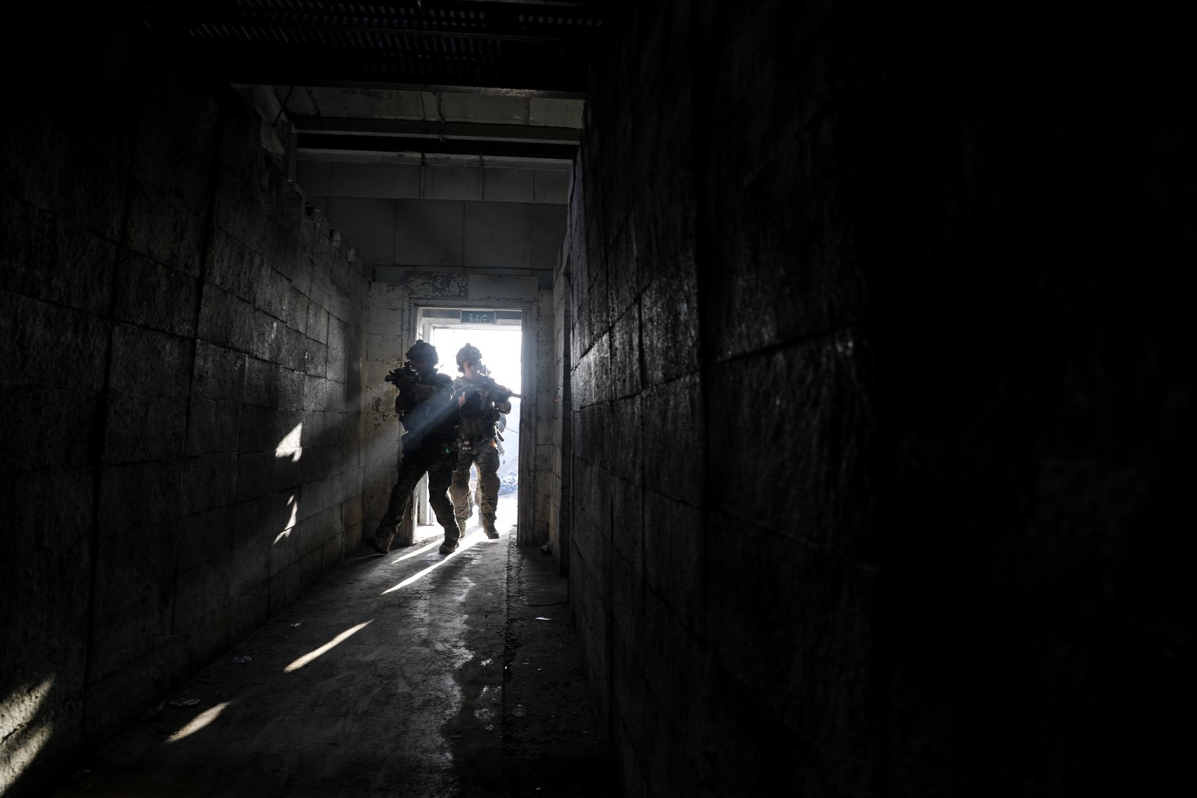
SPECIAL OPERATIONS RECRUITING TEAM EUROPE
BUILDING 621, Room 231 Grafenwöhr, APO-AE 09114
DSN: (314) 569-2881 / (314) 569-2882 / (314) 569-2883 / (314) 569-2865
WEEKLY SPECIAL OPERATIONS BRIEF
DATE: Every Tuesday
TIME: 1200 - 1300
LOCATION: BLDG 621 ROOM 225 IN TOWER BARRACKS (ABOVE THE CUSTOMS OFFICE)
JOIN US TO LEARN MORE ABOUT SPECIAL OPERATIONS OPPORTUNITIES FOR OFFICERS AND ENLISTED. YOU WILL BE ABLE TO ENGAGE WITH EXPERIENCED ARSOF MEMBERS, ASK QUESTIONS, AND LEARN HOW TO JOIN AN ELITE TEAM.
*SOCIAL DISTANCE PROTOCOL WILL BE IN PLACE AND FACIAL COVERING WILL BE REQUIRED TO ATTEND*

Slide 10
SPECIAL OPERATIONS RECRUITING TEAM EUROPE
BUILDING 621, Room 231 Grafenwöhr, APO-AE 09114
DSN: (314) 569-2881 / (314) 569-2882 / (314) 569-2883 / (314) 569-2865
SPECIAL FORCES
DSN (314) 475-8054 CELL +49 162 2630738
PSYCHOLOGICAL OPERATIONS
DSN (314) 475-7212 CELL +49 162 2630526
CIVIL AFFAIRS
DSN (314) 475-5155 CELL +49 162 2573219
160th SOAR
DNS (314) 475-7333 CELL +49 162 2630438
@SORB Europe
@sorb_europe

