Slide 1
APG COMMUNITY INFORMATION EXCHANGE
27 MARCH 2025

Slide 2
APG COMMUNITY INFORMATION EXCHANGE
27 March 2025
Opening Remarks
Purpose
Installation/Community Program Updates
Open Forum
Closing Remarks

Slide 3
APG COMMUNITY INFORMATION EXCHANGE
Purpose
The purpose of the USAG Aberdeen Proving Ground Community Information Exchange is to allow organizations to discuss services and support provided to the Community. This forum facilitates dialogue and an opportunity for units and APG service providers to obtain information to take back to their Soldiers, Family Members, Civilians and Retirees.
Our Goals
Publicize and synchronize information with respect to APG community services and programs provided by installation support agencies
Increase awareness on upcoming and key installation events and initiatives
Support Readiness by fostering a well informed APG community

Slide 4
APG COMMUNITY INFORMATION EXCHANGE
SERVICE BRIEFERS
APG COMMUNITY SPOUSES’ CLUB
ARMY COMMUNITY SERVICE
BETTER OPPORTUNITIES FOR SINGLE SOLDIERS
CECOM APG IG
CHILD YOUTH & SCHOOL AGE SERVICES
CORVIAS FAMILY HOUSING
DEPARTMENT OF PUBLIC WORKS
DIRECTORATE OF EMERGENCY SERVICES
DIRECTORATE OF HUMAN RESOURCES
DIRECTORATE PLANS, TRAINING, MOBILIZATION & SECURITY
FAMILY MORALE WELFARE AND RECREATION
HARFORD OFFICE OF COMMUNITY & ECONOMIC DEVELOPMENT
KIRK HEALTH CLINIC
PX
RELIGIOUS SUPPORT OFFICE
SHARP

Slide 5
APG COMMUNITY INFORMATION EXCHANGE
OPENING COMMENTS

Slide 6
FAMILY MORALE, WELFARE AND RECREATION
(FMWR)

Slide 7
FMWR
CURRENT OPERATIONAL STATUS
PROGRAM | SERVICES | CURRENT PATRONS | HOURS | CONTACT
AA Athletic Center EA Athletic Center | Physical Fitness Eqt; Cardio (24 hr Access!) | All eligible patrons IAW specific times and patron status | AA: 24-7 Access (Except Mil PT M-F; 0600-0800) EA: Full 24-7 Access | 410-278-7933 410-436-7134
Fanshaw Turf Field | Outdoor Athletic Activities | All eligible patrons | Dawn-Dusk/By Reservation | 410-278-7933
Army Community Service | All Support Svs/ In-Out Processing/ EFMP; FAP/ VA/ Fin Counseling | All eligible patrons | M-F 0800-1630 | 410-278-7572
Child & Youth Services | Childcare – 3 CDCs, 2 YS | DOD Priority Categories | M-F 0630-1730 | 410-278-2223
 | CYS Youth Sports Clinics | DOD Priority Categories | Based On Activity/Program Schedules | 410-306-2297
Outdoor Recreation | Campgrounds/Marinas/Eqt Rentals/ Storage | All eligible patrons | M-F 0900-1700 | 410-278-5789
Shore Park Pool | Open Swimming; Swim Lessons | All eligible patrons | Closed for Season | 410-278-5789
Auto Craft Shop | Self-help Auto Svs/Paint Booth/Wash Room | All eligible patrons | Sat-Su 0800-1600 | 410-278-5178
Top of the Bay | Catering Svs/Special Events | All eligible patrons | Based On Event Schedules | 410-278-5915
Recreational Lodging | Short Term Rentals/Hospitality Svs | All eligible patrons | M-F 0900-1700 | 410-278-2621
Golf Course | Individual/Group Play/Special Events (Hrs adjusted ICW weather during winter) | All eligible patrons | 0800-1700 Daily (Exton Closed) Ruggles: | 410-278-4794
Recreation Center | EA/AA Locations/Ticket Sales/Group Events/Library | All eligible patrons | M-F 0900-1700 | 410-278-4011
Bowling Center | Open Bowling/Leagues/Food Svs | All eligible patrons | T-Th 1100-1400; League Tue & Fri; 3rd Sat Each Month 1200-1500 | 410-278-4041
FMWR Director: Joseph Moscone
joseph.moscone.naf@army.mil
Phone: 410-306-4521
Let me know how we’re doing!
Potential expansion of other services under review and dependent on installation conditions. Thank you for your patience and understanding.

Slide 8
FMWR
CURRENT EVENTS AND INFORMATION
UPCOMING EVENTS AND INFORMATION
Next APG Community Exchange (ACE): 26 June at TOB
Physical Fitness Center News:
New equipment (bulk-buy); expected this month
New wellness classes ongoing
Installation of new cable system
Outdoor Rec Equip. Rental: New Spring/Summer items
Reservations for events still being taken at TOB, Golf, Bowling facilities—we need your business!
27 Mar: Tell Me A Story
5 Apr: Run to Honor
18 Apr: Commanders Cup Golf Tourney
19 Apr: Community Egg Hunt:
20 Apr: Easter Brunch
29 Apr: Volunteer Recognition Ceremony
16 May: Armed Forces Golf Tourney
16 May: Wounded Warrior Shoot
24 May: Shore Park Pool Opening Day
11 Jun: TOB Quarterly Lunch
14 Jun: Summer Kick-Off Soaker
New Food Options:
Bowling Ctr-New Vendor (Eat Like A Greek)
Golf Course -Mission BBQ; MOGO Café coming soon
TOB Quarterly Lunches
TOB Food Truck-Bay Breeze
ADDITIONAL INFORMATION
WE ARE HIRING! Immediate need for Child Caregivers/Food Service/Lifeguards/Seasonal Positions; contractual opportunities available for instructional classes
FMWR continues to balance mission requirements, post conditions, and available resources/staffing; pls note that most FMWR operations are self-funded business operations---we need and appreciate your patronage moving forward!
Congrats to both ACS and CYS for their Certification/Accreditation achievements!
New FMWR Directories available
Business operations commitment----we will beat any off-post price!

Slide 9
QUESTIONS?
www.aberdeen.armymwr.com
www.facebook.com/apgmwr
www.instagram.com/apgmwr
www.twitter.com/apgmwr
www.flicker.com/photos/apgfmwr/albums
www.linkedin.com/company/Aberdeen-proving-ground-fmwr
Also follow our events on MyArmyPostApp

Slide 10
DIRECTORATE PLANS, TRAINING, MOBILIZATION & SECURITY

Slide 11
DPTMS, USAG APG
CURRENT EVENTS AND INFORMATION
UPCOMING EVENTS AND INFORMATION
MARCH:
27 Mar: Tell Me A Story, CYS (Bldg 2522)
28 Mar: National Vietnam War Veterans Day Celebration, Recreation Center
28 Mar: BOSS Movie Night (Gladiator 2), Theater
29 Mar: BOSS Movie (Moana 2), Theater
31 Mar: SAAPM Teal Ribbon Hanging (Route 22 Gate)
APRIL: Sexual Assault Awareness and Prevention Month & Child Abuse Prevention Month
1 Apr: Sexual Assault Awareness and Prevention (SAAPM) Kick-off ceremony (Myer Auditorium)
1 Apr: Proclamation Signing for Child Abuse Prevention Month (CDC)
APRIL continued:
1-30 Apr: Harford County SARC Food Drive
5 Apr: Run-To-Honor (Shore Park)
12 Apr: Spring Community Yard Sale (Housing Areas)
15 Apr: Military Child Appreciation Day at Corvias
17 Apr: BOSS Route 22 Axe Throwing (Aberdeen)
18 Apr: Commander’s Cup Golf Tournament (Ruggles)
20 Apr: Easter Brunch (TOB)
17-21 Apr: Harford County Public Schools Spring Break
21-25 Apr: Spring Cleanup
26 Apr: Aberdeen Youth Center Open House (Bldg 2522)
29 Apr: Volunteer Recognition Ceremony (Rec. Center)

Slide 12
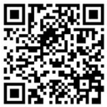
DPTMS, USAG APG
MAY:
10 May - BOSS Color Run (Shore Park)
12-16 May - Armed Forces Week
14 May - Quarterly APG Community Lunch (TOB)
16 May - Golf Tournament (Armed Forces Week) (Ruggles)
16 May - Wounded Warrior Skeet Shoot (Skeet Range)
6 Jun – Garrison Commander and Command Sergeant Major Change of Command and Relinquishment of Responsibility.
Please use the My Army Post App (MAPA)
Over 4,245 users.
App is updated daily.
USAG APG SharePoint Page: ID-S Aberdeen Proving Ground (sharepoint-mil.us)
Installation Events Calendar: DPTMS-OPS-Installation Events Calendar - Installation Events (sharepoint-mil.us)

Slide 13
ARMY COMMUNITY SERVICE
(ACS)

Slide 14
ARMY COMMUNITY SERVICE
PROGRAM INFORMATION
UPCOMING EVENTS AND INFORMATION
Mission: To facilitate commander’s ability to provide comprehensive, coordinated, and responsive services that support readiness of soldiers, civilian employees and their families
Core Services*
Employment Readiness
Exceptional Family Member Program
Family Advocacy Program
Financial Readiness (Army Emergency Relief)
Information & Referral
Military & Family Life Counselor
Relocation Readiness
Survivor Outreach Services
Victim Advocacy
Volunteer Corp
* All ACS services are non-clinical
Virtual FRP Lunch & Learn: Wed – Friday: 12-1pm
Mar. 28 – Healthy Sleep Habits
Apr. 2 – Money Smart for Older Adults
Apr. 3 – Marriage & Money
Apr. 4 – Divorce & Finances
For additional dates & topics visit https://aberdeen.armymwr.com/programs/financial-readiness-program
Upcoming Events:
5 Apr. Run to Honor Still time to sign up!
29 Apr. – Volunteer Awards Ceremony. Please nominate!
AD Soldier, AD Family Member, Retiree and Civilian Emp.
April is
National Child Abuse Prevention Month
ADDITIONAL INFORMATION
Lending Closet – Donations of gently used kitchen items and small household goods accepted daily
Tuesdays: In-processing & Welcome Brief with RELO - All welcome, no appointment necessary
Location: 2530 Advanced Tactics Road - All Staff on site to provide to support patrons
Hours: M-F 8am-4:30pm, closed weekend & federal holidays
Main Number: 410-278-7572
POC: Buzz Green, william.r.green.civ@army.mil, 410-278-4232

Slide 15
ARMY COMMUNITY SERVICE
National Child Abuse Prevention Month Activities
Kick Off Event- Chalk Walk - Educational Activity where a lesson will be taught about safety, and children will be encouraged to draw a picture on the sidewalk based on the lesson.
The CDC Chalk Walk Events will be held at the following times:
Apr. 1: Aberdeen Area (AA) CDC: 9am
Apr. 2: Bayside Area (BA) CDC: 9am
Apr. 3: Edgewood Area (EA) CDC: 9am
Apr. 4: Youth Center: April: 2pm
Apr. 1 Proclamation Signing - GC will visit the AA CDC building, in front of the chalked sidewalk, and sign a CAPM Proclamation, 2:30pm
Information Tables - will promote education on preventing child abuse and neglect, intrinsic items and available resources to the community.
Apr. 1-4: Kirk Army Health Clinic
Apr. 7-14: Aberdeen Area CDC
Apr. 14-18: Bayside CDC
Apr. 21-25:Edgewood Area CDC
Lunch & Learn Webinars - Child Abuse & Neglect Awareness Month. Sessions will be open to all in the APG Community on MS Teams
Apr. 15: Safety Skills for Parents, 12 noon
Apr. 22: Purple Crying & Safe Sleep, 12 noon
Apr. 29: Stress Management for Kids, 12 noon
FOR ADDITIONAL INFORMATION
Contact your ACS FAP Team!
410-278-1711 or 410-278-7478

Slide 16
LIFE SKILLS TRAININGS
STRESS MANAGEMENT
ACS
Stress Management
Resilience/Mindset
Training
Financial Training
Communication Skills
Training
Grief Support
Information & Referral

Slide 17
APG COMMUNITY SPOUSES’ CLUB

Slide 18
APG COMMUNUITY SPOUSES’ CLUB
CURRENT EVENTS AND INFORMATION
UPCOMING EVENTS AND INFORMATION
Our purpose is to create a supportive community for our members, give back to the local area, and foster a sense of unity within Harford County and Aberdeen Proving Ground. We come together monthly through mini-club meetups, volunteer with APG organizations and other local initiatives, and provide valuable resources for our members.
Each year, we proudly donate thousands of dollars' worth of items to benefit both Harford and Cecil Counties, making a tangible impact on the community.
We warmly welcome all active duty, retired, Department of Defense personnel, contractors, and their spouses to join our organization. With just under 100 members, we are a close-knit group that values connection, service, and support. Together, we make a difference!
April
4/4 Wine & Spirits
4/7 Book Club
4/10 Membership
4/16 Bunco
4/23 Culinary
4/23 Bowling
4/25 Lunch Bunch
May
5/2 Wine & Spirits
5/5 Book Club
5/8 Membership
5/16 Lunch Bunch
5/21 Bunco
5/28 Culinary
June
6/2 Book Club
6/18 Bunco
ADDITIONAL INFORMATION
Sonja Flanigan
President APG CSC
apgcommunityspousesclub@gmail.com
FB- APG Community Spouses Club
Instagram - APGCSC
Mailing Address
APG CSC
PO BOX 250
APG MD 21005
APG CSC
Building 325
6887 Colleran Rd
APG MD 21005

Slide 19
BETTER OPPORTUNITIES FOR SINGLE SOLDIERS
(BOSS)

Slide 20
APG BOSS Program
PROGRAM INFORMATION
UPCOMING EVENTS AND INFORMATION
The BOSS program is based on three program pillars:
Quality of Life
Community Service
Recreation and Leisure
As a member of BOSS, you have a voice in how you live, how you spend your leisure time and how you support the community around you. BOSS Single Service Members:
Coordinate and participate in community service projects
Organize recreation and leisure activities
Actively support the quality-of-life needs of single Service members
Who BOSS serves:
Single Soldiers community, Active Guard and Reserve, Single Soldier Parents, Geographical Bachelors, Foreign Service members assigned to the installation
BOSS MEETINGS: 1630 at 305 in the Main Conference Room: Last Thursday of the Month
MOVIE NIGHTS:
March 28th & March 29th
April 25th & April 26th
May 30th & May 31st
June 27th & June 28th
July 25th & 26th
August 29th & August 30th
September 26th & September 27th
VOLUNTEER DATES
3 April 2025
RECREATION & LEISURE EVENTS
17 April 2025- Axe Throwing
16 May 2025 BOSS Org Day @ Hopkins
17 May 2025- Six Flags Trip
CONACT INFORMATION
SOCIAL MEDIA LINKS
BOSS MWR Advisor: Karyssa Wilczek
Email: Karyssa.d.wilczek.naf@army.mil
Phone: 410-278-2134
@ apg_boss

Slide 21
CHILD & YOUTH SERVICES
(CYS)

Slide 22
Child and Youth Services
PROGRAM INFORMATION
UPCOMING EVENTS AND INFORMATION
31 March: Read Across America at Roye-Williams Elementary
Homeschool PE every Thursday from 1300-1400 at Aberdeen YS
April is Month of the Military Child
23 June: Youth Summer Camp begins
10-12 April CYS Babysitters; limited spaces
25 April: AAYS MOMC Open House, 0900-1300
30 May: CYS Strong Beginnings graduation at our three Child Development Centers
CONACT INFORMATION
For registration and enrollment, please contact Parent Central Services
(410) 278-7571/7479/2857
POC: Brittany Johnson, CYS School Liaison Officer, (410) 278-9061/1917
Brittany.e.johnson2.naf@army.mil

Slide 23
CITY OF ABERDEEN

Slide 24
City of Aberdeen

Slide 25
CORVIAS

Slide 26
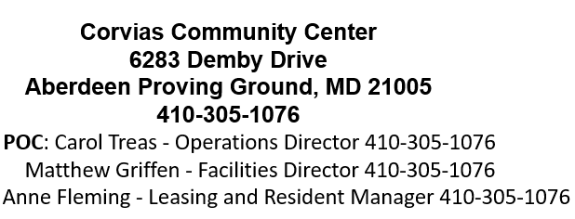
Corvias
PROGRAM INFORMATION
UPCOMING EVENTS AND INFORMATION
March Madness Trivia – week of March 24
April 12 – Community Yard Sale - 8am-12pm Rain or Shine
April 15 – Purple Up Event – 3pm – 5pm
May 24 – Corvias Pool Opening
May 26 - Corvias Office Closed
19 June - Corvias Office Closed
CEL Army Survey
Bark Park
Yearly Preventive Maintenance
New Landscaping company

Slide 27
DIRECTORATE OF EMERGENCY SERVICES

Slide 28
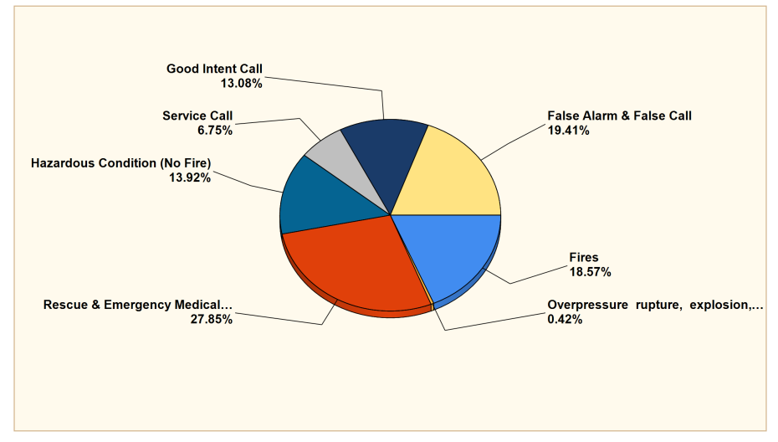
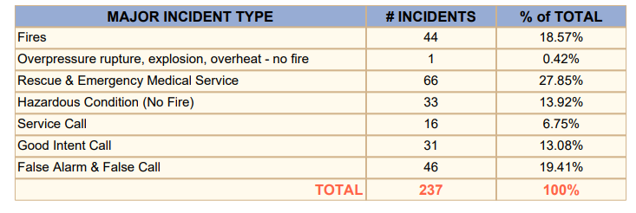
DES – Fire & Emergency Services Division
PROGRAM INFORMATION
UPCOMING EVENTS AND INFORMATION
Class | Date | Time | Location
Fire Extinguisher | 1 April | 09:00 | EA, Bldg. E5183
Fire Marshal | 1 April | 13:00 | EA, Bldg. E5183
Fire Extinguisher | May-Email for APPT | TBD | AA, Bldg. 2200
Fire Marshal | May-Email for APPT | TBD | AA, Bldg. 2200
Fire Extinguisher | June 3 | 09:00 | EA, Bldg. E5183
Fire Marshal | June 3 | 13:00 | EA Bldg. E5183
Fire Extinguisher | July-Email for APPT | TBD | AA, Bldg. 2200
Fire Marshal | July-Email for APPT | TBD | AA, Bldg. 2200
Fire Prevention Branch
Completed 467 Fire Inspections/Drills
Backbone of the Fire Dept.
Fire Prevention Classes POC: Tylor Ketring, Desk: 306-1780.
tylor.j.ketring.civ@army.mil or Shawn Buchanan Desk shawn.w.buchanan3.civ@army.mil

Slide 29
DES – Fire & Emergency Services Division

Slide 30
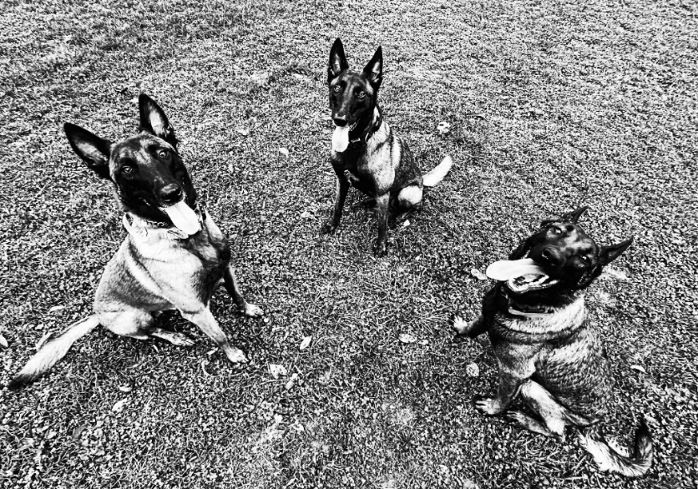
DES – Fire & Emergency Services Division
Pets are curious. They may bump into, turn on, or knock over cooking equipment.
Keep pets away from stoves and countertops.
Keep pets away from candles, lamps, and space
heaters.
Always use a metal or heat-tempered glass screen
on a fireplace and keep it in place.
Keep pets away from outside chimney vents.
Have a “pet-free zone” of at least 3 feet (1 meter) away from the fireplace.
Glass doors and screens
can stay dangerously hot for several hours after the fire goes out.
Consider battery-operated, flameless candles.
They can look and smell like real candles.
Some pets are chewers. Watch pets to make sure they don’t chew through electrical cords.
.
Pet Fire
Safety

Slide 31
DEPARTMENT OF HUMAN RESOURCES
(DHR)

Slide 32
DEPARTMENT OF HUMAN RESOURCES
CURRENT EVENTS AND INFORMATION
Military Personnel Division- Janet Barr, Bldg 4305
Pre-Retirement Briefing: 02 0800 Apr 25, Rm 243B
Pre-Separation Brief: 04 0800 April 2025. Rm 243B
TAP Week: 07-11 April 2025, Rm 243B, to register call 410-306-2358
APG CNO/CAO Training: 08-10 Apr 25
Retiree Council Meeting:19 0900 Apr 25, DHR Main Conference Rm
20th CBRNE Soldier Readiness Processing (SRP): 08 May 2025 @ Kirk Clinic
Army Substance Abuse Program
Problematic Gambling Awareness Month - 1-800-522-4700
988 if you are in crisis - APG EAP
Alcohol Awareness Month- Apr.
Prime for Life 14-16 Apr.
Personal Readiness Training 22 Apr. – Teams
Prescription Take Back 21-25 Apr.
Unit Prevention Leader Course 4-6 May
ASAP APG Family Wellness Day- 14 May
ADDITIONAL INFORMATION
MPD -1st Wednesday of the Month – Pre-Retirement Briefing
MPD/CAC office closed 0900-1300, every 3rd Wednesday of the Month for training
Follow Army TAP on social media! https://www.facebook.com/APGTAP https://www.linkedin.com/in/apgtap/
Follow APG RETIREMENT SERVICES on Facebook – https://facebook.com/apgretirementservices
Director – Matthew Reed, 410-306-2301, matthew.b.reed16.civ@army.mil
ASAP – Vivian Jackson, 410-278-1716, vivian.a.jackson.civ@army.mil
MPD – Delissa R. Greene, 410-306-2303, delissa.r.rodgersgreene.civ@army.mil

Slide 33
DEPARTMENT OF PUBLIC WORKS (DPW)
Natural Resources

Slide 34
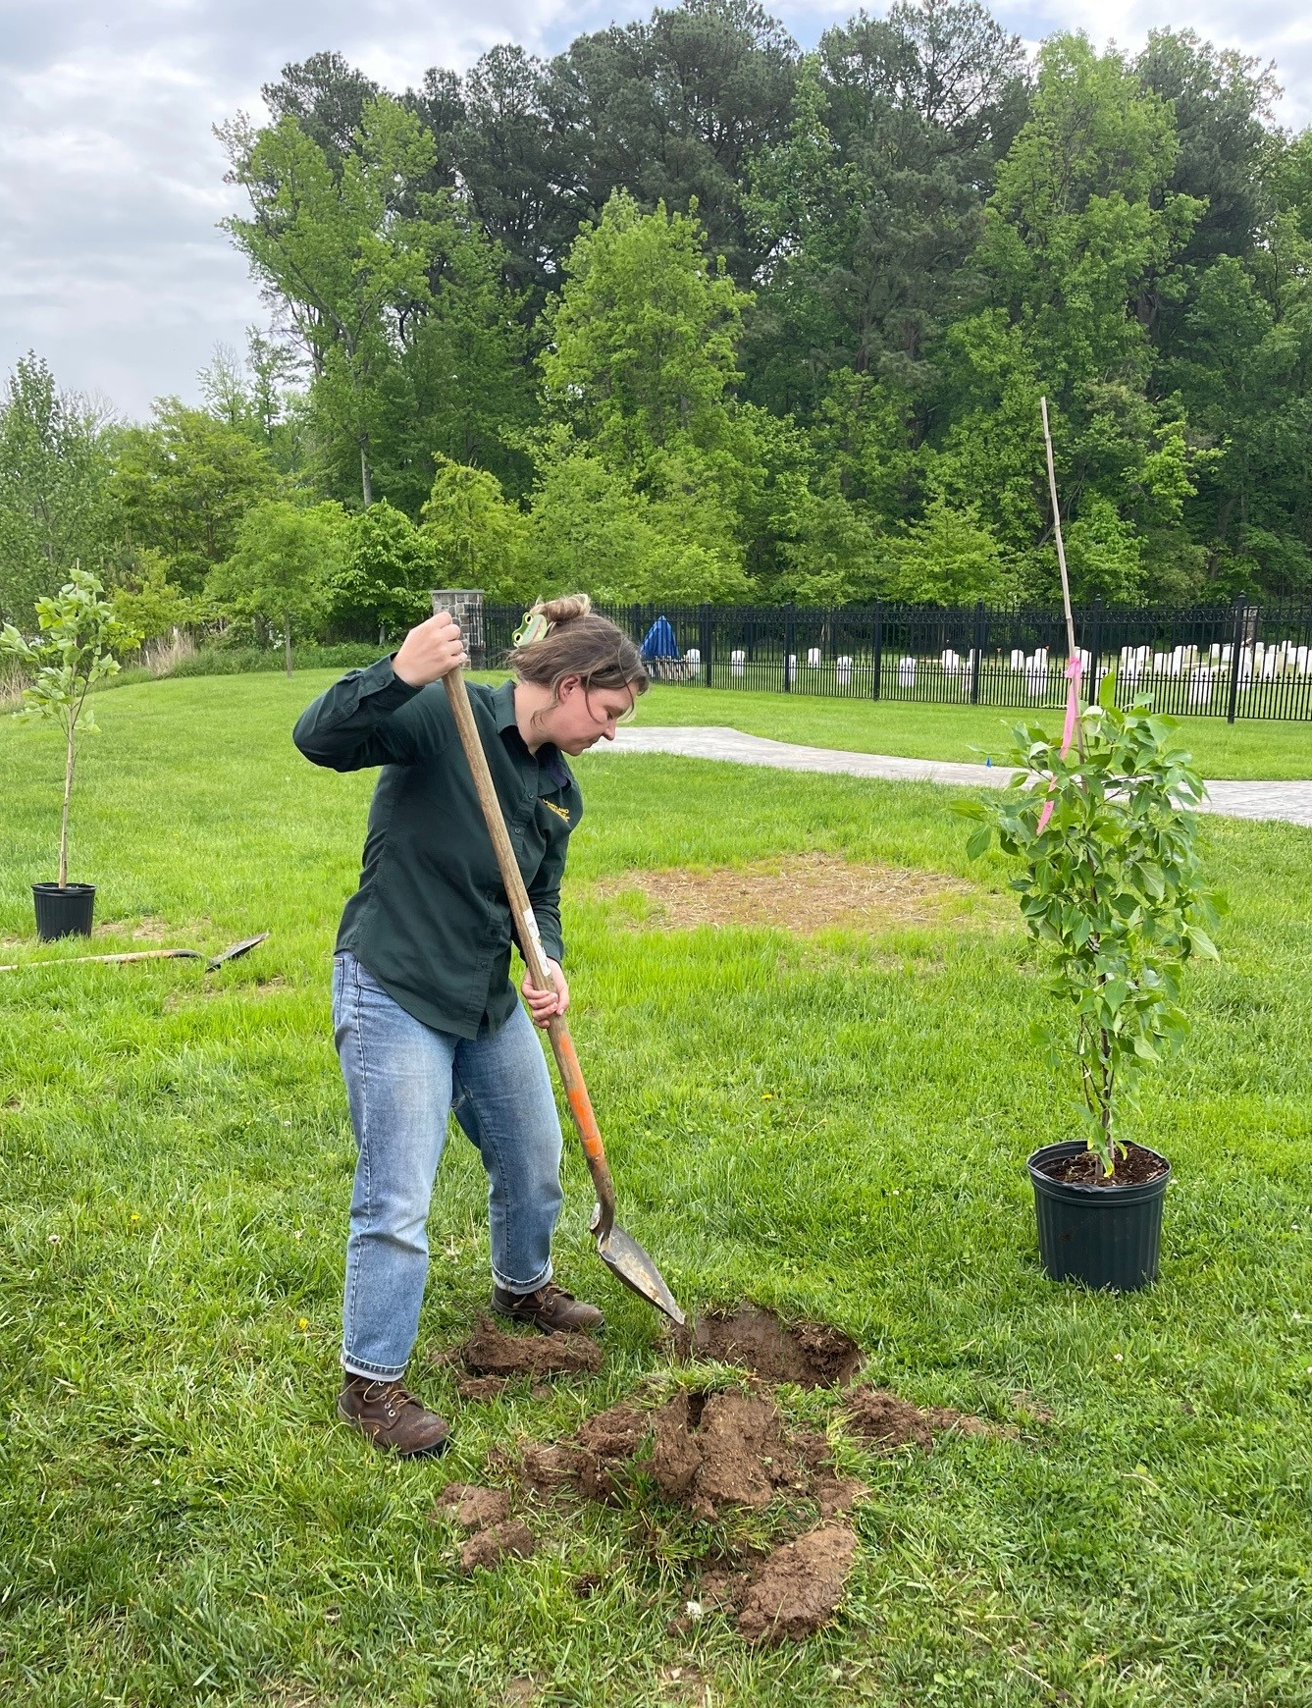
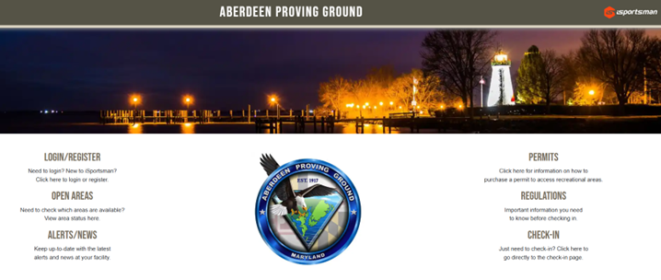
Directorate of Public Works - Natural Resources
PROGRAM INFORMATION
UPCOMING EVENTS AND INFORMATION
Baby Wildlife
Rarely abandoned by parents
Assess situation
If visibly injured contact licensed rehabilitator
Observe from a distance and keep pets away
Best chance of survival is with parents
Arbor Day 2 APR 2025 for State of Maryland and APG
20th year of APG being recognized
20 Years
CONTACT INFORMATION
iSportsman
APG portal for permit purchases
Hunting, Fishing, Firewood
Contact for Natural Resources questions
Website: https://aberdeen.isportsman.net
POC: usarmy.apg.usag.mbx.dpw-natural-resources- team@army.mil

Slide 35
KIRK ARMY
HOSPITAL

Slide 36
Kirk U.S. Army Health Clinic
CURRENT EVENTS AND INFORMATION
UPCOMING EVENTS AND INFORMATION
Sick call is available for ADSM’s M-F for acute issues. Check-in between 0730 and 0900​
​
Next Readiness Rodeo is ​08 May
Refill Prescriptions through MHS- Genesis Patient Portal
10 April – Commanders Call (Facility Closed 1230-1630)
26 May – Memorial Day (Facility Closed)
19 June – Juneteenth Day (Facility Closed)
ADDITIONAL INFORMATION
Reminder: The Kirk appointment line is 410-278-KIRK(5475). You do not need to make appointments in-person.
Use the MHS-Genesis Patient Portal for an enhanced patient experience
PX ScriptCenter is a great way to skip the line at the Pharmacy—for Refills only
Mobile prescription activation (Q-Anywhere) available for new and renewed prescriptions
LIKE us on Facebook! https://www.facebook.com/KUSAHC

Slide 37
HARFORD OFFICE OF COMMUNITY & ECONOMIC DEVELOPMENT

Slide 38
Harford County Department of Economic Development
PROGRAM INFORMATION
UPCOMING EVENTS AND INFORMATION
Doing Business with APG – April 9 at CONVERGE Innovation Center
Aberdeen Chamber of Commerce’s Taste of Aberdeen – April 10 at Wetlands Golf Course
American Legion’s Celebration of Champions Gala – April 19 at Water’s Edge Event Center
Harford County Chamber of Commerce’s 2025 Legislative Wrap Up – April 30
Veterans Resource and Community Services Fair – April 30 at Edgewood American Legion
Harford County Chamber of Commerce’s Military Appreciation Luncheon – May 14
Car Cruise and Fly-In Event – June 7 at Harford County Airport
Army 250 Events – June 8 to 14 – begins with concert in Shamrock Park in Bel Air
Tourism Related Grant Funding programs – application deadline May 16
Hello Harford launching April 1
Edgewood Façade Improvement Grant for U.S. Route 40 and MD 755 – spring/summer 2025 open
Economic Analysis by Matrix Design Group as part of Grow Rural Opportunity in Maryland project – found on DED website
CONACT INFORMATION
Karen Holt Director, Harford County Department of Economic Development 410-638-3058 or klholt@harfordcountymd.gov

Slide 39
Harford County Department of Economic Development
Business Kudos
Maryland Department of Commerce’s Manufacturing 4.0 Program had six Harford recipients and 22% of the program’s allocated funding:
Better Engineering - $36,610
Dunlop Protective Footwear - $408,971
Independent Can Company - $103,500
Modular Components National - $119,520
Rapid Prototyping & Manufacturing Technologies - $67,988
Veritech - $320,000
Grants were awarded to manufacturers who invested in state-of-the-art technologies to increase productivity and sales, cost savings, retention of employees, and more
Klein’s ShopRite is celebrating 100 years in business in 2025
Harford Happenings
Harford County featured in Business in Focus Magazine: https://bit.ly/HarfordBizinFocus

Slide 40
POST EXCHANGE
AAFES

Slide 41
PX/AAFES
INFORMATION
INFORMATION
C5ISR- Junes Thai, April Opening Date TBD
Dunkin Contract Awarded- 6 Months timeline to Open
Mini Mall Hours of Operation Change
Weekend closed starting 5/6 April 25
Barber new closing hours 1730 hrs, starting 31 March 25
Food Trucks (Active)
Crabby Pretzel, Moes Slice of Life, Travel Tom Coffee
Old Line Grill
Museum Pad Tues & Thurs 1100-1400, EDG on Wed
Vietnam War Commemorative Event 28 March
* Eligible Veterans honor with a lapel pin
C5ISR 6010- Food vendor has expressed interest
Food Trucks- Special Events
Kona Ice, Auntie Anne Pretzel
Micro Markets locations being reviewed:
C5ISR 6001 & 6003, Kirk Medical Center
H&R Block starting 17 March-18 April 25
Edgewood Express open Sat, 5 April (0900-1500) support drill
Pharmacy kiosk being worked to relocate
INFORMATION
Crabby Pretzel- Museum Pad every 2nd and 4th Wed each Month
Travelin Tom Coffee- C5 Courtyard, Tue-Thurs 0730-1330 hours
Moes Slice of Life- March Dates, 5, 6, 12, 13, 20 & 27
Old Line Grill- Museum Pad Tues & Thurs 1100-1400 hours

Slide 42
SHARP

Slide 43
SHARP Fusion Directorate
CURRENT EVENTS AND INFORMATION
UPCOMING EVENTS AND INFORMATION
SAAPM Food/ Toiletry Drive: 1-30 April; donation boxes will be in all tenant buildings
SAAPM Teal Tuesdays: Every Tuesday in April
Paint with A Twist: 0900 hours, Thursday, 10 April at Mallette Training Facility Room 10A
SAAPM Walk: 1030 hours, Thursday, 17 April (Rain date 24 April) at APG-N track
Denim Day/ SAAPM Spoken Word: 1000 hours, Wednesday, 30 April at Post Theater
SAAPM Teal Ribbon Hanging: 1000 hours, Monday, 31 March Route 22 Gate
SAAPM Kick-off and Teal Badging Ceremony: 0900 hours, Tuesday, 1 April at Myer Auditorium
CONTACT INFORMATION
SHARP Fusion Directorate
Bldg. 4305, 2nd Floor
6488 Rodman Road
APG, MD 21005
Office: 410- 278-3612
Hotline: 410-322-7154
Email: usarmy.apg.cecom.mbx.sharp-fusion-directorate@army.mil

Slide 44
SHARP Fusion Directorate
ADDITIONAL INFORMATION
Kirk U.S. Army Health Clinic Behavior Health: (410) 278-1715
Harford County Sexual Assault/Spouse Abuse Resource Center (SARC): 24/7 Helpline: (410) 836-8430; sarc-maryland.org
Sexual Assault Forensics Exam (SAFE) Program at UM Harford Memorial Hospital: umuch.org/safe; (443) 843-5500
Department of Veteran’s Affairs, Aberdeen Vet Center: (410) 272-6771 or (877) 927-8387
DOD Safe Helpline: (877) 995-5246 or safehelpline.org
DOD Safe Helpline App: safehelpline.org/app
National Sexual Assault Hotline: (800) 656-HOPE (4673) or rainn.org
Military One Source: (800) 342-9647 or militaryonesource.mil/
Army SHARP: https://www.armyresilience.army.mil/sharp/index.html
Office of Personnel Management (OPM) Website for DA Civilians: http://www.opm.gov/policy-data-oversight/worklife/reference-materials/resource-list.pdf
Army Training Network: https://atn.army.mil/sexual-harassment-assault-response-and-prevention/sharp-training

Slide 45
RELIGIOUS SUPPORT OFFICE
(RSO)

Slide 46
RELIGIOUS SERVICES
CURRENT EVENTS AND INFORMATION
GOSPEL
Gospel Worship Service Sundays 1200
Bible Study Wednesdays, 1830-1930, CR #4
Women Everywhere (WE) Thursdays, 1730-1900, FH
Midweek Dial-in Prayer Meeting Wednesdays 1730
Dial 978-990-5000 (enter Pin: 695689#)
Gospel Singles Meeting Monthly (APR-DEC), FH
CATHOLIC
Mass and Confession Saturdays 1600
Weekday Mass (Except 4-day weekends) Fridays 1145
Catholic Women of the Chapel (CWOC) Monthly Meeting
(AUG-JUN) 4th Mondays, 1800, Fellowship Hall
CWOC-sponsored Brown-Bag Bible Study (men & women)
(SEP-JUN) 1145 on Tuesdays, Fellowship Hall
PROTESTANT
Protestant Worship Service Sundays 1000
Adult Sunday School Sundays 0900, CR #3
Korean Ladies Bible Study Tuesdays, 1000, CR #4
Protestant Women of the Chapel Thursdays 1000, FH
Protestant Men of the Chapel
(OCT-JUN) 2nd Saturdays, 0800, meets at 1SG Grill
UPCOMING EVENTS AND INFORMATION
Every Friday, 7 March through Lent, Stations, in the
Sanctuary, 1800, and Soup and Bread, 1830, FH
Jewish Purim, 10 March, 1200, APG Chapel FH
Holy Thursday, 17 April 1900, Sanctuary
Good Friday, 18 April 1700, Sanctuary
Seder Meal, 17 April 1730, APG Chapel FH
Easter Sunrise Service, 20 April, 0700, location TBD
ADDITIONAL INFORMATION
On-Call Duty Chaplain: For Emergency Access to a chaplain after regular duty hours, call: (443) 307-3936
Religious Support Office Phone: 410-278-4333
Links for Social Media and streaming Worship Services
RSO Web page: https://home.army.mil/apg/about/Garrison/RSO
Catholic – https://www.facebook.com/APG-Catholic-Community-144325727963
Protestant – https://www.facebook.com/APG-Protestant-Chapel-247779101971368
Gospel – https://www.facebook.com/apggospelservice
Online Giving

Slide 47
COMMUNITY INFORMATION EXCHANGE
CLOSING COMMENTS
Next ACE: 26 June at TOB

