Slide 1

Community Bank
Newcomer Services Briefing

Slide 2

Provided by the Military Services
Exclusively for You
Country-specific and traditional banking products and services to help make banking easier while you serve overseas
Products, services, operating locations, fees, and charges are established by the Military Services via a contract between a U.S. commercial financial institution and the Department of Defense
The Defense Finance and Accounting Service, in coordination with the Military Service banking representatives, is responsible for oversight of Community Bank

Slide 3

Personalized Service for Your Banking
Needs Overseas
Experience
    We understand the overseas military lifestyle and the unique banking
    needs that go with it
    We can help you address gaps in your stateside banking relationship
    which may help prevent local financial-related challenges
  Customer Service
    In-person at Community Bank locations
    24/7 Automated Service
    Live Customer Service Representatives are available nearly 24/5
    Live Debit and ATM card assistance available 24/7

Slide 4
Addressing Your Immediate Needs
Easy Access to Local Currency and U.S. Dollars
    Banking Centers
    Dual Currency ATMs
      24/7 Availability
      No International Service Fee
      Service Charge Free
      Most ATM Debit Cards Accepted
Pay Local* and Stateside Bills
    Recurring or one-time payment options
    We can help recommend the payment option right for you
*Payment options may vary by country

Slide 5
Addressing Your Ongoing Needs
  Online and Mobile Banking with Fraud Protection
  Competitive Loan Rates
  Chip-Enabled Debit Cards
  Checking and Savings Accounts
  Account Alerts
  Life Stages

Slide 6
Community Bank Is Here To Help
  Ansbach, Katterbach Banking Center
  Building 5824
  Monday – Wednesday & Friday 09:00-16:00
  Thursday 11:00 – 18:00
  Phone: CIV: 09802-95030 DSN: 467-2122
  ATM locations:
    Banking Center – Building #5824 / URLAS Shopping Center Building #8135 / Bismarck Kaserne Building #5843D
  DoDCommunityBank.com
  Request an appointment by using the My Appointment link on our website
  Illesheim Banking Center
  Storck Barracks –Building 6532
  Monday – Friday 09:00-16:00
  Phone: CIV: 09841-8791 DSN: 467-4540
  ATM locations:
    Banking Center – Building #6532 / Gas Station - Building #6528
  DoDCommunityBank.com
  Request an appointment by using the My Appointment link on our website

Slide 7

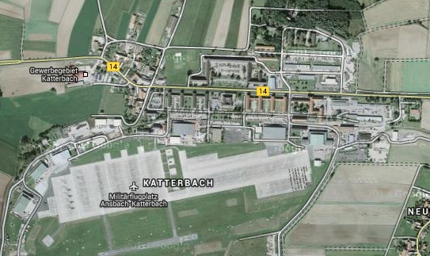
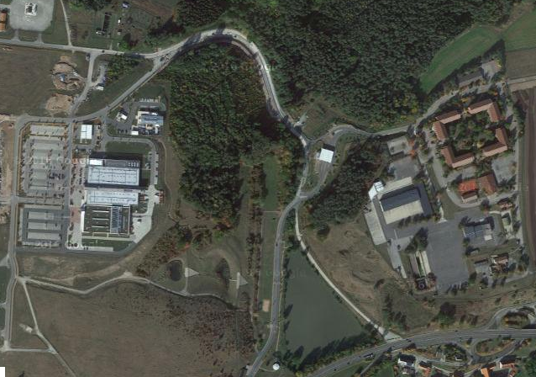
Community Bank Locations throughout the Garrison (Ansbach)
Bismarck ATM, Bldg 5843D
Banking Center & ATMs, Bldg 5824
Urlas Shopping Center ATM, Bldg 8135

Slide 8
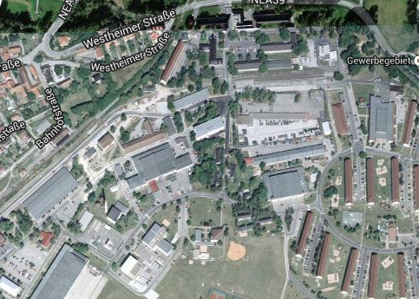
Community Bank Locations throughout the Garrison (Illesheim)
Shoppette / Gas Station ATM, Bldg. 6528
Banking Center & ATM, Bldg. 6532

Slide 9
Thank you!

