Slide 1
Newcomers’ Guide to Service Credit Union

Slide 2
Welcome to Germany
Service Credit Union has everything you need for wherever you go!
We are a not-for-profit; our members are owners.
Our approach to service goes above and beyond what you’ll find at any other financial institution.
Serving the military since 1957.
2

Slide 3
Banking in Germany
What does SEPA stand for?
Single European Payment Area and is a project managed, supported and promoted by the European Payment Council.*
How is paying bills in Germany different than in the US?
Checks? I don’t want a check. Send an Ueberweisung. What is that?
What is an IBAN?
IBAN stands for International Bank Account Number.
What is a BIC?
BIC stands for Bank Identifier Code.
What is an ISA Fee?
ISA Fee stands for International Service Assessment Fee.
*See slides 8 &9 for program and disclosure information
3

Slide 4
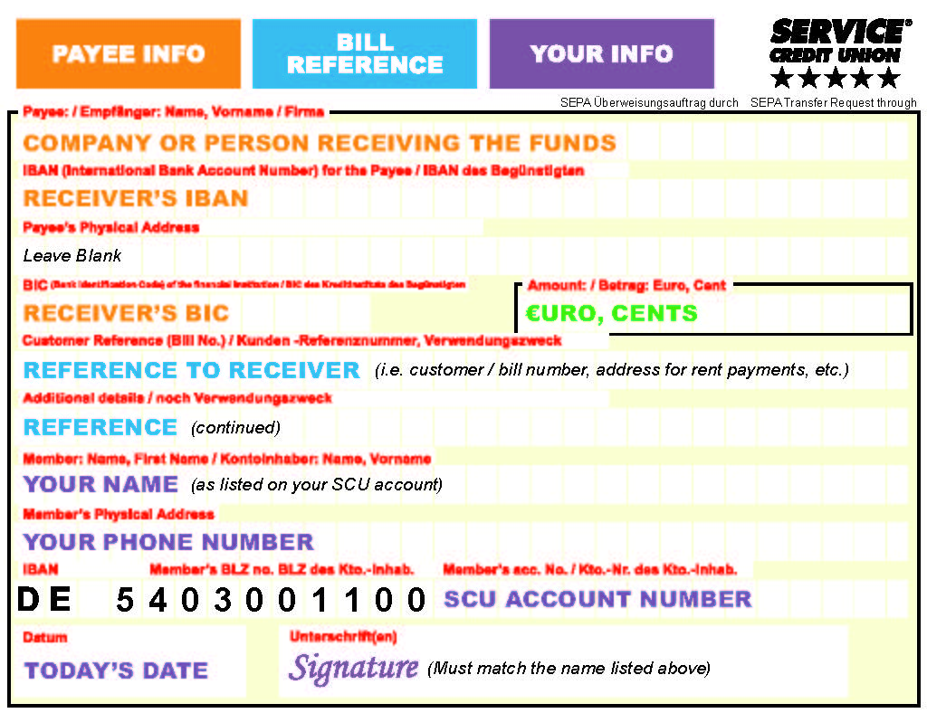
Euro Bill Pay
*See slides 8 &9 for program and disclosure information
4
*See slides 11 and 12

Slide 5
Conveniences for Our Members
International Bill Pay*
Get Paid Up To Two Days Early*
5% APY Primary Savings Account*
Deployed Warrior Savings*
Online Banking
Instant Issue Debit/Credit Cards
Contact us 24/7 via phone or Live Chat (00800.4728.2000)
Readiness Pack
Cashier’s Checks
VISA® Gift Cards
Certificates / IRAs / Money Market
Access to over 85,000 surcharge-free ATMs through the CO-OP and Allpoint Networks
*See slides 8 &9 for program and disclosure information

Slide 6
Military Branch Locations
Find a Service Credit Union near you, visit us online at servicecu.org or by phone 24/7.
SCHLESWIG-HOLSTEIN
NORTH DAKOTA
MECKLENBURG-VORPOMMERN
Grand Forks Air Force Base
Ansbach, Germany
Baumholder, Germany
Garmisch, Germany
Grafenwoehr, Germany
Grand Forks, North Dakota
Hohenfels, Germany
Kapaun Air Station, Germany
Kleber, Germany
Pease Air National Guard, NH
Ramstein, Germany
Ramstein - KMCC, Germany
Sembach, Germany
Spangdahlem, Germany
Stuttgart-Panzer, Germany
Stuttgart-Patch, Germany
Vilseck, Germany
LOWER SAXONY
Berlin
BRANDENBURG
Jamestown
Fargo
NORTH RHINE-WESTPHELIA
SAXONY-ANHALT
South Dakota
SAXONY
THURINGEN
NEW HAMPSHIRE
HESSEN
Spangdahlem
RHINELAND-PALATINATE
Sembach
Baumholder
H
Grafenwoehr
Ramstein
SAARLAND
Kleber
Vilseck
Portsmouth
Kaiserslautern
Ansbach
Hohenfels
Pease Air National Guard
Stuttgart-Patch Stuttgart-Panzer
BAVARIA
BADEN-WURTTEMBERG
Augsburg
Landshut
MUNICH
Garmisch
6

Slide 7
USAG – Ansbach Location
Ansbach: Katterbach Kaserne Building 5823
Mon-Fri 9 a.m. – 5 p.m.
DSN 467.2556 | CIV 09802.8680 | branchansbach@servicecu.org
For a full list of our branches, please visit https://servicecu.org/locations
7

Slide 8
Program and Disclosure Information
Must be a member of Service CU or eligible for membership.
GET PAID UP TO TWO DAYS EARLY
Immediate credit of your direct deposit to your Service CU account up to two (2) business days early is based upon when we receive your payroll from your employer. Service CU cannot assume any liability for not depositing these funds to your account early.
INTERNATIONAL BILL PAY/SEPA
The International Bill Pay services is available online, on a mobile device or by contacting a representative via branch, phone or chat. Online or mobile International Bill Pay (recurring or one-time) is available only from a Service CU checking account. Automatic debits are available only to merchants in Europe. All payments are transferred in the selected currency.
If the beneficiary accounts to which the funds are ultimately credited is not denominated in the selected currency, the amount will be converted to the appropriate currency (i.e. British Sterling, Swiss Franc, Swedish Kroner, etc.) or returned by the receiving financial institution. Service CU is not liable for, and has no influence over the conversion rate applied to the conversion of the fund. Any funds returned to SCU will be converted using the reconversion rate in effect on the date of credit.
PRIMARY SAVINGS ACCOUNT
Annual Percentage Yield (APY) is accurate as of the last dividend declaration date of 5/01/2020 and subject to change without notice. Dividends paid on average daily balances of
$500; variable APY of 5.00%. If average daily balance exceeds $500, the remaining balance will receive variable APY of 0.250%. A minimum deposit of $5 is required to open a Primary Savings account.
MILITARY READINESS PACK To qualify for Readiness Pack, PCS orders or deployment orders to any overseas duty station are required. Returnees to U.S. installations and temporary duty assignments are not eligible. Loan application must be received within 120 days before or after the members reporting date to new assignment. Membership is required with direct deposit (not allotment). An instant issue Visa credit card with a limit between $500 and $1,000 will be provided along with the personal loan. The personal loan amount is not to exceed $2,500. Amount of the personal loan and the credit card limit cannot exceed $3,000. (Example $1,000 credit card limit and a $2,000 personal loan = $3000) Term restrictions apply. Subject to loan approval.
8

Slide 9
Program and Disclosure Information
DEPLOYED WARRIOR SAVINGS Warriors deployed in combat zones may deposit up to $10,000 into a SCU Warrior Savings Deposit Account which earns 10% APY (Annual Percentage Rate) up to $10,000.00. $10,000.01 and above earns 0% APY. Rates are variable and subject to change; accurate as of 11/01/2019. Service member must be serving in a combat zone as defined by the IRS; orders of deployment to a combat zone must be provided. No minimum balance is required to open the account; $5 deposit is required to open the savings account. Monthly deposits into Warriors Savings account cannot exceed the amount of your monthly government pay, however, deposits into the Warrior Savings account may be direct deposit, an allotment, or a transfer of funds from an SCU account. Withdrawals are not permitted from the Warrior Savings account, or it will revert back to a SCU Regular Savings account. Account will stop accruing 10% APY at the end of the month of return date per deployment orders plus 120 days. E-Communications are required.
Euro Bill Pay All Euro Bill Payments are made by transfers from the member’s account and are subject to available, collected funds. Payments cannot be disputed or pulled back. Payments can take up to 5 business days to post to the beneficiary account. A fee of $2.00 is applied for each transfer paid inside a branch office. Each Euro bill payment must be processed in a separate transaction. Requests received after 2:00 PM will be accepted, but processed the next business day at that day’s accommodation rate.
Visa is a registered trademark of the Visa International Service Association
CardValet is a registered trademark of Fiserv, Inc.
V PAY is a registered trademark of the Visa International Service Association.
9

